Slide 1
Spring 2026 OAC Meeting
ODIN Director’s Report
Jason Bedsaul
May 1, 2026

Slide 2

Overview
General Office Updates
Alma Updates
Primo NDE
Polaris Updates
Vega Implementations
Other Project Updates

Slide 3

Liz Mason Retiring
26 years of Service to NDUS (NDSU, BSC, ODIN)
Was at Fargo Public Library before
Last day is May 15
Interviews for replacement this week

Slide 4

New Member
Griggs County Public Library
Go Live May 11
Lexi Broschat - Director
Located in Cooperstown, ND

Slide 5
2026 ODIN Workday Sessions https://www.odin.nodak.edu/about/odin-workdays
Academic:
Library of Things, Tech and Tools
Primo NDE UI
Letter Configurations
Library Spotlights: A Day in the Life of a Health Sciences Librarian & VSCU Programming Stories
Checking Data in Analytics
Copyright: The Basics
Public, K-12, and Special:
Leaping into Acquisitions and Serials
Checking your data in SimplyReports
Polaris Reporting Options
Vega LX Starter – what are you waiting for???
Public Library Discussion: Collections and Programming
Vega Discover – coming soon!

Slide 6

Listservs https://www.odin.nodak.edu/about/listservs
We have two primary listservs:
  ODIN-PKS-LIBS & ODIN-ACAD-LIBS
Recent confusion with evening/weekend outages
Easiest way is to send us all staff contacts with an email

Slide 7
Digital Accessibility https://www.odin.nodak.edu/digital-accessibility
Justice Department issued an extension last Monday for an additional year
We continue to work towards full compliance for us and our vendors
  All new contracts require compliance or a clear roadmap for meeting compliance
  ODIN Office have been going through and captioning videos, improving contrast, adding more descriptive Alt text to screenshots, etc.
  Page above has resources and a link to our VPAT/ACR list we will curate and keep for the community to reference

Slide 8
New Ticketing System / Form
May 11 – New form and system
More Service centric (i.e. Choose Alma, Polaris, etc. first)

Slide 9

Alma / Primo Updates

Slide 10
Latest Release

Slide 11
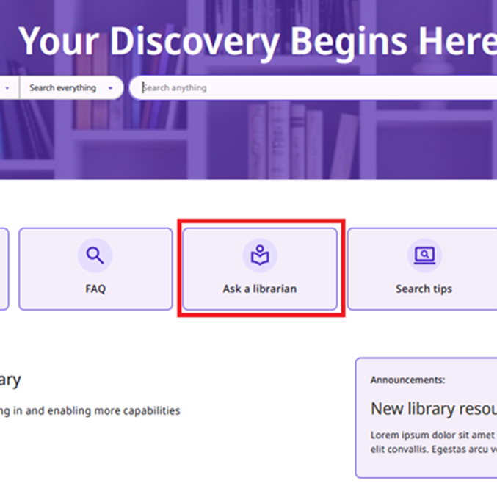
Primo NDE
May Cohort begins Tuesday, May 5
Several libraries have signed up
Discovery User Group has been working/meeting on this all Winter/Spring

Slide 12

Polaris / Vega Updates

Slide 13

Polaris 8.0 Updates
Installed on Production in February
Dated Patron Notes
Automated Patron Aging (From Child to Adult)
Most Admin Settings into Web SA
  ODIN exploring ways to allow for more access to staff to view admin settings

Slide 14

Polaris 8.1 (July/August)
Find Tool…with Tabs! (MEEP)
Return to Place in Record Set (MEEP)
Customizable TOMs - Better support for Library of Things/non-traditional material types
“Stackable” Sorting (sort by more than one column Find Tool and Record Sets (MEEP)

Slide 15
MEEP for 8.2 (Early next year)
Ability to place holds on all items in a record set
Create multiple items in Leap
Create a new status of lost and paid (Top pick for ODIN libraries!)

Slide 16
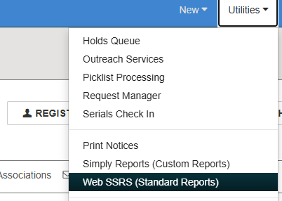
Reporting Options now accessible from LEAP
Added SSRS (Standard Reports) access from LEAP
  Schedule Reports
  Create Favorite List
  No longer need to go to Client for ‘canned’ reports

Slide 17
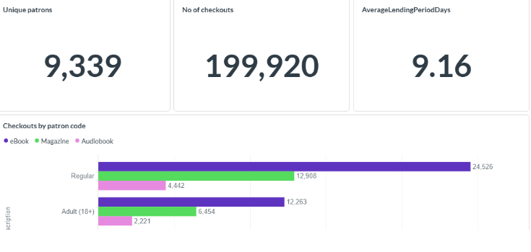
Vega Reports
Included with Discover
Search dashboards and reports for usage statistics based on Discovery Data
Coming in 8.2 (Q1 2027)
  ILS Circulation Data
  Overdrive Checkout Data

Slide 18
Vega Discover Implementation
Rollout of new Patron Interface (OPAC)
May 18 - Start configuration work
Late May/Early June - “Soft launch”
June/July – work with public and special libraries on carousels, tweaks, Overdrive, update search forms, etc.
August/September – work with schools

Slide 19
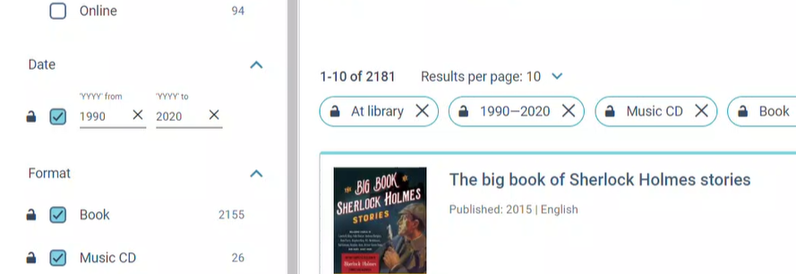
Multi-faceted Search

Slide 20
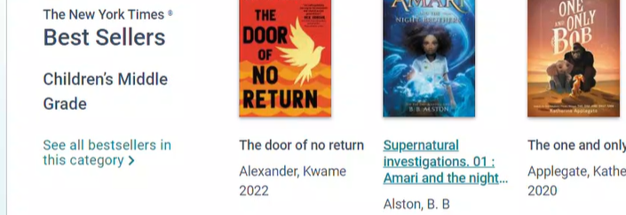
Better Carousel Experiences / Options

Slide 21
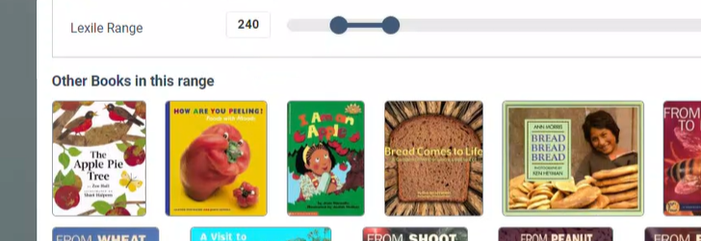
Lexile, AR, Age /Grade Level

Slide 22

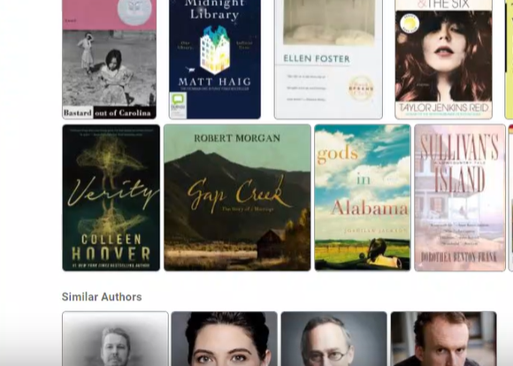
Read-alikes, Author Pages, Topics, Reviews, Awards, and more…

Slide 23
Vega Mobile
Will start shortly after May 11

Slide 24
Shoutbomb SMS Channels

Slide 25
Thank you
Brita Tamm
502-555-0152
brita@firstupconsultants.com
www.firstupconsultants.com

