Slide 1

Copyright Considerations
Presented by someone who is not a lawyer!

Slide 2
Purpose of Copyright Laws
U.S. Constitution Article I Section 8 | Clause 8 Patent and Copyright Clause of the Constitution.
[The Congress shall have power] “To promote the progress of science and useful arts, by securing for limited times to authors and inventors the exclusive right to their respective writings and discoveries.”

Slide 3
Copyright Review
Owner’s Rights
Reproduce
Distribute
Derive
Perform
Display

Slide 4
The Limitations Pyramid
Risk
Limitation
110
107
108
109
lower
narrow
higher
broad
Dames, K.M. (2005) Copyright clearances: fair use action and apathy. Online, 29(5), 32-34.
Graph on page 33

Slide 5
TEACH Act (Section 110)
RULE
QUALIFICATIONS
Use/Transmission
No copyright infringement for:
Performing nondramatic literary works.
Performing nondramatic musical works.
Performing limited portions of other works.
Displaying same amount that would be shown in the classroom.
Is supervised and core part of regularly offered class.
Directly related and assists the instructional content.
Transmission made for and limited to students in class
Transmitting School (Must be accredited & nonprofit)
Institutes copyright policies
Promotes copyright compliance
Provides notice that materials may be copyrighted
Locks digital content to prevent retention or redistribution
EXCEPTIONS
TEACH does not apply to distance education materials
Illegally made copies get no protection
Dames, K.M. (2005) Copyright clearances: navigating the TEACH Act. Online, 29(2), 25-29.
Graph on page 28

Slide 6
First Sale Doctrine (Section 109)
Gives the owner of a particular copy of a work the ability to sell or otherwise dispose of the copy (distribution right)
Exceptions
Record Rental Amendment of 1984 which prohibits the rental of phonographic material for direct or indirect commercial advantage
Computer Software Rental Amendment Act of 1990 (similar to record act)
License instead of Purchase
User agreements limit uses of digital content
Overrides rights consumers would have with general copyright

Slide 7
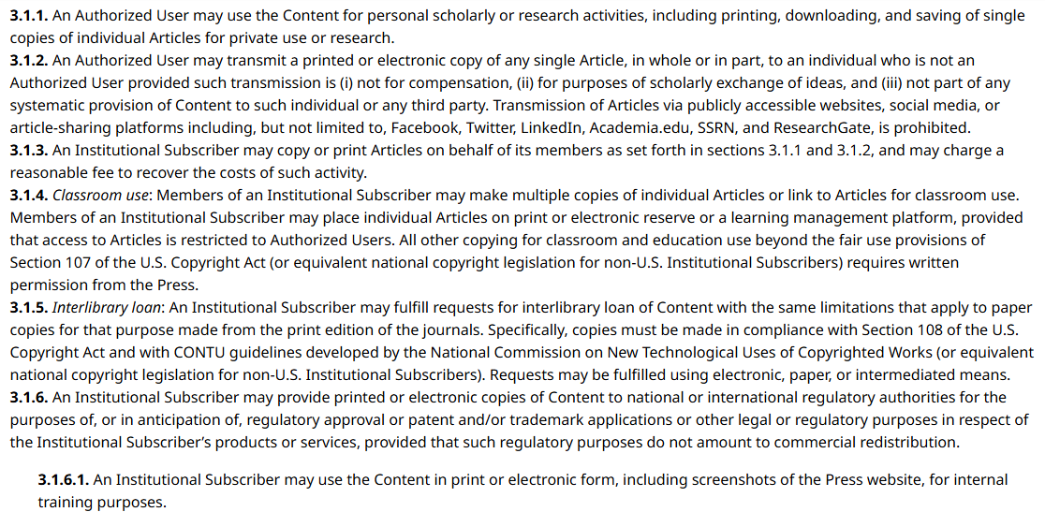
Library Copying (Section 108)
While section 109 allows libraries to borrow complete works, 109 lets library’s make copies of parts of works for patrons or archival purposes.
Most digital works are governed by license agreements instead of copyright
https://www.journals.uchicago.edu/t-and-c

Slide 8
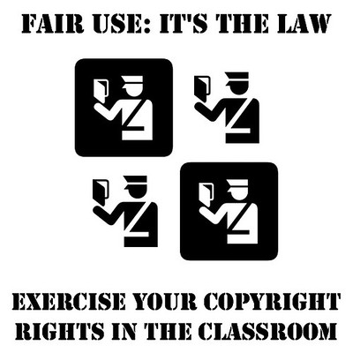
Fair Use (Section 107)
Fair use is an affirmative defense
Fair use can be used for the purpose of:
Journalism: comment, criticism, and news reporting
Education: teaching, scholarship, and research
Four Factors
Purpose and Character of the Work
Nature of the Work
Amount
Potential Market Value
Fair use classroom poster draft by Timothy Vollmer is licensed under CC BY 2.0.

Slide 9
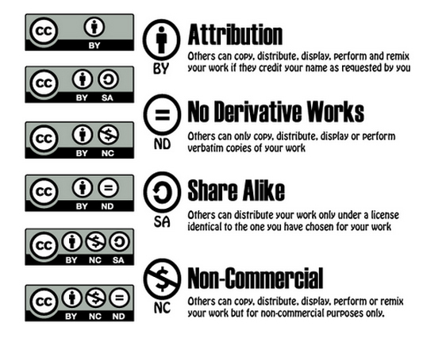
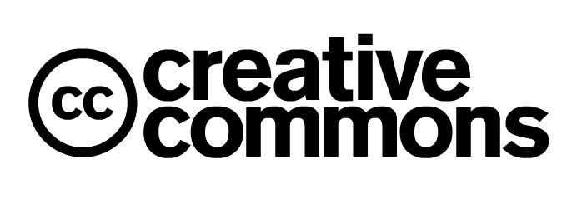
Creative Commons Licensing

Slide 10
Using Creative Commons Licensed Materials
Find resources using Google Advanced Search
Use, reproduce, and distribute materials without worrying about copyright infringement
Some licenses allow you to derive new works and remix works to better fit the content to your course
Being able to make copies ensures that the resource will not disappear from a hosted website or a library database

Slide 11
Using Library Resources
Print Materials
Books and other multimedia materials can be placed on reserve
Students have a limited check out time to read a chapter of a book, watch a DVD, etc.
Only works well for on-campus students
Online Articles
Provide article citations and have students find articles within the library’s databases
You can provide direct URLs
Databases are yearly subscriptions, they are fairly consistent but changes can happen

Slide 12
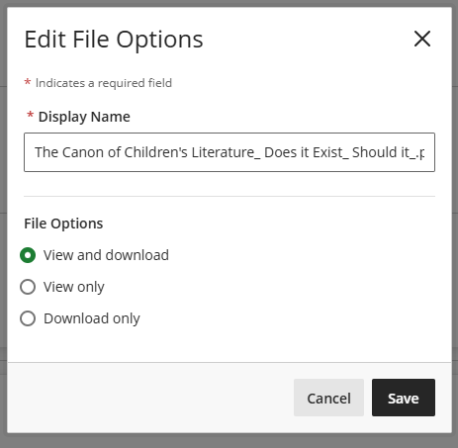
Using Freely Available Online Materials (not licensed by CC)
File uploading options in Blackboard
Find materials via Google
Provide links to the materials to students
If providing a copy of the document within a course shell, prevent downloads
Web is not static, there is no guarantee the materials you find today will be there tomorrow

Slide 13
Copyright Lawsuits Involving Schools
DynaStudy, Inc. v. Houston Independent School District, 2017)
Final settlement of $7.8 million
Egregious violations…cutting off copyright warning and making multiple copies of study guide.
Cambridge University Press v. Patton
Use of an eReserves system at Georgia State University
In the end, only 10 out of 99 claims, were infringements
Marcus v. Rowley (1983)
Marcus wrote a booklet on cake decorating for adult education class. Charged students for the booklet.
Rowley took the course, bought the book and derived a new book for her high school classes (11 of 24 pages copied, no attribution)

Slide 14
Resources
Dames, K. M. (2005). Copyright Clearances: Copyright Limitations & Risk Analysis for Information Professionals. Online (0146-5422), 29(1), 24-27.
Dames, K. M. (2005). Copyright Clearances: Fair Use Action and Apathy. Online (0146-5422), 29(5), 32–34.
Dames, K. M. (2005). Copyright Clearances: First Sale’s Slow Fade. Online (0146-5422), 29(3), 32–36.
Dames, K. M. (2005). Copyright Clearances: The High Stakes of Fair Use. Online (0146-5422), 29(6), 38-42.
Dames, K. M. (2005). Copyright Clearances: Library Copying in the Digital Age. Online (0146-5422), 29(4), 32–36.
Dames, K. M. (2005). Copyright Clearances: Navigating the TEACH Act. Online (0146-5422), 29(2), 25-29.

Slide 15
Questions?
Kelly Kornkven, Library Director, Mayville State University
Kelly.kornkven@mayvillestate.edu
Byrnes-Quanbeck Library’s Copyright Information Page: https://mayvillestate.libguides.com/openeducationalresources/copyrightinfo
LinkedIn: https://www.linkedin.com/in/kelly-kornkven-96133817/

