Slide 1
Vega lx starter
What are you waiting for??
Odin workday 2026 presentation

Slide 2
The Problem
What is the problem?
Utilitarian (AKA plain and boring) email notices for patrons
Who has this problem?
YOU do if you have not yet made the switch to Vega LX Starter!
Why should this problem be solved?
We can do better with customizable, exciting notices that can also be tracked.

Slide 3
Background Information
Vega Library Experience (LX) Starter offers a modern interface to easily create and send dynamic, exciting email circulation notices.
Staff can develop customized notices and view patron email history.
Metrics are available to check for delivered, bounced and failed email notices.
Tightened email criteria has resulted in significant increase in bounced emails. Vega LX Starter can be configured to reduce that problem.

Slide 4
Key advantages of Vega LX
Customized circulation notices
Many email circulation notices are available to be sent via Vega LX.
Ability to track metrics
The Vega LX dashboard allows you to track the emails that have been sent.
You can see at a glance the delivery, open, bounce, fail, and marked as spam frequencies.
Reduction in number of undelivered emails
ODIN has worked with NDUS to get special email addresses set up and registered so notices are not sent to the spam folders.
Ability to see which items were included in the notification.
You can still have replies to those emails to be routed to your preferred library email.
These notices can be designed and/or customized for your library.
Notices can be configured to be sent on a time schedule that works for you.

Slide 5
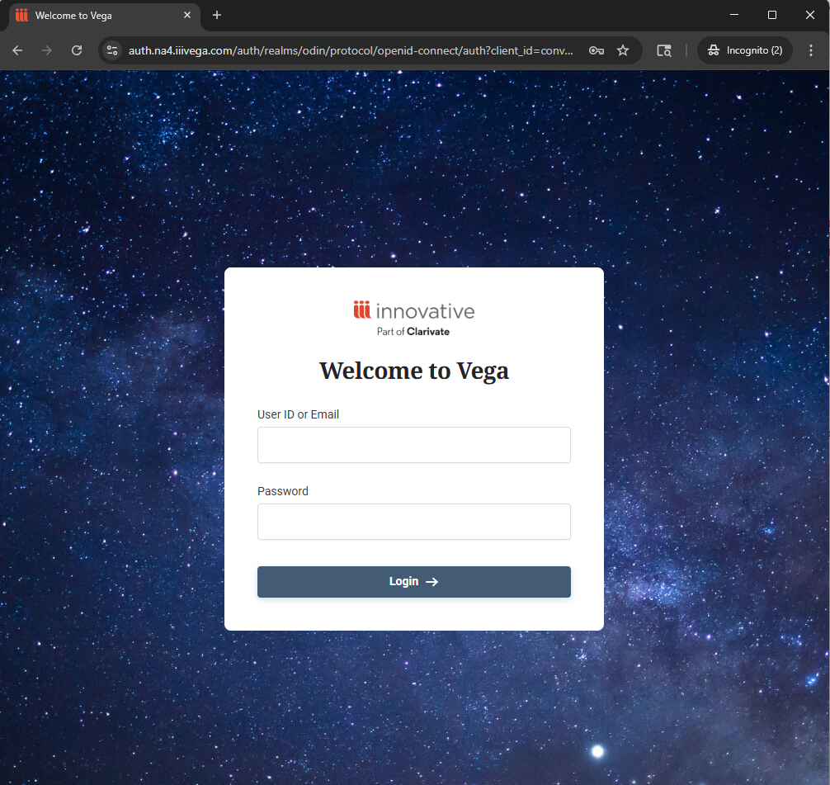
Sign-in page
Example of the Vega LX signin page.
This is ONLY needed for those with administrative access to create STAFF accounts, review and design templates, search patron notices, and evaluate the metrics created. In other words, it is for access to the back-end of Vega LX.

Slide 6
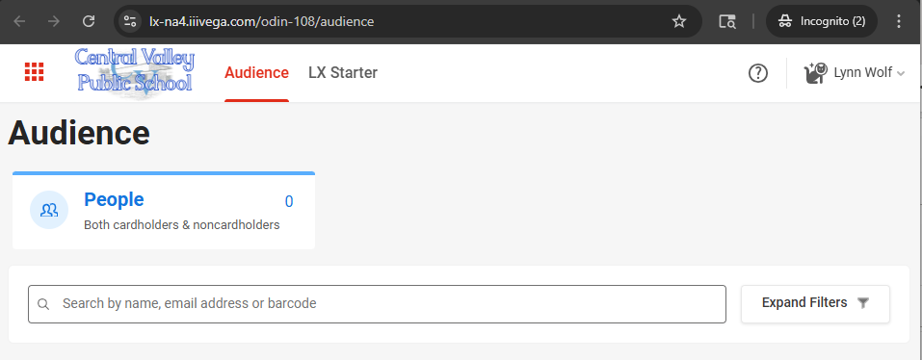
Initial screen
Components of the initial login page:
URL contains your library instance number. It is unique to your library.
Your library logo should be found in upper left corner.
You can search for your patron’s activity by searching their name, email address or barcode.
Next to the Audience option, is LX Starter where you access templates, metrics, etc.
In the dropdown containing your name, you will find LIBRARY SETTINGS.

Slide 7
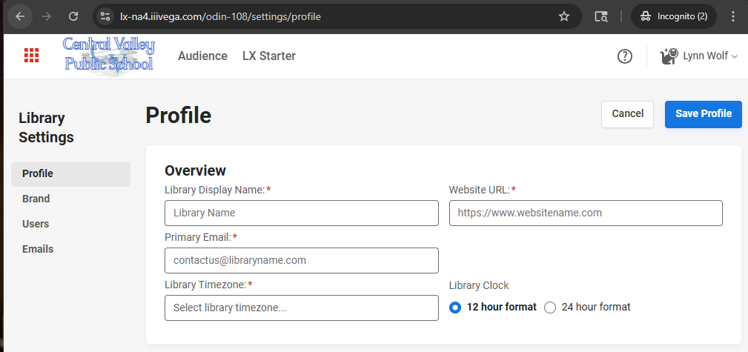
Library Settings
We will configure this section together when we have our initial work session.
Profile Overview contains the display name for your library, your library website, primary email and time zone. ** note: time zone is offset from GMT. DST will impact the timing of the notices!!
Brand is where you place any/all logos and define any unique colors your library uses.

Slide 8
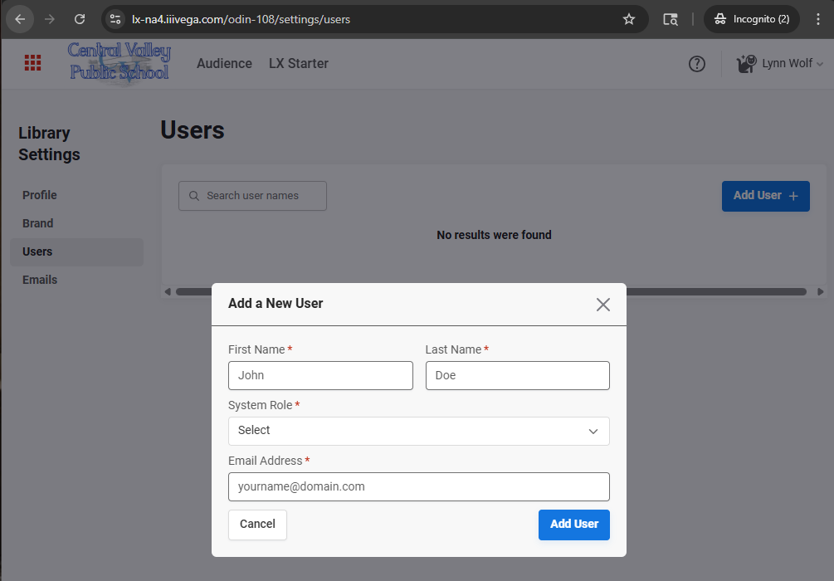
Users
This area is where you add new users that will have administrative access to Vega LX.
System Roles include: Manager Reviewer Admin Super Admin
Most of your users will likely fall in the Admin Role since the Manager and Reviewer have limited functionality.

Slide 9
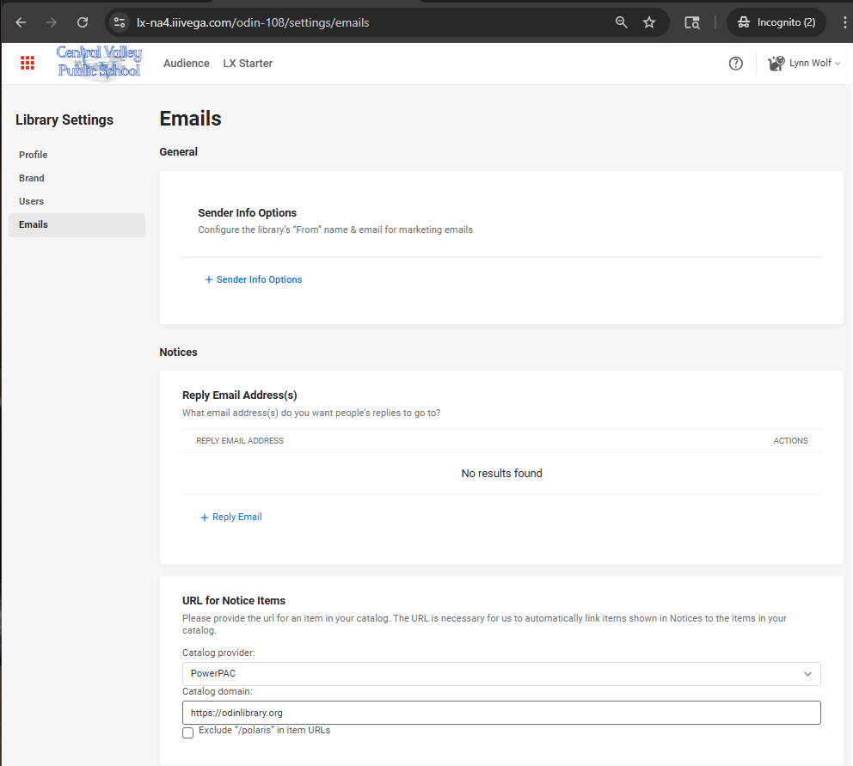
Emails
We configure during initial work session. You cannot send user notifications without having this area configured.
General – defines Sender Info Options. SPECIAL EMAIL entered here will receive an email from Amazon Web Services with a verification link.
Notices – defines email address you want any replies from the patrons to be directed.
URL for Notice Items – This controls linking to the catalog and thumbnails appearing on notices. If a catalog search does not have a cover image displayed, the same icon will appear on the notices. Provider will likely change when we go to Vega Discover.
Default Contact Method and Configure Dates are also defined on this page.

Slide 10
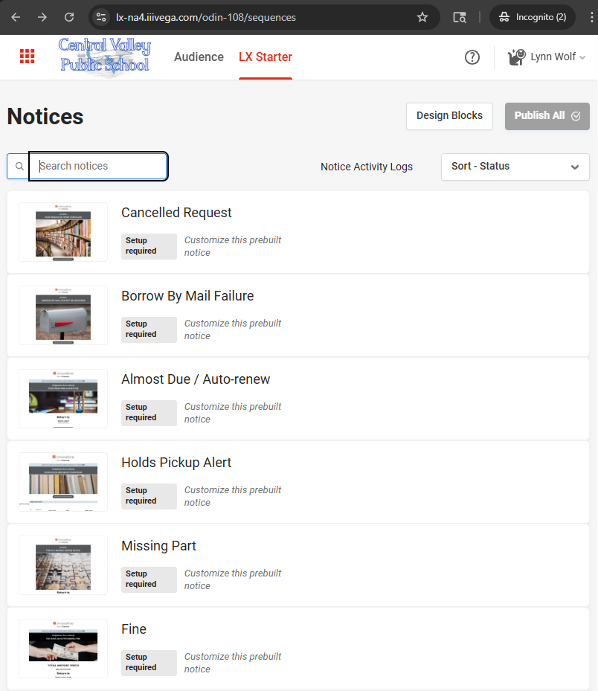
LX Starter area
This is where the templates are stored.
Currently available templates: Cancelled Request Borrow By Mail Failure Almost Due / Auto-renew Holds Pickup Alert Missing Part Fine 2nd Overdue 3rd Overdue Final Holds Pickup 1st Overdue Overdue Bill Manual Bill

Slide 11
Which templates to customize?
There are 12 templates available as of today. Documentation on website indicates more will be developed as time goes on.
You only need to customize the templates you wish to use – for most that will be the 1st and 2nd overdue notices, Almost Due / Auto-renew, Holds Pickup Alert, and perhaps the Manual Bill (if you choose to send via email instead of printed).
A summary report is run to show which notices have been used in the past year as a starting point for your library.

Slide 12
Work smarter – not harder
Use the DESIGN BLOCKS option to create elements that can be used in each template for consistency.

Slide 13
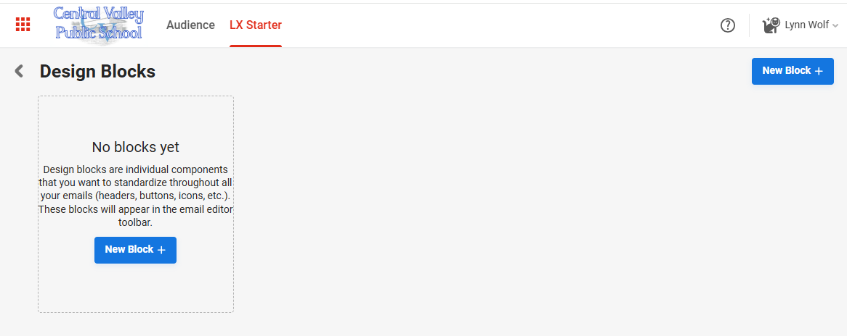
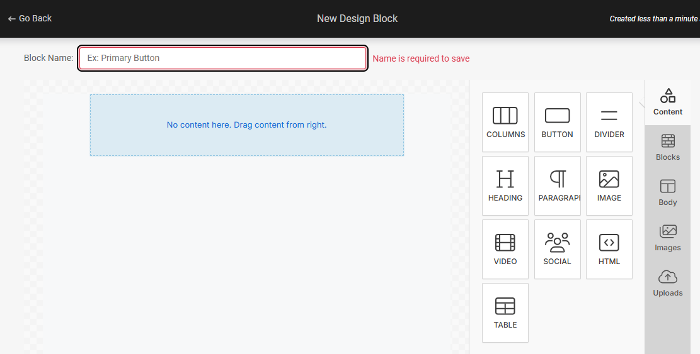
Work smarter – not harder possible blocks: header/logo, library hours and contact info, links/social media section
Starts out as a blank slate – click NEW BLOCK to create
Example of new design block – drag and drop to create elements

Slide 14
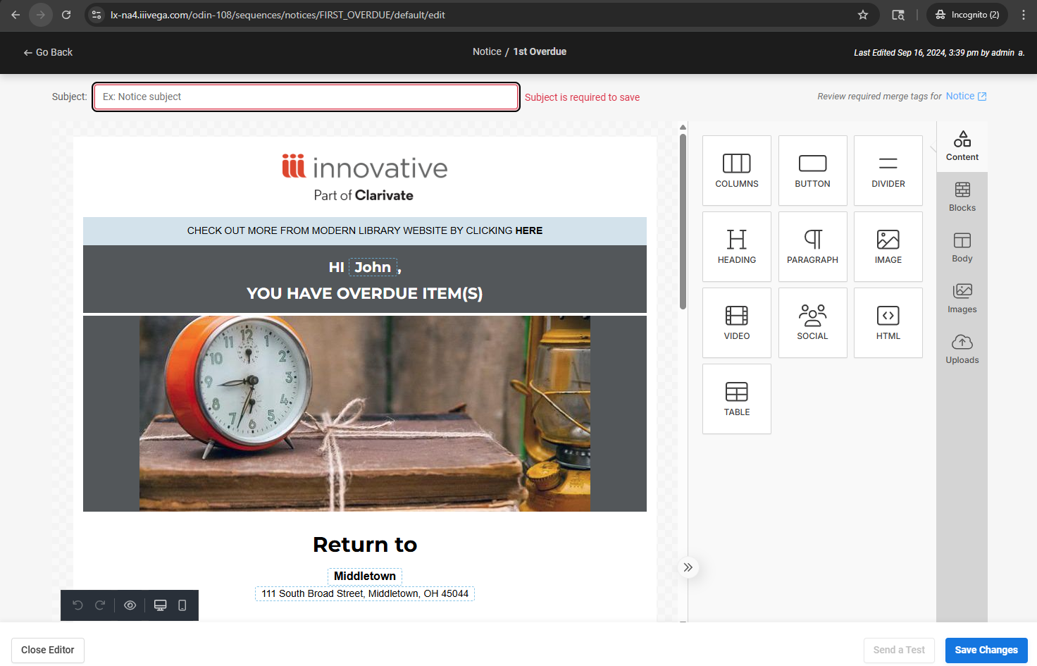
Customizing the templates
Example of the 1st Overdue template default.
SUBJECT – this is the subject of the email – strongly recommend you include the name of your library – e.g. “You have overdue item(s) at Central Valley High School Library”
LOGO / HEADER – you can use your library logo and colors to brand the notice
From here …. Anything goes!! You can create a format that works for you (utilize the DESIGN BLOCKS where you can for continuity across your notices). Almost everything is customizable – colors, fonts, buttons for linking (consider linking to your catalog and/or website), social media, etc. Simple drag and drop design.

Slide 15
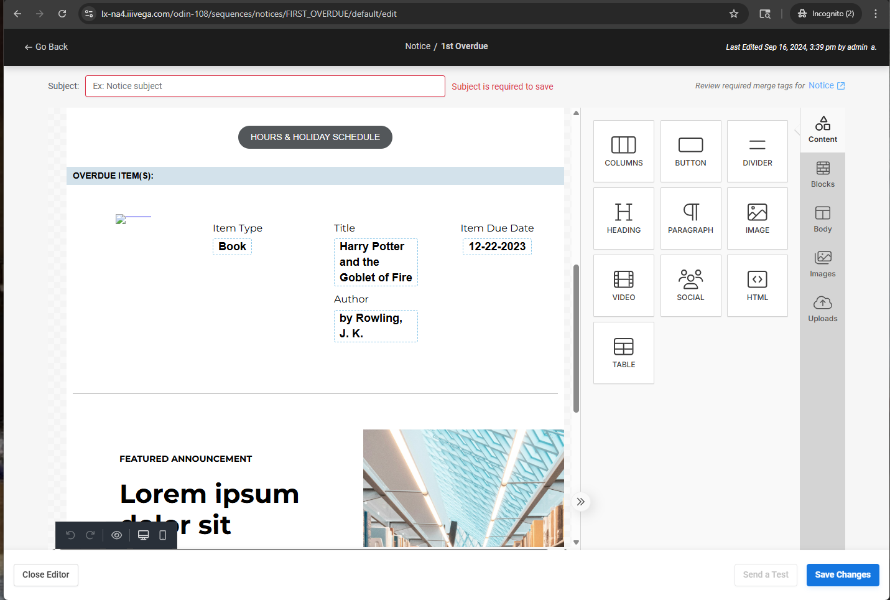
Customizing the templates - continued
More of the ITEM SECTION – once configuration is set up, there will be a cover image under OVERDUE ITEM(S).
Each notice type has additional fields that can be included within the notice.
Once you have your first draft of notice, hit the SAVE CHANGES button in lower right – you MUST have a subject entered to be able to save it.
You can click on the SEND A TEST button to test (again, there must be a subject entered above but template does not necessarily need to be saved).
When sending a test, you have option to enter a patron ID or barcode, item record ID, and email address. Note: once you enter your email, add space at end to actually add the email address.

Slide 16
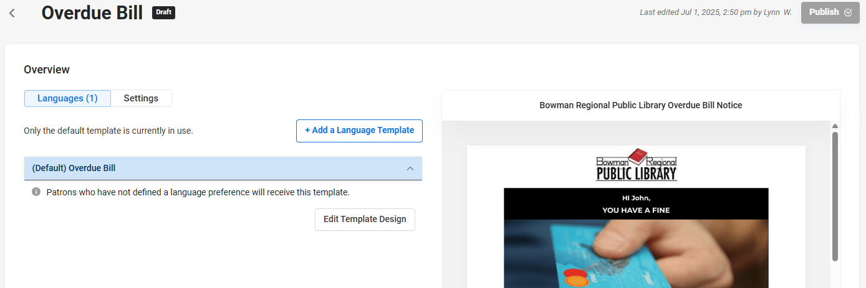
EDITING and Scheduling your notices
Once you have a template saved and click into it again from the LX Starter Notices page, the appearance is different. You can continue to customize by clicking on the EDIT TEMPLATE DESIGN or go to the SETTINGS tab to complete the initial setup. The SETTINGS must be completed before the PUBLISH button will be activate to go live with your notices.

Slide 17
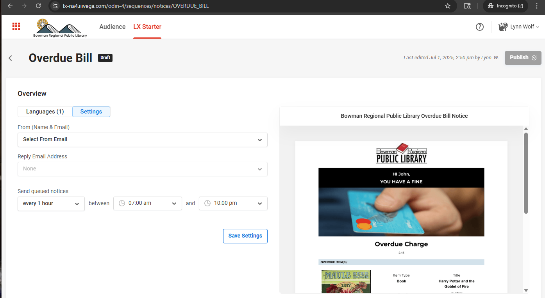
Scheduling your notices
Using email addresses defined when we started configurations, select the FROM address (use the “special email” defined for your library that contains the @odinlibrary.org). Set your REPLY EMAIL ADDRESS.
For SEND QUEUED NOTICES – recommend every hour scoped to fall within the library open hours. YOU MUST AVOID THE TOP OF THE HOUR as that is when Polaris jobs may be updating some notices.
SAVE SETTINGS and then you will be able to PUBLISH the notice when ready.

Slide 18
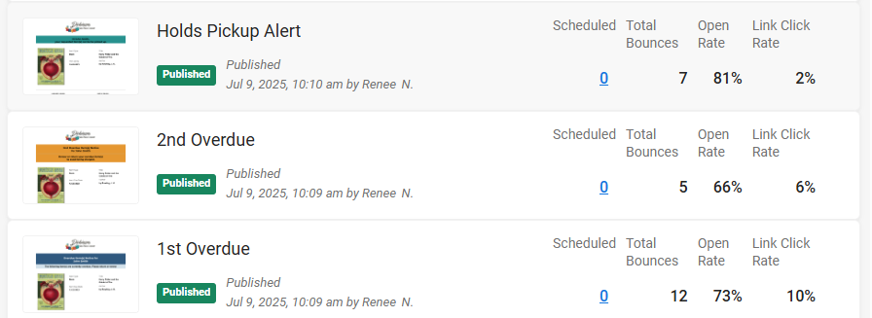
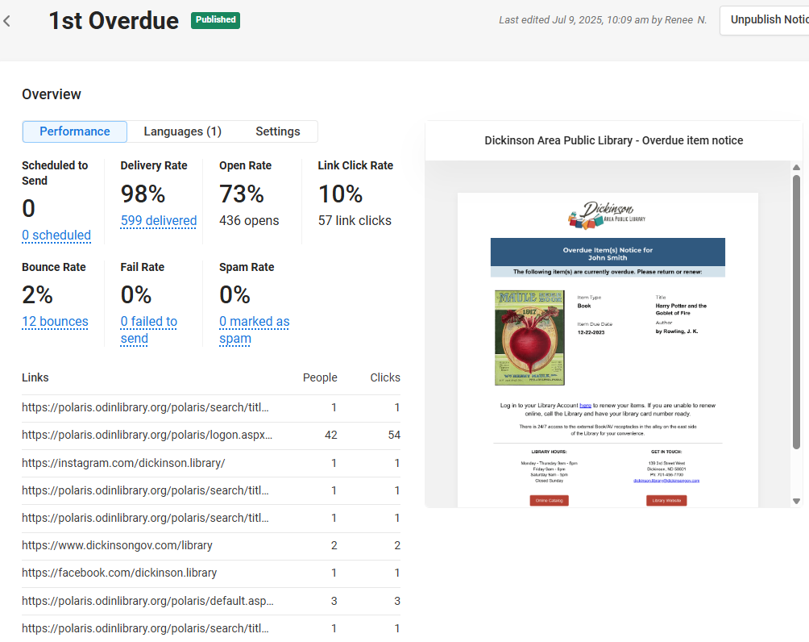
metrics
Example of what the notices section looks like after a few cycles
Drilling down to find stats and potential issues to resolve

Slide 19
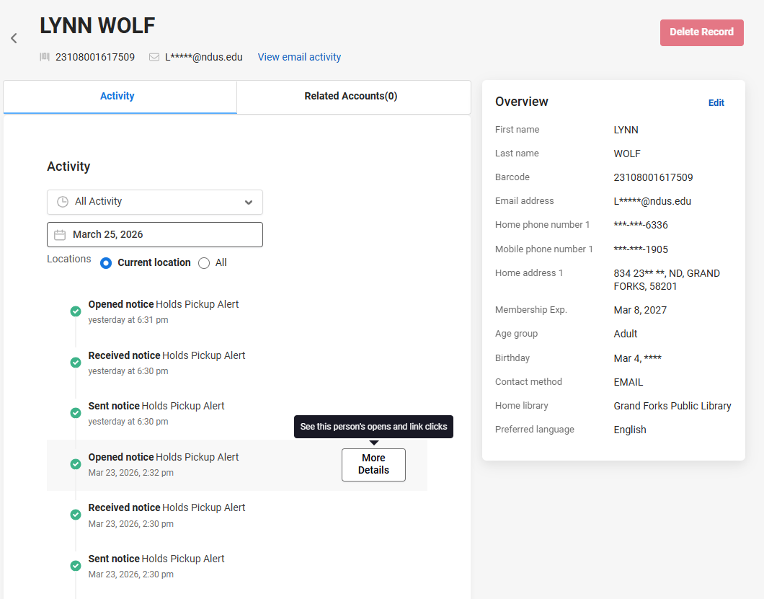
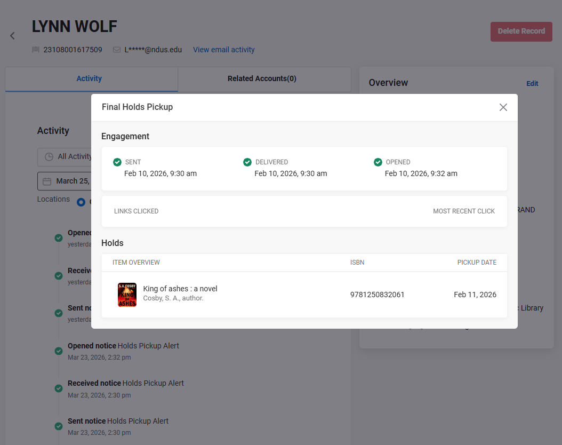
Example of patron record information

Slide 20
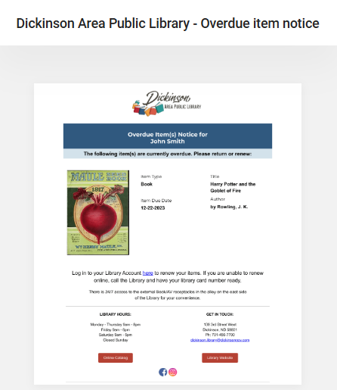
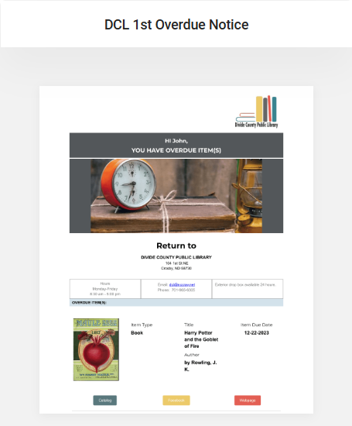
Examples of 1st overdue template currently in use

Slide 21
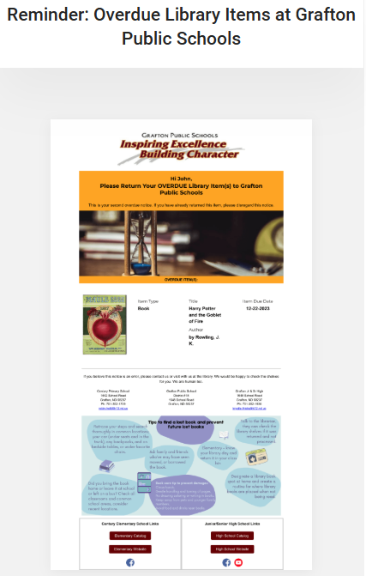
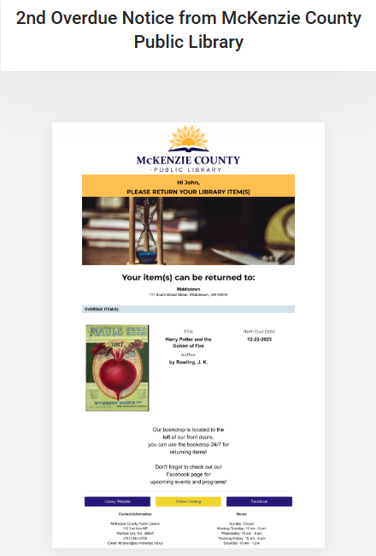
Examples of 2nd overdue template currently in use

Slide 22
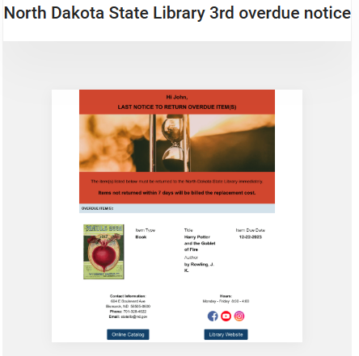
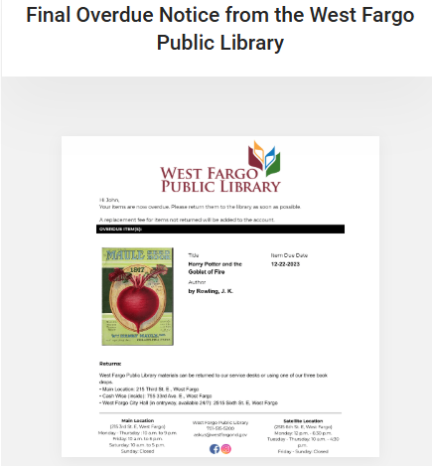
Examples of 3rd overdue template currently in use

Slide 23
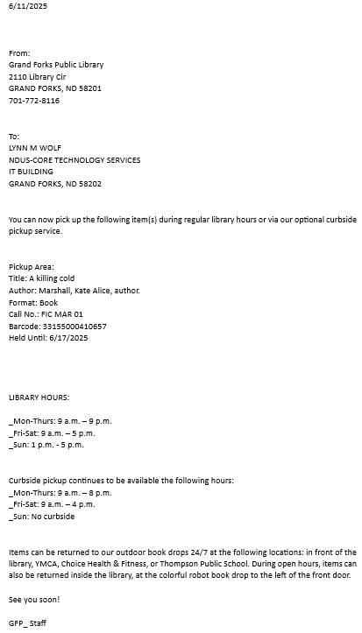
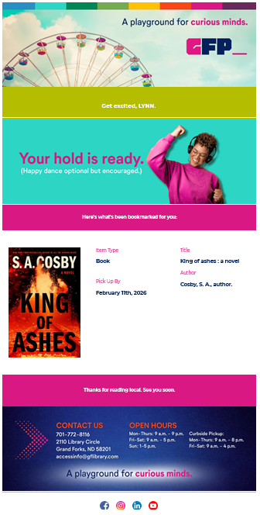
GFP_ Hold notice – Polaris vs Vega LX

Slide 24
Final Result
As you have one (or all) of your templates designed, contact the ODIN Office. We will review and possibly offer suggestions (never hurts to have an extra set of eyes take a look).
When ready, you take a deep breath and PUBLISH the templates. Once PUBLISHED the emails being sent will use those designs. Any unpublished notices will still default to the Polaris notices.
Your library may want to promote changing over to email to save money on postage as you are working on the templates.
REMINDER: these templates are EMAIL only. Texts and print notifications remain unchanged.

Slide 25
So … what are YOU waiting for?
Thanks for attending!!
Please submit a ticket and we can schedule a meeting to get you started.
Lynn – ODIN Office lynn.wolf@ndus.edu

