Slide 1

VEGA DISCOVER – coming soon!
ODIN Workday 2026

Slide 2

Agenda
Why change to Vega Discover?
Key Features
Documentation and a few new Vega Discover Sites
Implementation Schedule
Questions?

Slide 3


Why change to Vega Discover (and Vega Mobile)?
This upgrade represents a shift from traditional “inventory” search to a “discovery” journey that more closely mirrors the experience of a streaming app than a traditional catalog.
The Vega Mobile app will provide patrons with digital library cards, self-checkout capabilities, and multi-account management.
Accessibility & Inclusion. Built with ADA Title II compliance and the updated federal requirements at its core, Vega ensures that all patrons, regardless of ability, can navigate the collection with dignity and ease and our libraries are in compliance.

Slide 4
Key Differences between PowerPAC and Vega Discover
Technology and Design:
Vega Discover is a modern, multi-tenant, web-based platform designed for better user experience, offering enhanced visual searching, "work-level rollups" (grouping different formats of the same title, like book/eBook, into one result), and faster searching.
PowerPAC is the traditional, more mature, and established interface, which may feel more fragmented in its display of search results (requiring more clicks).
Discovery and Content:
Vega Discover features expanded Syndetics Unbound integration for rich content (book covers, reviews).
Vega Discover integrates with eContent more smoothly, allowing for better branding and management of eResources (eBooks, eAudio).
Functionality and Features:
Vega Discover supports multiple pickup locations, better filtering, and more intuitive navigation.
PowerPAC is often considered more stable in its functionality because it is tightly coupled with the core ILS, but it offers a less modern interface.
Vega Discover is still developing in some areas, such as patron registration, which some libraries still handle through PowerPAC.
Integration and Future:
Vega Discover is being marketed as the future of discovery for Polaris, allowing libraries to maintain their Polaris ILS backend while offering a superior, modern, and branded user experience on top.
PowerPAC is still heavily used, but many libraries are moving to Vega Discover for a more modern, intuitive interface.

Slide 5




Key Features
Smart "Roll-Up" (FRBRized) Results. Vega Discover groups all versions of a title (print, ebook, audiobook, large print, etc.) into a single search result.
Recommendations and Reader Advisory. Much like popular streaming services, Vega Discover uses a "Context Engine" to suggest related topics, authors, and series. Vega also helps patrons discover related materials through "Person" and "Topic" pages and provides review and rating information from external sources; effectively acting as a digital reader’s advisory tool.
What is different than the Polaris PowerPAC we have now?
Polaris PowerPAC and Vega Discover are both library patron-facing catalog interfaces offered by Innovative (a Clarivate company) that work with the Polaris Integrated Library System (ILS).
.Vega Discover was developed and available for General Release for Polaris in April 2021.
Deep Integration with e-Content. Vega’s seamless integration with providers like OverDrive/Libby and Hoopla means that digital circulation can be accessed, tracked, and managed from within the discovery layer.
Customizable Collection Pages. Allows libraries to create unique collection pages for different audiences such as a Children’s PAC.

Slide 6
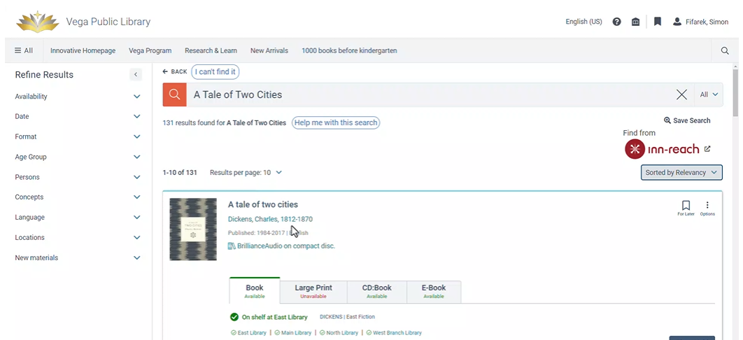
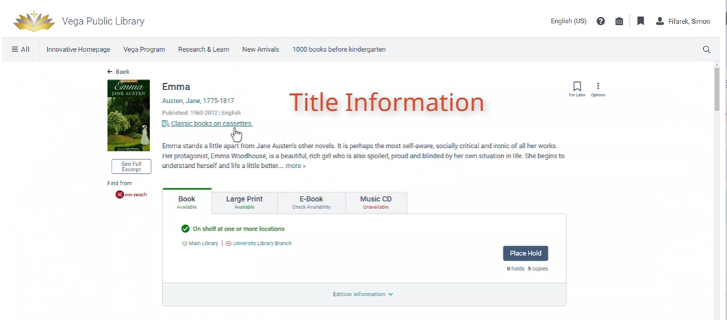
Smart “Roll-Up” Results
This feature groups all versions of a title (print, ebook, audiobook, large print, etc.) into a single search result.
The second slide illustrates what a patron would see if they clicked on the title of the item.

Slide 7
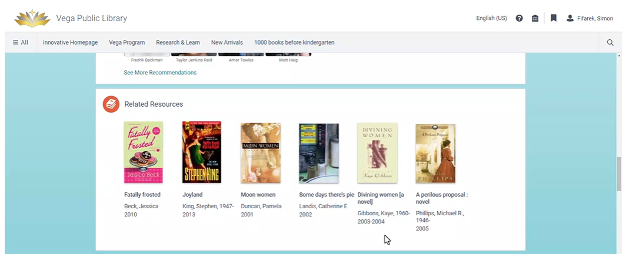
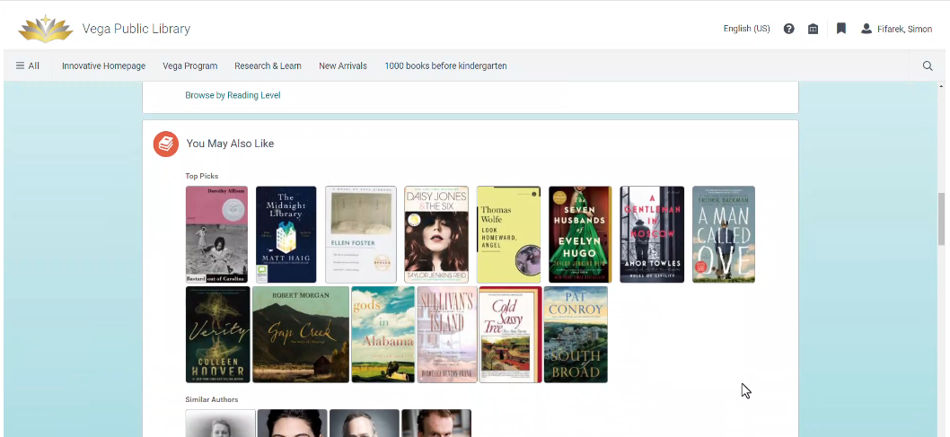
Recommendations and Reader Advisory
Vega Discover uses a "Context Engine" to suggest related topics, authors, and series. Vega also helps patrons discover related materials through "Person" and "Topic" pages and provides review and rating information from external sources; effectively acting as a digital reader’s advisory tool.

Slide 8
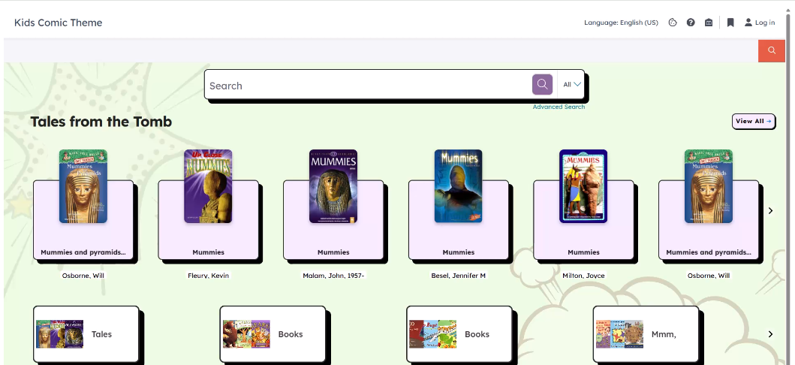
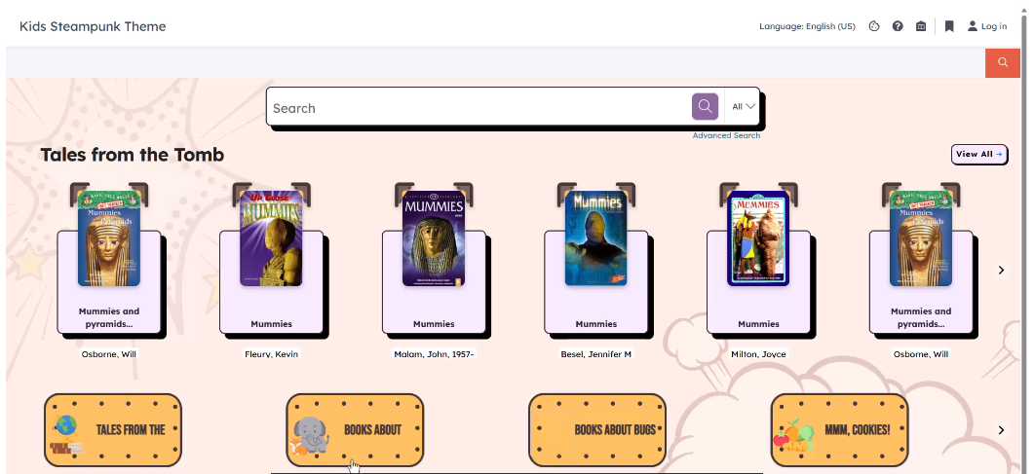
Different options for Themed Home Pages
Allows libraries to create unique themes for different audiences such as a Children’s PAC.

Slide 9
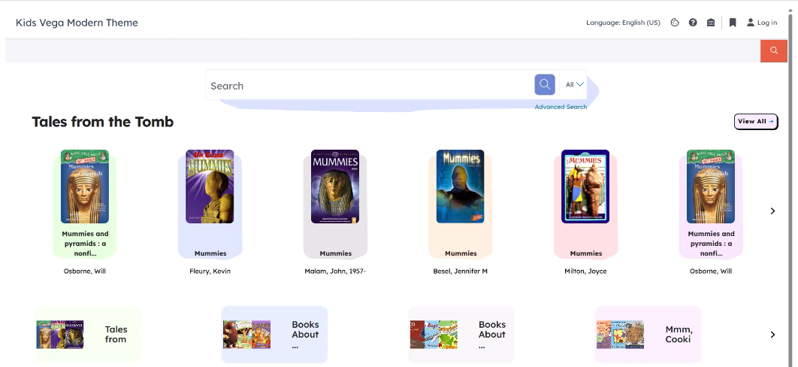
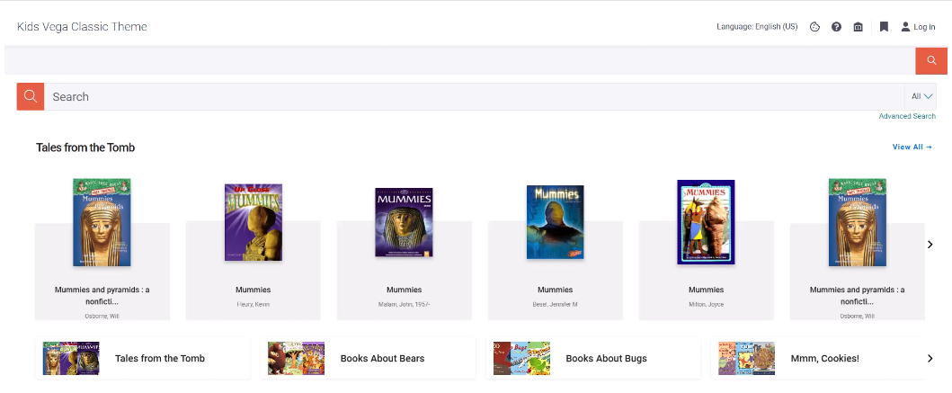
More Themed Home Page options
More theme options for a Children’s PAC.

Slide 10
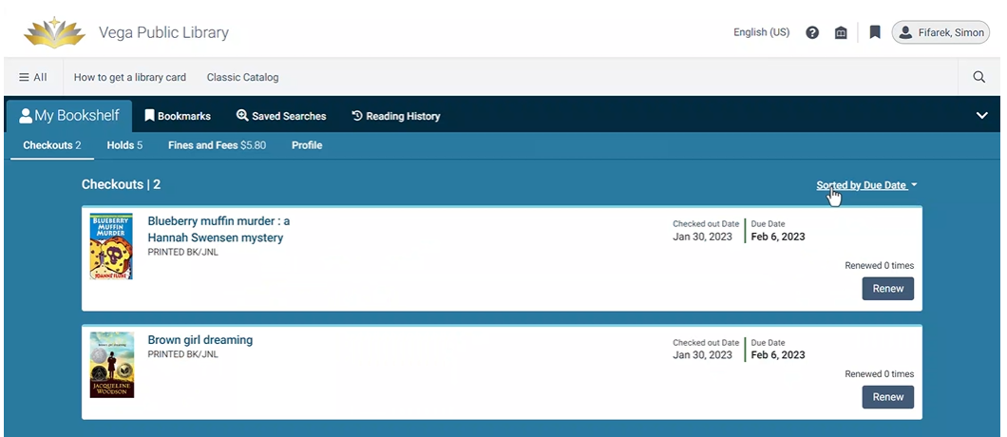
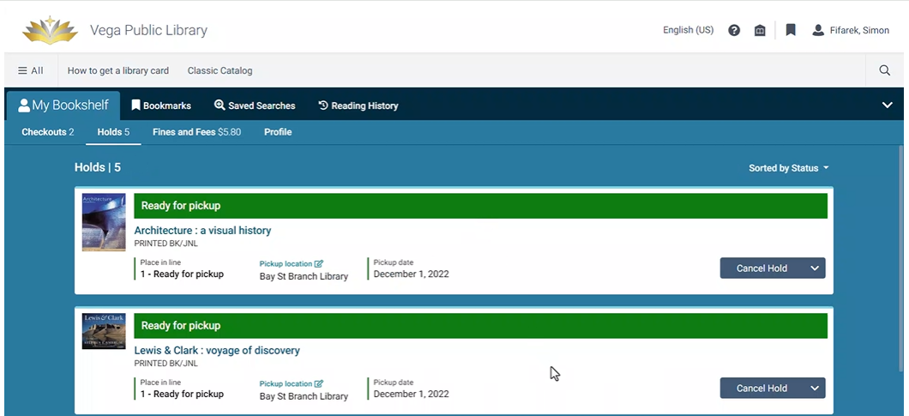
Enhanced Patron Account options
Patrons will have more tools to create reading lists, manage their account, and link accounts.
To the right is an example of My Bookshelf tab for Checkouts and Holds.

Slide 11
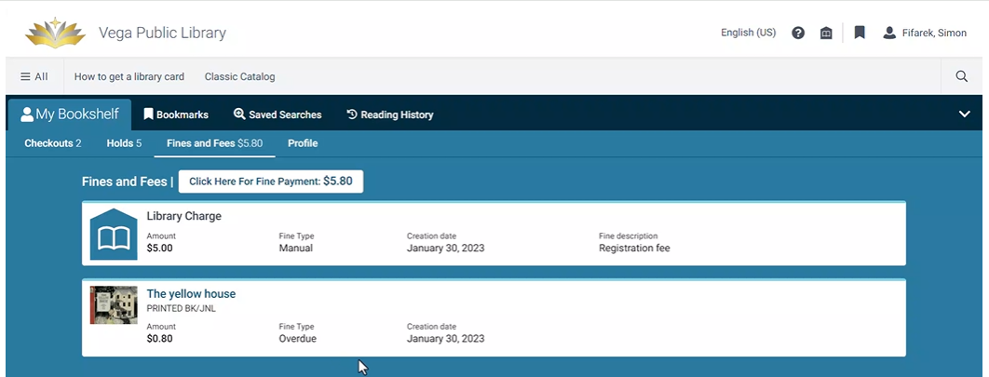
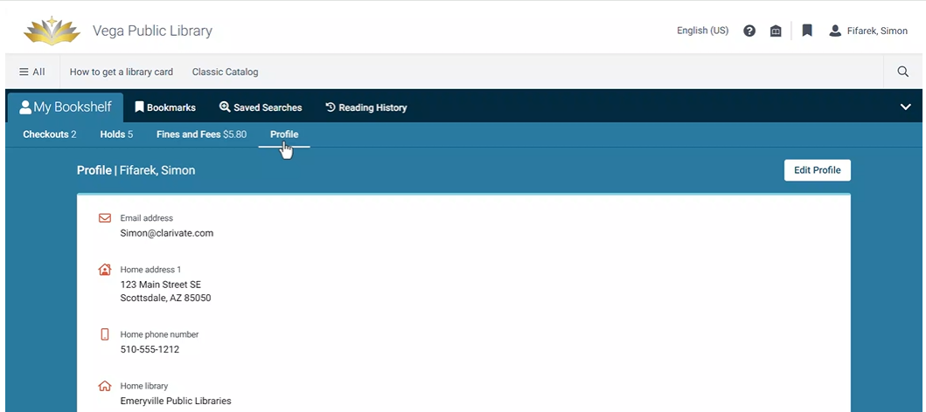
Enhanced Patron Account options
To the right is an example of My Bookshelf tab for Fines and Fees and Profile.

Slide 12
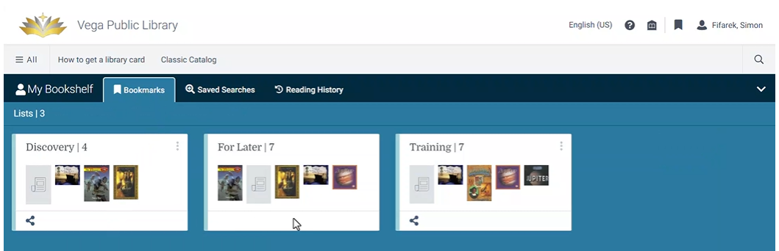
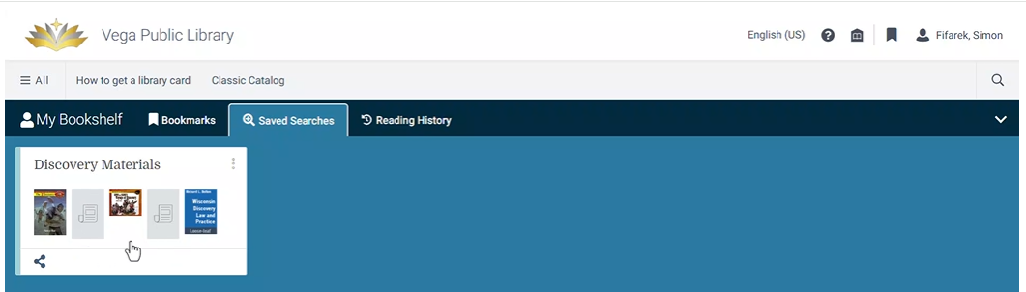
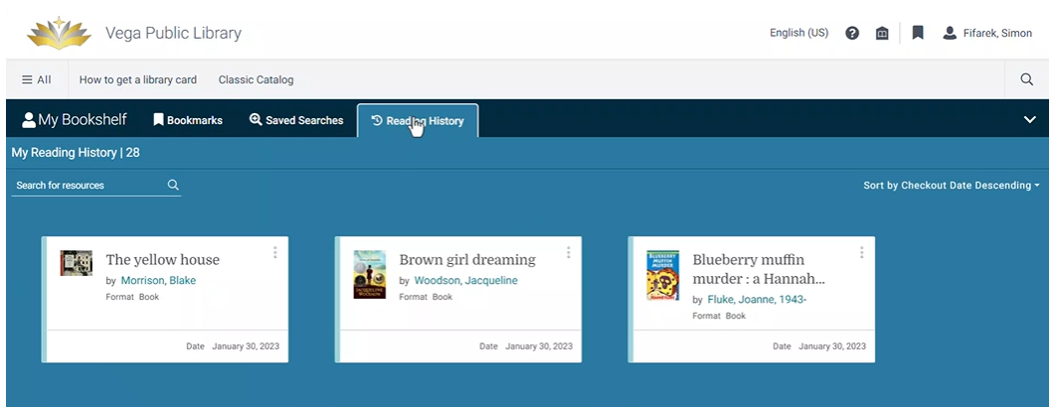
Enhanced Patron Account options
To the right is an example of Bookmarks tab (where patrons can keep lists of items), Saved Searches and Reading History.

Slide 13
Enhanced Patron Account options
To the right is an example of My Bookshelf tabs of Fines and Fees and Profile.

Slide 14

Documentation Vega Sites
Documentation
Libguides for Vega Discover:
https://innovative.libguides.com/Vega/Discover
A few new Vega libraries
Troy Public Library in Michigan: Vega: https://discover.troymi.gov/ PowerPAC: https://catalog.troymi.gov/polaris/
Thousand Oaks Library in California: https://discover.tolibrary.org/

Slide 15

Implementation Schedule

Slide 16

Questions?
Thanks for attending!
Lynn – ODIN Office
lynn.wolf@ndus.edu

