Slide 1
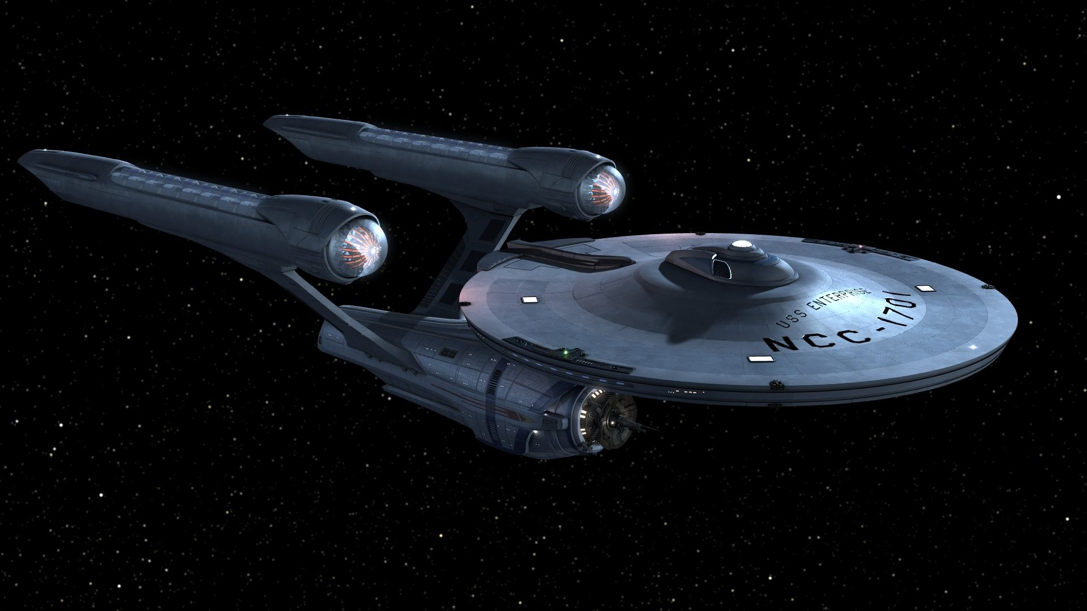
Primo NDE UI – Primo’s Next Discovery Interface
ODIN Workday 2026 Presentation Monday, March 23
This Photo by Unknown Author is licensed under CC BY-NC-ND

Slide 2
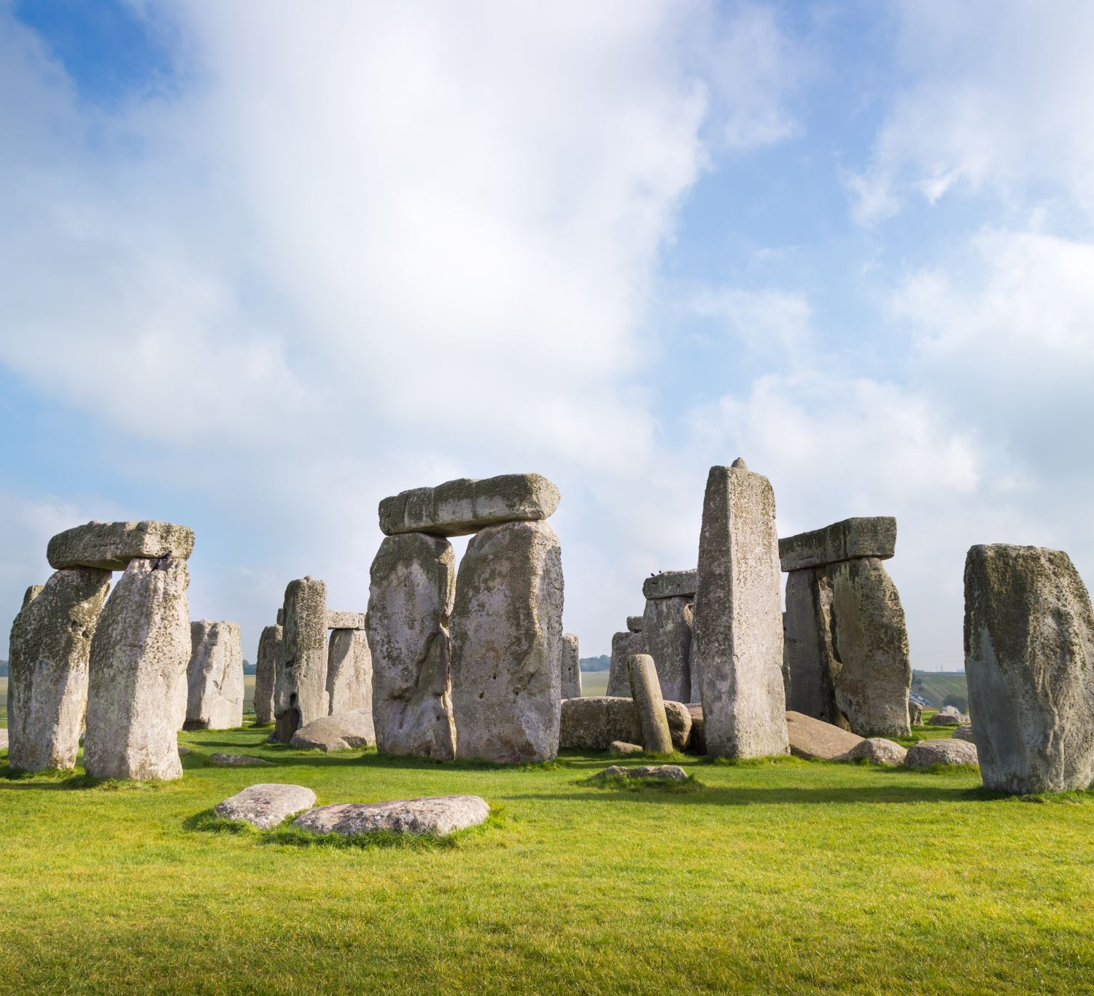

Agenda
Why should you switch to NDE
Key Updates
How to plan for the transition
Training Opportunities
Resources to help

Slide 3




Why should you switch to NDE?
Accessibility: VPAT - https://knowledge.exlibrisgroup.com/@api/deki/files/195011/Clarivate_Primo_NDE_VPAT.pdf?revision=1
Discovery related data managed in Alma remain unchanged - local fields/resource types, external data sources and labels. Plus you work alongside the live view.
“Do we have to?”
Primo VE Next Discovery Experience (NDE) represents a shift in the user interface design.
It provides a modern and streamlined interface for library users.
Documentation, videos, training and the Cohort Program are all available to assist in the transition.
There is no downtime during the cut-over and it is considered a “self-service migration option.”
Common customization activities are being added to the configuration area.
In January 2028, this will be the exclusive UI for Primo VE, following the gradual sunset of the existing UI.

Slide 4




Key Updates
Simple Search
Advanced Search
Brief Record Display
Full Record Display
Some things are changing ….
Enhanced User Area
Other Items of Note

Slide 5
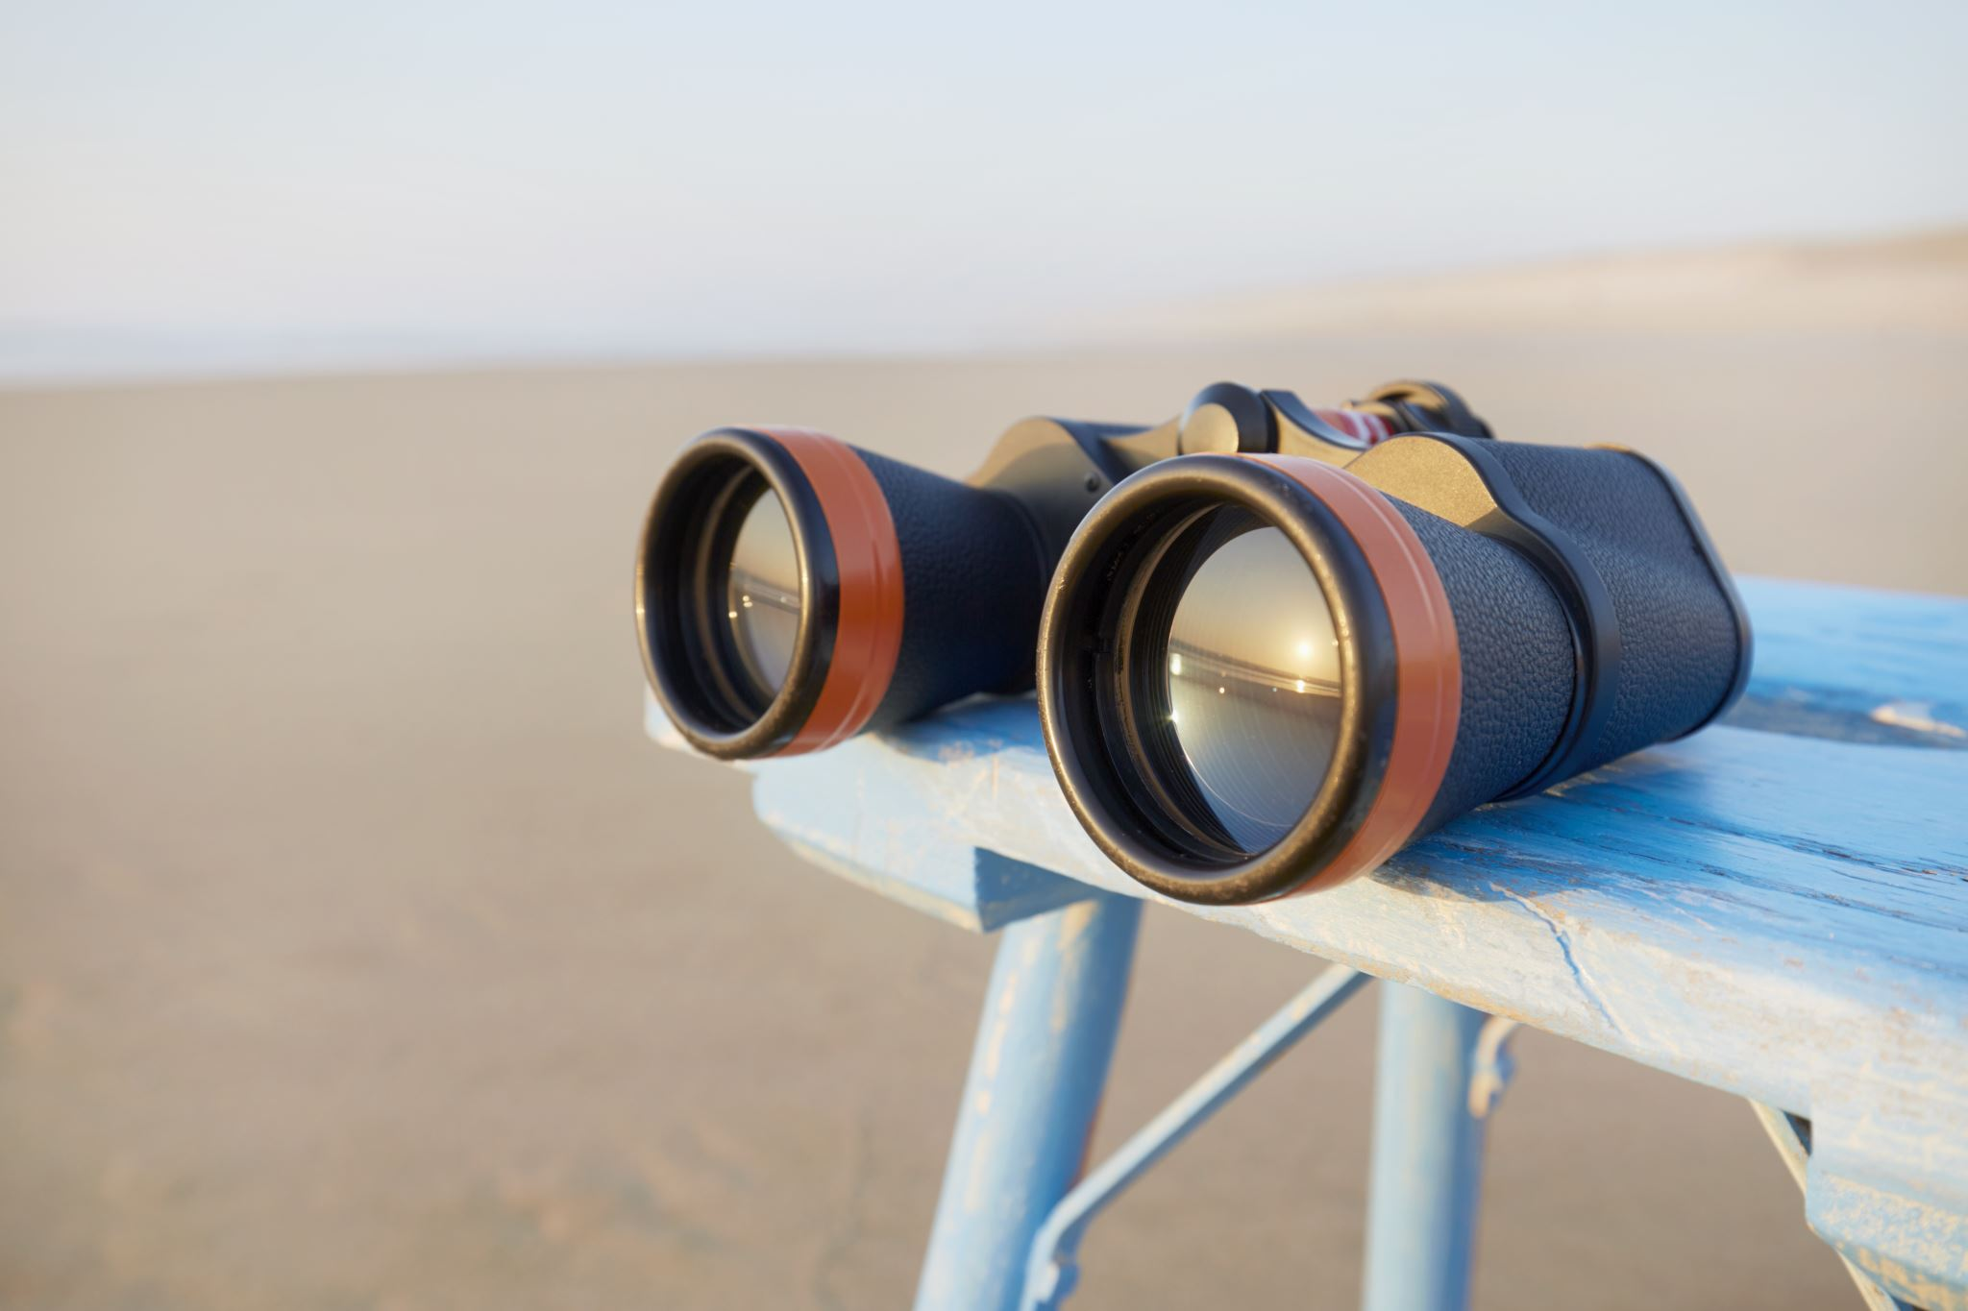
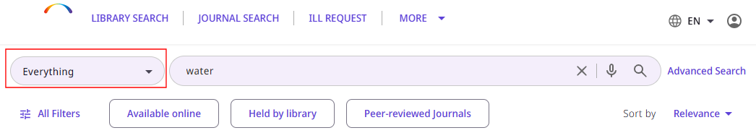
Simple Search
SEARCH PROFILES – taken out of the search box and placed to the left of the search bar.
SEARCH BAR and TOP-LEVEL FACETS – stay at the top of the search results when patrons scroll.

Slide 6
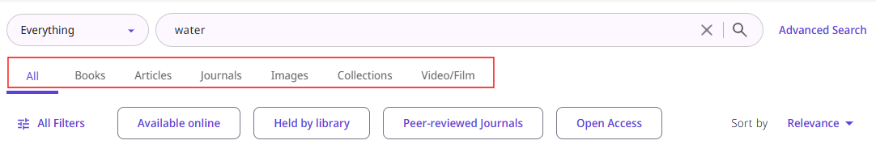
Simple Search
RESOURCES TYPE FILTER BAR – patrons can filter results by resource type (not available in Advanced Search

Slide 7
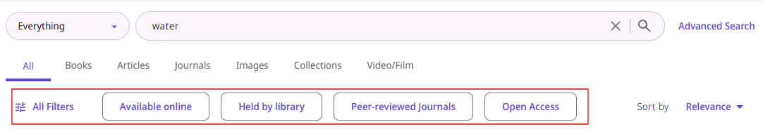
Simple Search
FACETS – appear below resource types filter and are closed by default. ALL FILTERS can be selected to open the facet options to appear next to the top-level facets such as AVAILABLE ONLINE

Slide 8

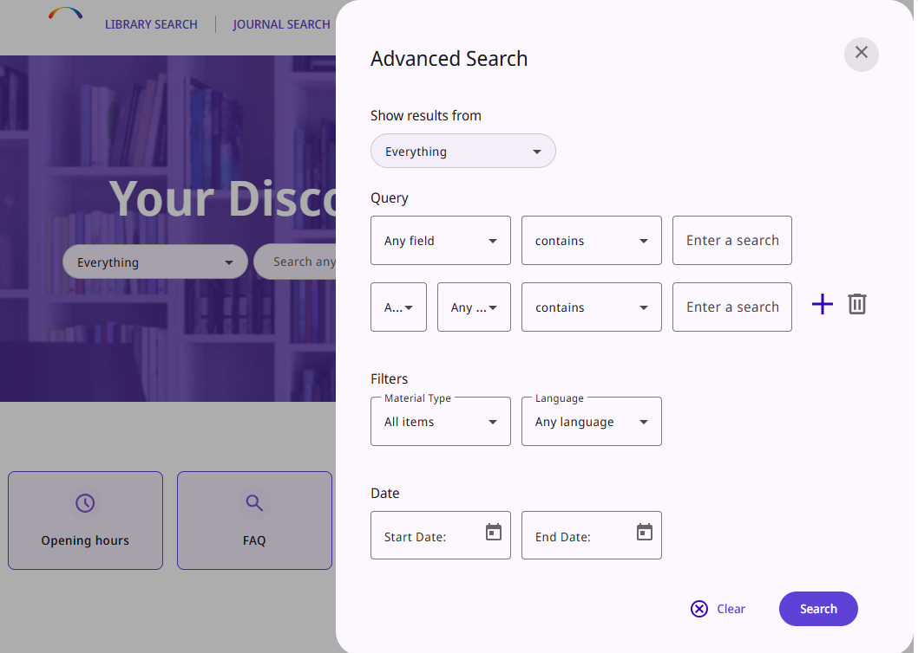
Advanced Search
The Advanced Search will open as a slide panel of the current page. This is to provide increased visibility for the search results
More improvements are planned for March and April based on feedback from users.

Slide 9

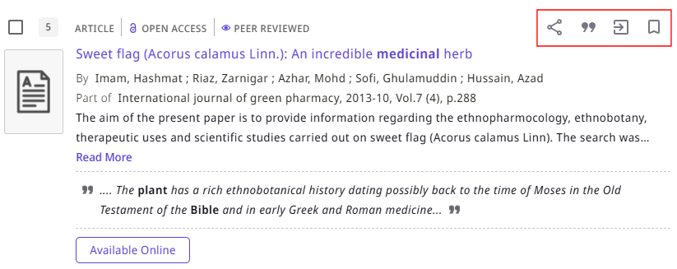
Brief Record Display
The Brief Record Display has changed.
At the top of the record, you see record indicators listed next to the resource type.
Commonly used availability fields can be enabled in the Quick Filters (controlled in the View Configuration / Brief Results tab). Defined availability filters are Available On Shelf, Full-Text Online, Held by library, Peer-reviewed Journals and Open Access.
Options have also been added to display the Summary and/or Snippet fields. These are also controlled in the View Configuration / Brief Record Display area.
Record actions are grouped by categories and displayed to the right of the indicators. You can enable Share (includes email, permalink, social media), Citations, Export (print, excel, Leganto, RefWorks, etc), Email (for single records only), and Add/Remove record from Favorites. This display is controlled in the View Configuration / Brief Record Display tab in the NDE Record Actions area.

Slide 10
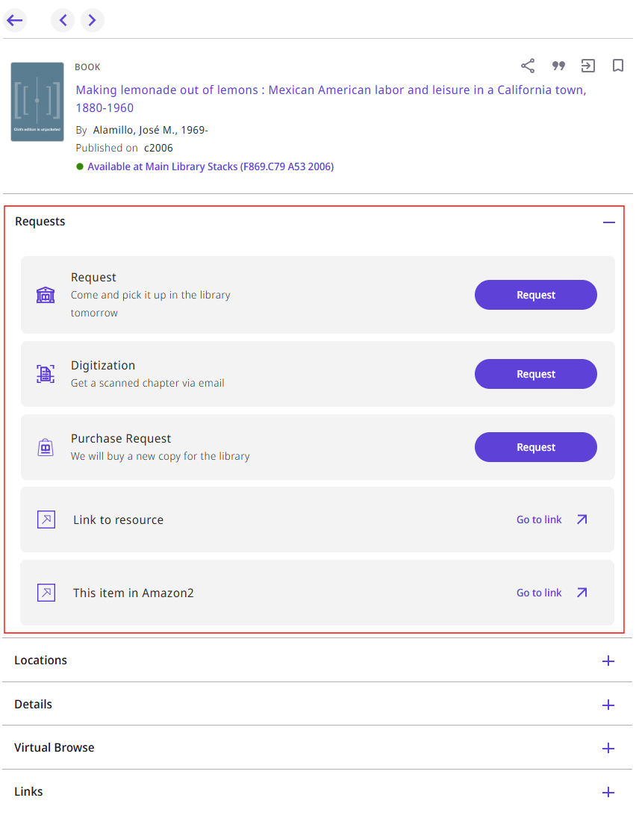

Full Record Display
Dedicated Requests section (Request, Digitization, Purchase Request, link to resource) and enhanced request forms (opens as pop-up window, closes upon submission, link to view my requests). This section is recommended to be placed at the top of this list. If you do not define to be expanded by default, up to 3 requests are displayed with option to view more.
Locations area shows availability of items grouped by library/locations. Note: when patron selects item that appears in Location area, there are only THREE elements displayed. Primo VE currently displays FOUR. You will want to check your configuration to make sure you are displaying your highest priority elements. Locations was previously called View It/Get It but renamed since it now only shows item availability. *** currently under development ***
New Places Map widget appears in full display when record contains geographical coordinates in 034 tag and option is enabled on the GENERAL configuration page.

Slide 11
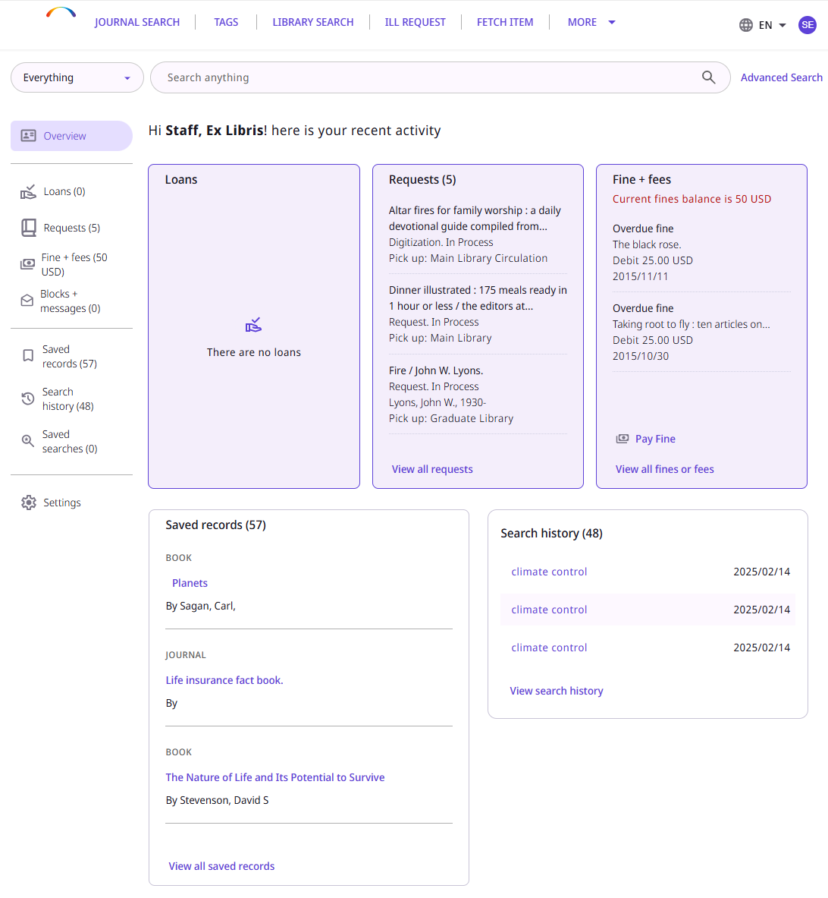

Enhanced User Area
Improvements have been made to the User/Patron Account area.
The Search bar and header always appear across the top for quick navigation.
Easy User Dashboard Configuration table to display (or not) the different activities in the user area (Loans, Requests, Fines and Fees, Saved Records, Saved Searches, Search History, Settings – which includes password maintenance, choose library notices, expiry date, etc.). Settings are found in Configuration / Discovery > Library Card Configurations > User Dashboard Configuration. Each different category can be enabled/disabled and also specified to be included in the OVERVIEW section of the display.
The OVERVIEW display is shown here but when you click into each area, it gives more related details.

Slide 12

Other Items to Note
When duplicating your view to NDE, check the brief display fields as they are reset to the OTB configuration. Any customizations will have to be replicated in the new view. OTB fields are:
Vernacular Title ; Title
Creator ; Contributor
Creation date
Is Part Of
As you work on your NDE view, any changes made to your current view that you want to use going forward, should be replicated on your NDE view also.
Primo Studio is NOT available with NDE UI. The functionality has been transitioned to the ALMA configuration where you can manage options previously supported such as branding themes and add-on configurations. Some of this functionality is still in development.
In the Manage Customization Package tab, the color theme contains a limited choice of colors.
Features NOT SCHEDULED for NDE include the RSS from saved searches, personalizing search results, and pre-filters in the basic search.

Slide 13
Other Items to Note
New method for finding the display-label codes has been implemented in the NDE UI: label codes can be found by adding &debugLabels=true at the end of the URL of the Primo VE page and pressing Enter to reload the page. The page then opens with all the configurable labels replaced by their codes.
Mixpanel – Analytics for NDE. ODIN Office will submit request for setup so it is ready when you go live. Any Analytics you may want from Primo using OBI should be retrieved before transitioning to NDE.
May 2026 release – configuration for NDE Homepage with ALMA DISCOVERY
August 2026 release – booking request form, embedded showcase in landing page, barcode search.
If using a search box to search in VE from your library page or elsewhere, the queries are automatically redirected to NDE after you go live – no need to create new search box.
Recommend copying your existing PrimoVE view and naming it to reflect it was the Primo VE used prior to NDE cutover. Once you switch over to NDE, all traffic to your Primo view will go to the NDE view and you will not be able to access the old one.

Slide 14
How to plan for the transition
BRANDING: themes, icons, favicon, CSS and logo (must be .png or .svg format with max dimensions of H: 100 px and W: 300 px and file size cannot exceed 30 KB)
LANDING PAGE: elements to include such as library hours link, welcome message above search box, search tips, background image, header/footer contents, etc.
A few items you will want to start to consider and discuss ...
You will want to start thinking about and discussing a few things within your library. Things can be revisited and revised later but having a foundation to work with will make the initial customizations move along more quickly.
Current customizations applied to your view defined in the CUSTOMIZATION PACKAGE will NOT carry over to NDE and must be reconfigured if you wish to retain. If you need help evaluating what types of customizations are in your current view, submit a ticket and we will work with you to obtain that information.
MAIN MENU OPTIONS: do you need a change in choices, order, wording?
USER AREA: which library card options should be displayed – Loans, Requests, Fines and Fees, Saved Records, Saved Searches, Search History

Slide 15
Training Opportunities
Go NDE. Page contains list of resources, transition steps, features, release plan, best practices, and link to Cohort Program.
NDE UI Transition Cohort Program is a 4 week structured training program designed to guide you through migration to NDE UI.
You are not alone …
Ex Libris offers numerous presentations and step-by-step documents including a 4-week Cohort Program explaining how to configure your NDE environment.
https://knowledge.exlibrisgroup.com/Primo/Product_Documentation/020Primo_VE/Primo_VE_(English)/Go_NDE/NDE_UI_Transition%3A_Cohort_Program
May 2026 Cohort registration is now open through April 16th with program start date of May 4th.
Registration link: https://forms.office.com/r/jgRuaUKx7h
Note: for Q5 – are you planning to use Angular and advanced customization? Please answer YES.

Slide 16
Resources to help
Starting point: Go NDE main resource page (see link to the left). There are separate tiles for transition steps, available features, best practices, FAQ and Cohort.
All Resources in One Place – includes links to webinars, documentation, and videos for targeted areas of the transition like branding your NDE UI.
How to get from here to there …
https://knowledge.exlibrisgroup.com/Primo/Product_Documentation/020Primo_VE/Primo_VE_(English)/Go_NDE
Customization Best Practices – framework for much of the needed basic customization. NOTE: be very careful when working with Customization Package.
Keep an eye on New Feature Release Notes for further developments and timing.

Slide 17
Why should you switch to NDE?
Primo VE Next Discovery Experience (NDE) represents a shift in the user interface design.
It provides a modern and streamlined interface for library users.
Documentation, videos, training and the Cohort Program are all available to assist in the transition.
There is no downtime during the cut-over and it is considered a “self-service migration option.”
“Do we have to?”
Actually ….
We GET to switch to NDE!!

Slide 18
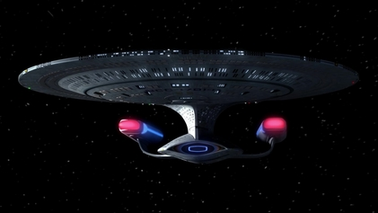
Thank you for attending. Lynn - ODIN Office lynn.wolf@ndus.edu
This Photo by Unknown Author is licensed under CC BY-SA

