Slide 1

Winter 2025 OAC Meeting
ODIN Director’s Report
Jason Bedsaul
December 8, 2025

Slide 2

Overview
General Office Updates
Election Results
Polaris Updates
Discovery RFP
Alma Updates
Primo NDE
Other Project Updates
System Roadmap

Slide 3

New Staff Reminder
Please Let us know when you hire new staff!
We can help with Onboarding and Training.
Add to Listservs, Team Channels, Website Directory, etc.
Help with library continuity
Just hit the ‘ugly’ orange button on our website (www.odin.nodak.edu/helpticket) or email us: odinhelp@listserv.nodak.edu

Slide 4
New Branch
Marshfield Clinics (Sanford)
Brian Finnegan and Jane Konop, Librarians
Sanford acquired Marshfield Clinics earlier this year
Library located in Marshfield, WI
Went live Dec 1 (records only for now)

Slide 5

New Member Library
Griggs County Public Library
Lexi Broschat - Director
Located in Cooperstown, ND
Signed on December 1
Anticipated Go Live - Mid-May 2026

Slide 6
ODIN User Group Election Results
OAC
Chair – Jenna Kahly, WFP
Vice Chair – Rebecca Bichel, UND Chester Fritz
Academic (Alma / Primo)
Acquisitions – Tuya Dutton, VCSU
Resource Management – Ben Ferguson, VCSU
Discovery – Ethan Fria, UND Chester Fritz
Fulfillment – Chris Gasink, UND Chester Fritz
Resource Sharing – Shannon Hofer, Mayville
PKS (Polaris / TBD)
Acquisitions – Olivia Peterson, WFP
Cataloging – Bobbi Wood, GFP
Discovery – Tonya Palmer, GFP
Circulation, Holds, ILL – Kayla Birkholz, WFP
NDAC
  Hannah Beebe, VCSU
  *All positions except NDAC are for CY26 - CY27

Slide 7

Polaris Updates

Slide 8
Coming in 8.0
Dated Patron Notes (MEEP)
Automated Patron Code Aging (MEEP)
Offline Check-in
Bibliographic Record Templates in LEAP
Additional System Administration Tools in the Web SA
    Bulk update Tables
    SQL Job Monitoring
    Log File Access
  Expected Upgrade in February/March 2026

Slide 9
MEEP Results
Enhancements for 8.1 (expected update for late Summer 2026)
Leap Find Tool window and New tabs from Find Tool in Leap
Stacked Sorting (Multi Sort)
Add ability to enter a reason when cancelling a hold
Return to where you were in your record set
Reminder that the Idea Exchange is the primary source for enhancement selections: Polaris Idea Exchange

Slide 10
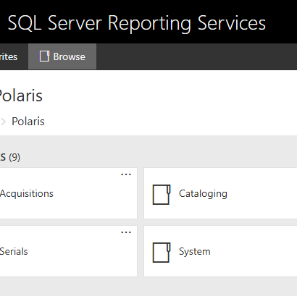
SSRS Rollout
No longer need to access the client (Web Based) to run standard ‘canned’ reports
Uses Staff Account to login
Includes a Favorites List
Schedule emailed report delivery (including published Simply Reports)
Save reports directly to PC
ODIN planning to rollout access to SSRS with next Polaris update

Slide 11
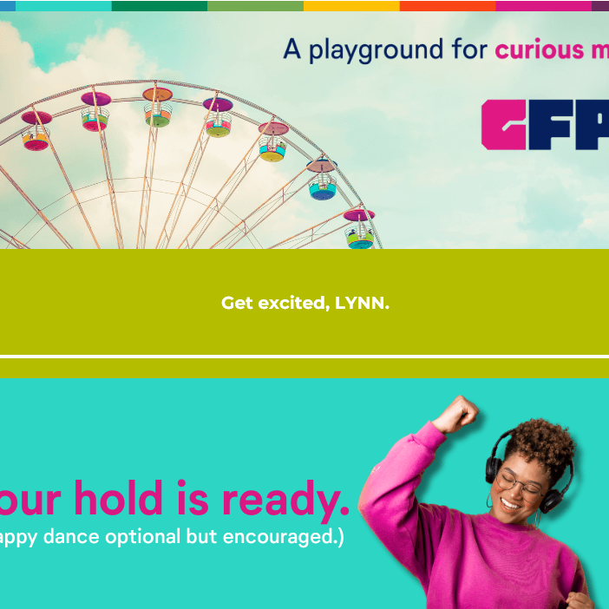
Vega LX Starter
We are entering the ‘nudge’ and ‘prod’ phase of rollout
FREE upgrade to standard text-based email notices
More secure and reliable (DMARC Compliant)
Can be customized a lot...or…
“claim the email”, publish the ODIN-created default templates, and do a happy dance ;-)

Slide 12

Alma / Primo Updates

Slide 13
November Release Highlights
AI Insights (opt-in):
  Circs and link resolver views/access (rolling 3 months)
  Configuration > General > AI Features > AI Usage Profile
Patron Purge Job Improvements
Metadata Editor Improvements
General release of Primo NDE for Consortia
ODIN Highlights Session: https://www.odin.nodak.edu/events/announcement/almaprimo-ve-november-feature-release-highlights

Slide 14
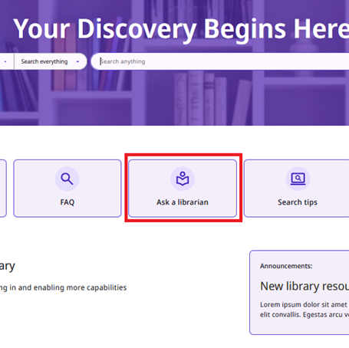
Primo NDE Update
ODIN Office currently participating in NDE UI Transition Cohort Program
We are developing an implementation schedule and rollout for the Consortium
Lynn and the Discovery UG meetings will focus on this for Q1/Q2 of 2026.
Expected to wrap up transition(s) by mid-summer.

Slide 15
A Few Technical Things
Email Notices
  Fixed DMARC Compliance (NDUS now enforcing)
  Replacing SMTP Authentication (Microsoft is deprecating) with Oauth (using Azure Graph)
  Still working on a solution to allow multiple “From” emails w/ institution domain
SAML Certificate Expiring (Alma)
  Expires 12/31
  Will update closer to expiration

Slide 16
Clarivate Customer Success
ODIN has been meeting monthly with Clarivate
Review usage and develop plans to improve engagement
Reviewing Data collected from survey and will create some action items
Four Key Strategic Objectives/Areas for CY 26:
  Improve Analytics / Data Visualizations (OBI and MixPanel)
  Workflow Reviews and Automations (On Going)
  Primo NDE Adoption and Implementation
  AI Integration and Adoption

Slide 17
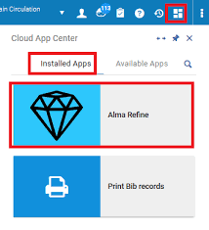
Cloud Apps Training
Monday, Dec. 15 - 2pm
How to enable and access Cloud Apps
Overview of Item Creator and Alma Refine.
Use cases and examples.
Link to meeting

Slide 18
Other Project Updates

Slide 19
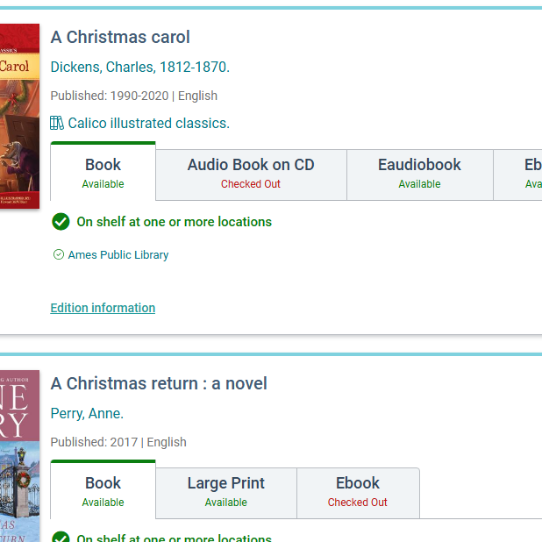
PKS Discovery / Mobile RFP
Committee has completed their work
Expect to finalize contract first of the year
Discovery: Meets new ADA Accessibility Rule changes, Content Rollups, Reader Advisory, Dynamic Content Carousels, Multiple Views (Children, Topics, eResource Collections, etc.)
Mobile: Same as above + Digital Cards, Self-Checkout, Location-based services

Slide 20
Shoutbomb Statistics
Working with Shoutbomb on delivering monthly reports to each Library via email
Will use same emails associated with Vega LX Starter (email notices)
Monthly report will include:
    Delivery numbers by notice type
    Keyword usage
    New accounts
    Opted Out, Incorrect, Invalid numbers
Reminder: FTC regulations require patrons be allowed to STOP all messages; we recommend email + text as the preferred notices.

Slide 21

Shoutbomb Broadcasts
  Broadcast (ALL)
    Send a text message to all patrons
    Weather closures, emergencies, etc.
  Broadcast (Channel)
    Create a ‘channel’ patrons can subscribe to for updates/messages
    Book Club, Summer Programming, Events, etc.
  Broadcast (Closures)
    Scheduled reminder to patrons of planned closures
    Memorial Day, 4th July, Christmas, etc.
  Look for rollout also in early 2026

Slide 22
A look at our History…
1989 – Live on PALS
(15 years)
2004 – Live on Aleph
(15 years)
2019/20 – Live on Polaris / Alma
(?? years)
20?? – Latest and Greatest Wiz Bang

Slide 23

Takeaways and Thoughts
Historical System Lifecycle ~ 15 years
Transition from Aleph to current systems arguably should have been sooner
State Procurement requires us to review contracts every 10 years
Transitions are costly (time, money, sanity)
Early runway allows for potential to identify challenges and opportunities in current environment to course correct

Slide 24
Proposed RFP Timelines
Date | Event
January - September 2027 | Form committee, review solutions for Public, School, Special Libraries
September 2027 | Report to Fall OAC; Consortium votes to stay or explore alternatives
September 2027 - June 2028 | Form committee, review solutions for Academic Solutions
June 2028 | Report to Summer OAC; Consortium votes to stay or explore alternatives
January – April 2029 | Legislative Session – Request migration funding (if necessary)
June 30, 2029 | Current Polaris contract end date
June 30, 2030 | Current Alma contract end date

Slide 25
ADA Title II Compliance
Rule applies to all state and local governments and associated vendors (contracted or otherwise)
Applies to ALL public web sites and apps
Goes into effect April 24, 2026
Working on an Accessibility Statement that explains ODIN’s commitment to accessible services, roadmap to compliance, and review process
Collecting VPATs/ACRs where available; Current list: Vendor Accessibility Compliance
Beth Valentine, UND Accessibility Officer, is helping review our Vendors

Slide 26
Some Resources to Review
Resources related to ADA Title II Digital Accessibility Compliance Rule Change:
    Fact Sheet
    Small Entity Compliance Guide
    Planning for Compliance
    Full Rule
    Webinar: Americans with Disabilities Act Title II Web & Mobile Application Accessibility Rule

Slide 27

Questions / Contact
Jason Bedsaul​
701-969-9135​
jason.bedsaul@ndus.edu

