Slide 1

Fall 2025 OAC Meeting
ODIN Director’s Report
Jason Bedsaul
September 8, 2025

Slide 2

ODIN Office Updates
CIO - Corey Quirk
  Former Deputy CIO
  25 years with NDUS/UND
  ODIN will continue to report to Corey

Slide 3
NDLA Conference
Alerus Center (Grand Forks, ND) Oct 1 - 3
ODIN is a Vendor/Sponsor
Schedule one-on-one training or help with any of the staff
Two sessions:
  “Building the ILL Bridge” (Mary and Jason)
  “What the WCAG is a VPAT?!?” (Jeremy and Jason)

Slide 4

Alma / Primo Updates

Slide 5

August Release - Alma
Installed on Production 8/3
Default new Title Search UX
Several UX improvements to all the functional areas
https://www.odin.nodak.edu/events/announcement/almaprimo-ve-august-feature-release-highlights

Slide 6

August Release - Primo
More improvements to the Collection Discovery Pages
New Exact Title Search (requires setup and reindexing)
More features added to NDE UI
  Featured Newspapers
  A-Z Journal Search/Browse
  Database Search

Slide 7
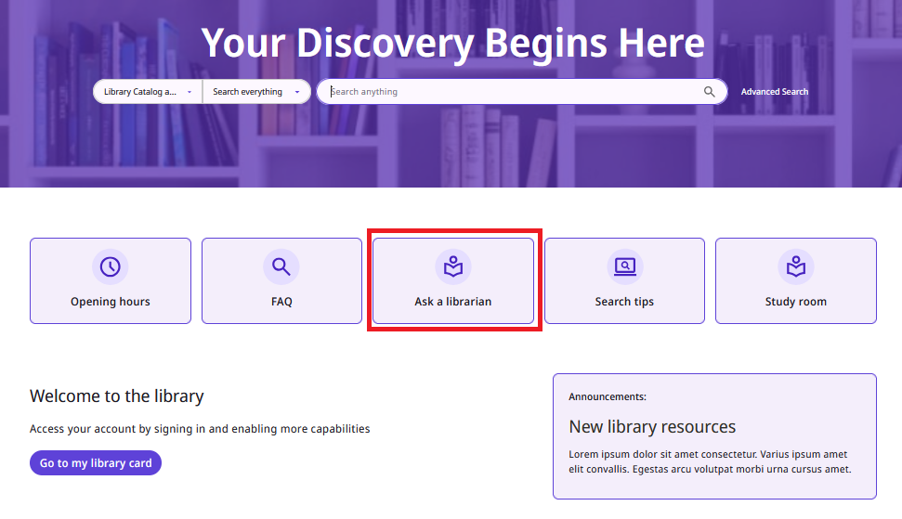
New Discovery Experience
General release for consortia coming in November
ODIN Office will help create a ‘preview’ view package
Customization can be done ‘in the background’
Rolling implementation in Spring/Summer

Slide 8

Polaris Updates

Slide 9
Polaris 7.8 Highlights
Live August 16th
Highlights:
  Polaris Web System Administration
      Significant push from client to cloud
      Additional permissions granularity and control
  Student Import in LEAP (CSV)
  Import Profiles now editable from LEAP
  Statistics – Renewals are now separate

Slide 10

QZ Tray
New direct-to-printer functionality in LEAP
Requires a client and cert install on each Workstation
https://www.odin.nodak.edu/training/circulation-holds-ill/leap-direct-printer

Slide 11
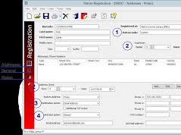
Polaris Client to Web Migration
Functional Transition will be effectively complete with next release (8.0)
Remaining points of concern:
  Web access to canned reports
  Cataloging workflows
  System Administration tasks
No timetable yet; tentative plans for early 2027

Slide 12
Vega LX Updates
Rolling migration continues…
Improves delivery, security, and insights
Included with our Polaris Subscription
Flexible templates: ‘set and forget’ or use for marketing / outreach
Live: Divide County, Dickinson High School, Dickinson Area Public, McKenzie Public, Grand Forks Public, Leach Public, West Fargo Public
Setup and working on templates: NDSL, Carrington City, Kidder County, Cavalier Schools
Setting up walk-thru meeting: Bowman, Grafton Public, Grafton Schools, Velva, Harvey, McVille, and Lakota
Libraries next on the schedule: New England, Carrington Schools

Slide 13

Shoutbomb Go Live
Went Live August 13th
Text Notices (SMS) Solution for Polaris
Automated patron feed from Polaris to Shoutbomb
Opt-Outs and Invalid reports will be compiled and sent out monthly now
Still working out a few hiccups
Library Usage Reports and “Broadcast” functionality will come later this Fall

Slide 14
ShoutBomb By The Numbers
Total Registered Users:
10,334
Total Registered Barcodes: 12,932
Top Keywords (August Usage):
MYBOOK: 414 times
RA (Renew All): 255 times
STOP: 124 times
HELP: 85 times

Slide 15
Discovery/Mobile RFP
Focus on improving the Patron Experience
Replacement for the Power PAC
New Mobile App
RFP Members: Susan Moberg (DIZ), Renee Newton (DIP), Steve Hammel (NDL), Tonya Palmer (NGF), Lynn Wolf (ODIN), Jess Leraas (SFD)
Tentative Timeline:
  September: RFP requirements drafted
  October: RFP issued
  Mid-November: Responses due
  Late November: Responses reviewed and finalists selected
  December: Finalist demos and selection
  January – June: Implementation

Slide 16

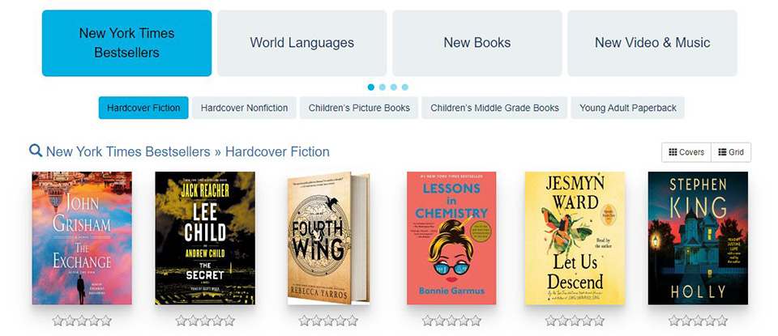
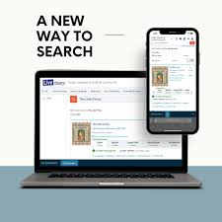
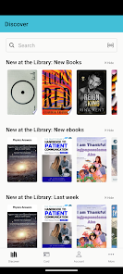
Enhancing the User Experience

Slide 17

Shared E-Resources (SER) Task Force
Minitex-led RFP for MN, SD, and ND for statewide e-resources
Selection for new list starting in FY27
  Current Vendors: EBSCO, Gale, ProQuest, Capstone, Britannica
NDSL and ODIN are Funding Partners
ND Representatives: Laura Egan (UND), Al Peterson (NDSL), Leif Fritzell (NGF), Misti Frink (Bismarck Public Schools)

Slide 18
ODIN Billing
FY26 Bills went out late last week via email
Formula Explanations were attached for each bill
New Academic Cost Sharing Formula in effect
Reach out directly to me with any questions or concerns
Operational Billing
  Alma/Primo: $551,459
  Polaris: $219,616
Statewide Resources
    Base Package: $179,526
    ASC: $44,300

Slide 19
User Group Elections
Current Terms end in December
2-year terms 2026-2027
Timeline:
  October: Nominations open
  November: Ballots go out
  December OAC: New Chairs announced
OAC – Chair and Vice Chair
Academic User Groups
  Acquisitions, Discovery, Fulfillment, NDAC, Resource Management, Resource Sharing
PKS User Groups
  Acquisitions, Cataloging, Circulation/ILL, Discovery

Slide 20

Questions?
Jason Bedsaul​
701-969-9135​
Jason.Bedsaul@ndus.edu

