Slide 1
Where's my stuff?
Reporting problems in Primo
Notes:
Please Note: This template has been created using the University of North Dakota brand guidelines. All colors and typefaces/fonts are within the brand guidelines and altering them isn’t suggested. Please visit UND.edu/brand for more information on using the UND brand or email identity@UND.edu with any UND branding questions.
TIPS:
Check out the Layout Dropdown for more layout design options
It’s recommended not going below 24-point font size for presentations
If your text overflows a placement text box it’s recommended to edit/delete down text content instead of increasing size of text box to accommodate more text
Guides are available under View tab > check Guides checkbox

Slide 2
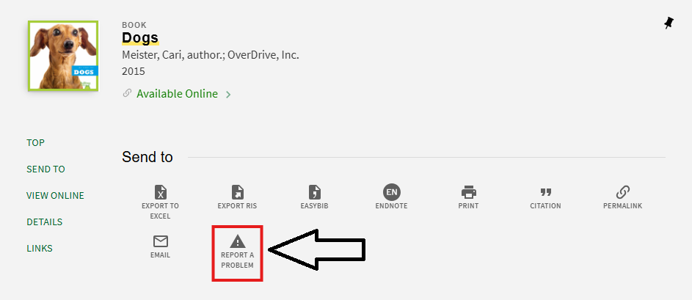
Custom reporting: what is it and why do we need it?
Uses and how it helps
Instantly receive notifications from users about issues with Primo records.
Provides a direct feedback mechanism, allowing users to flag issues with search results, links, and access errors.
Notes:
TIPS:
Check out the Layout Dropdown for more layout design options
It’s recommended not going below 24-point font size for presentations
If your text overflows a placement text box it’s recommended to edit/delete down text content instead of increasing size of text box to accommodate more text
Guides for textboxes are available under View tab > check Guides checkbox

Slide 3
Considerations for Integrating Button
Determine how feedback will be collected and routed to appropriate staff.
Decide whether reported issues will be stored in a database, emailed to administrators, or integrated into an existing ticketing system.
Ensure data security and privacy measures are in place.
3
Notes:
TIPS:
Check out the Layout Dropdown for more layout design options
It’s recommended not going below 24-point font size for presentations
If your text overflows a placement text box it’s recommended to edit/delete down text content instead of increasing size of text box to accommodate more text
Guides for textboxes are available under View tab > check Guides checkbox

Slide 4
Setting it Up in Primo
ODIN can take care of this for you. All you need to figure out is:
The URL of your reporting form
The label you want (typically “Report a Problem”)
The order of the button in the view can be adjusted to taste

Slide 5
Submission Form Option 1
LibWizard
LibWizard provides an easy-to-use, integrated solution for creating feedback forms.
Forms can include fields such as issue description, user contact information, and affected resource details.
Advanced Email settings to respond directly
Proper field mapping
5
Notes:
TIPS:
Check out the Layout Dropdown for more layout design options
It’s recommended not going below 24-point font size for presentations
If your text overflows a placement text box it’s recommended to edit/delete down text content instead of increasing size of text box to accommodate more text
Guides for textboxes are available under View tab > check Guides checkbox

Slide 6
Submission Form Option 2
Custom Submission Form:
Libraries can customize the submission form template to suit their needs.
This allows for custom styling, validation rules, and workflow automation.
The form can be hosted by ODIN and linked directly from the "Report a Problem" button.
6
Notes:
TIPS:
Check out the Layout Dropdown for more layout design options
It’s recommended not going below 24-point font size for presentations
If your text overflows a placement text box it’s recommended to edit/delete down text content instead of increasing size of text box to accommodate more text
Guides for textboxes are available under View tab > check Guides checkbox

Slide 7
Initial Testing
After inserting the button code, test it in the Primo sandbox environment.
Common issues:
  Button not displaying due to incorrect selector targeting.
  Form link not opening correctly.
  Button interfering with other UI elements.
7
Notes:
TIPS:
Check out the Layout Dropdown for more layout design options
It’s recommended not going below 24-point font size for presentations
If your text overflows a placement text box it’s recommended to edit/delete down text content instead of increasing size of text box to accommodate more text
Guides for textboxes are available under View tab > check Guides checkbox

Slide 8
Beyond the problem button
The same method used for the "Report a Problem" button can be applied to add other custom buttons in Primo.
Examples include:
  Request Digitization
  Suggested tags
  Course reserve
8
Notes:
TIPS:
Check out the Layout Dropdown for more layout design options
It’s recommended not going below 24-point font size for presentations
If your text overflows a placement text box it’s recommended to edit/delete down text content instead of increasing size of text box to accommodate more text
Guides for textboxes are available under View tab > check Guides checkbox

Slide 9
Oh, there's my stuff!
Notes:
Please Note: This template has been created using the University of North Dakota brand guidelines. All colors and typefaces/fonts are within the brand guidelines and altering them isn’t suggested. Please visit UND.edu/brand for more information on using the UND brand or email identity@UND.edu with any UND branding questions.
DON’T FORGET TO CHECK THE PRESENTATION FOR ACCESSIBILITY!
To Check Presentation Accessibility:
1.) Click on Review Tab
2.) Click Check Accessibility
3.) Window will open on right side of the screen
4.) Click on specific result for steps to fix the error and an explanation on why it needs fixing

