Slide 1
Polaris Canned Reports & Report Scheduling Options
ODIN Workday 2025
Presented by Lynn Wolf
Notes:
NOTE:
To change the image on this slide, select the picture and delete it. Then click the Pictures icon in the placeholder to insert your own image.

Slide 2
Polaris Canned Reports
Several “canned reports” are available within the Polaris Remote Client. Many libraries have moved to strictly using LEAP; however, the ODIN Office can run or create a schedule to run these canned reports for you. We are also able to set up most of these reports to pull the same information from SimplyReports
During this session, we will look at several reports that are available in the client that might be of interest and what Simply Report options might exist, along with potential scheduling options for both.

Slide 3
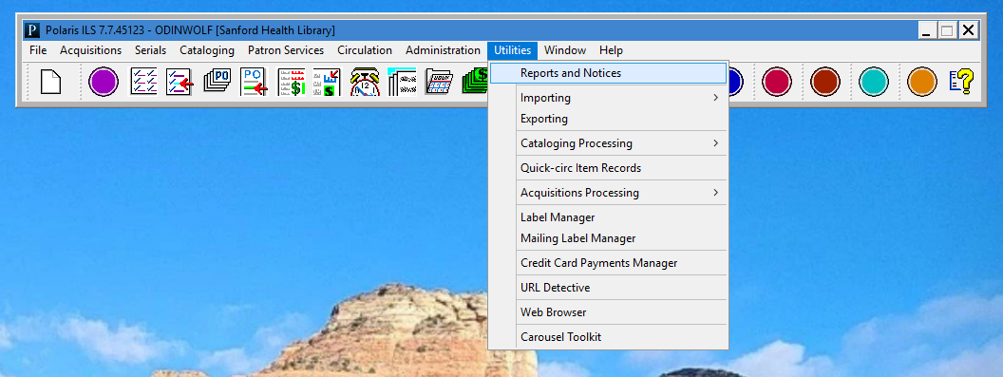
Polaris Canned Reports
Polaris canned reports are found in the client under Utilities / Reports and Notices.

Slide 4
Polaris Reports - categories

Slide 5
Polaris Reports – sub-categories

Slide 6
Select Canned Reports You May Find Helpful
Circulation Reports
Overdue Patrons
Overdue Items
Long Overdue Items
Cataloging Reports
Item Records Without Barcodes
Lost and Missing Items
Statistical Reports
Item Circulation Statistics
Item Circulation By Collection
Top Circulating Titles by Collection
Uncirculated Items

Slide 7
Circulation reports
Overdue Patrons, Overdue Items, Long overdue items

Slide 8
Overdue Patrons
This report contains the patrons with overdue material. Patrons are listed in alphabetical order.
For each item, the Title, Material/Barcode, Call Number, Due Date, and Item Branch is listed.
Blacked out fields in the example page to the right are patron name, address, barcode, patron class and phone number.

Slide 9
Example of Overdue Patron list done in Simply Reports

Slide 10
Key criteria used for Simply Reports option

Slide 11
Overdue Items
This report lists any item that is overdue. It is sorted in call number order and also provides title, material type/item barcode, due date, borrower name/branch and phone number if it exists.
Since report is in call number order, it may be useful when checking the shelves for any items that may have been returned but not properly checked in.

Slide 12
Example of Overdue Items list done in Simply Reports

Slide 13
Key criteria used for Simply Reports option

Slide 14
Long Overdue Items
This report contains material that is overdue by at least 24 weeks (6 months). Sorted by call number order, it also lists item information such as title, material type/item barcode, checked out and due dates, last notice date, patron name and barcode.
Patron names and barcodes have been masked out in the example.

Slide 15
Example of Long Overdue Items done in Simply Reports

Slide 16
Key criteria used for Simply Reports option

Slide 17
Cataloging reports
Item records without barcodes & Lost and Missing Items

Slide 18
Item Records without Barcodes
This report will list items without a barcode. It can be filtered by organization (library/branch), collection(s), material type(s), and start/end dates.
This example was run for a library’s Bluray and DVD material type from 1/1/24 through 3/24/25.

Slide 19
Example of Item Records without Barcodes from Simply Reports

Slide 20
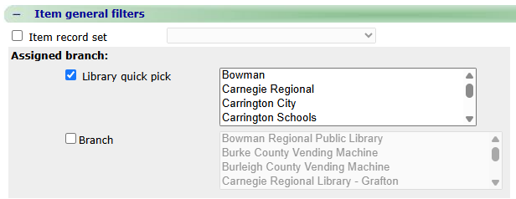
Key criteria for Simply Reports option

Slide 21
Criteria for Simply Reports (cont’d)

Slide 22
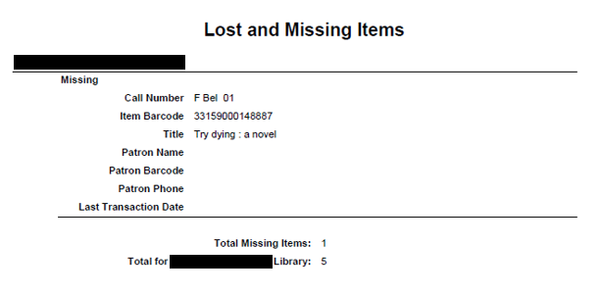
Lost and Missing Items
This reports lists items that are Lost or Missing. The first part (to the right) contains Lost items and the second part (below) are the Missing items. Both sections list call number, item barcode, title, patron name/barcode/phone if available and date of last transaction. It also generates subtotals for each section along with total for library.
.

Slide 23
Example of Lost and Missing Items in Simply Reports

Slide 24
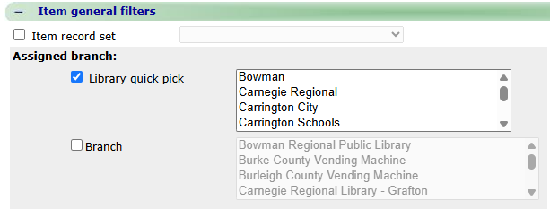
Key criteria for Simply Reports option

Slide 25
Statistical Reports
Item Circulation Statistics, Item Circulation by Collection, Top Circulating Titles by Collection, Uncirculated Items

Slide 26
Item Circulation Statistics
This report is found in the Circulation area of the canned reports. Required fields are library/branch and date range.
In this example, the circulation statistics were run for one of the high school libraries for the prior completed school year. It breaks down the information by material type and type of circulation transaction before providing totals.
We also run these reports each year for the public libraries to assist with their annual public library survey statistics.

Slide 27
Example of Item Circulation Statistics in Simply Reports

Slide 28
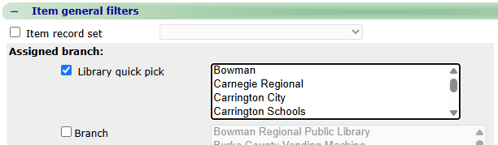
Key criteria used for Simply Reports option

Slide 29
Item Circulation by Collection
Another item circulation report breaks down the statistics by collection. The example is from the same library as before with the same reporting dates.
The totals are the same as the previous report, but the information is more granular as to which collections were the most popular.
This report requires library/branch along with dates to run.

Slide 30
Example of Item Circulation by Collection in Simply Reports

Slide 31
Key criteria used for Simply Reports option

Slide 32
Top Circulating Titles by Collection
This report was included with the public library survey reports this year (basically because I thought it might be interesting for the libraries!).
Criteria includes library/branch, collection (filtered or all), begin/end dates and number of titles to show.
Example is from large library for their Childrens Graphic Novel collection for 2024. I specified top 100 but this segment is a good example.
Important note: report will TRUNCATE results. In this case, if there were 100 separate titles with 1 checkout, only enough would be listed to fill the required number of titles to show (appears to go alphabetically).

Slide 33
Example of Top Circulating Titles in Simply Reports

Slide 34
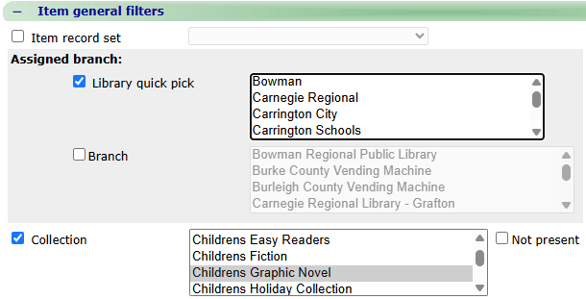
Key criteria used for Simply Reports option

Slide 35
Uncirculated Items
When it is time to weed your collections, this would be a great report to use.
Criteria include “items created before date” (so recently created items are not listed,) “last circulation date before” (so recently popular items are not listed), and numeric value for “maximum circulated lifetime” (so popular items that have been in your collection awhile are not listed). This report can be run by library/branch and further filtered by collection.
This example is for items created before 1/1/2015 with last circulation date 1/1/2000 and max circ lifetime of 0.

Slide 36
Examples of Uncirculated Items in Simply Reports

Slide 37
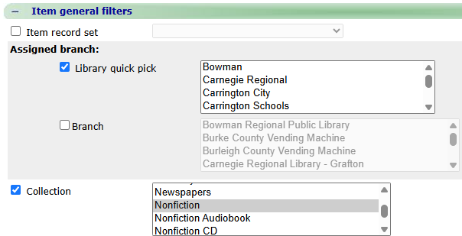
Key criteria used for Uncirculated Items in Simply Reports

Slide 38
Scheduling Reports
How to get reports run on a regularly scheduled basis and delivered right to your email!

Slide 39
Just a few comments about scheduling reports …
As stated earlier, you have the option to run these reports when you need them if you have the Polaris Client installed. Many of our libraries prefer to work strictly in LEAP or take advantage of creating reports in SimplyReports.
For most of the reports that you need run on a regular basis, did you know we can set up automatic reports that will run and then email the results to you?

Slide 40
How to Request Scheduling for Canned Reports
We reviewed several canned reports during this session. Those that do not need dates entered can be set up easily. However, those with “hard coded dates” can be problematic as they need to be manually updated on at least an annual basis. Reports that can be configured in Simply Reports to use the “relative dates” are generally a better option in those cases.
Saving and sharing the output of manually run canned reports can be confusing. If the report is scheduled, it can be sent directly to your email box to be easily opened, saved, or forwarded.
To request a canned report, fill out a HelpTicket identifying which report you want, how frequently you want it run, what format you prefer to receive it (Excel or Word), and email address(es) to receive the report.

Slide 41
How to Request Scheduling for SimplyReports
Did you know we can also schedule some of the reports you create in SimplyReports?
First create a report (or request ODIN Staff to create if you need some help) in Simply Reports and SAVE.

Slide 42
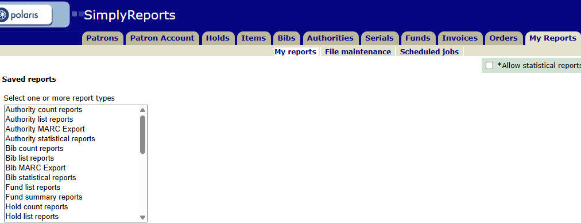
How to Request Scheduling for SimplyReports
Go to the My Reports tab and choose REPORT TYPE used to create the report.
The report must be PUBLISHED.

Slide 43
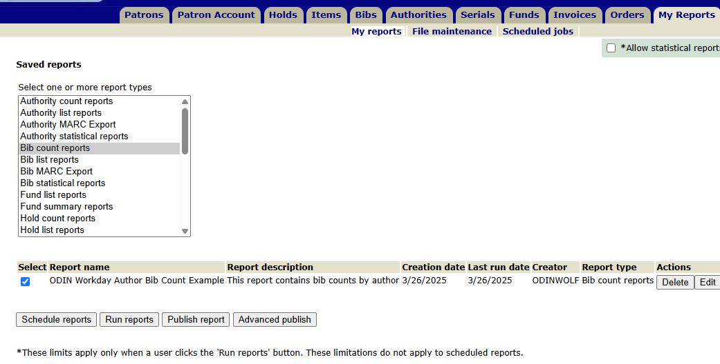
How to Request Scheduling for SimplyReports - Publish
Select the report you want scheduled and click on PUBLISH REPORT.

Slide 44
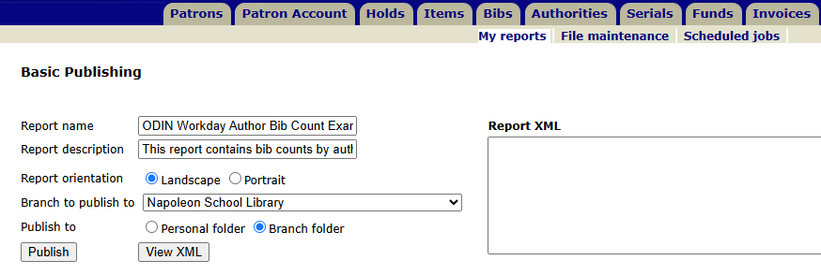
How to Request Scheduling for SimplyReports – Publish
Choose the report orientation – defaults to Landscape.
Make sure to publish to YOUR library/branch (use dropdown).
There is option for Personal or Branch folder. Recommend opting for Branch folder.
Click Publish. You should see Report published directly below Basic Publishing line.

Slide 45
How to Request Scheduling for SimplyReports – Final Steps
Submit a HelpTicket to request the report be scheduled. Include the following information:
Name of report.
Folder to where it was published.
Run schedule. Examples: Every Monday, Every Month, Every Monday in May, Every January 1st, etc.
Report recipients. Please include the full email(s).
Format desired. Most common are Excel, Word and PDF.

Slide 46
SimplyReports vs Canned Reports
Advantages for reports created in Simply Reports:
You control criteria entered and fields included in the output along the order in which they appear.
For many reports, you can use “relative dates” which means you can specify dates within the last week/month/year.
Reports in Excel can be sorted in different ways as needed without creating a new report.
These tend to work better than canned reports when making lists for internal library use.
Disadvantages for reports created in Simply Reports:
Report configurations are saved to individual’s user account so easy adjustments or duplications of criteria by someone else are not possible.
As new libraries are added or perhaps software changes are introduced, report may need to be adjusted or redone.
“Statistical Report” categories are not able to be saved and therefore not able to be run automatically via the scheduler software.
Many of the canned reports look more polished than a simple spreadsheet.
Submit a HelpTicket and we can walk you through the steps and get things set up!

Slide 47
Still have questions?
If you didn’t see what you are looking for or would like to discuss other options, please let us know.
We can work together to get the right reports, delivered at the right time, to the right staff to make life easier!
To submit an ODIN HelpTicket go to: www.odin.nodak.edu
click on the big orange button!

Slide 48
Thanks for attending today’s session!
Lynn Wolf
ODIN Workday 2025

