Slide 1
Who you gonna call…The State Library!
School Library Specialist: Kathy Cline
Public Library Specialist: Monica Struck

Slide 2

School Library Specialist

Slide 3

Support
Notes:
My role...

Slide 4
Assistance
  Guidance on library services
  Assist in developing plans, policies, and procedures
  Advise on marketing and promoting library programs, materials, and library statistics
  Identify and assist in developing grant opportunities
  Guidance concerning budgets, grants, and funding
  New school librarian orientation
Develop Resource Material
Create and maintain LibGuides
Develop and provide professional learning opportunities
Write Flickertale articles
Notes:
My role...

Slide 5

Sharing Information
Flickertale
Facebook: North Dakota School Librarians
SCHLIBTALK
Notes:
Group email

Slide 6
Communicate
Personal email
Library Development email
Phone call
Teams Meeting
Notes:
Promoting...training opportunites

Slide 7

Site visit
Weeding
Processing books
Reorganize library collection
Move library collection
ASK—I may be able to assist!

Slide 8
Projects
North Dakota school libraries and staffing study and report
Site visits
Professional development opportunities
School librarian chats
Notes:
Questionnaire—emails, phone calls on Microsoft forms
Snapshot view of what's happening in school libraries across the state
Advocacy document
Cataloging, weeding, book fair, processing tasks

Slide 9

Public Library Specialist

Slide 10
What do I do?
Help libraries be awesome!
New Director Orientations
Consulting services
Site visits
Work with library boards
Provide board training
Provide continuing education opportunities
Administer the Public Libraries Survey
Provide training prior to the opening of the survey
Provide support throughout the survey window
Share information with IMLS
Write Flickertale articles
Maintain LibGuides

Slide 11

Consulting
There is no stupid question.
Century Code Thoughts are just thoughts. For actual legal interpretation, consult an attorney.
I am happy to be a sounding board.

Slide 12
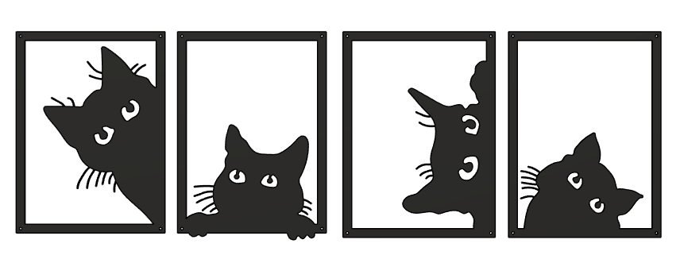
Site Visits
The Photo by PhotoAuthor is licensed under CCBYSA.

Slide 13

Communication
For general news/information/etc.
  Flickertale
  ndsl-ndpubliclib listserv
For individual messages
  Direct emails
  Phone calls
  Teams Meetings

Slide 14

Projects
Trustee Training Update/Survey
Director Hangouts
State Park Pass Program
United for Libraries
Public Libraries Survey
  And other surveys that come up throughout the year (PLA, general research, etc.)

Slide 15

Thank You!
ndsl-ld@nd.gov
Kathy Cline: (701) 328-2185
Monica Struck: (701) 328-4680
Some of these resources and programs are funded under the provisions of the Library Services and Technology Act from the Institute of Museum and Library Services.

