Slide 1
Shelf Inventorying using Alma
Presented by
Benjamin Ferguson
Technical Services Librarian
Allen Memorial Library
Valley City State University

Slide 2
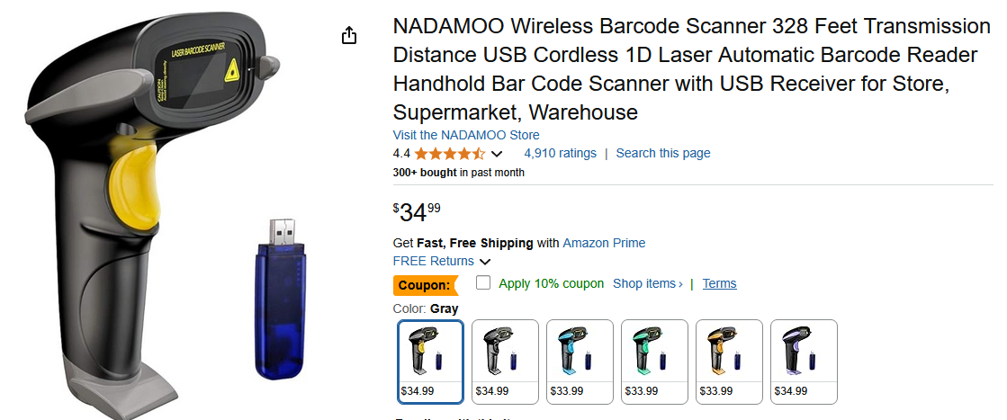
Inventory set-up
Equipment
Scanner: plug-in or wireless?
Planning
Should it be a year round student project? Or a summer / break project?

Slide 3
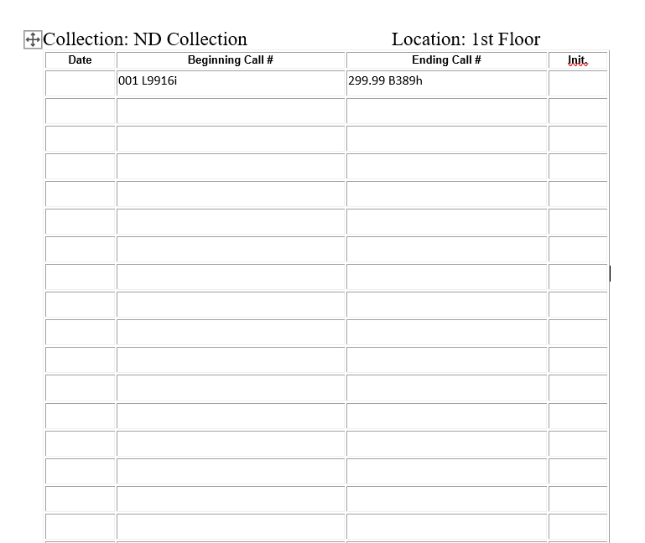
Scanning
One location at a time
Some locations may be broken up
Potential problem: scanned barcodes lost in the process

Slide 4
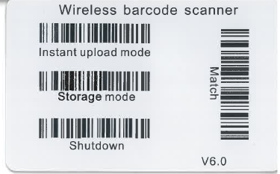
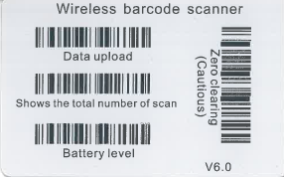

Slide 5
Follow up:
1. Missing items but marked in place
2. Items on shelf but marked not in place
3. Known items not in place
4. Items on shelf but out of range/set
5. Barcodes with no matched item

