Slide 1
Academic Library Outreach Ideas for Events and Programming
Rebecca Bichel
Chester Fritz Library University of North Dakota 03/27/2025

Slide 2
Overview
What is Outreach?
Developing “creative programs and communications that promote library collections, services, and staff to target audiences.” – Rebecca Metzger and John M. Jackson, College & Research Libraries, 2022
Outreach Program at Chester Fritz Library at UND
Established in September 2023 as a strategic priority
Incredible Team of Leaders
Three Unique Audiences | Three Unique Strategies
Impact: 26% in library entrances in the next year

Slide 3
Chester Fritz Library Outreach Team
Incredible Team of Outreach Leaders
Rebecca Brown – Co-Leader for Student Outreach, 2023-
Zeineb Yousif – Co-Leader for Student Outreach, 2023-
Brian Garrison-Nguyen – Leader for Faculty Outreach
Jenny Arends – Administrative Support
Danielle Masursky – Leader for Community Outreach in 2023-2024
Rebecca Bichel – Overall Coordinator 2023-2024
As of January 2025, Brian is providing overall coordination for outreach
We couldn’t do it without support from Jay Gillen and Tony Moen!

Slide 4
Unique Audiences – Unique Events
Student Outreach
Mix of academic and social programs
Focus on social programs as academic supports were more established
Faculty Outreach
Faculty Lectures; Conference Partnerships; Showcasing Scholarship & Creativity
Community Outreach
Expand partnerships
Increase CFL’s Community Presence
Increase our Welcome

Slide 5
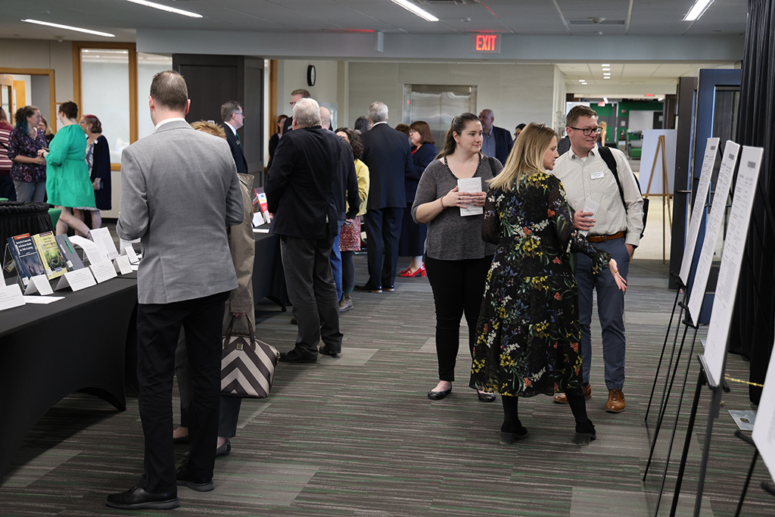
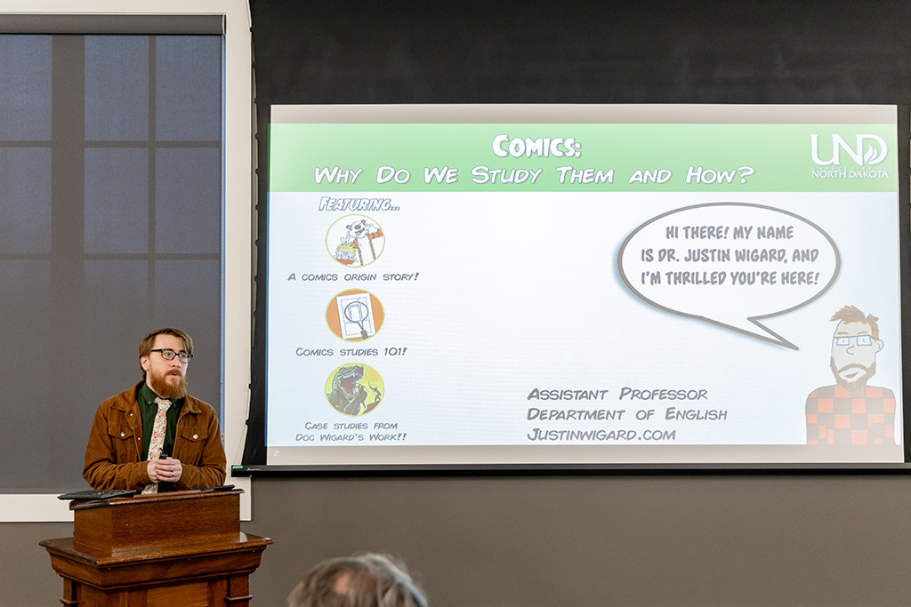
Faculty Events & Programs
Randy Rasmussen Memorial Lecture Series
Faculty Scholarship & Creative Works Celebration
Justin Wigard, UND assistant professor of English, delivers the latest Randy Rasmussen Memorial Lecture. March 2025

Slide 6
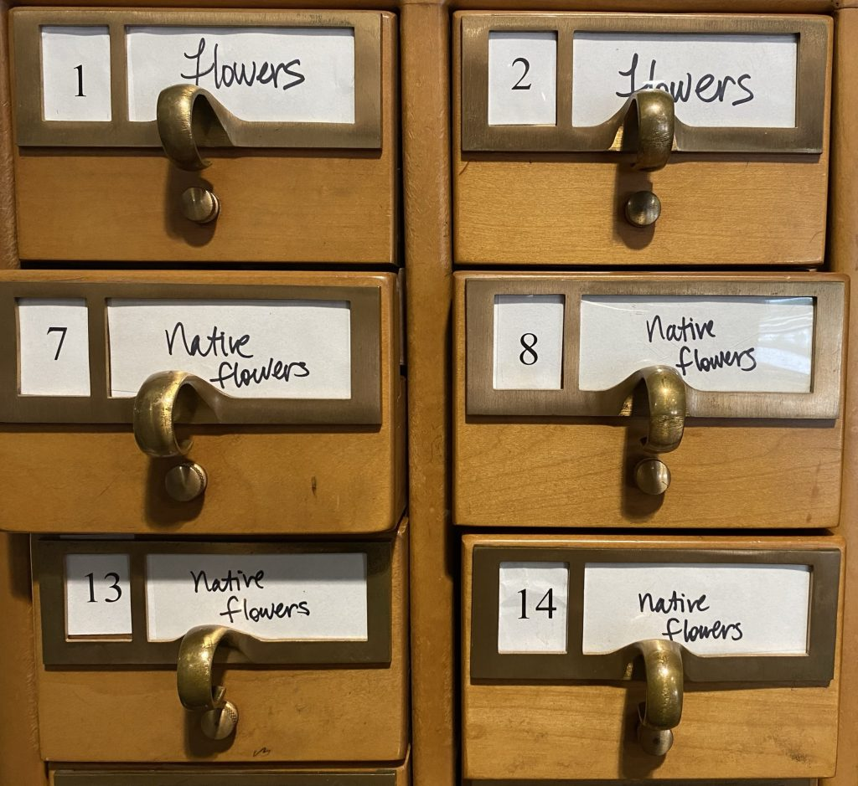
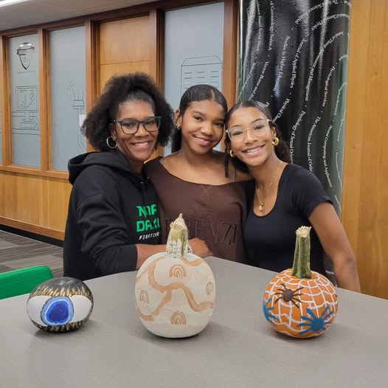
Community Events & Programs

Slide 7
Student Events & Programs
Monthly Events Series Across Days of the Week so Students Can Plan Ahead
Film Screenings on Mondays
Popular Pics Book Club on Tuesday
Board Game Nights on Wednesday
Silent Book Club on Thursday
Tiny Donut Thursday
Crafternoon
Targeted Academic Support
Chester Fritz Library Drop-In Hours
Academic Success Workshops with campus partners
Date-Based Events
Love Data Week
Halloween Ghost Hunt
Holiday Crafting Event in December
University Tie-Ins
Orientation – CFL Block Party (for 6 Days)
Welcome Week – CFL Beach Party
Special Events
Escape Room
Dino Hunt

Slide 8
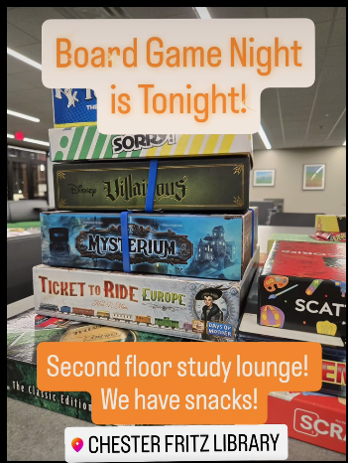
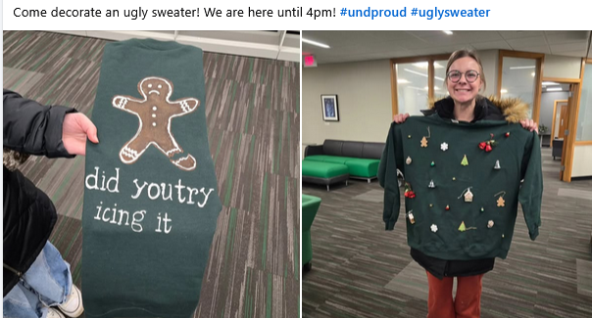
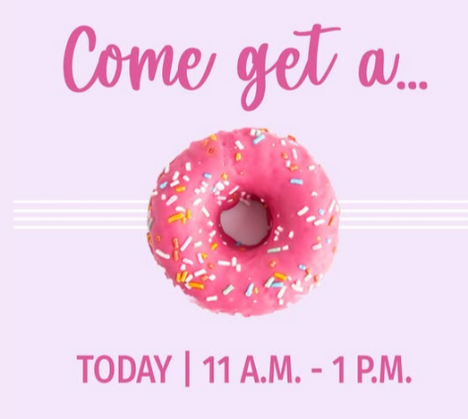

Slide 9
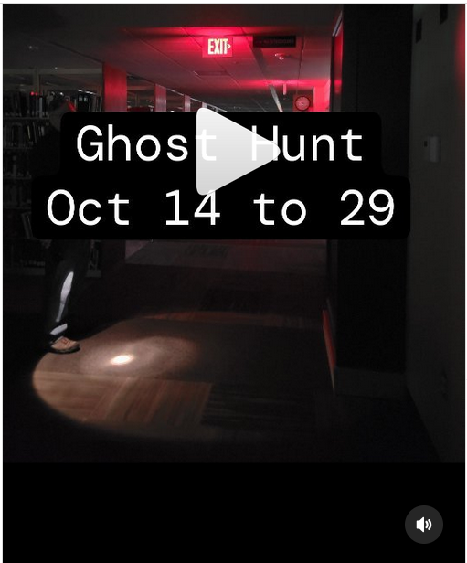
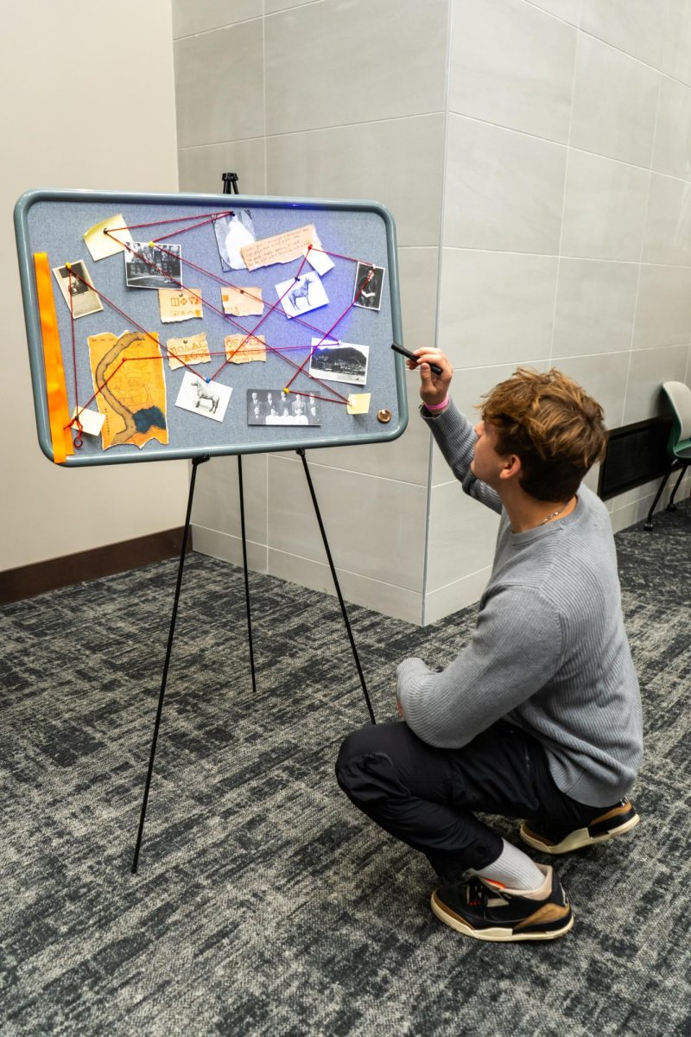
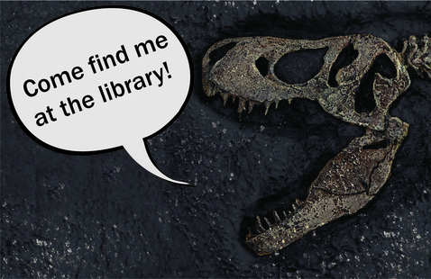
Ghost Hunt
Escape Room
Dino Hunt
https://www.instagram.com/chesterfritzlibrary/reel/DA_sy90pHnQ/und cfl dino hunt 2024
https://dakotastudent.com/17606/arts-comm/students-solve-haunted-library-mystery/

Slide 10
Love Data Week
https://libguides.und.edu/LoveDataWeek2025/

Slide 11
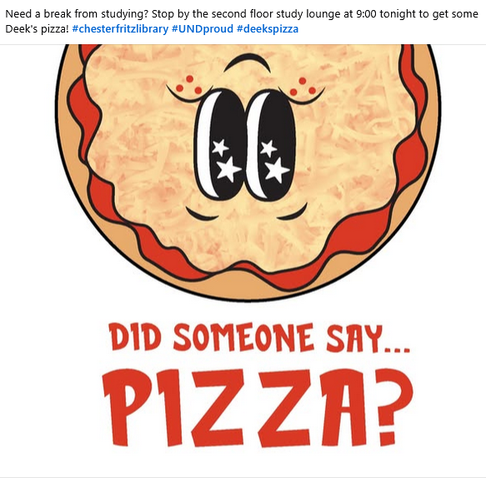
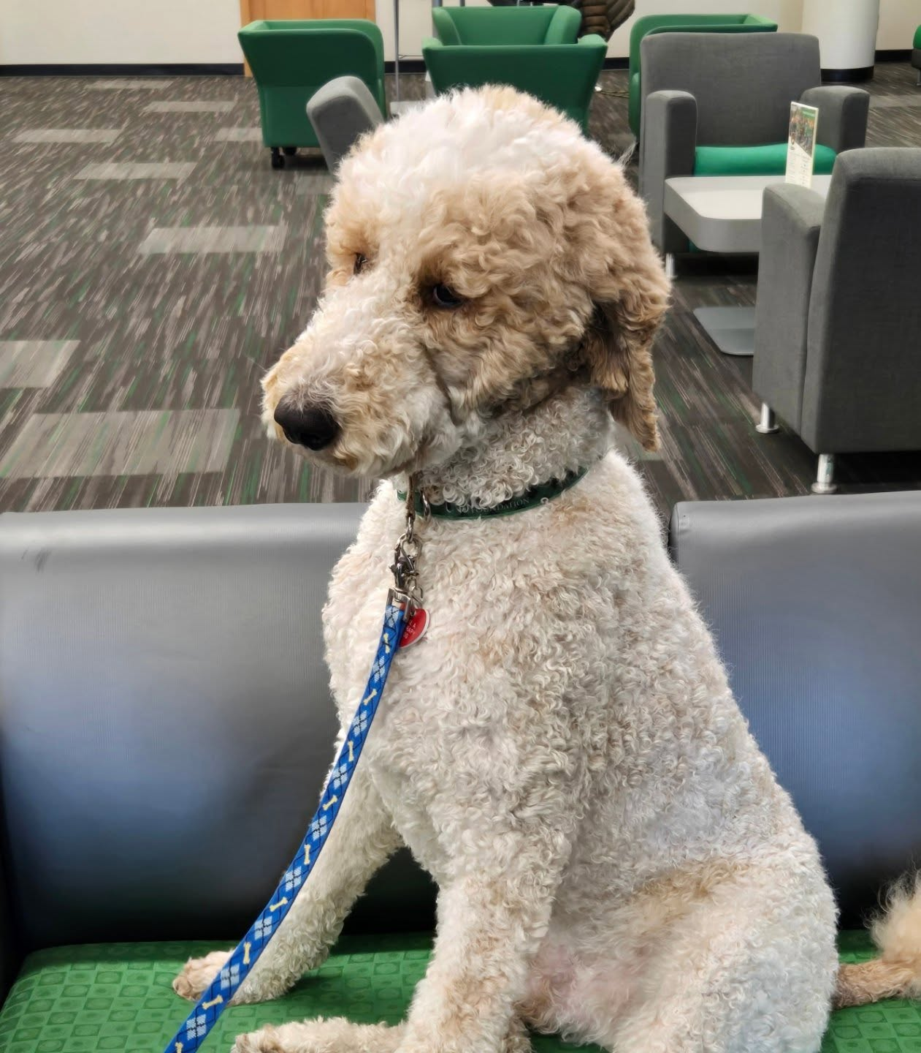
Finals Programming
https://www.facebook.com/UNDCFLibrary/

