Slide 1
Spring Programs 2024
Dickinson Area Public Library

Slide 2
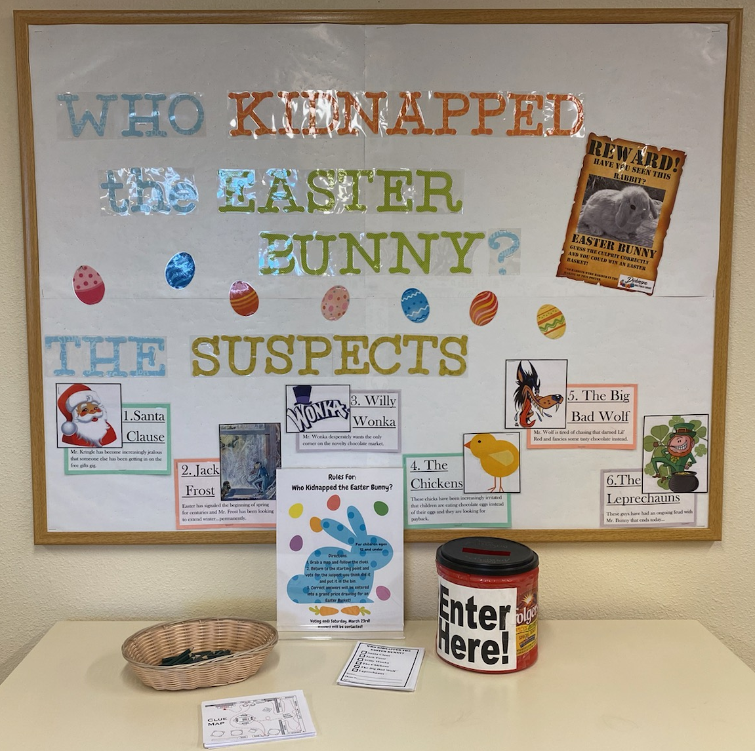
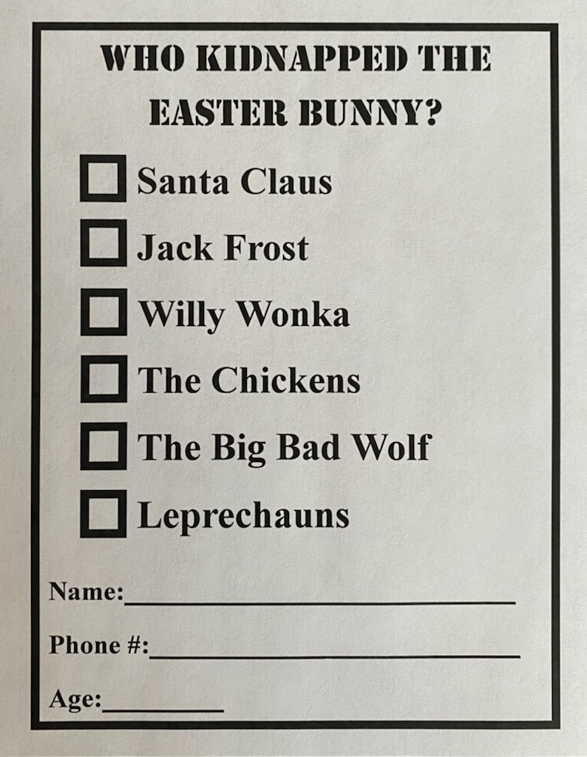
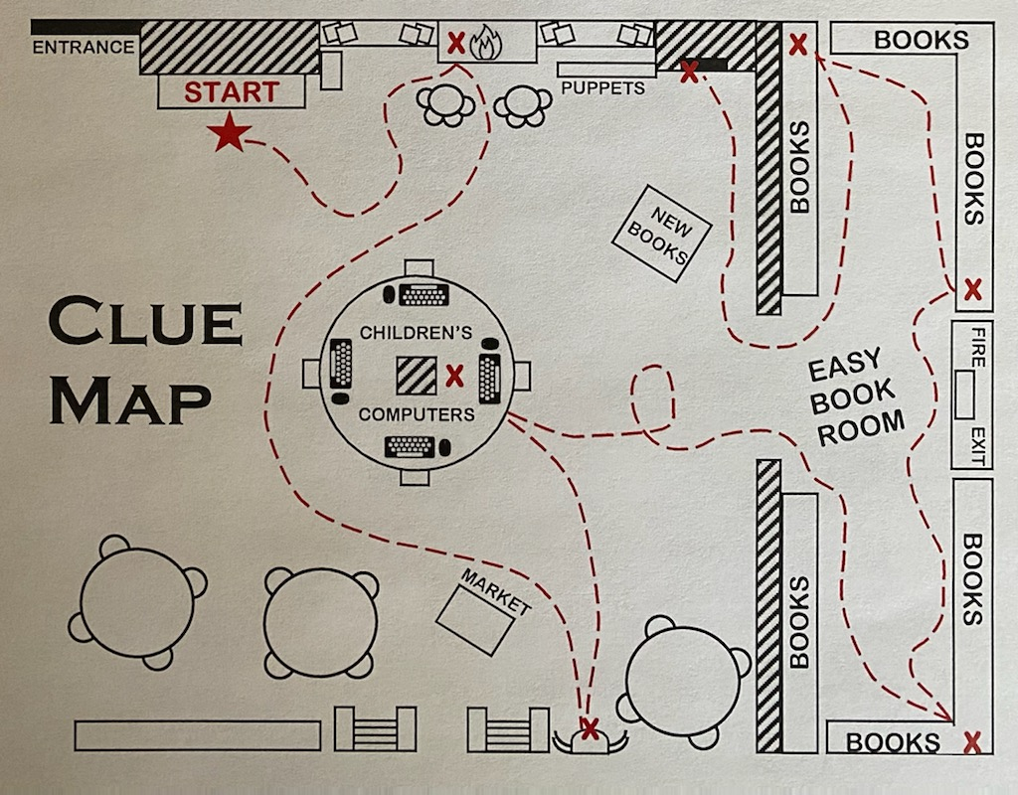
Who Kidnapped the Easter Bunny?

Slide 4
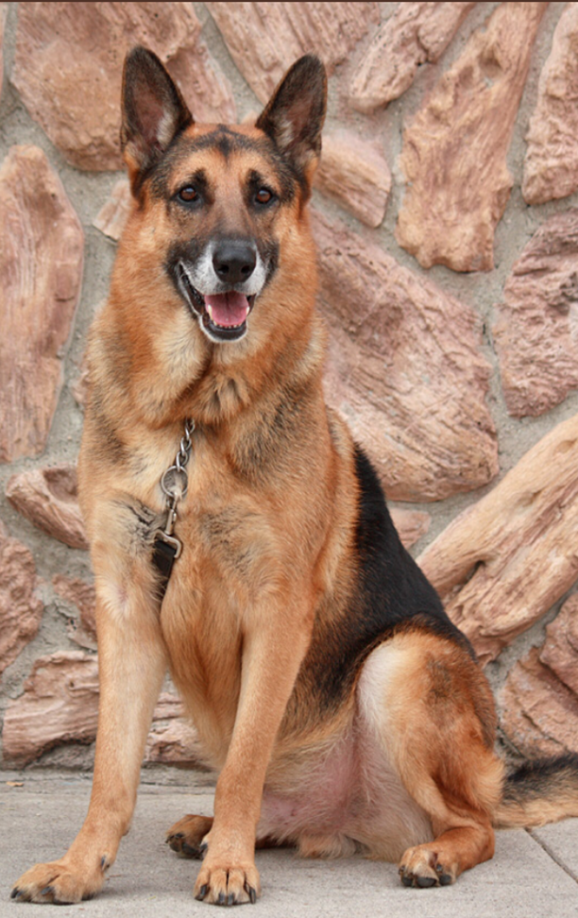

Slide 5
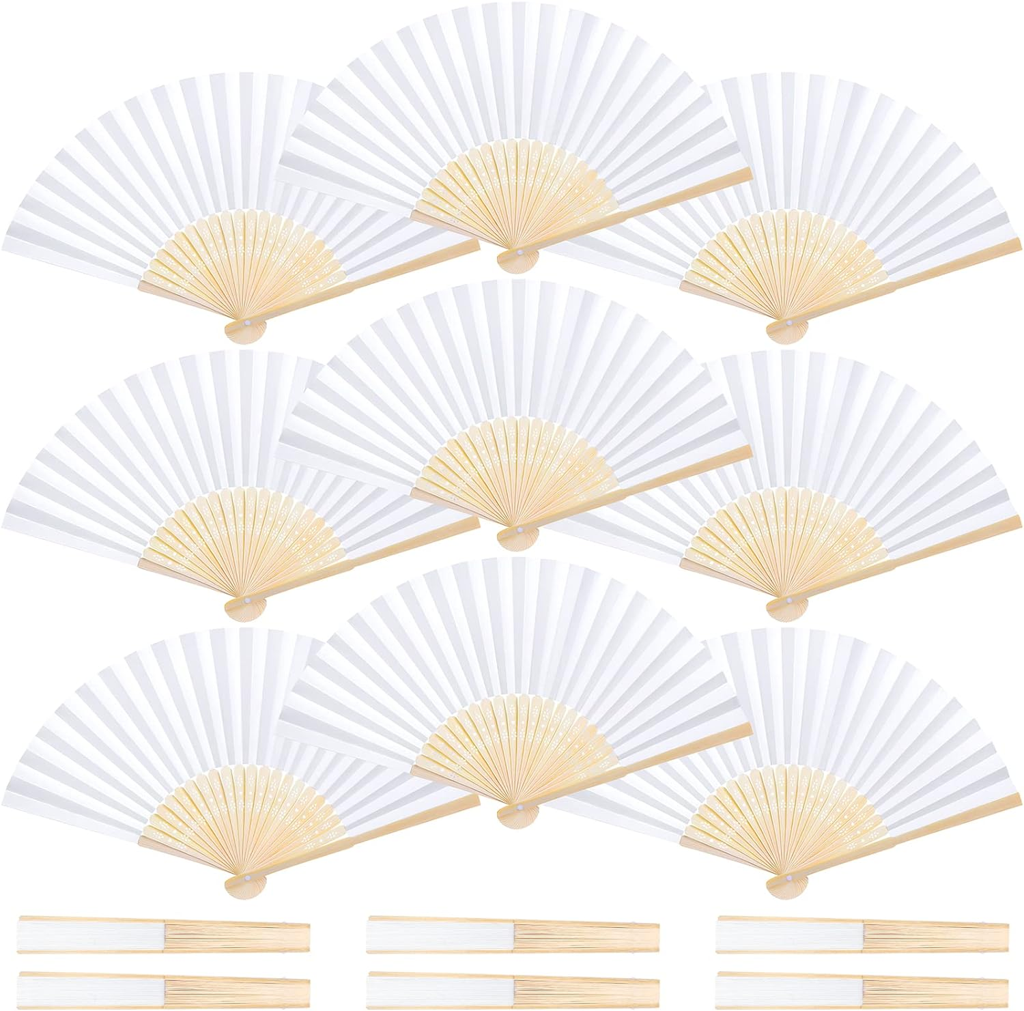
JOI Partnership

Slide 8
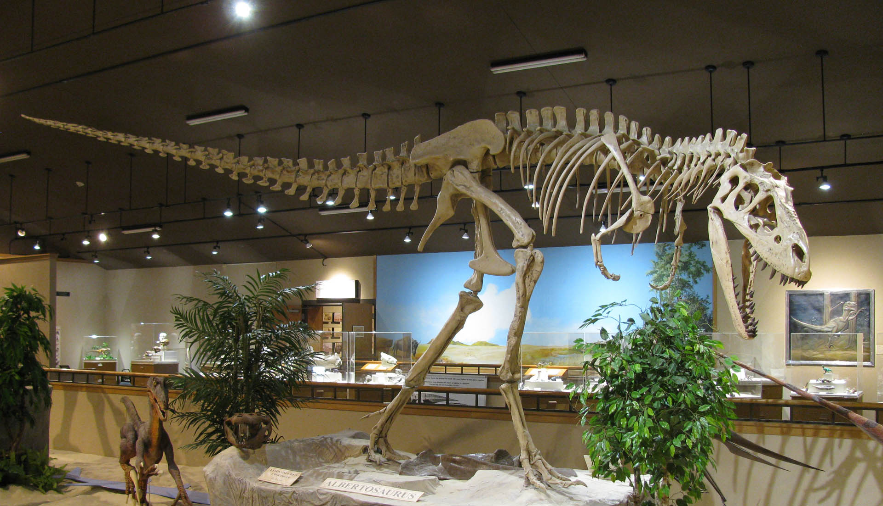
New Tyrannosaur Presentation

Slide 9
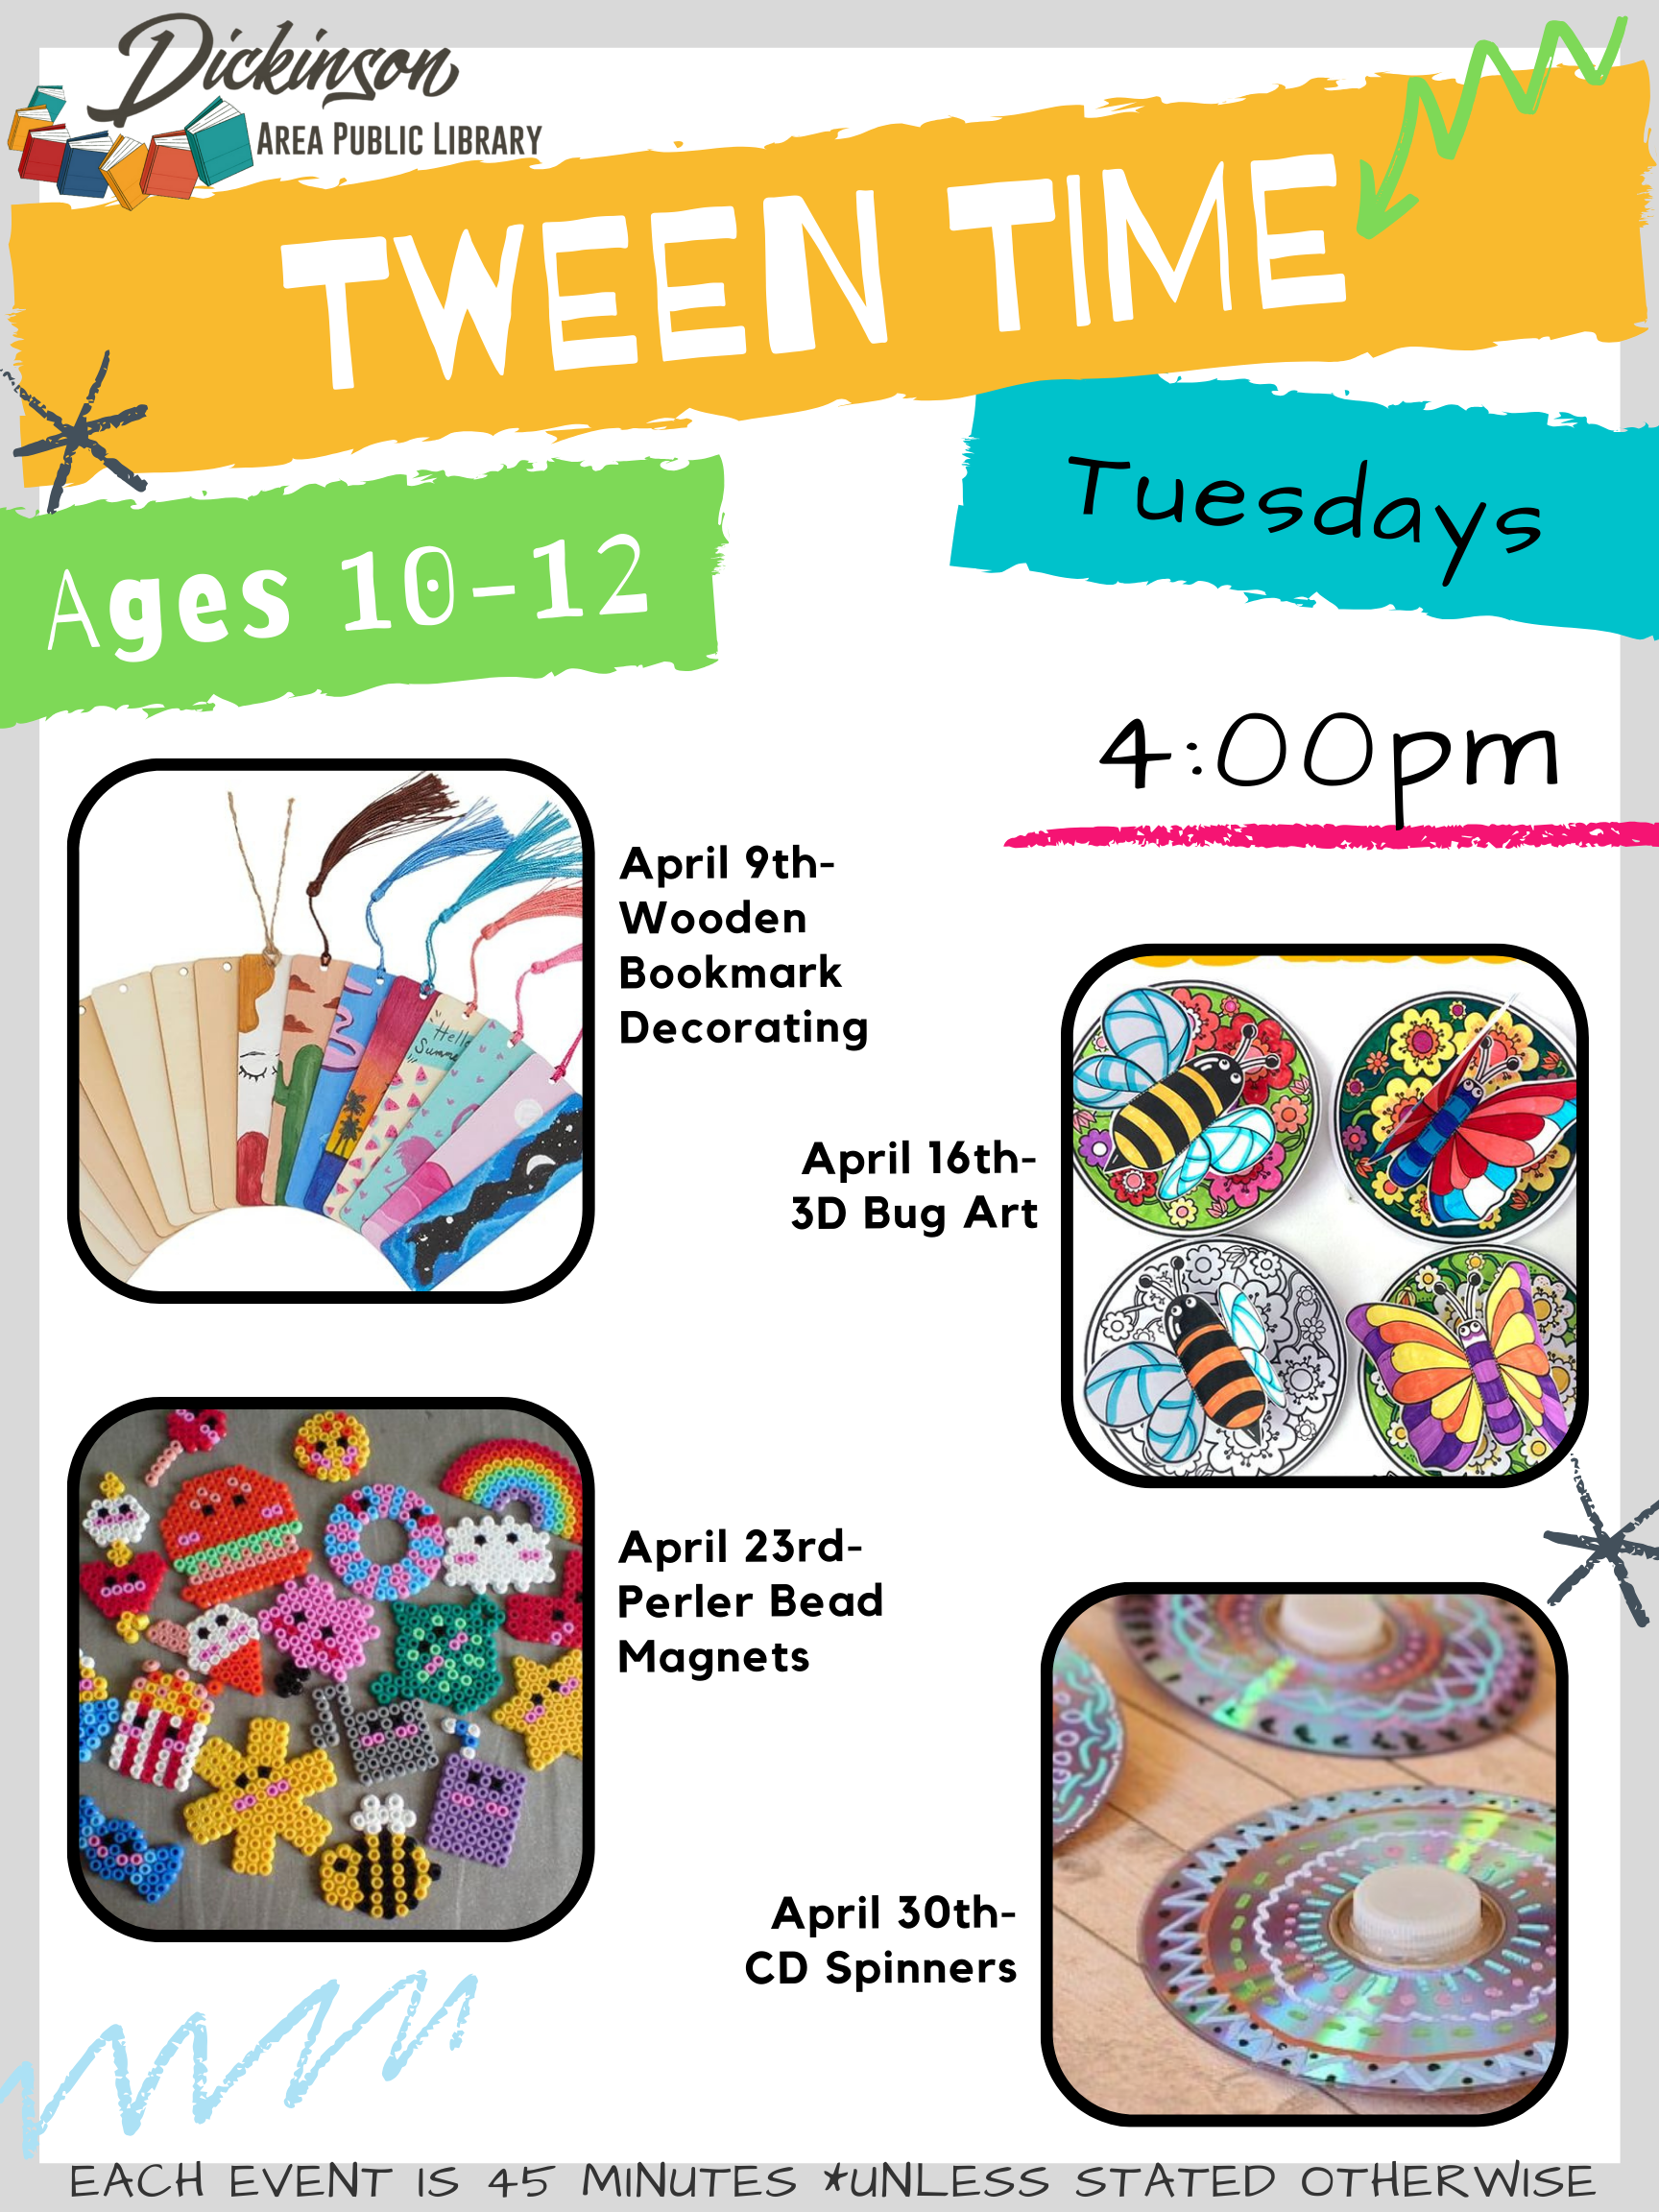

Slide 13
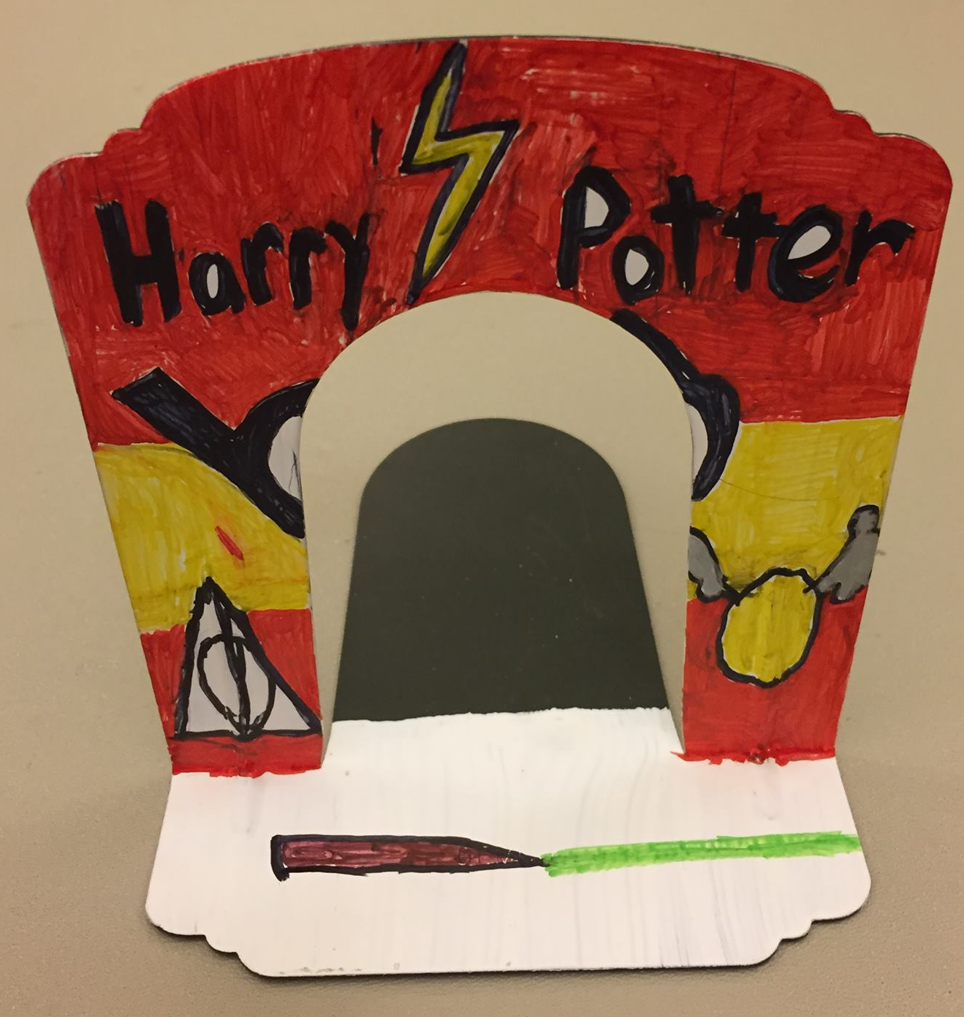
National Library Week

Slide 14
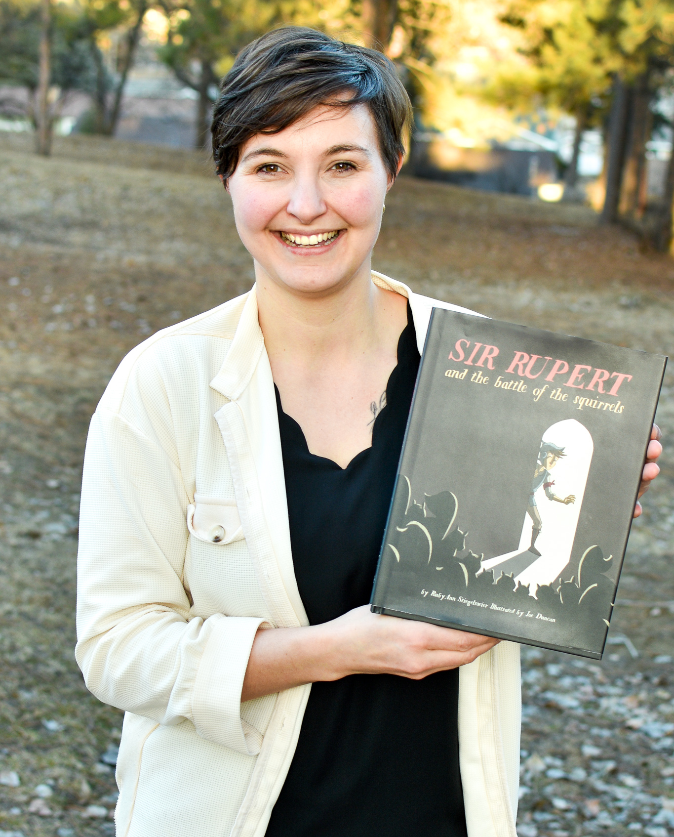
Author Visit: RubyAnn Stiegelmeier

Slide 15
