Slide 1
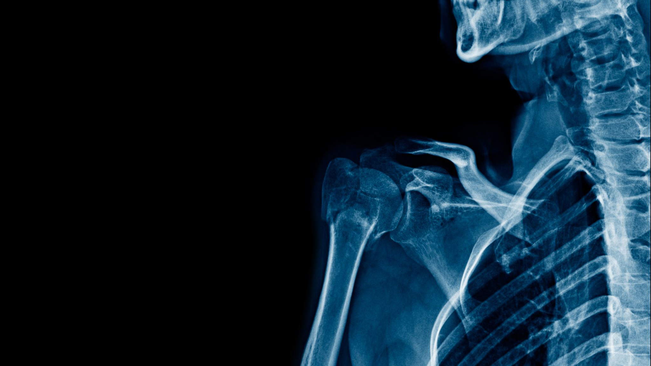
Spine Relabel Project or how to tackle a big project and stay (mostly) sane
Bree Schmidt
West Fargo Public Library

Slide 2
Project Overview
Relabel all the collections using Cutters and replace with author’s last name (plus add genre stickers and series names/number in series)
This includes:
Adult Fiction
Adult Graphic
Large Print
Teen Fiction
Teen Graphic

Slide 3
Let’s look at Numbers
Total of 23,740 items to relabel (give or take)

Slide 4
Timeline
Began the first week of June (also first week of Summer Boost, yay!)
Finished Adult Fiction on August 22
Completed replacing all Cutters on November 29
Grand total of 6 months to finish

Slide 5
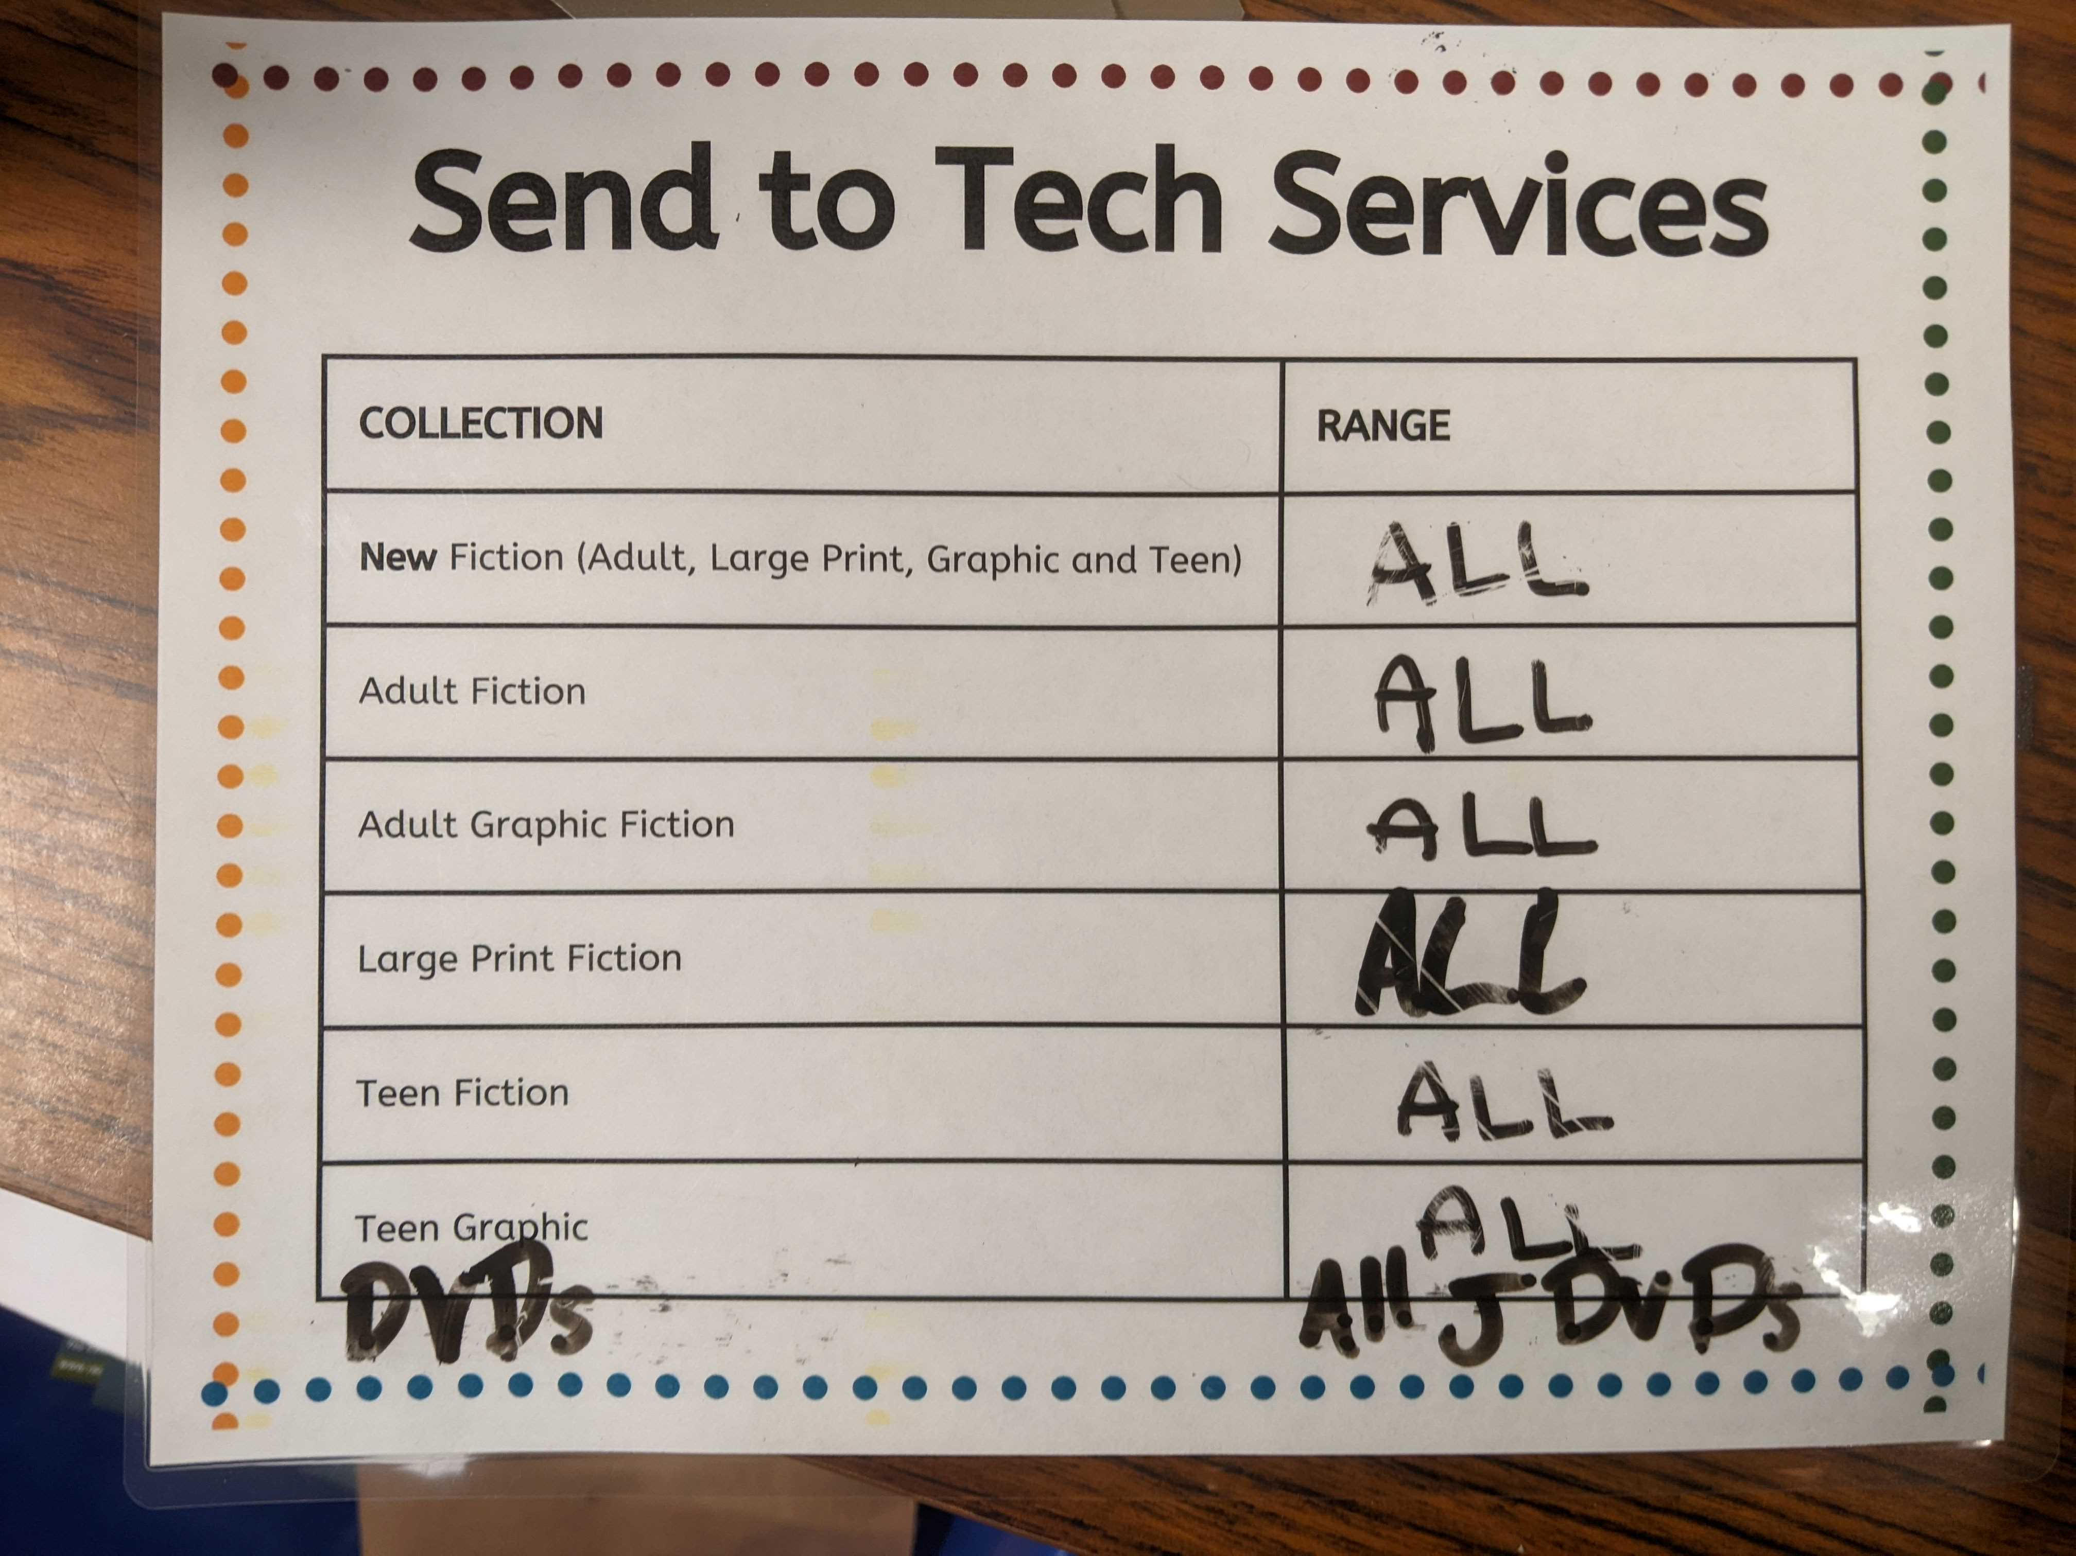
Procedure
Staff filled out a survey about what they’d like spine labels to look like
Ran numbers to figure out how many supplies to order
Labels, label protectors (2 sizes), genre stickers, WFPL address labels
Document the rules
Created a folder in Sharepoint
Label template
Missing series books Excel file
Genre of popular authors/series
Work on 1 shelf at a time per staff member
Take the entire shelf to relabel so we didn’t get our spacing mixed up
Kept track by placing a label with our name in the shelf we were currently working on
Chart in the circ office of how far we were so they could set aside items need relabeling
Did not change item status as the items were off the floor for such a short period of time

Slide 6
Where we started
Prefix
Cutter
Suffix
No genre stickers

Slide 7
Finished Product
Prefix
Author last name
Series title & number (if applicable)
Genre sticker (if applicable)

Slide 8
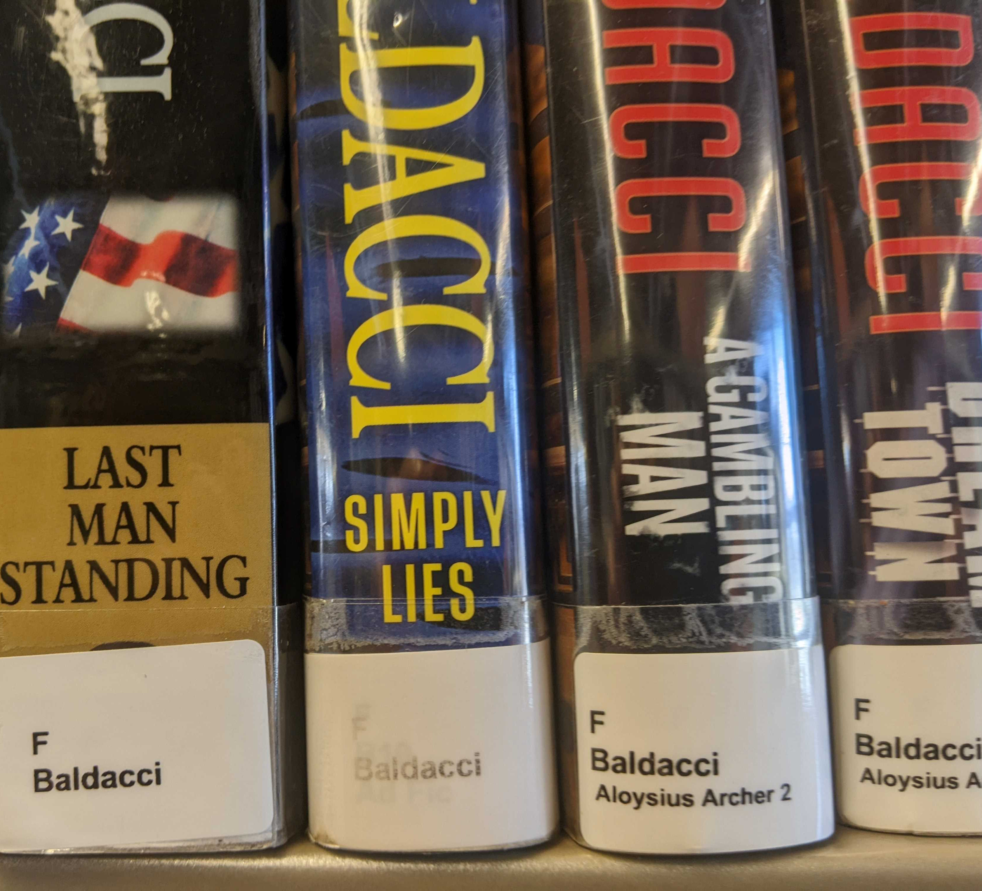
Setbacks
Faded labels (UGH)
Lessons learned
Don’t rush things – double check series names, genres
Communicate with circulation folks

Slide 9
Future Projects
Consolidated DVD TV series (package discs from season together)
Relabeled Junior Fiction Graphic Novels (author and series)
Decided to relabel ALL DVDs (they were/are a MESS)
Slowly working on getting all spine labels to be consistent since there have been several changes of the years
Junior Fiction
Easy Readers
Picture books

Slide 10
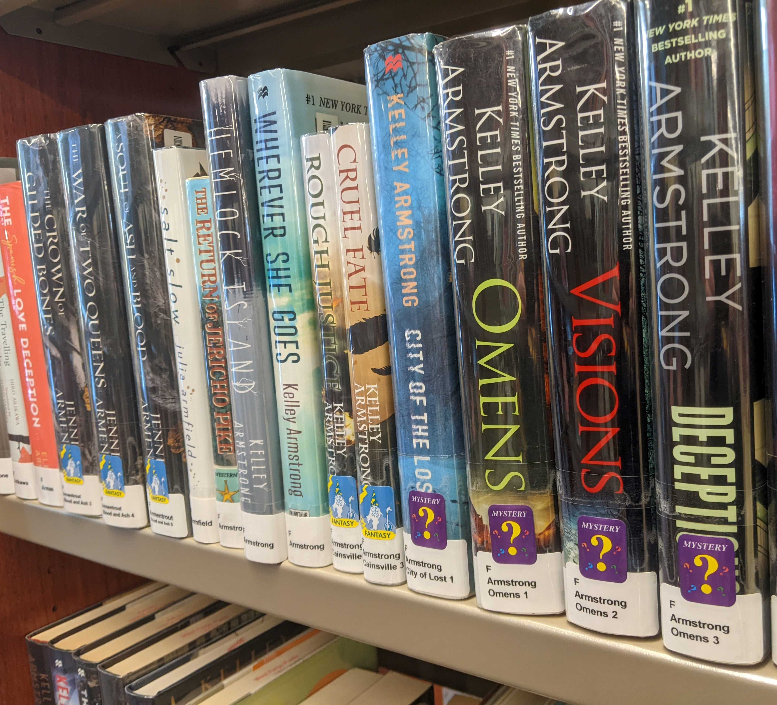
Questions?
Contact me
Bree Schmidt, West Fargo Public Library
Brianne.Schmidt@westfargond.gov
701-515-5206 (but seriously, use email)

