Slide 1
ODIN Director Report March 11, 2024 OAC Spring Meeting JASON bEDSAUL

Slide 2
Happy 35th ODIN!

Slide 3
Staffing Updates
Jeremy Wegener - Library Systems Administrator and Applications Developer
Jeremy brings 15+ years of experience working in IT programming, web applications development, and system security administration. Previously, Jeremy was a senior software engineer at the University of North Dakota where he was responsible for designing, developing, and maintaining applications and sites. Prior to that he worked as a senior developer for STP Ventures in Concord, NC and served as director of development for Anchor Marketing in Grand Fork, ND.

Slide 4
OAC and User Group Election Results
OAC Chair – Jolie Graybill, NDSU OAC Vice-Chair – Jenna Kahly, West Fargo Public Library
ODIN ACADEMIC USER GROUPS (ALMA)
ACQUISITIONS & SERIALS – Katie Lynn, UND Law
RESOURCE MANAGEMENT (Cataloging) – Benjamin Ferguson, Valley City State University
DISCOVERY PRIMO VE – Jenny Sjoquist, NDSU
FULFILLMENT – Christopher Gasink, UND Chester Fritz Library
RESOURCE SHARING – Shannon Hofer, Mayville State University
ODIN PUBLIC, K12, SPECIAL USER GROUPS (POLARIS)
ACQUISITIONS & SERIALS – Bree Schmidt, West Fargo Public Library
CATALOGING – Bobbi Wood, Grand Forks Public Library
DISCOVERY – Tonya Palmer, Grand Forks Public Library
CIRCULATION, HOLDS & ILL – Kirsten Henagin, West Fargo Public Library
*All terms begin January 1, 2024 and end on December 31, 2025 unless eligible to run for re-election.

Slide 5
New User Group – NDAC
Academic Consortium for Overdrive
Chair - Brittany Fischer, UND Chester Fritz
ODIN Liaison – Nicole Murphy
Will meet quarterly
Next meeting this Thursday at 9am

Slide 6
New Member
Located in Watford City, ND
Main Branch and Bookmobile
Went live with Cataloging and Circulation February 27th
Participating in Holds/ILL soon

Slide 7
Library Director Changes
Dickinson Public Library – Ian Anguiano
McKenzie Public Library – Miah-Joy Kay (Interim)

Slide 8
Polaris Updates
7.5 Installed on Production in January
7.6 Scheduled for release in Q2, 2024
Focus on Cataloging in LEAP – Advanced Metadata (MARC) Editor and Item Templates
Some additional Bulk Change options from the Find Tool

Slide 9
IUG Member Exclusive Enhancement Process (MEEP)
Will work similar to the NERS process utilized by Exlibris (selection, scoring, voting, etc.)
Feb. 5 – Mar. 18: Polaris Development points ideas
By April 8: ODIN collects feedback and casts our vote for the winning idea
Each IUG member gets 1 vote (One Consortium Membership)
Individual Libraries can also become members for additional votes
Nicole is on the Polaris Working Group and will also manage the internal process for ODIN

Slide 10
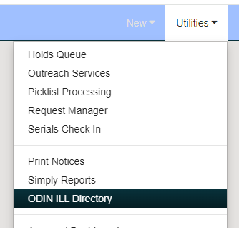
Polaris Holds/ILL
Emphasis on Pick-List Management
Various messages in Polaris
Updated trainings on the ODIN Website
Placing Holds in LEAP and PAC
Managing Hold Requests in LEAP

Slide 11
Other Polaris News/Reminders
IUG Meeting end of the month in Detroit, MI
Vega LX Starter (new Notices System) should be coming soon after IUG for Consortia
Main Polaris contract has been renewed for 5 additional years (June 2029)

Slide 12
Alma February Feature Release
Held an Overview Session earlier this month
Highlights:
New Layout for PO Lines Task List
New Primo Showcase Tool – Collections
Analytics Data Visualization Improvements
Improvements to various ILL Workflows

Slide 13
Pendo Communications
3rd Party software
Intended to help improve the UX
Future improvements like in-app guides
Information is only collected on Alma usage (not Primo – Students/Faculty)
Anonymized
ODIN has officially requested/suggested a Webinar from ExLibris to explain further and provide a real-time forum for questions

Slide 14
NERS Process Voting Details
ODIN has 100 votes each for Primo and Alma
March 4 - March 29 -- First round of voting ODIN has 100 votes
April - May -- Top 20-25 enhancements to Ex Libris for pointing.
June 10 - June 21 -- Second round of voting on pointed enhancements
After June 22 –
The top enhancements are determined.
ELUNA has 200 total development points
Ex Libris delivers the accepted enhancements within one year
Submit feedback to Nicole by Thursday March 28th, 2024

Slide 15
ELUNA Reminder

Slide 16
ODIN WorkDay Sessions – March 18 - 22
Building serendipitous collections with Alma Kelsey Riggs and Rebecca Brown
How to Customize the Alma Interface Liz Mason
Online Educational Resources Kelly Kornkven
Calendar Management Tina Stockdill
Self-Check with Meescan Will Martin and Bryan King*
Creating sets and Doing bulk changes Liz Mason
Deep Dive into the Leap Find Tool Nicole Murphy
Vending Machine Process Steve Hammel
Programs and Special Projects
Grand Forks Public Programming Tonya Palmer
Dickinson Area Public Programming Jade Praus
West Fargo Public Relabeling Project Bree Schmidt
Idea Exchange Process Tina Stockdill
*Both Academic and Public/K12/Special Audiences

Slide 17
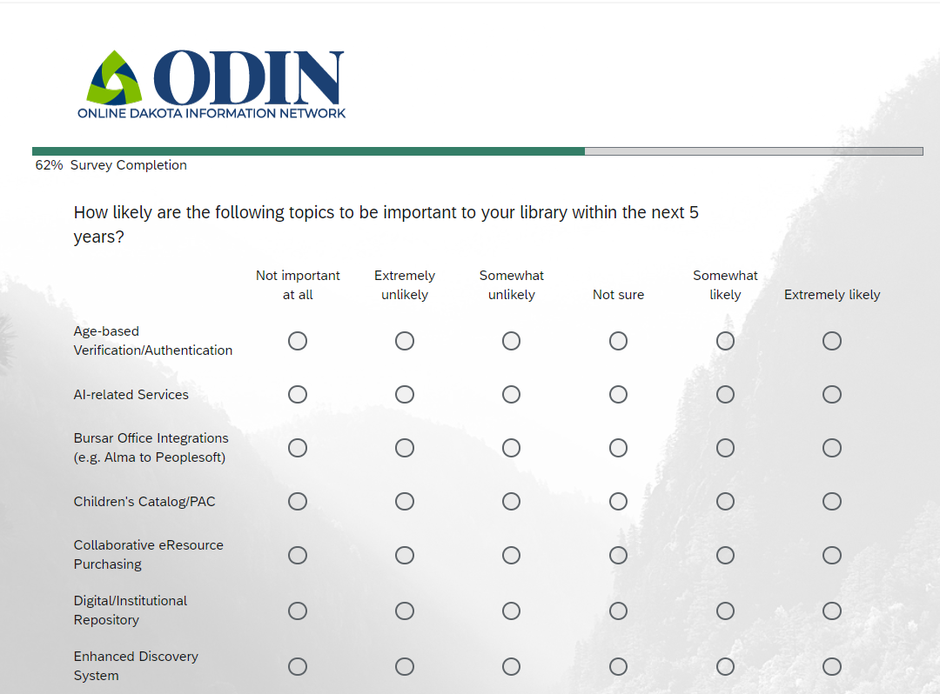
ODIN Annual Survey
Four Focus Areas
System
Support
Vendors
Priorities
Mix of Qualitative and Quantitative

Slide 18
Thank you
Jason Bedsaul Jason.Bedsaul@ndus.edu | 701-969-9135
ODIN
Help Ticket: https://www.odin.nodak.edu/helpticket
Email: odinhelp@listserv.nodak.edu

