Slide 1
Meescan Self-Checkout in Alma and Polaris: A Comprehensive Overview
Will Martin Bryan King

Slide 2
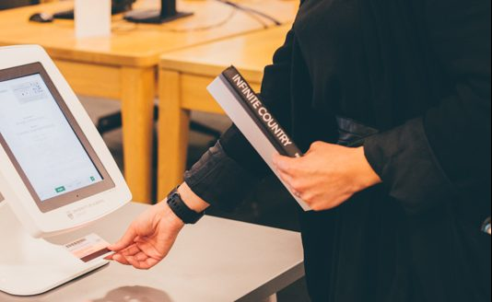
What is Meescan?
Meescan is a self-checkout solution for libraries, consisting of an app for use on patron devices plus iPad-powered kiosks. The kiosks can also serve as catalog stations.
Who uses Meescan?
Public libraries. Academic libraries. School libraries. Museum libraries. Corporate libraries. Big libraries. Small libraries. Teeny-tiny libraries. Mobile libraries. UND library. GFP_ library
Libraries of all kinds and sizes benefit from this unique self-checkout system.

Slide 3
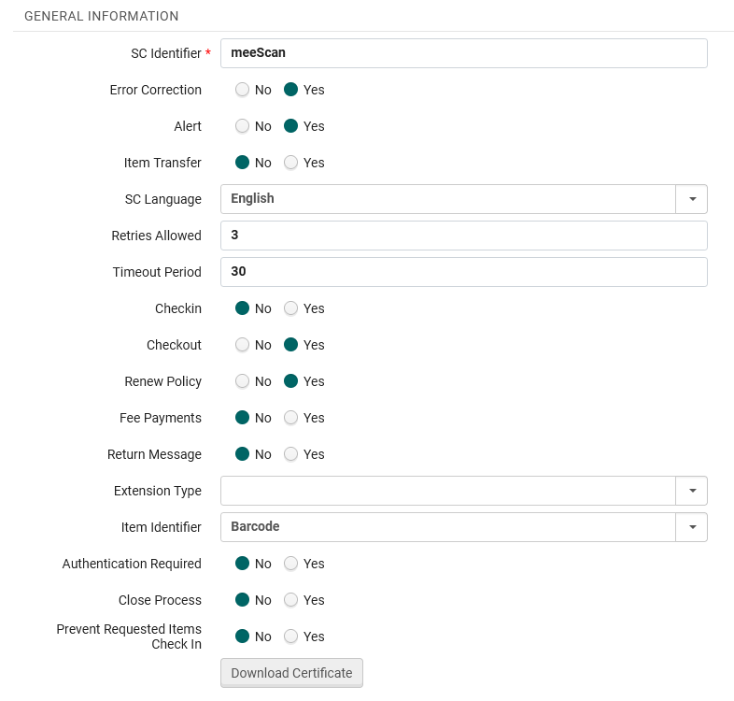
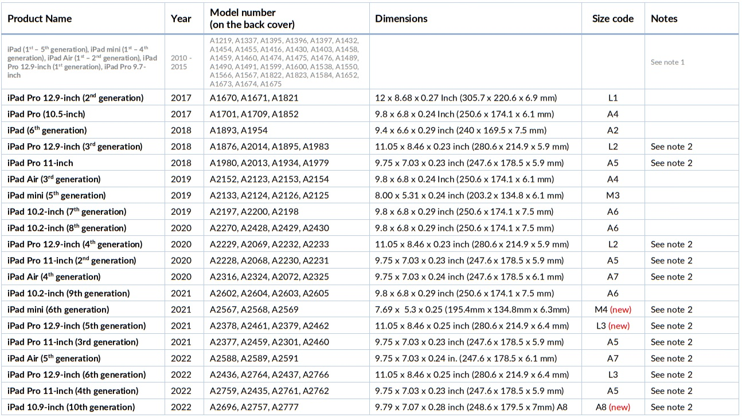
Meescan Client On-boarding
ILS Integration
Station configuration (RFID, barcode, mag stripe)
E-mail and Branch configuration
Customize App
Portal Access

Slide 4
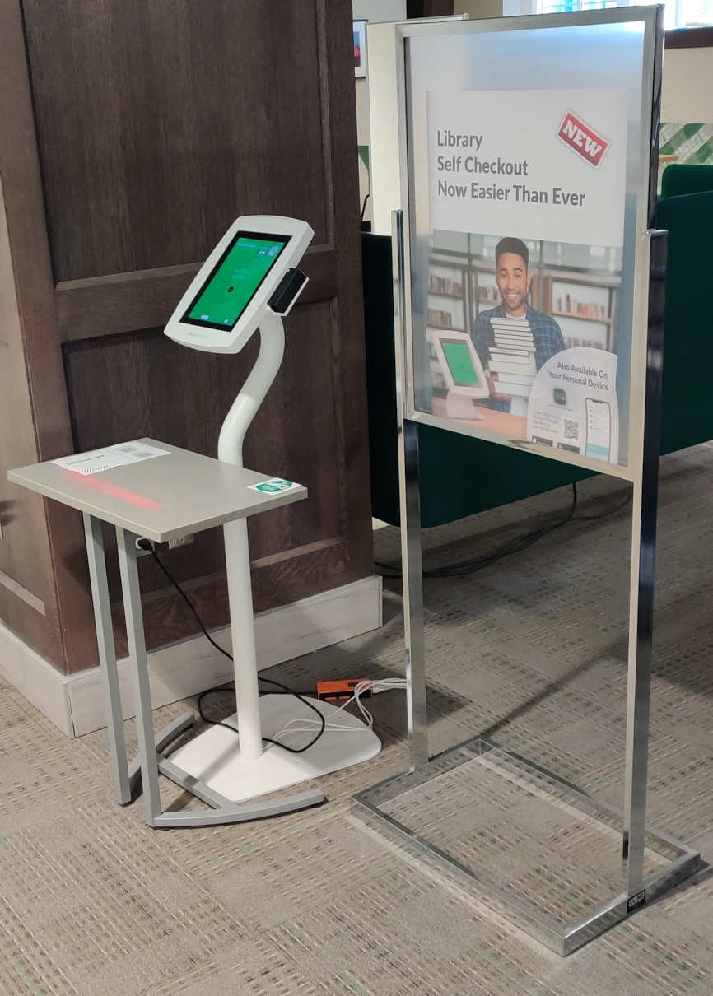
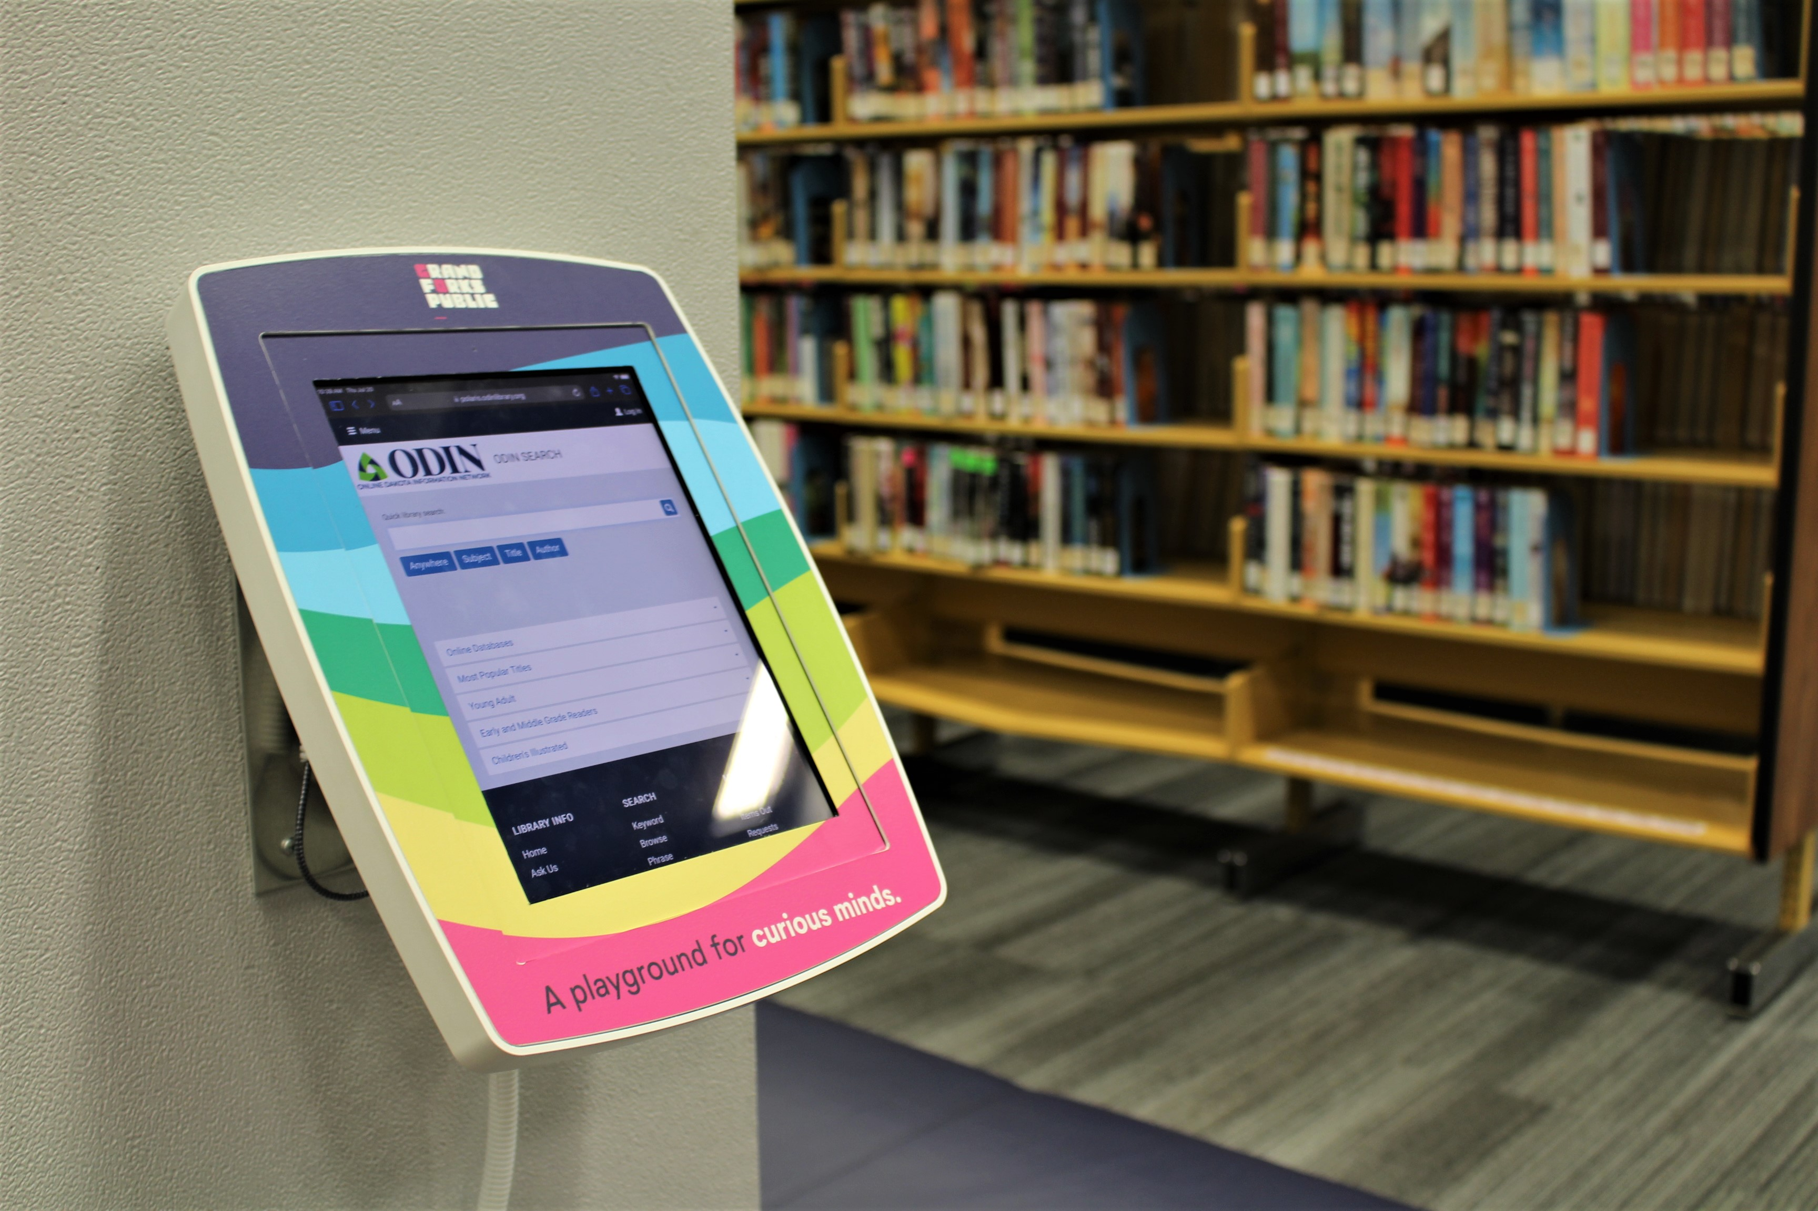
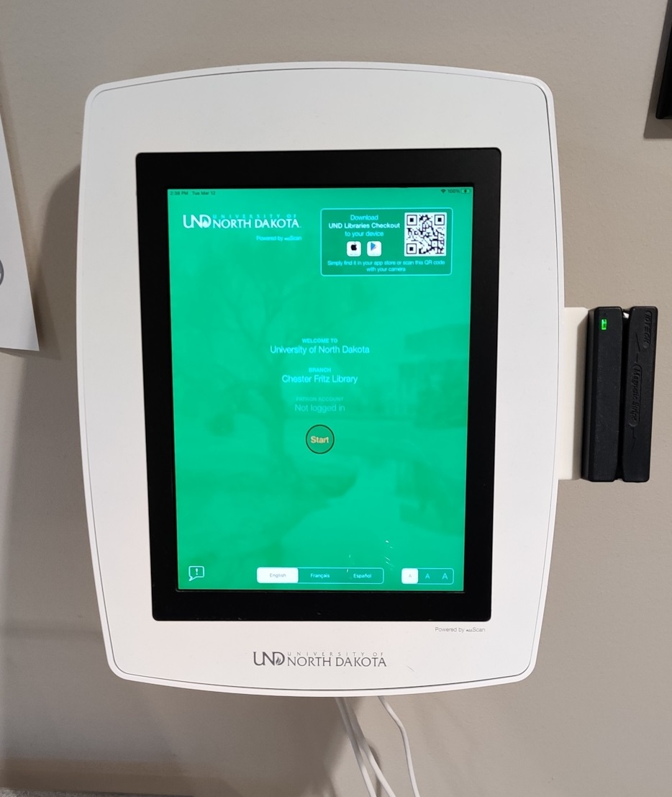
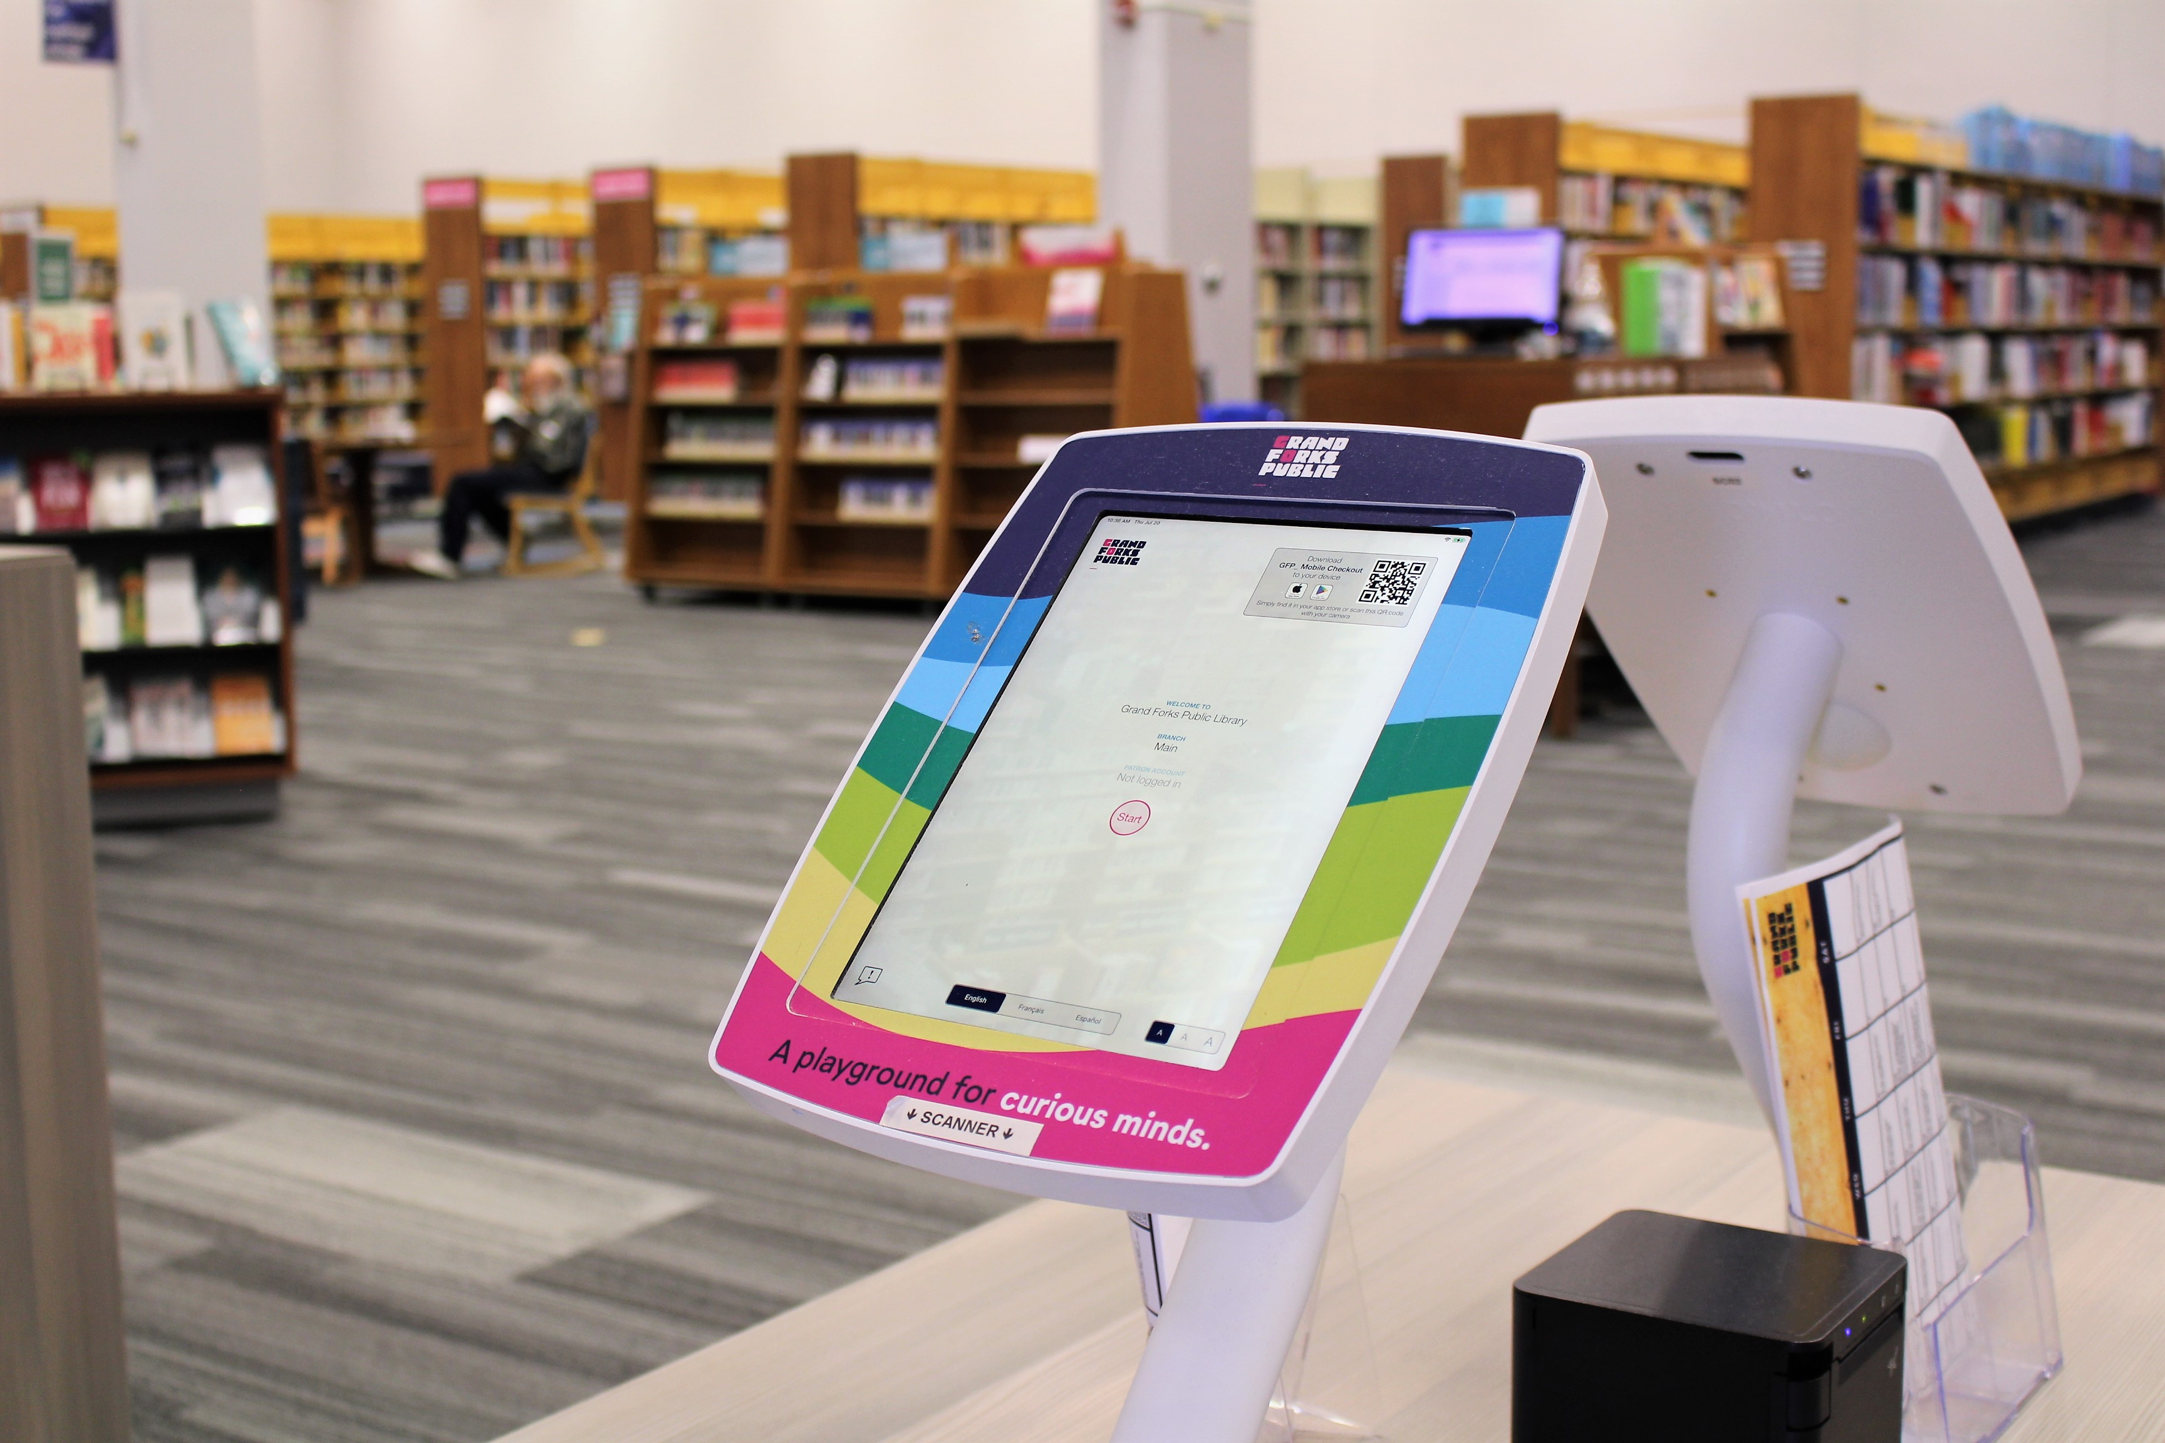
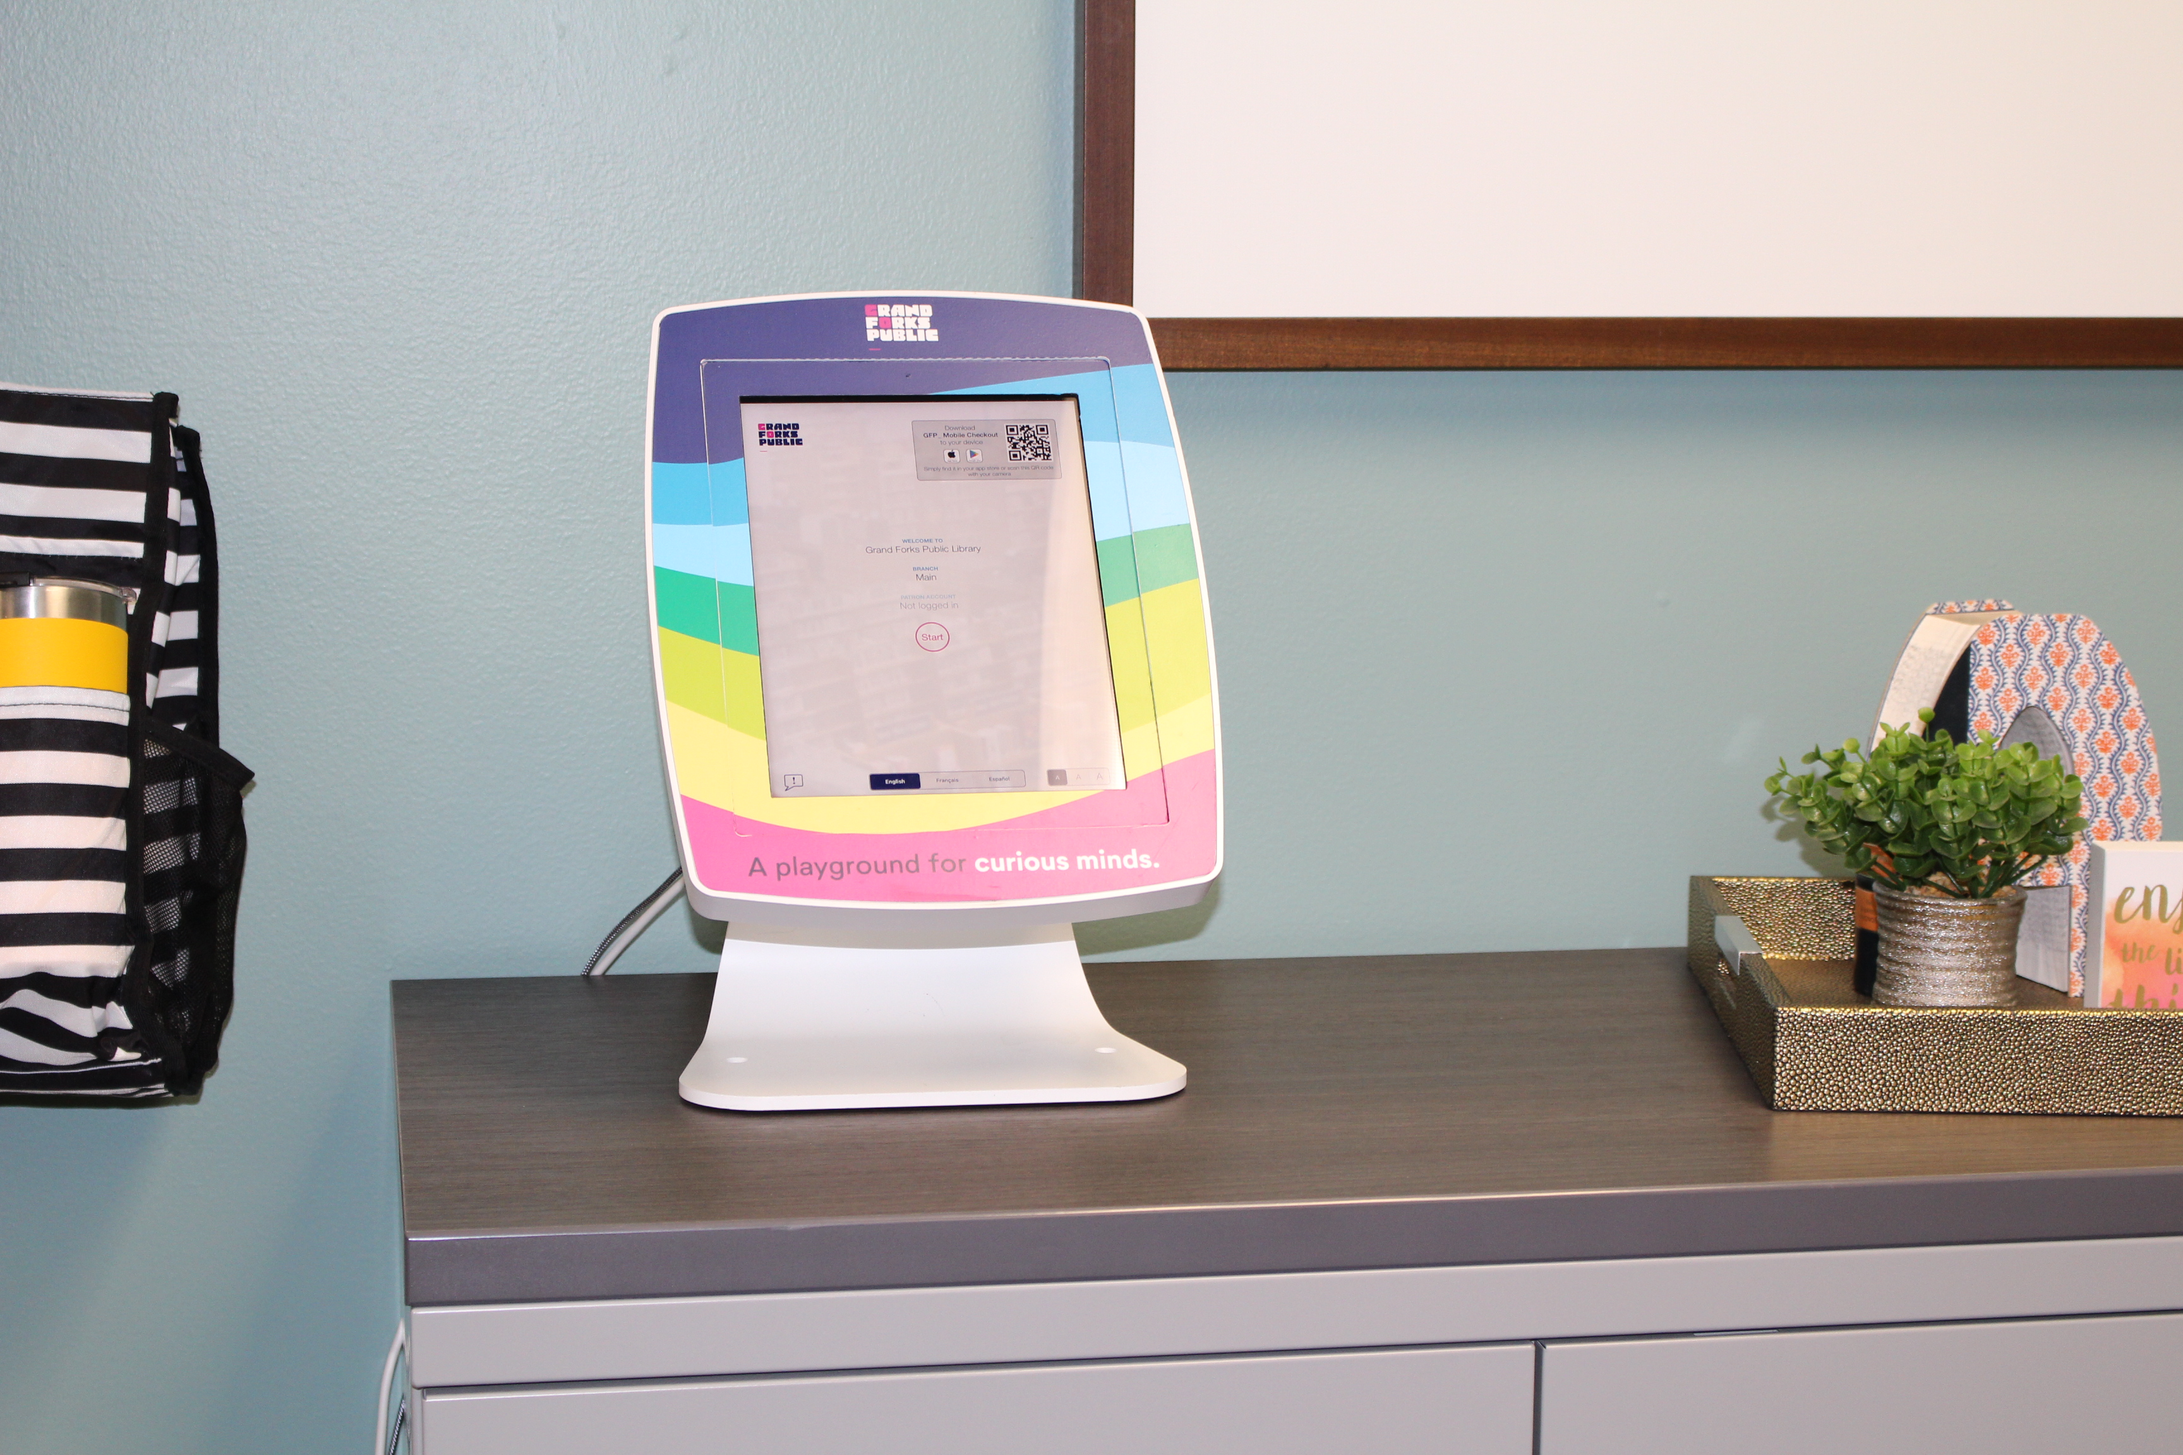
Meescan Configurations
Floor standing
Desktop standing
Wall mounting
E-mail receipt
Receipt Printer
Both
Barcode
Magnetic Stripe
RFID
Tattle Tape

Slide 5
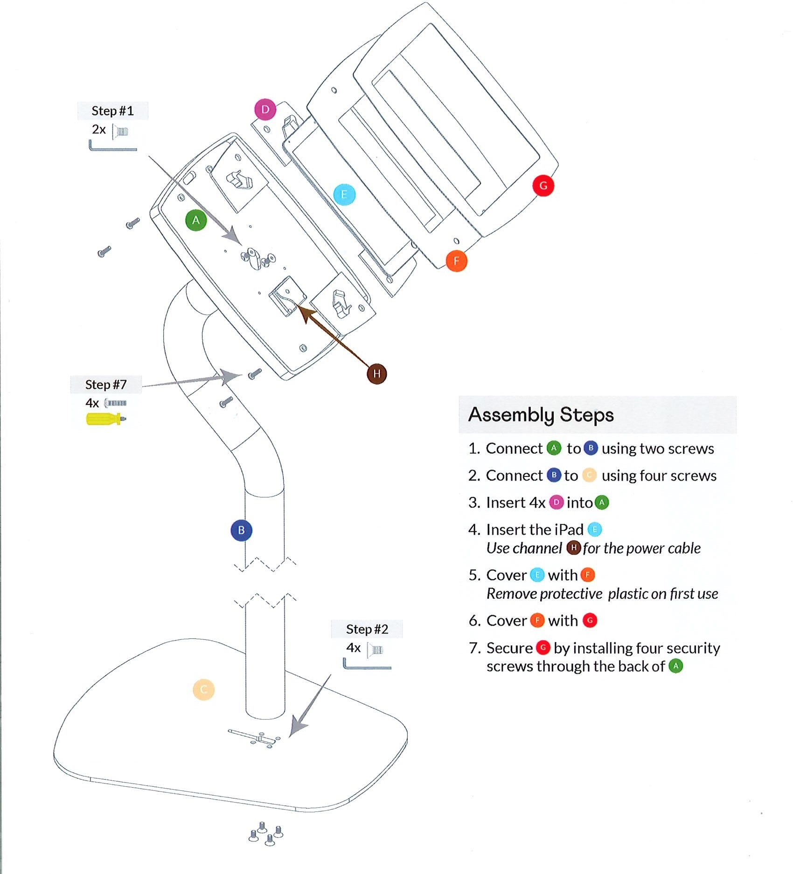
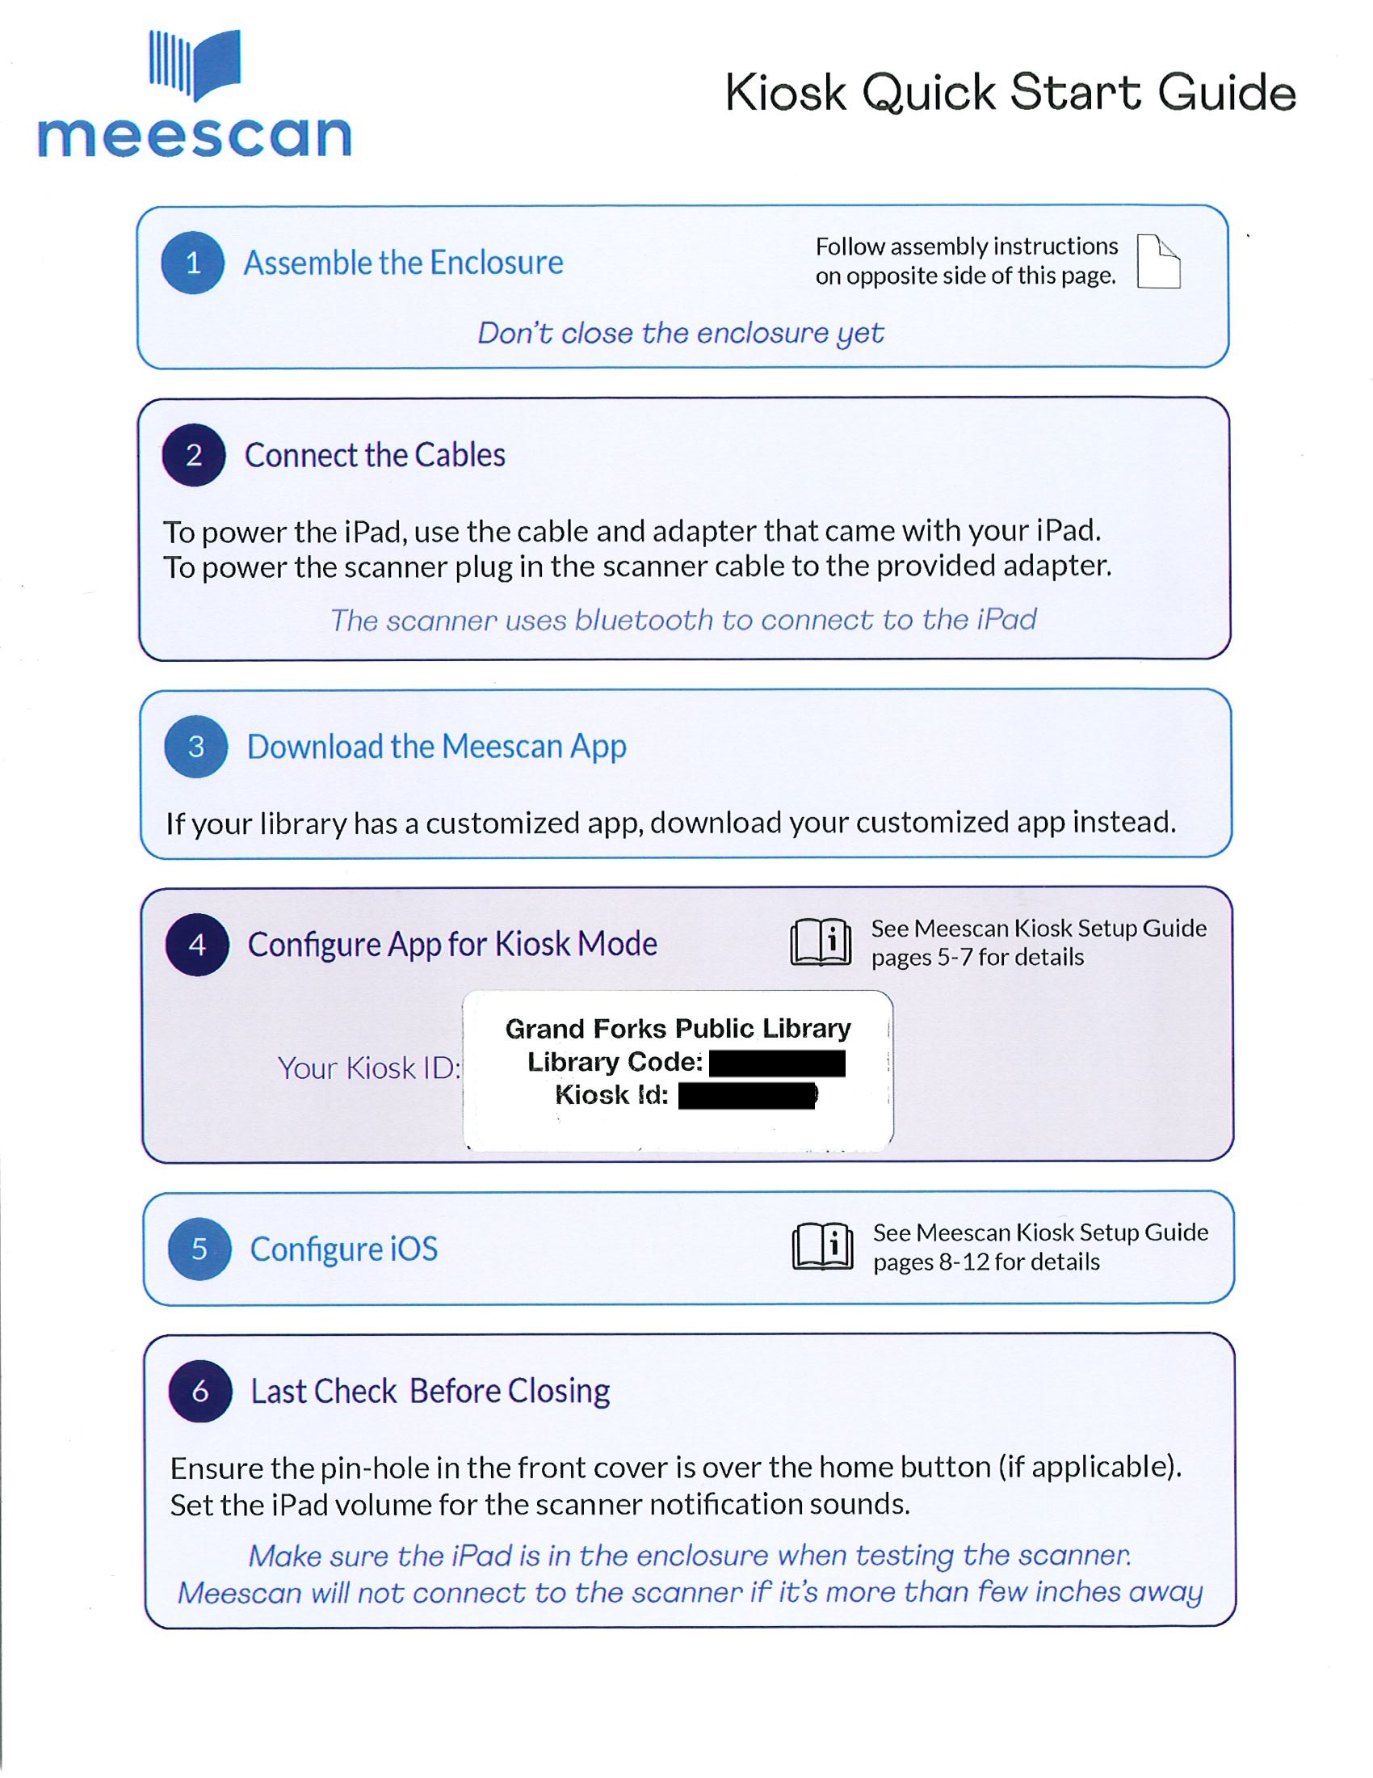
Meescan Deployment

Slide 6
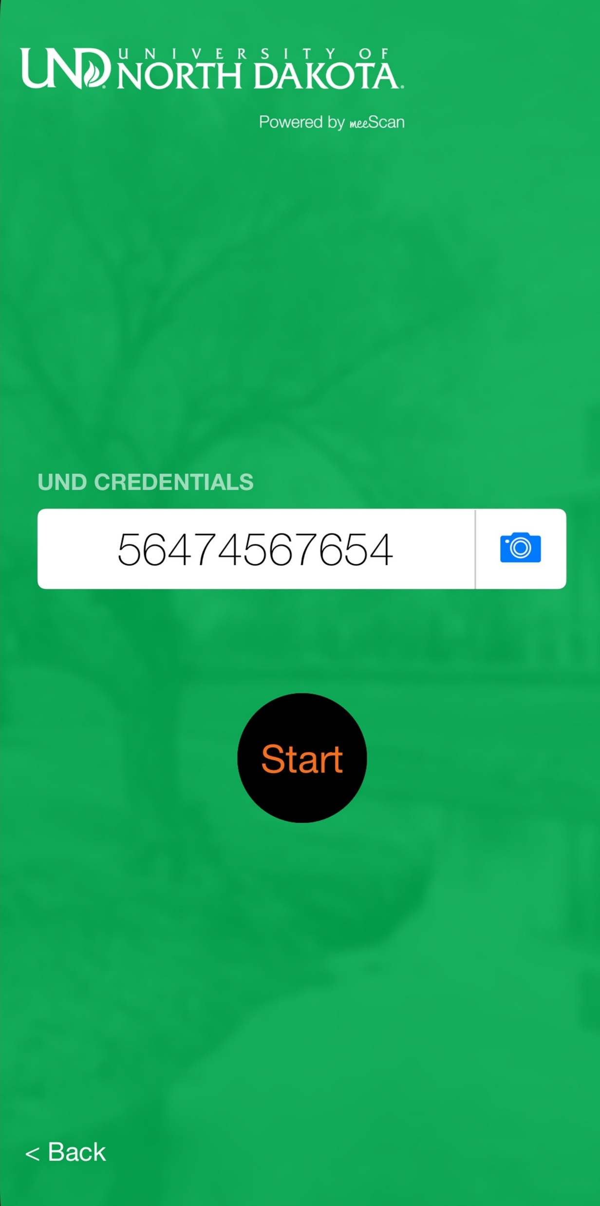
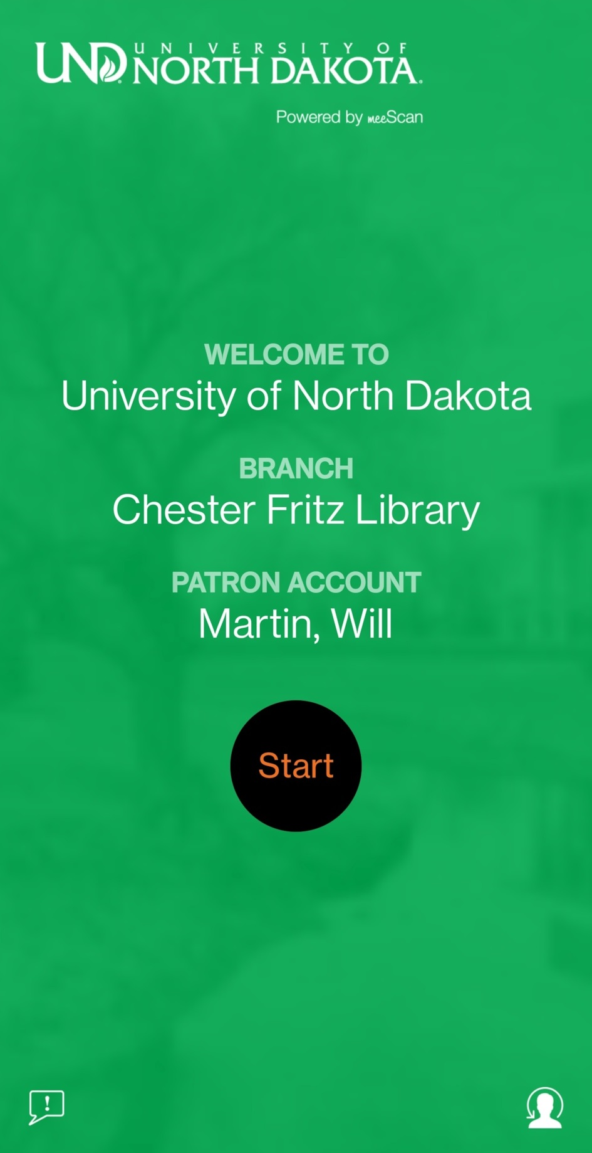
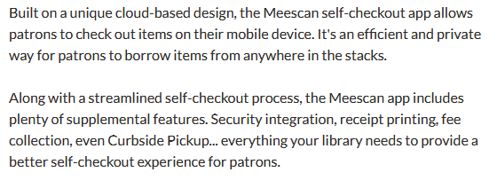
Meescan Mobile App
Meescan.com:

Slide 7
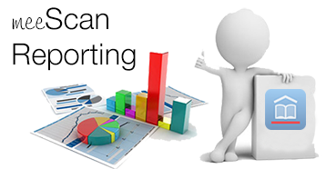
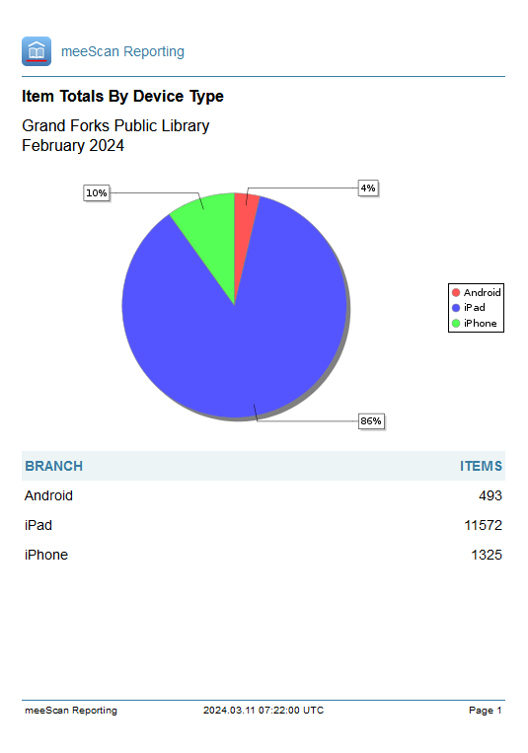
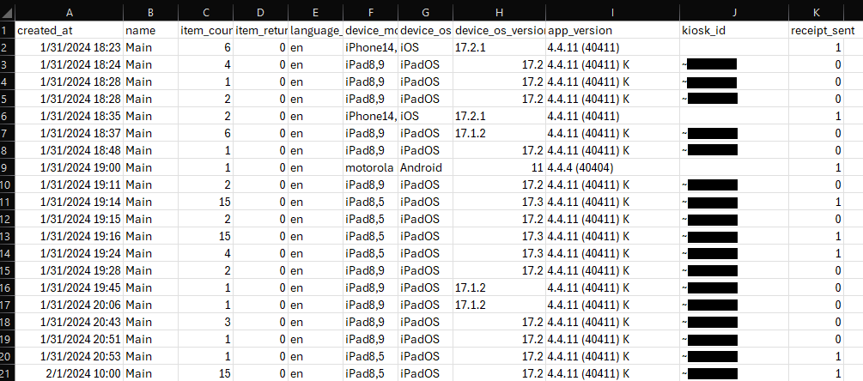
Meescan Reporting

Slide 8
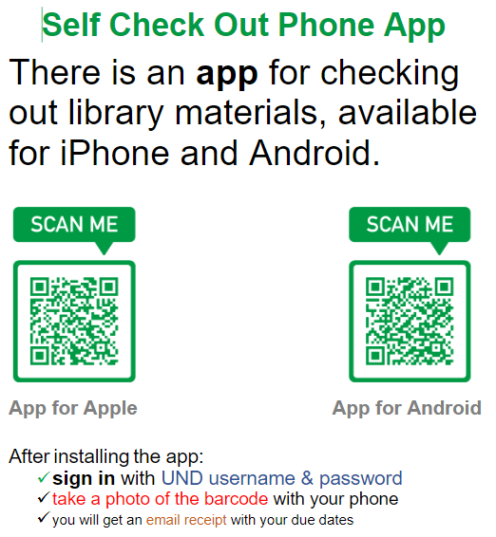
Meescan Marketing
Meescan will provide QR codes for your branded app. This codes can be used in marketing materials to help promote the new self-checkout.

Slide 9
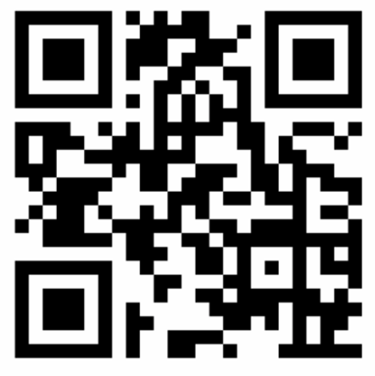
Try Meescan:

Slide 10
Q & A
Contact Info:
Will Martin
william.d.martin@und.edu
Bryan King
bryan.king@gflibrary.com
Meescan Contact Info:
Toll free: +1 (888) 510-7095
info@meescan.com
https://Meescan.com

