Slide 1
How to Customize the Alma Interface

Slide 2
Agenda
Customizations by User Login – will only be seen by you
Customizations by User Role – these are available to users that share a certain role and are seen only by you
Institution Level Customizations – these apply to all users

Slide 3
Customization by User Login
UI Preferences – font size, shortcuts customizations
Alma Navigation Bar
Results Lists
Action Buttons
Tables
Widgets

Slide 4
UI Preferences
Display Density – select a larger font
Shortcuts Customization

Slide 5
Alma Navigation Bar
Click the top option, called "Search and Manage Alma Links" to configure the Nav Bar
Click Collapse menu so bar takes up less space
Add stars to your most used menu items and they will appear in the Quick Links Menu
Click Pin Quick Links Menu to pin the links to the main screen
Customize menu links to hide links you don't use

Slide 6
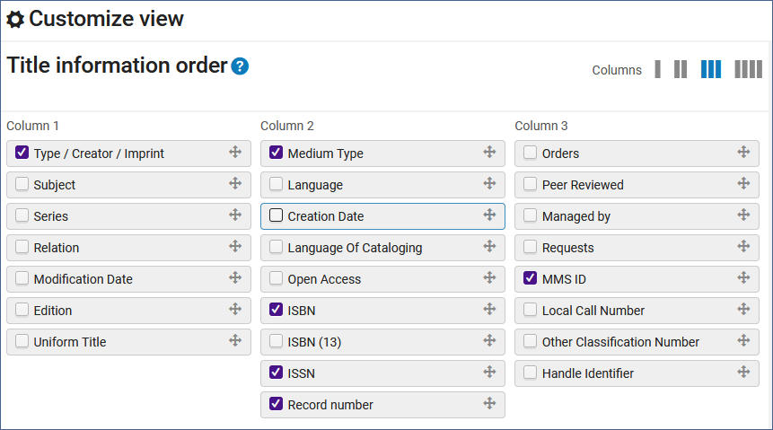
Results Lists
You can configure which fields appear for each item in a results list. Click the configure icon, clear a fields check box to remove a field. Drag and drop fields between columns.

Slide 7
Customize Action Buttons
You can drag and drop actions to configure which ones appear as the two action buttons.

Slide 8
Customize Table Columns
Click the customize button and uncheck the boxes for columns you do not want to display.

Slide 9
Widgets
The out of the box widgets are available for all users. Users can each select which widgets they want to see on the Alma homepage.

Slide 10
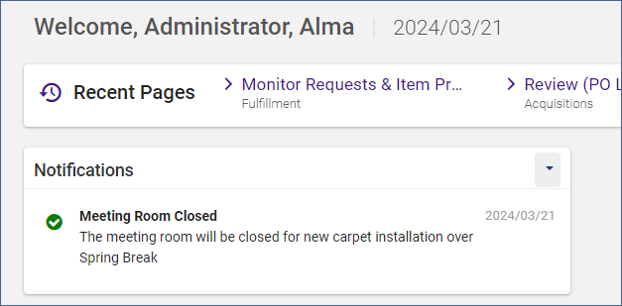
Homepage Notifications
The user must add this widget to their Alma homepage.
To configure the notification message, go to: Configuration > General > General Configuration > Home Page Notifications.
This message is persistent for as long as the user has the widget on their homepage.

Slide 11
Customization by User Role
Customized Widgets by User Role
Analytics Widgets by User Role
Data Visualizations by User Role

Slide 12
Customized Widgets
These must be created by trial and error as many websites do not work as widgets.
Go to Configuration > General > Widgets > Customized Widgets
Add a row to the table, add a word for a key, widget name, privileges (see below), paste the url without "url=" in front. Alma will add this, and a description.
These can be limited to users with certain roles. Put in the role with underline instead of spaces. Leave the field blank for all roles.

Slide 13
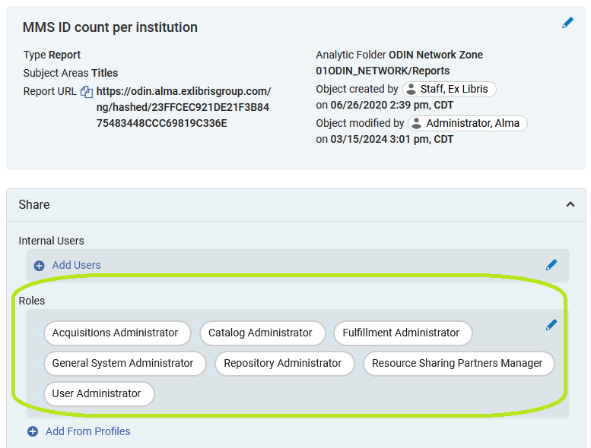
Analytics Widgets
These can also be limited to add to the Alma homepage by role.
For users to be able to add the widgets, roles must be added to the analytics objects.

Slide 14
Analytics Widgets
To make an analytics object a widget, check the Add as widget box.

Slide 15
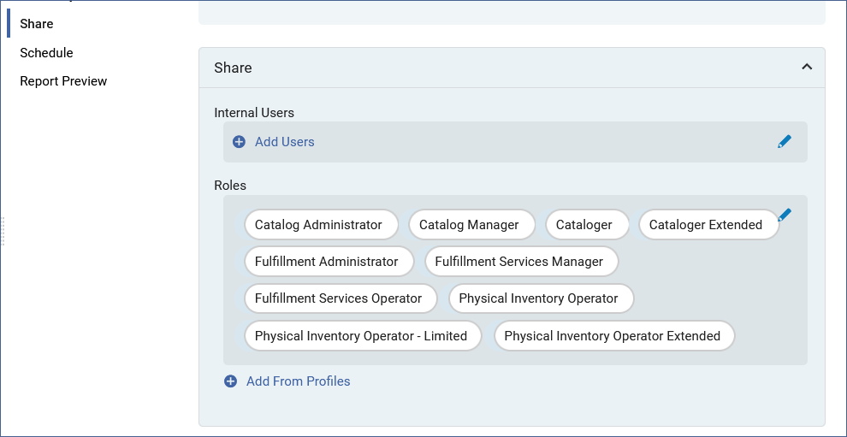
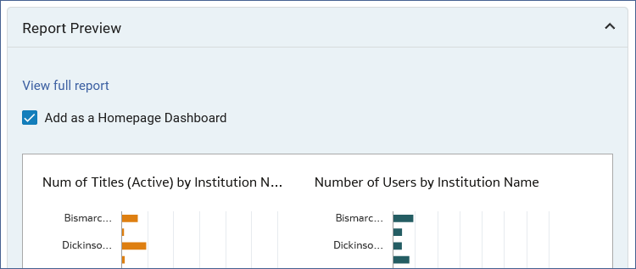
Data Visualization Alma Homepage
In the Analytics Objects List add the roles to the data visualization object and check the box "Add as a Homepage Dashboard."

Slide 16
Institution Level Customization
Book Thumbnails in search Results
Institution Notifications

Slide 17
Book Thumbnails in Search Results
Configuration > Resources > Search Configuration > Repository Search Thumbnails
Then click "Show for all objects."

Slide 18
Institution Notifications
These notifications are pushed out to all Alma users.
These notifications appear during a scheduled period.
These notifications can be dismissed by the Alma user. Once they are dismissed, they do not appear again.
To configure Institution Notifications, go to Configuration > General > General Configuration > Institution Notifications

Slide 19
Thanks for Attending!
The Alma User Interface
Configuring Widgets
List of Widgets

