Slide 1
Book machines, lessons learned
ODIN workday presentation March 20, 2024
Steve Hammel, Patron Services Director, North Dakota State Library

Slide 2
What was this project all about?
The State Library purchased 10 book vending machines to place in communities around the state that don’t have easy access to a local public library.
North Dakota is the first state to deploy book vending machines on the statewide level.
In January of 2023, installation of the machines began. This is where I come into the story. It was a cold and snowy Monday…

Slide 3
What was this project all about?
Notes:
53 counties in ND; 19 without countywide library service. First priority were the five counties without any public library services, Sioux, Oliver Steele, Sheridan, and Slope. Next priority were the twelve counties NDSL has identified as “underserved” 6 machines are in county courthouses- provides more access but still limited hours; one is in a city community center that’s open 24/7 and one in a grocery store- these are our busiest locations; 1 is in FT Ransom state park, and final machine is currently at the state capital

Slide 4
What is the purpose of a book vending machine?
It helps extend the reach of your library by providing materials in locations away from your library.
They can be used to provide service to communities without library services. It is a significantly less expensive option versus a branch or bookmobile.
Depending on location a vending machine can also extend library hours.
Possibility for 24 hour access at your library.

Slide 5
Different machine types. What to know before you buy.
There are several different types of machines, each has their advantages and disadvantages.
Considerations: cost, space, amount of staff time to service the machines, types and quantities of materials to put in machines

Slide 6
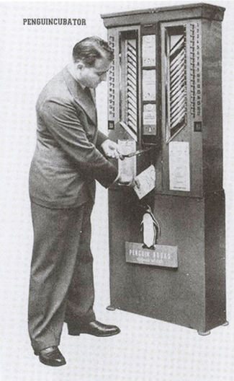
Is this a new idea?
The Penguincubator
appeared in London in 1937.
Conceived by Allen Lane, the founder of Penguin Books, the Penguincubator dispensed classic literature in paperback form for about the same price as a pack of cigarettes

Slide 7
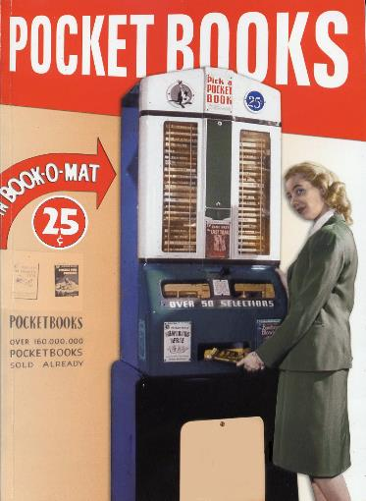
Is this a new idea?
In June 1947, Popular Science featured an early book vending machine called the Book-O-Mat, which featured a selection of 50 books, any one of which could be purchased for a quarter.

Slide 8
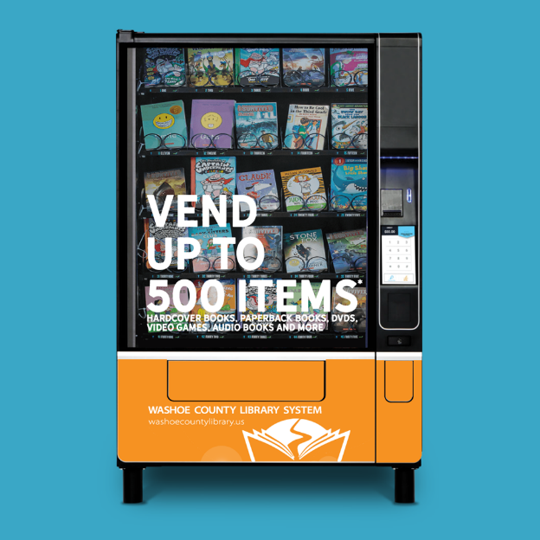
Notes:
Candy machine
Configuration is everything. 500 = 25 slots of 20 for small paperbacks, DVDs and similar. Thicker and taller items would reduce capacity.

Slide 9
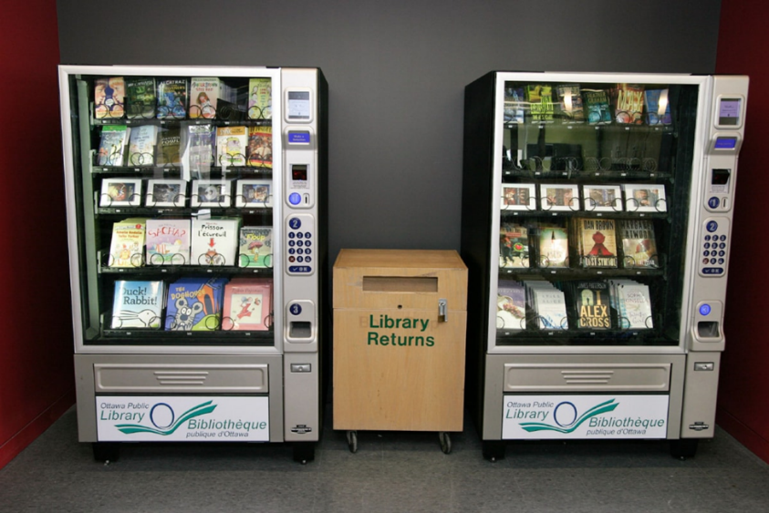
Notes:
Toronto Public library

Slide 10
Is Toronto’s solution good or bad? It depends…
Notes:
In some situations, yes. For the NDSL project, no.

Slide 11
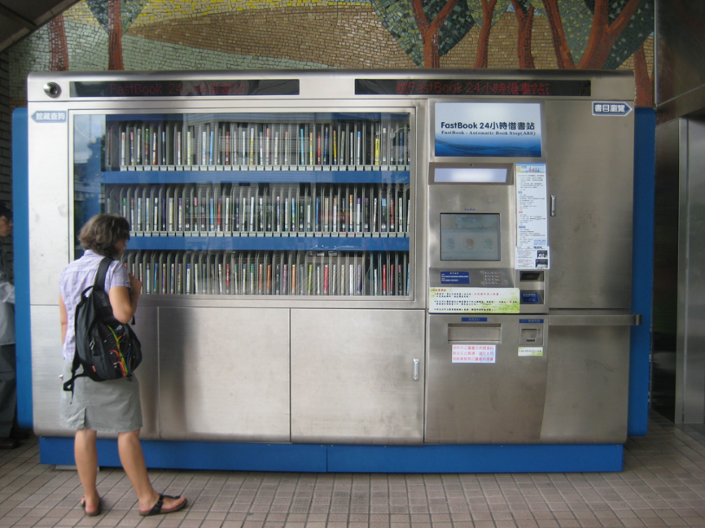

Slide 12
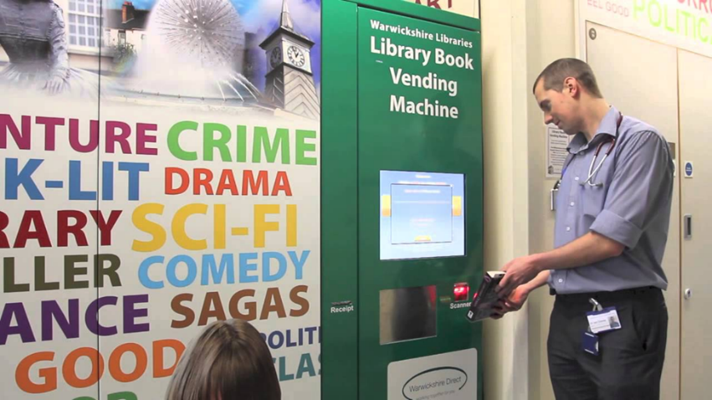

Slide 13
Notes:
This unit provides more of a browsing experience. Users can remove materials and look them over before deciding to check them out. The machine works using RFID to scan the contents before the user opens the door and then again when the door is closed. It then checks out any items that are removed. There is no way to limit the number of items checked out by a single user. Smaller capacity, 200ish items?

Slide 14
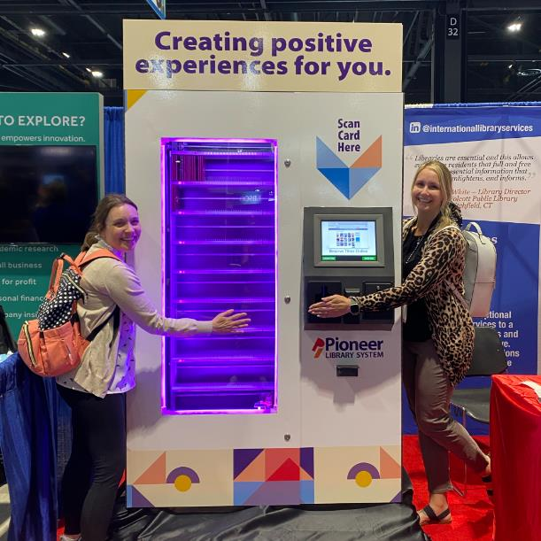
Notes:
Library Media Box. This machine holds up to 3,000 CDs, DVDs, Games, Audio Books, etc. Downside, no books.

Slide 15
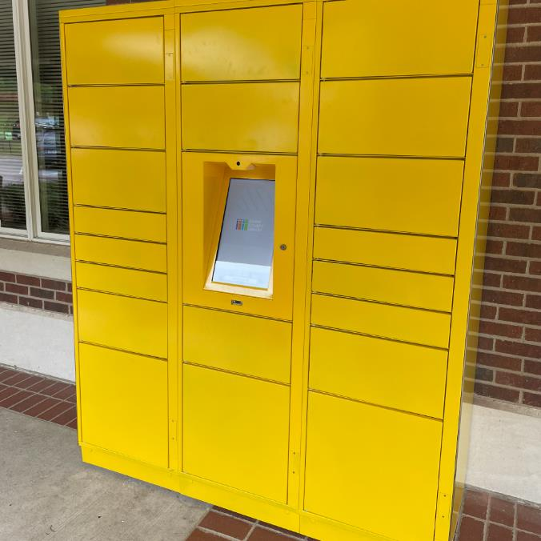
Notes:
Locker systems. Can be used for hold pickups, library of things, laptops

Slide 16
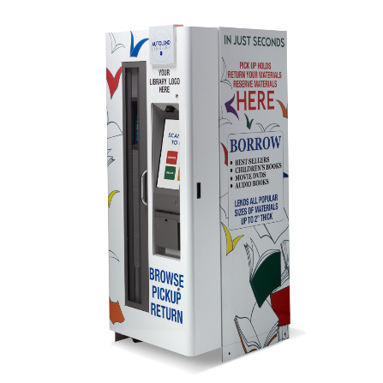
What did the state library choose and why?
THE AUTOLEND LIBRARY
The first device to offer browse, hold, pickup, and return of the diverse materials that libraries need and patrons want. The AutoLend can handle the widest range of popular library material types and sizes in the smallest footprint of any product available.
Notes:
Off company website

Slide 17
What did the state library choose and why?
The Autolend machine was chosen primarily because it could act as a standalone without regular staff intervention. It provides both checkout and return.
The machine was purchased mainly because of the smaller footprint and also because we thought initially it would hold more items.
Collection items can include Hardcover, Children’s Picture Books, Juvenile, Paperback, Audiobooks, DVDs, Video Games, Wifi HotSpots, Tablets or small laptops.
Product Features: Integrates with all ILS’s via SIP2, Works with Barcode and RFID, Standard 120 Volt power and RJ45 Data Line Jack, UL Rated, Powder Coated Sturdy steel construction, Hi-Res 19″ TouchScreen, Custom Screen Interaction Branding, Custom Wraps Included, Made & Serviced in the USA
Notes:
eg not having to refill from a dropbox.
Advertised up to 400 items but the standard configuration is only 228

Slide 18
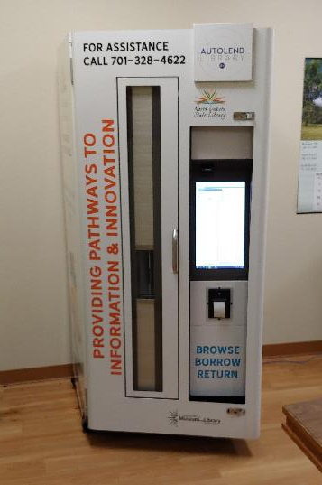
Notes:
Slope county, Amidon

Slide 19
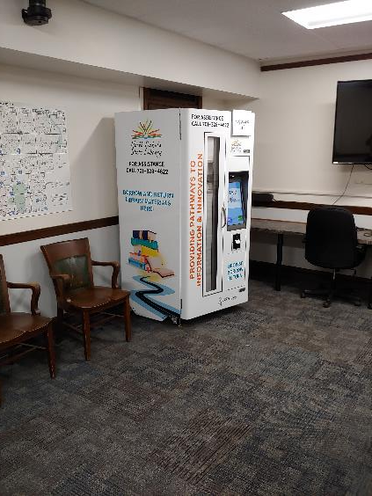
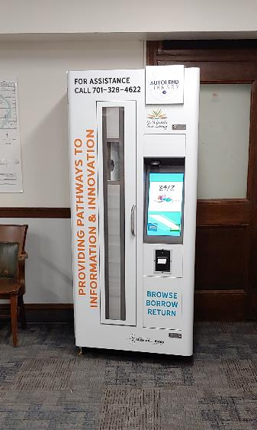
Notes:
Burke county, Bowbells

Slide 20
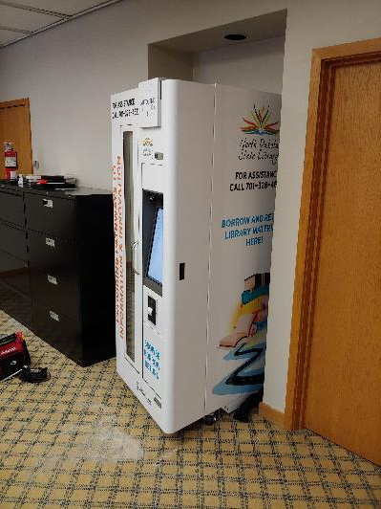
Notes:
Traill county, Hillsboro

Slide 21
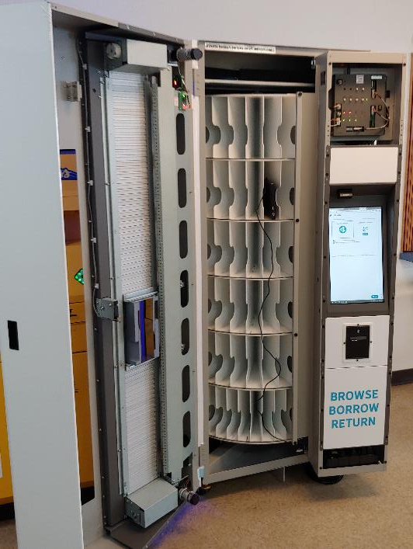
Notes:
Top five rows hold 36, bottom row holds 48 = 228
Model 1 is designed to accommodate the widest array of material sizes (in North America 95%). Model 1 has all the same height.
Model 2 has a combination of the current and shorter levels and has 8 shelves for a total of 322
Model 3 has a combination of shorter and taller levels and has 9 shelves for a total of 425.

Slide 22
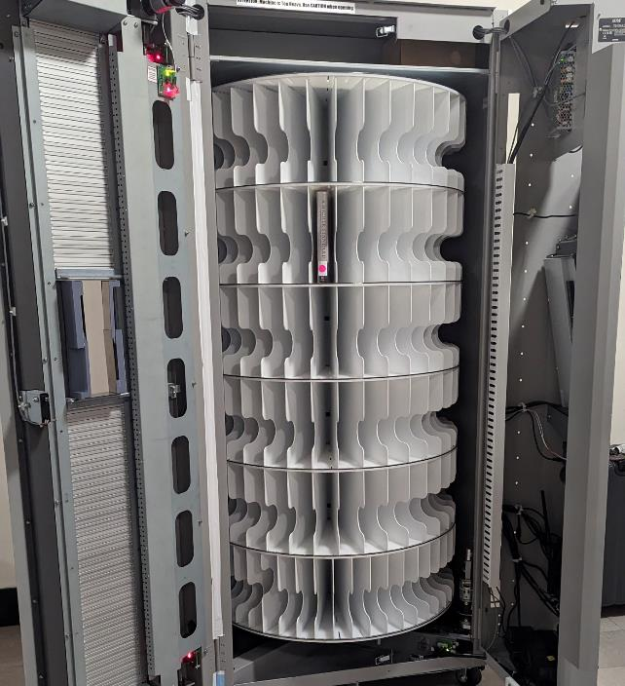
Notes:
Top five rows hold 36, bottom row holds 48 = 228
Model 1 is designed to accommodate the widest array of material sizes (in North America 95%). Model 1 has all the same height.
Model 2 has a combination of the current and shorter levels and has 8 shelves for a total of 322
Model 3 has a combination of shorter and taller levels and has 9 shelves for a total of 425.

Slide 23
So, what does it cost? And how did we pay for it?
Each machine was about $75,000
Total for ten machines with maintenance contract $759,400
Add an additional $140,000 for new books
Total project $ 901,863
The project was paid for by American Rescue Plan Act (ARPA) dollars from the Institute of Museum and Library Services (IMLS)

Slide 24
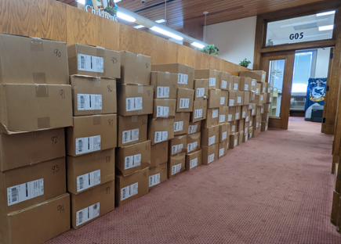
First delivery of books Did you know 4000 books weighs 2 tons?

Slide 25
Initial machine materials load
Machines hold 228 items. We load 225.
This includes 100 adult fiction and 50 adult nonfiction; 25 each of young adult, juvenile, and picture books.
The adult books were “opening day” selections – general high interest titles
The first order of 4000 books consisted of 5 copies of each title, the restock collection of an additional 4000 books is only two of each title.
All the children’s materials were taken from the existing collection at NDSL
We will adjust collection ratios as we learn what checks out most in each area.

Slide 26
Lessons learned, some the hard way Integrated library system (ILS)
Have a discussion with your ILS provider before starting the project.
Think about how you are going to categorize the machine. Is it a branch? Is it a workstation? Those decisions will affect what you can and cannot do when configuring the machine.
Make sure to get all the details when the vendor says, “we have some issues integrating with your ILS”. Be sure to get all the details and see what any workaround configurations look like beforehand.

Slide 27
Lessons learned, some the hard way Delivery
Who is doing the delivery and setup? Make sure you understand the difference between onsite, on the ground, and in the building.
Machine delivery is realistically a three person job if there are any kinds of obstructions, ramps, tight doorways, etc.
The machines are 800 lbs empty and tippy when pushing from the back. Once leveled and loaded, they are very stable. No, you cannot carry them up any steps.
Thoroughly check the machine packing before unwrapping, note any damage on the shipping documents. Thoroughly check the machine after unwrapping, note any damage to vinyl wrap, wheels and casters, leveling legs, and any dents. Take pictures to document.
Find out if the machines can be tilted and if so, how much. Yes, this matters.

Slide 28
Lessons learned, some the hard way Delivery, continued
Before you finalize a location, have someone on staff make an in-person inspection of the facility. Check the path from the outside to the final location. Be sure to measure all door openings (widths and heights), hallways, elevators…
Confirm there is electric in the desired location, confirm internet access via ethernet or a strong WiFi signal. Who pays to have electric and internet run to the location, if not currently there?
Find out from location host if they are willing to have their maintenance staff move automatic door openers, threshold plates, and other possible obstructions.
A door opening a ¼ inch too short will ruin your day. Ask me how I know.

Slide 29
Lessons learned, some the hard way Setup and getting started
Put barcodes on machine materials on the front, away from any ISBNs or UPCs. You may want to consider covering or blacking out any other barcodes. Patrons who are used to self-checkout at the grocery store will inevitably scan the wrong code.
Put all descriptions and how to’s in plain language. Do not assume patrons understand librarianese or how the circulation process actually works. Use pictures and graphics.
Make sure you can modify the patron interface to suit your local needs. Configuration is not one and done, it’s a constantly evolving process.
Make sure staff who might be answering patron questions have remote access and plenty of training for troubleshooting over the phone. Most questions are easy to answer if you know the sticking points in the process up front.

Slide 30
What should I consider next?

Slide 31
What should I consider next?
How long will it take to service machines. Include staff time to get materials ready to exchange.
Our machines are currently configured to hold a maximum of 228 items. We load 225, just in case.
When restocking, get a count of the number of items currently out and subtract that from the total you are planning on adding/exchanging.
If the location is more than 30-60 minutes away, see if the location host would be willing to have a key to open the machine in case internet access is lost and the machine needs to be manually restarted.
Driving two hours one way to push a reset button is not efficient use of staff time, especially if you have to do it three weeks in a row.
Notes:
Initial loading of a machine takes about an hour. Partial restocking time depends on number of items being swapped. Complete collection exchange is less than two hours. Complete exchange could take less time than a partial reload. You will not know actual timings until you do it several times.

Slide 32
Things to consider before you start this type of project.
Do you have enough staff to take on the project?
Who will be the project leader?
Do you have funding for the initial cost and more importantly the ongoing costs?
Will you have a dedicated “vending machine person” or will that be added to someone’s duties?
How often will you need to service machines? Daily, weekly, monthly, quarterly?

Slide 33
Things to consider before you start this type of project.
Will you create a dedicated vending machine collection or pull from your existing. What happens if someone want’s an item currently in a machine?
Will you allow hold pickup at the machine?
If the machine is offsite, do you have a “company car”. Can you use a city or county fleet vehicle? Will staff be using their own vehicle. Make sure you, staff, and impacted stakeholders know what each entails.
After you have confirmed a location, make sure you have a MOU (memoranda of understanding) or similar before you deliver a machine. In most public libraries that would be between the library board and the host location decision makers.
Identify alternate locations in the beginning. Sometimes the first location doesn’t work out. This also helps set things up for adding additional machines in the future.

Slide 34
Steve Hammel Patron Services Director North Dakota State Library shammel@nd.gov O: 701-328-4021

