Slide 1
Rapid Weeding
ODIN WORK DAY
April 27, 2023
Tuya Dutton
Image by https://pixabay.com/images/id-806073/
Notes:
Line spacing + Page numbers

Slide 2
Agenda
01 Circumstances
02 Deselection Criteria
03 Reports
04 Summary
05 Questions/Discussion

Slide 3
Circumstances
Notes:
2022 April – June (heavy rains): Flooding in the basement which created breeding ground for mold to grow on the drywall, on some of the wooden shelves and journals as well.
Communications with the Dean of UC and the campus PP department resulted in a larger scale clean up project to tare down the drywalls, remove deteriorated wooden shelves and sending weeded print journals to recycling.
This project involves library staff and student assistants, UJ sports teams, PP staff, a third-party construction contractors (Hillerud) and UJ faculty.
-The goal from the perspective of PP is to reduce the humidity accumulation in the basement by removing all drywalls and wooden studs and general decluttering of the basement space to prevent similar situations recurring.
-The goal from the perspective of the library is to withdraw print journals responsibly with establishing deselection criteria and meet the deadlines from PP so they can arrange the logistics (staffing, additional help, contractor timeline, project deadline) of the project.

Slide 4
Deselection
Physical Condition
Curricular Relevance
Holdings Coverage
Notes:
I established 3 main criteria to identify the titles for withdrawal
Serials in poor condition that is beyond reasonable preservation effort (active mold): library staff and students pulled out some of the worst water damaged journals and tagged boxes for journals for retention.
Curricular relevance – is the print journals meets the research needs of the students? I sought input from faculty as the specialists in their subject area. UJ faculty responded timely and gave valuable inputs to that made my job easier. I learned that some departments have very strong preference for online journals (nursing, Business, English), some faculty said that they usually recommend their student to use resources that were published within the last five years, few wanted to review the journals in-person (music, religion, biology) and they did .
We reviewed ODIN libraries holdings and online journal title duplications, so there is minimal coverage gaps when the print issues withdrawn.
Examples: Nation, Saturday evening post from online collections, American Journal of Psychology that has been withdrawn
Examples: serials relevant to ND and regional history is retained – American Historical Society of Germans from Russia, ND journal of education

Slide 5
Reports
OCLC: Query Collection Workflow, formerly Local Holdings Offline
https://help.oclc.org/Metadata_Services/WorldShare_Collection_Manager/Troubleshooting/Can_I_request_files_of_all_the_print_serial_holdings_for_our_library
ALMA: Look up Titles Analysis Report
https://knowledge.exlibrisgroup.com/Alma/Product_Documentation/010Alma_Online_Help_(English)/040Resource_Management/070Advanced_Tools/010Overlap_Analysis
Notes:
To gather data on holdings coverage we mainly used two reports that you can see on the screen.
We used the OCLC report because it was the easiest one for our cataloger to retrieve and manipulate data last year. This report gave us our local serials holdings information along with identifiers such as ISSN and OCLC number.
The report is in OCLC Worldshare/Metadata/
Our students helped us to look up other academic library holdings
ALMA: Look Up Titles Analysis Report

Slide 6
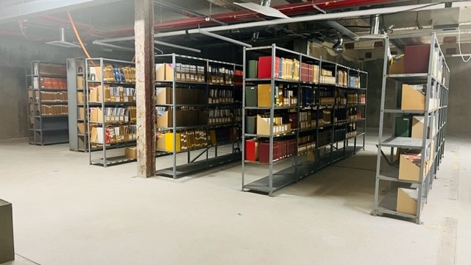
Summary
We are not done…
Reviewed over 800 serials records
Retaining less than 30%
Preference for online serials acquisition
Notes:
So, the initial conversation for the project started in 2022 May. We heard about the details of the clean up project in 2022 Fall. Removal of the journals started in 2022 November and wrapped up in 2023 January.
We have been re-arranging the periodicals stacks in the basement with help from PP staff, students from UJ’s leadership program students as well our library student workers. Library basement is gutted – open wide space now, no dry walls, no wooden shelves, only metal frame shelves.
We are not putting anything at the bottom shelves. We started reviewing our retention list and checking our serials records in ALMA.
We haven’t removed records from ALMA yet, they are moved into our WEED (Physical Titles/Location/WEED) – suppressed from discovery services.
We are hopeful to wrap up this project by end of the month.
Support for online resources from faculty and administration and moving forward acquire online journals and pilot options for PDA in the coming year or two.

Slide 7
Questions

