Slide 1
Polaris PAC Customization and Carousels
Improve the Catalog Discovery Experience

Slide 2
Overview of Topics Covered
Custom Search Limiters/Scopes
Expandable Menus with Custom Options
Overdrive Integration
Novelist Select
Kanopy Integration
Content Carousels
Messages for Logins and Notices
More Libraries (ILL requests)

Slide 3
Customizing the PAC

Slide 4
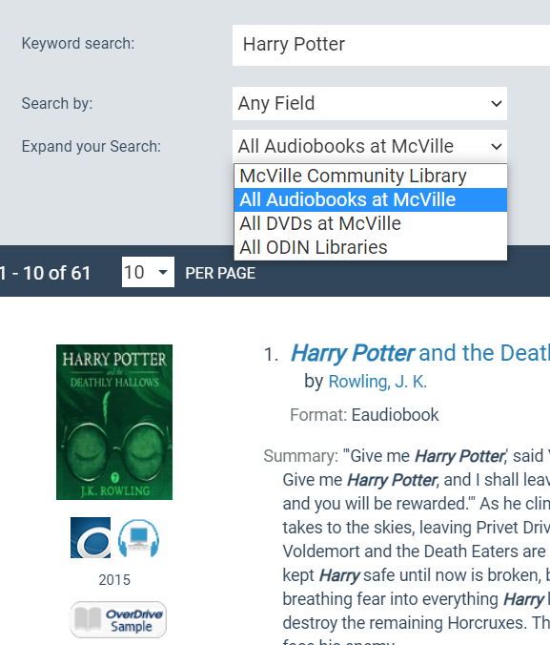
Custom Search Limiters/Scopes
Limit By or Expand the Search Scope
A few options:
  Material Type,
  Library (or Libraries),
  Audience
  Record Sets

Slide 5
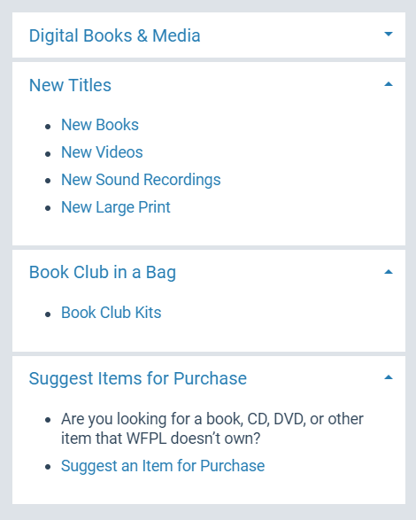
ExpandableSidebar Menus
Custom links and lists for a variety of things: Collections, Record Sets, Forms on Library websites, etc.

Slide 6
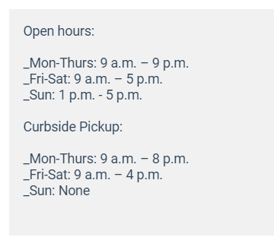
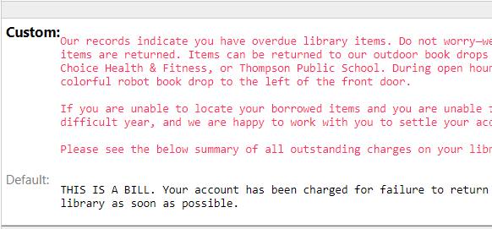
Customize Messages

Slide 7
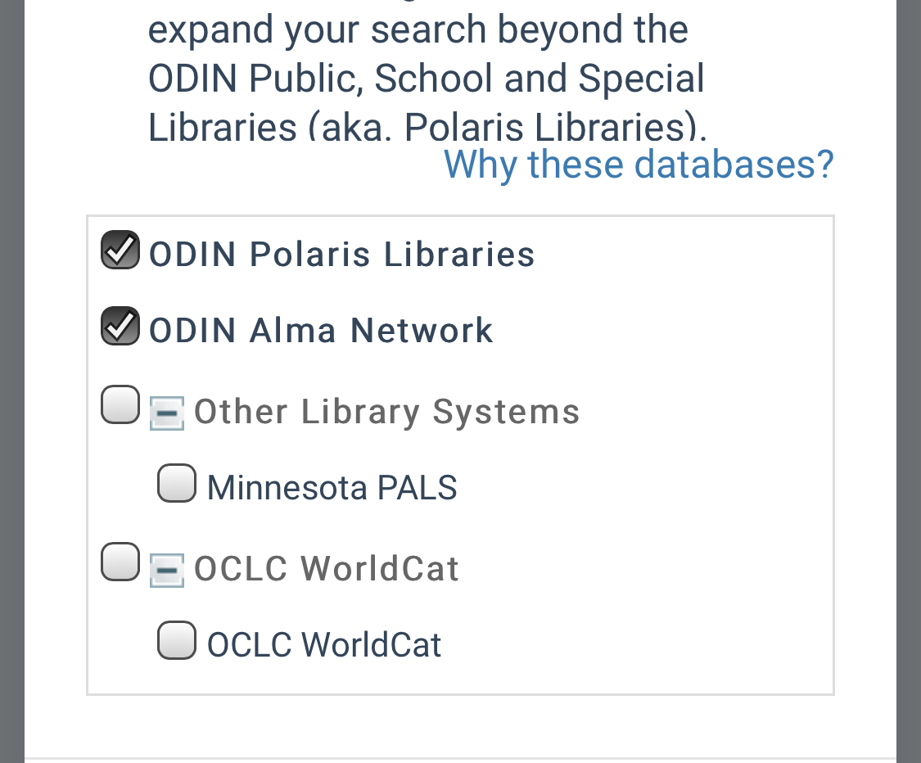
Searching beyond Polaris
Polaris allows for z39.50 searches from the PAC as well.
Use to help find and create better ILL requests

Slide 8
Custom Content Carousels

Slide 9
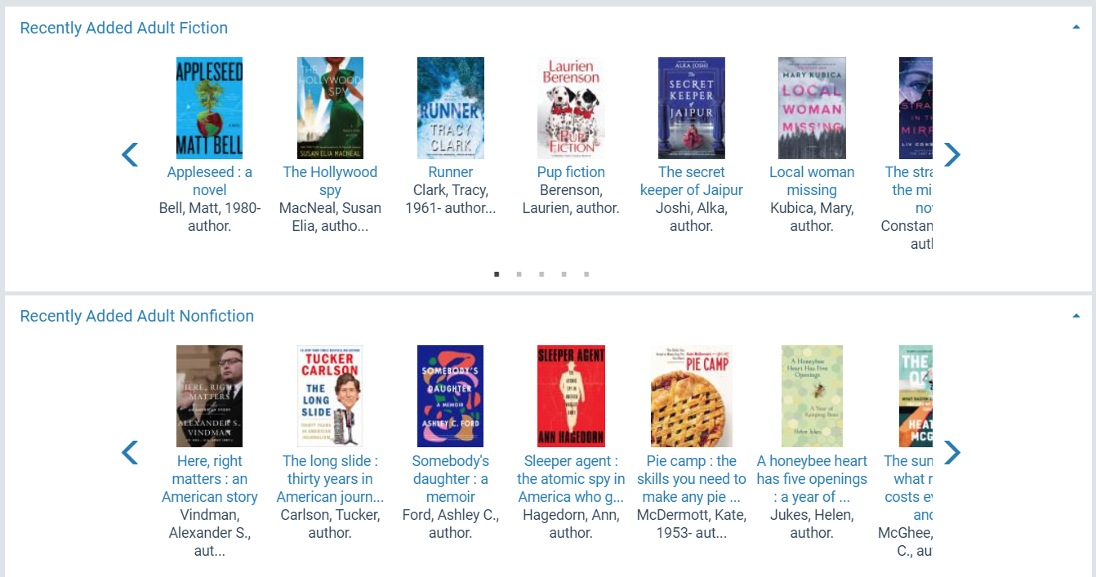
Content Carousels
Handful of Default Dashboard ones
Can be selected and curated by library staff using Bibliographic Record Sets
Can be added to a library’s website (iframe or api): http://www.dickinsonlibrary.org/new-items--adult-collections-12434

Slide 10
Initial Setup for Custom Carousels
Step 1
Search and filter
Step 2
Save as a “Power Search”
Step 4
Convert Item Set to a Bib Set
Step 5
Contact ODIN
Step 3
Save results to Item Record Set

Slide 11
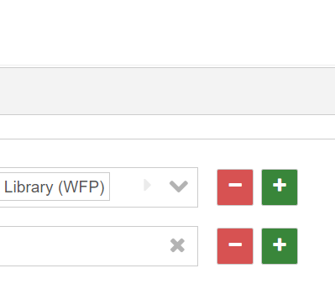
Search and Filter
Search for Items, putting in whatever filters and terms you want

Slide 12
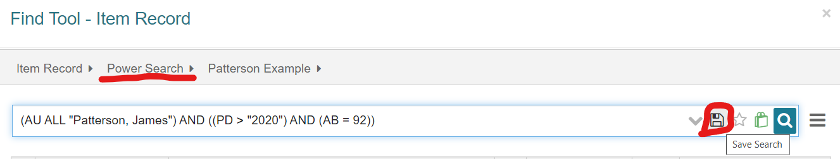
Power Search
When satisfied with the results, switch to “Power Search” and save the search for future use/updates

Slide 13
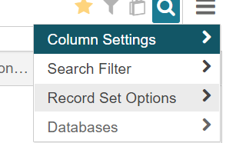
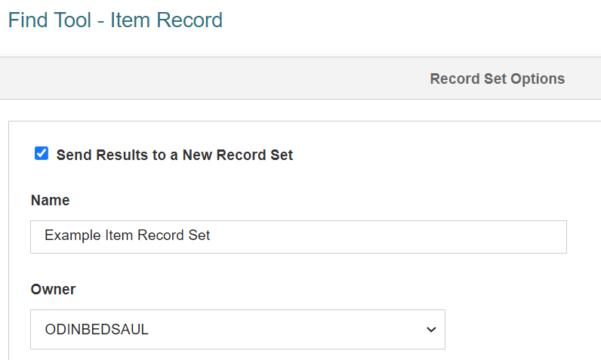
Item Record Set
Before running the search again, go under Record Set Options
Name the Item Set and check the “Send Results to a New Item Record Set”

Slide 14
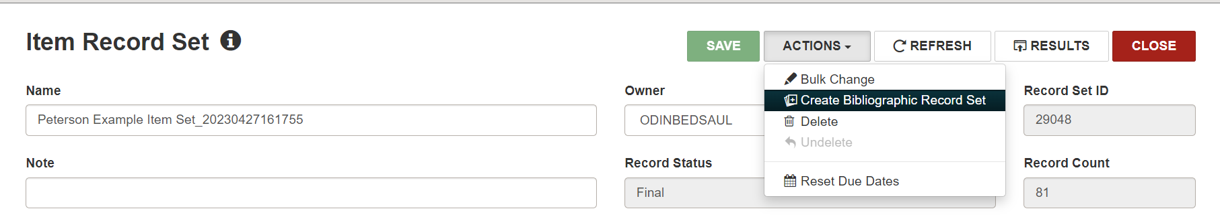
Bib Set
Create Bibliographic Record Set from the Item Record Set

Slide 15
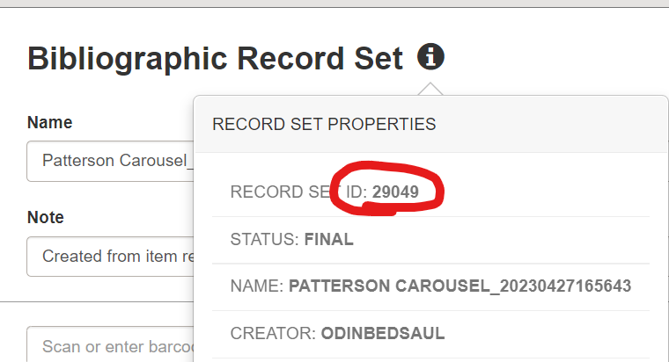
Send to ODIN
Tell us:
Record Set ID and Name
Name you would like it to Display As
Where in the order of the existing Carousels

Slide 16
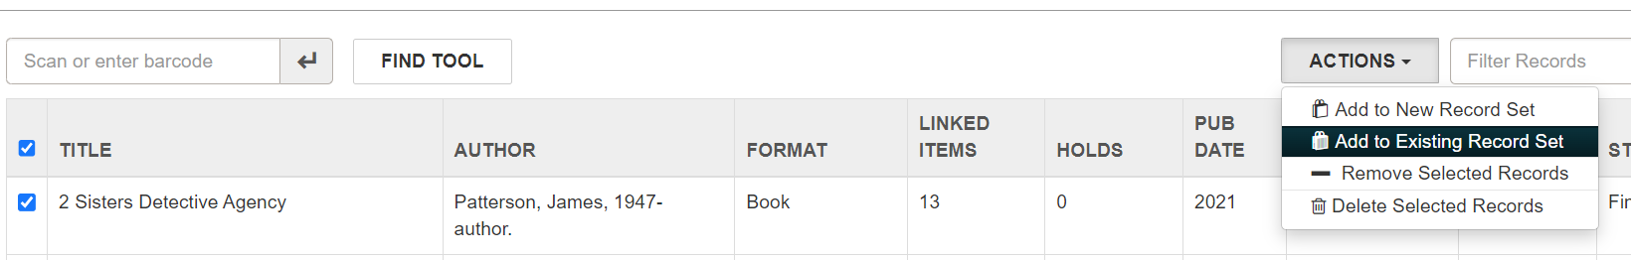
Updating the Carousels
Find Permanent Carousel Bib Set and remove bibs you no longer want
Update the Power Search Parameters
Repeat Steps 3-4 (Item Set -> Bib Set)
Select all from new Bib Set and add to Permanent Carousel Bib Set

Slide 17
3rd Party Integrations

Slide 18
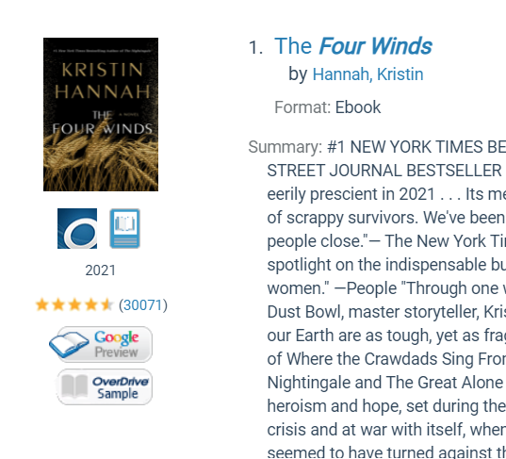
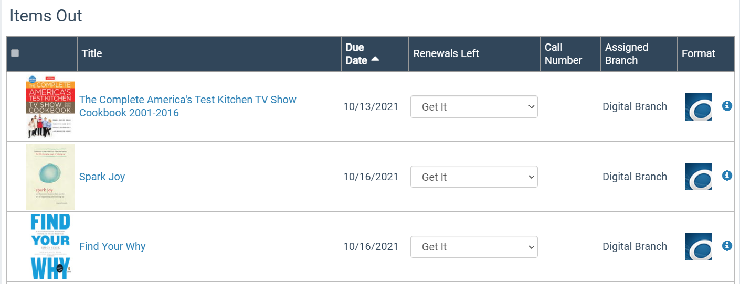
Overdrive
Overdrive in a Search
Overdrive in the Patron Account

Slide 19
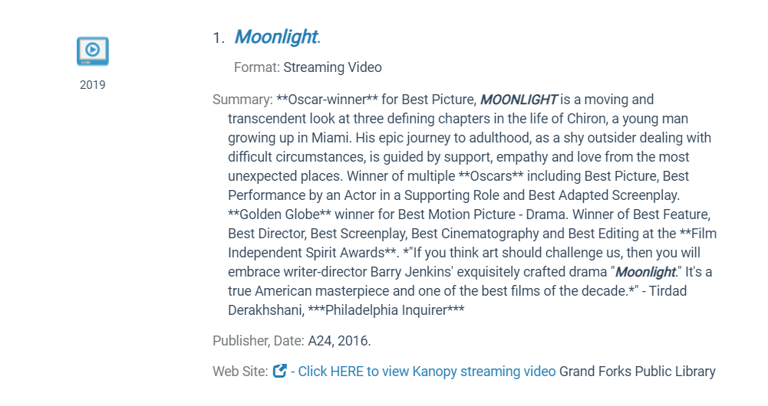
Kanopy
Displays a custom link directly to the streaming video

Slide 20
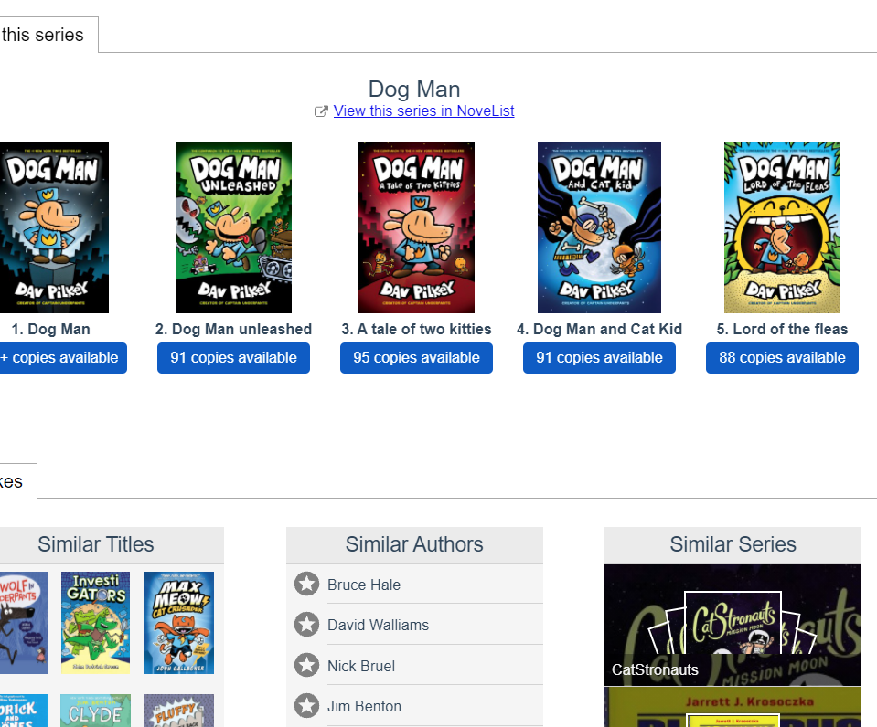
Novelist Select
Add on Enrichment
Pulls in Reviews
Series titles
“Like” series/titles
Lexile levels

