Slide 1

Notifications & Customizations
Presented by: Ginny Millette & Lynn Wolf

Slide 2
Here is the notices we are going to address today
Overdue – First Overdue notice
Hold Request
Hold Cancellation
Fine
Reminder for Almost overdue/Auto-renew
Reminder for patron record expiration
Reminder for Inactive patron
Reminder for Missing Part notice

Slide 3
Example
1st Overdue letter

Slide 4
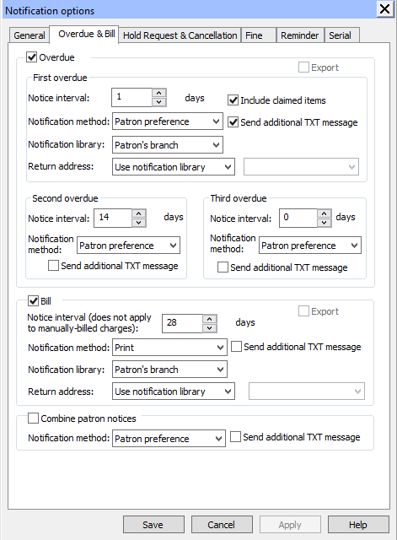

Slide 5
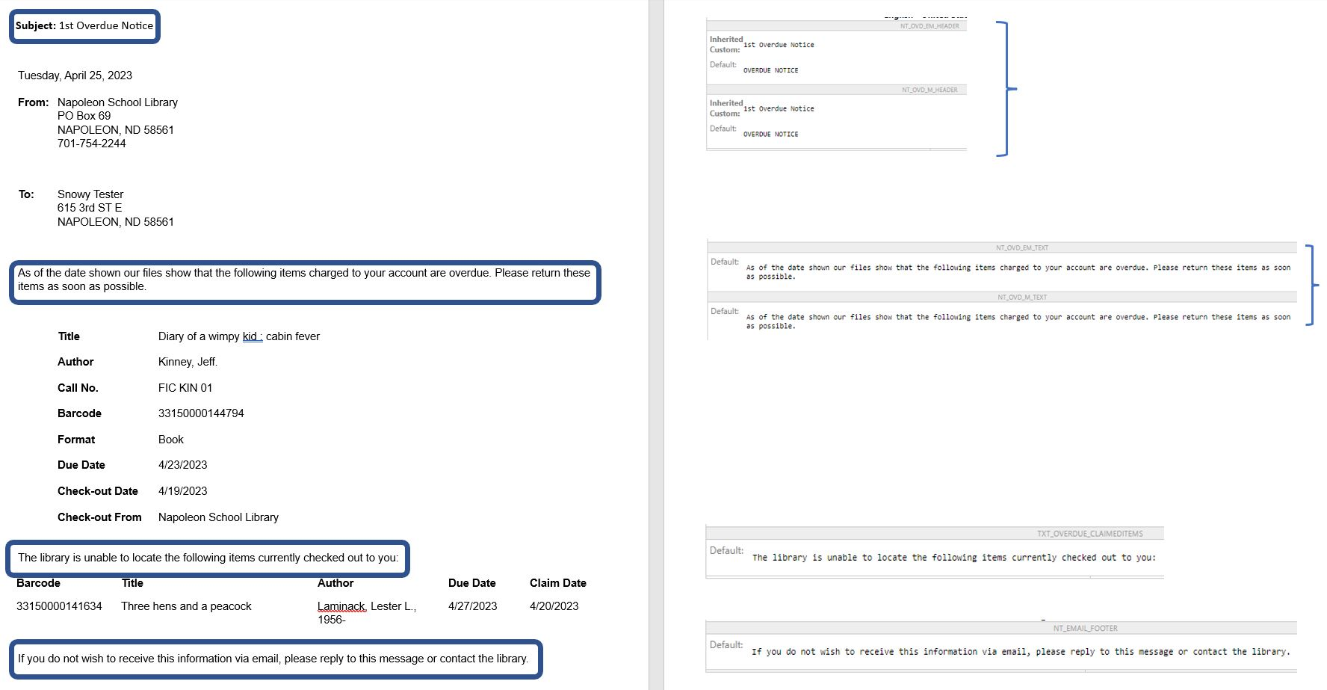

Slide 6
Example
Hold request
Monday, April 24, 2023
From:
Napoleon School Library PO Box 69 NAPOLEON, ND 58561 701-754-2244
To:
Snowy Tester 615 3rd ST E NAPOLEON, ND 58561
The following items are being held for you at the library. Please pick the items up on or before the date indicated.
Title | Author | Format | Call No. | Barcode | Held Until:
Go, Goofy, go! | Higginson, Sheila Sweeny, 1966- | Book | ER FIC DIS 01 | 33150000104822 | 5/1/2023
If you do not wish to receive this information via email, please reply to this message or contact the library.
Subject: Requested items are ready for you

Slide 7
Example
Hold Cancellation

Slide 8
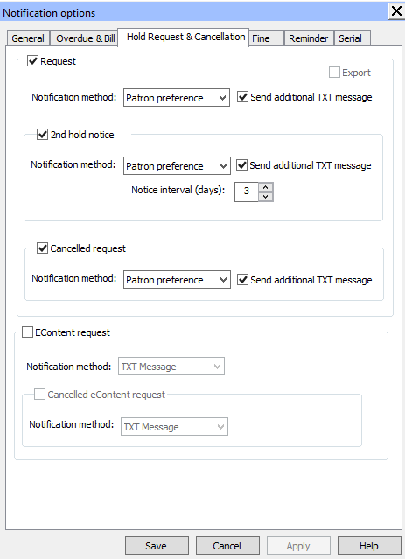

Slide 9
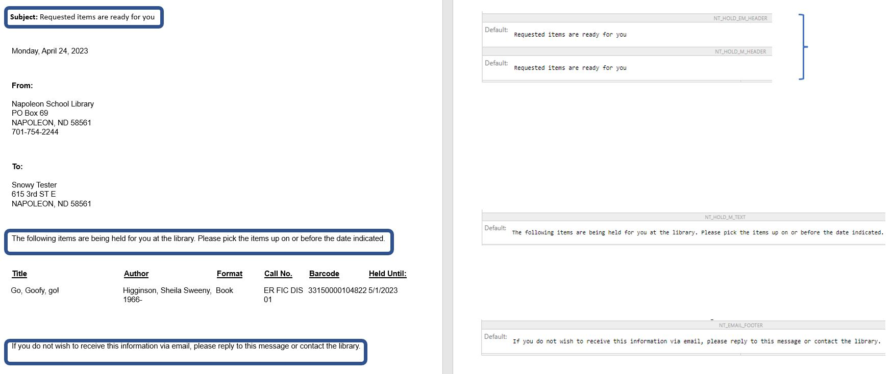

Slide 10
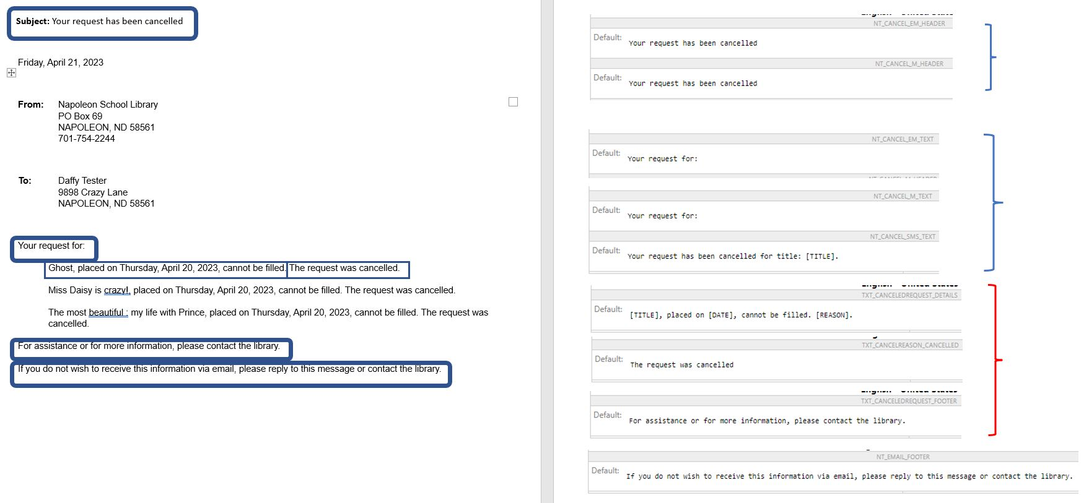

Slide 11
Example
Fine letter
Subject: FINE NOTICE
Friday, April 21, 2023
From:
Napoleon School Library PO Box 69 NAPOLEON, ND 58561 701-754-2244
To:
Summer Tester 114 Central Ave NAPOLEON, ND 58561
Our records show an outstanding fine balance on your account. Please contact the library as soon as possible to resolve these fines.
Call No. | Author | Title | Txn Date | Amount
ER FIC LEG 01 | King, Trey. | Last laugh! | 4/20/2023 | $34.99
 |  |  | Total Due | $34.99
If you do not wish to receive this information via email, please reply to this message or contact the library.

Slide 12
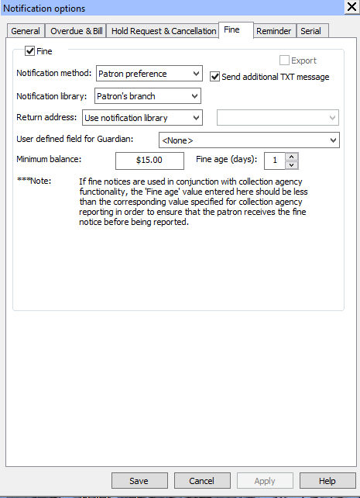

Slide 13
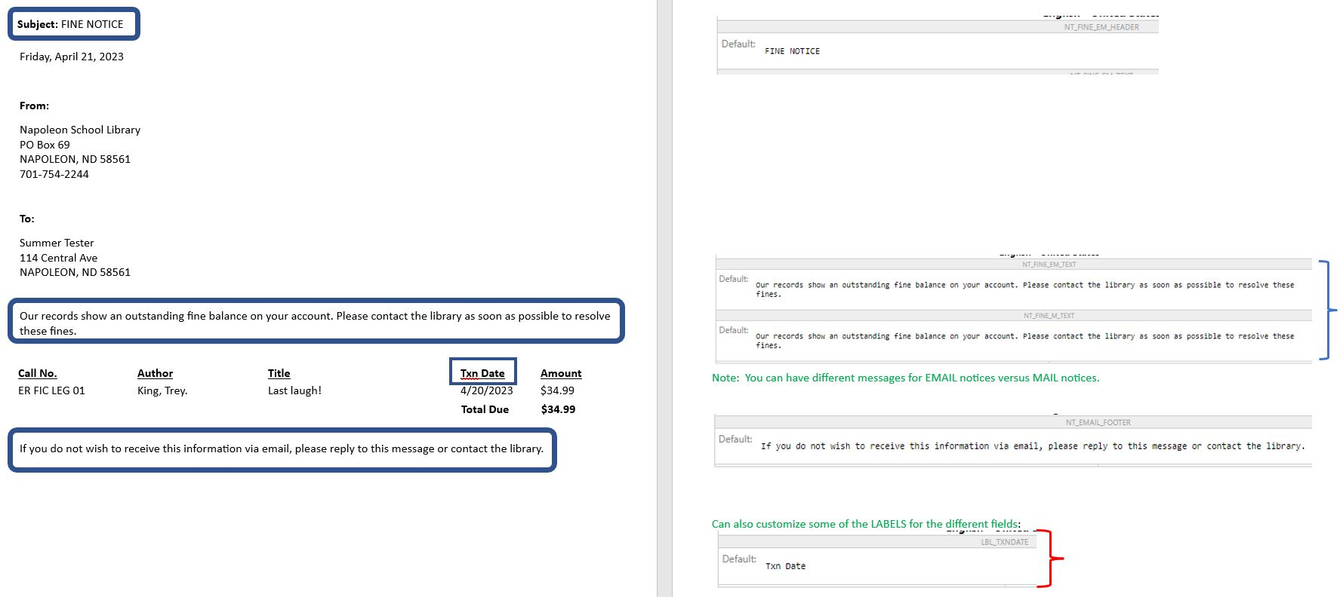

Slide 14
Example
Reminder letter

Slide 15
Example of Reminder of card expiring
Subject: Your library membership will expire soon
From:
Napoleon School Library
PO Box 69
NAPOLEON, ND 58561
701-754-2244
To:
Summer Tester
114 Central Ave
NAPOLEON, ND 58561
Your library membership will expire in 10 day(s). You can renew your membership by calling the library during business hours.
Home Address
114 Central Ave
NAPOLEON, ND 58561
Phone Number
701-792-6283
E-mail Address
virginia.millette@ndus.edu;lynn.wolf@ndus.edu
If you do not wish to receive this information via email, please reply to this message or contact the library.

Slide 16
Example
Missing part

Slide 17
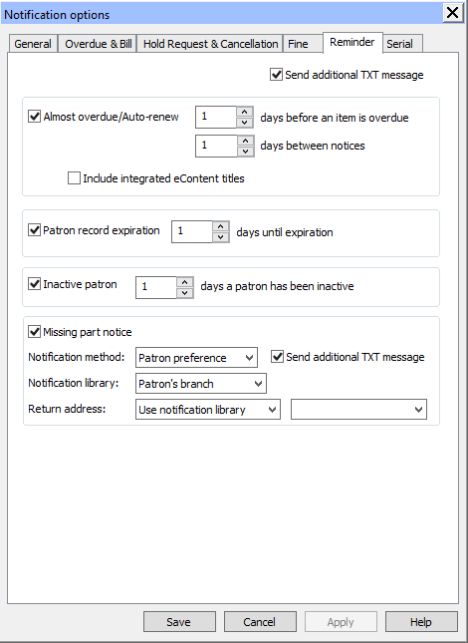

Slide 18
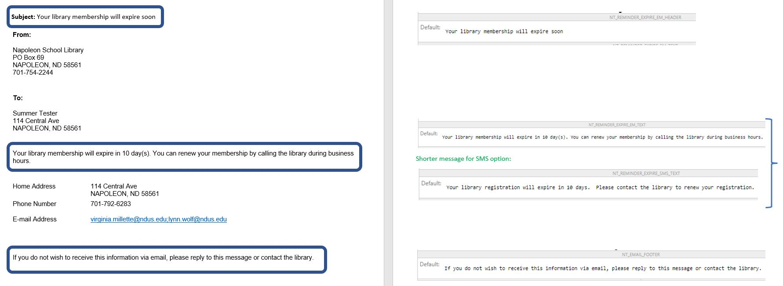

Slide 19
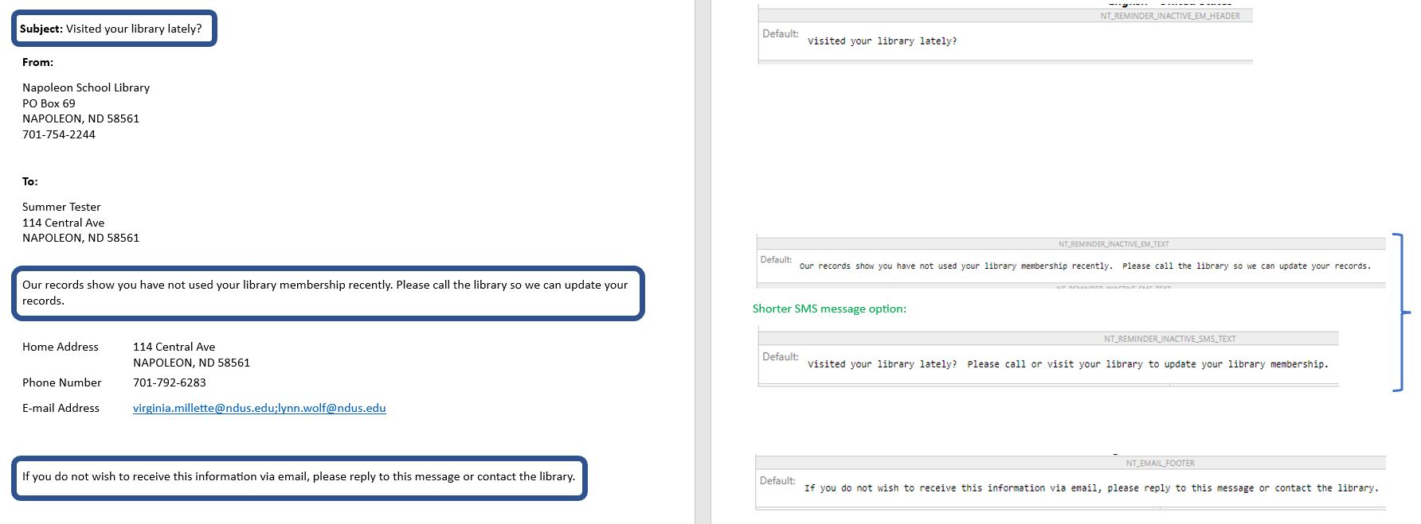

Slide 20
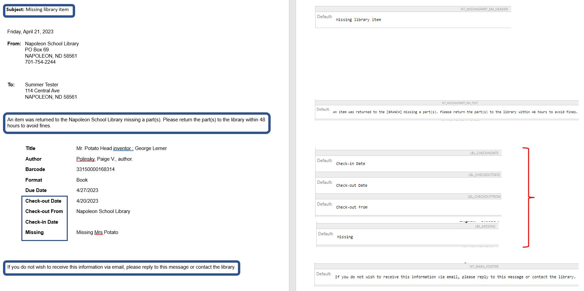

Slide 21
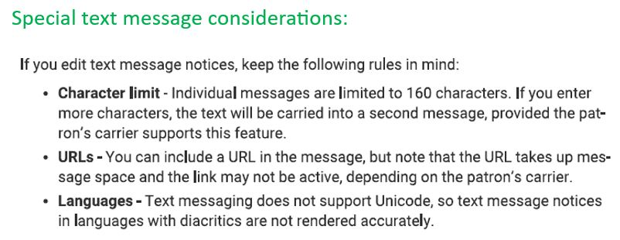

Slide 22
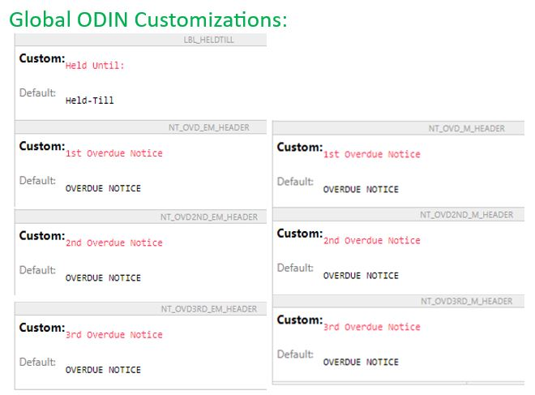

Slide 23
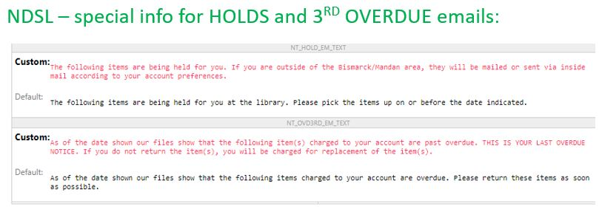

Slide 24
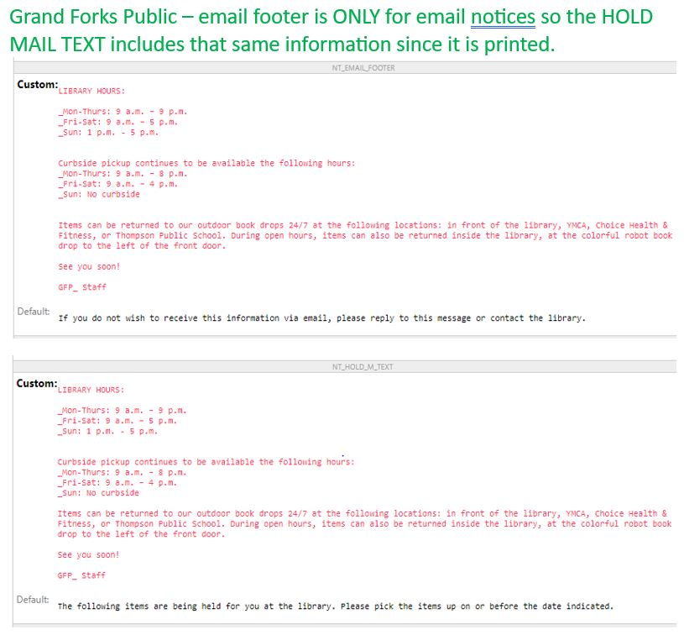

Slide 25
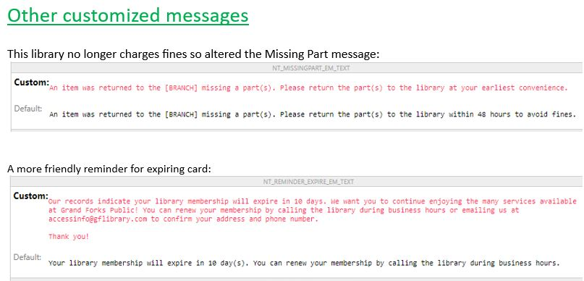

Slide 26
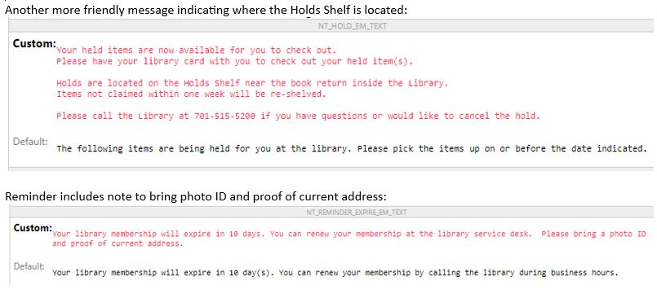

Slide 27


