Slide 1
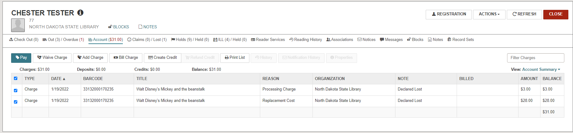
Payment Procedures for a Lost Transfer Item
When a patron pays for a lost item that was transferred from another PK12, here are the steps to ensure that the lending library know which item was paid for.
*You may need to contact the library to confirm charges for lost item.
Ex. NDS library patron has lost an item borrowed from Leach Public Library
This patron has lost an item from Leach Public Library. North Dakota State Library staff have accessed the replacement cost, based on the replacement cost of the item provided by the lending library. Also a processing fee is being added per policy of the lending library. We added a note stating which library was owed the money. This will aid in tracking payments to the lending library.

Slide 2
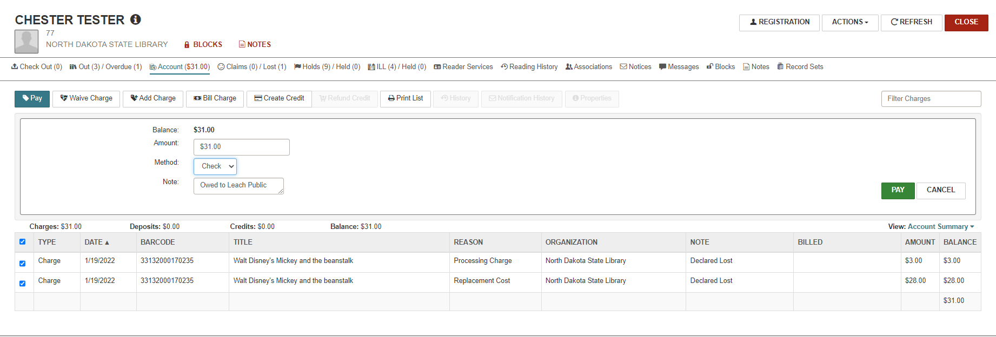
To pay for the item, simply click the Pay button. The billing will display.
Please add a note stating which library was owed the money.
Click on Pay button on the Charges page to complete the transaction.

Slide 3
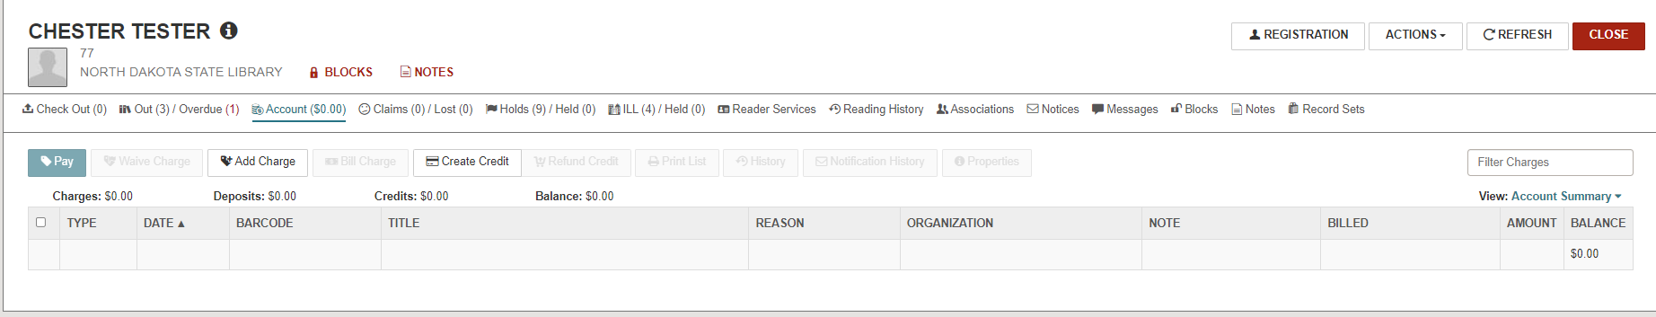
Now that the item is paid for, the charges are taken off the patron record. At this point, the item shows in the catalog as LOST but the charge has been removed. As the borrowing library, you have a payment for the item and your patron has a clear account on their patron record.

Slide 4
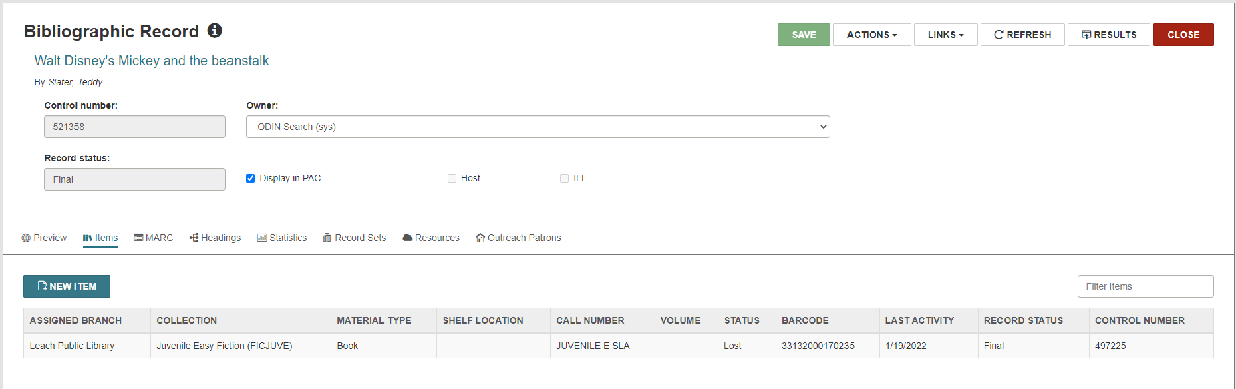

Slide 5
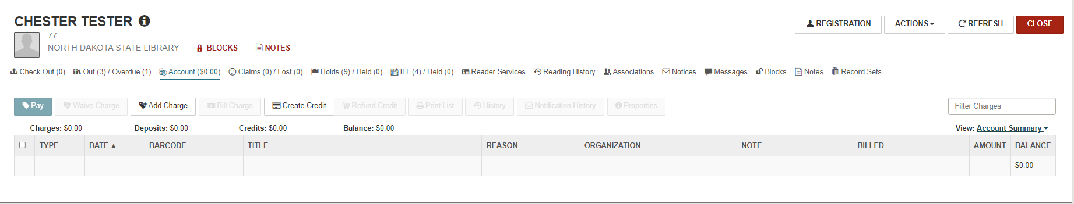
Now we need to pay the lending library.
Locate the Account Summary on the patron’s record.

Slide 6
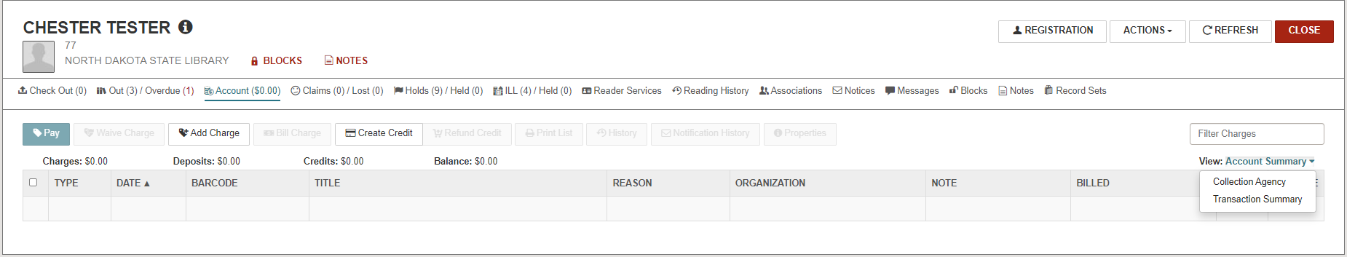
Then choose Transaction Summary from the menu.

Slide 7
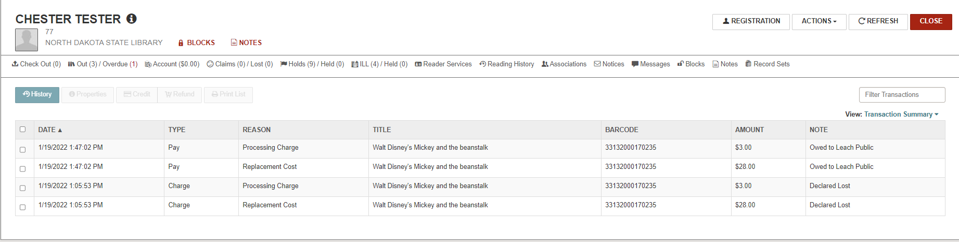
This will give you a listing of all transaction associated with this account.
This includes billings, payments, lost items, lost item found, etc.

Slide 8
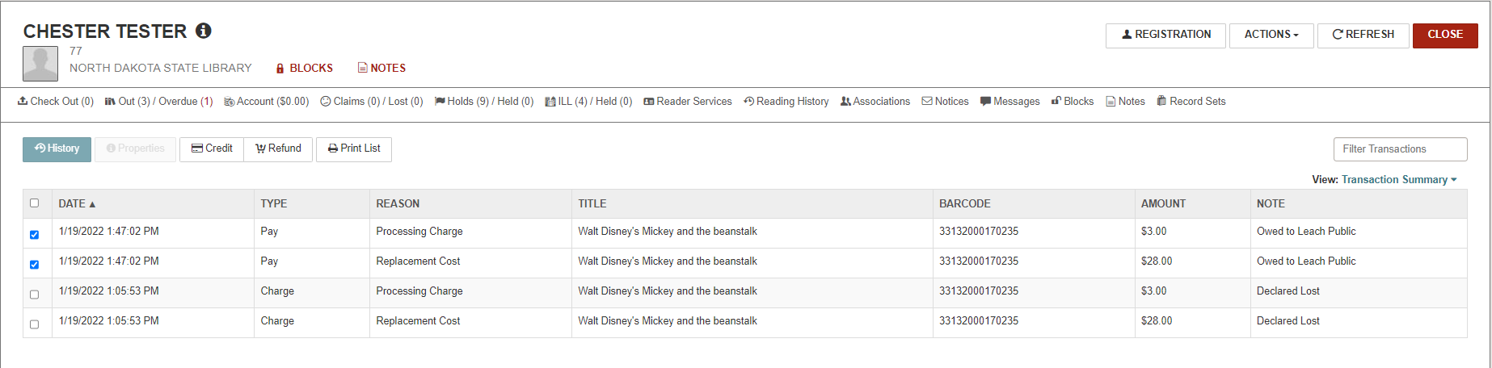
Select the payment(s) for the item that the patron paid for. Click on Print List. This printout will provide enough information that the lending library can process this lost book, whether they decide to replace it or withdraw it.

Slide 9
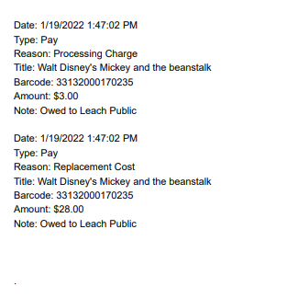
Use this sheet to wrap around the check, for example fold the payment summary sheet into threes and place the sheet and the check in an envelope and mail it to the lending library.
Please send the payments to the contact located on the ODIN Website.
https://www.odin.nodak.edu/libraries/members
Choose the library and the click on Library Details and go to the ILL Information tab.

