Slide 1
New Unified PO Line Task List
Yoel Kortick
Senior Librarian

Slide 2
Agenda
Introduction
The Menu
Task List as Facets
Existing Task List Menu Links for PO Line Task Lists
Multi-Select Facets
Sensitive Top List Actions
Clear Information Hierarchy
Presentation Toggle Button
Split View (Side By Side View)
Slide-Out Panel
Receiving Items from within the PO Line
PO Line Actions Sensitive to Workflow Step
The "Items In Claim" Section
The clickable "Sent" Status

Slide 3
Introduction

Slide 4
Introduction
In addition to this presentation see also The New Unified PO Line Task List.
The New Unified PO Line Task List is part of a larger improvement initiative under the umbrella of "an enhanced user experience across Alma navigation".
This initiative is a result of cooperation with Alma working groups and a response to the wider community feedback.
For more information regarding this larger initiative, see Usability Improvements.

Slide 5
The Menu

Slide 6
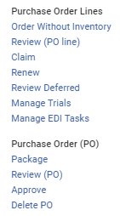
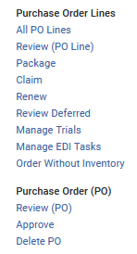
The new menu
Existing menu
New menu
A new entry "All PO Lines" has been added to "Purchase Order Lines"
"Package" has been moved from "purchase Order (PO)" to "Purchase Order Lines"

Slide 7
Task List as Facets

Slide 8
Task List as Facets
The presentation of the various assignment options as facets (Unassigned, Assigned to me, Assigned to others) enables the user to search for PO lines and immediately work on them (without the extra step of "Go to task list").
After selecting "Acquisitions > Purchase Order Lines > All PO Lines" there is a list of all PO Lines and facets by assignment.
The new "All PO lines" menu link allows the staff user to view all PO lines of all types and workflow steps (statuses).

Slide 9
Task List as Facets
New faceted task list

Slide 10
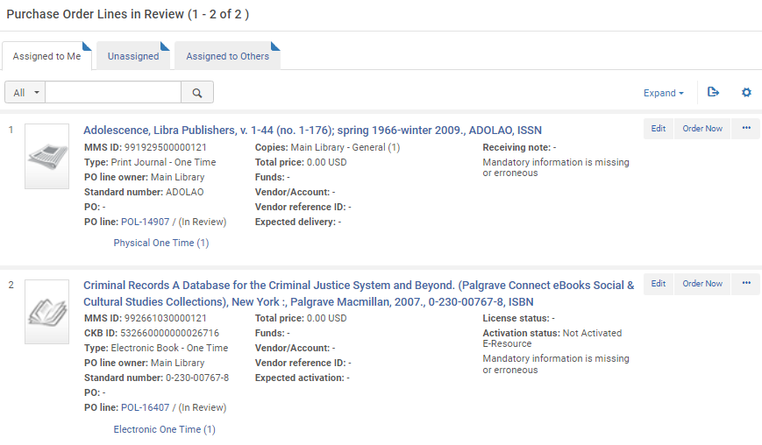
Task List as Facets
Existing tabbed task list

Slide 11
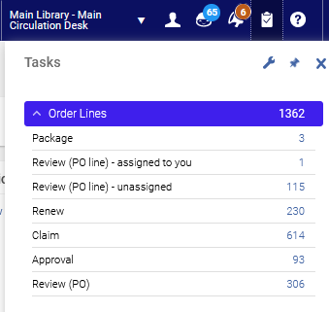
Task List as Facets
The new PO Line task list also appears when accessing from the task list in the upper right menu
For example, we will choose "Review (PO Line) – unassigned"

Slide 12
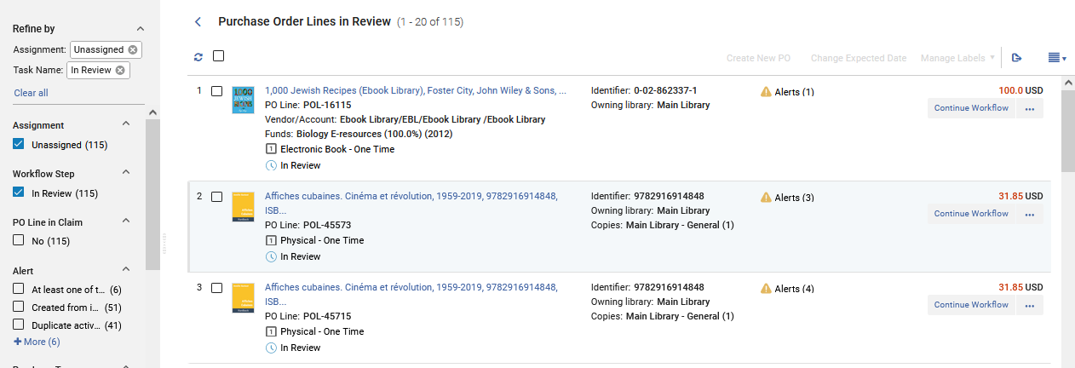
Task List as Facets
Because we chose "Review (PO Line) – unassigned" it is pre-faceted by "Assignment: Unassigned" and "Task Name: In Review"

Slide 13
Existing Task List Menu Links for PO Line Task Lists

Slide 14
Existing Task List Menu Links for PO Line Task Lists
Existing Task List Menu Links for PO Line Task Lists remain and navigates the user to the new unified task list with the relevant facets pre-selected.
These include:
In-Review
Package
Renew
Review Deferred

Slide 15
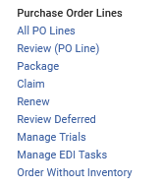
Existing Task List Menu Links for PO Line Task Lists

Slide 16
Existing Task List Menu Links for PO Line Task Lists
In Review
When we click "Review (PO Line)" we get the same list as if we clicked "All PO Lines" but it is pre-faceted by:
Assignment: Assigned to Me
Task Name: In Review

Slide 17
Existing Task List Menu Links for PO Line Task Lists
(I am logged in as Alicia Chen)

Slide 18
Existing Task List Menu Links for PO Line Task Lists
Package
When we click "Package" we get the same list as if we clicked "All PO Lines" but it is pre-faceted by:
Task Name: Manual Packaging

Slide 19
Existing Task List Menu Links for PO Line Task Lists

Slide 20
Existing Task List Menu Links for PO Line Task Lists
Renew
When we click "Renew" we get the same list as if we clicked "All PO Lines" but it is pre-faceted by:
Task Name: Waiting for Manual Renewal

Slide 21
Existing Task List Menu Links for PO Line Task Lists

Slide 22
Existing Task List Menu Links for PO Line Task Lists
Review Deferred
When we click "Review Deferred" we get the same list as if we clicked "All PO Lines" but it is pre-faceted by:
Assignment: Assigned to Me
Task Name: Deferred

Slide 23
Existing Task List Menu Links for PO Line Task Lists

Slide 24
Multi-Select Facets

Slide 25
Multi-Select Facets
PO line search results are presented in a single page, holding all the various PO line statuses and tasks.
After selecting "Acquisitions > Purchase Order Lines > All PO Lines" there is a list of (as the name suggests) all PO Lines.
All PO Lines can be faceted by a myriad of areas.

Slide 26
Multi-Select Facets
The staff user can facet by all PO Lines by
Assignment
Workflow Step
PO Line in Claim
Alert
Purchase Type
Vendor
Rush
Owning Library
Assigned User
Acquisition Method
Reporting Code

Slide 27
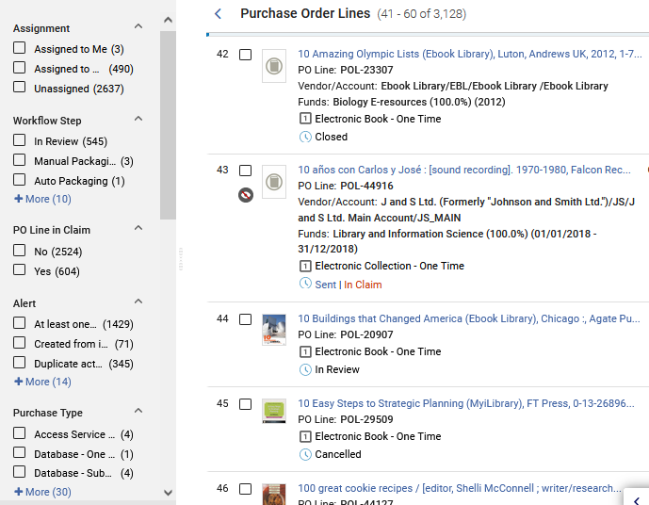
Multi-Select Facets

Slide 28
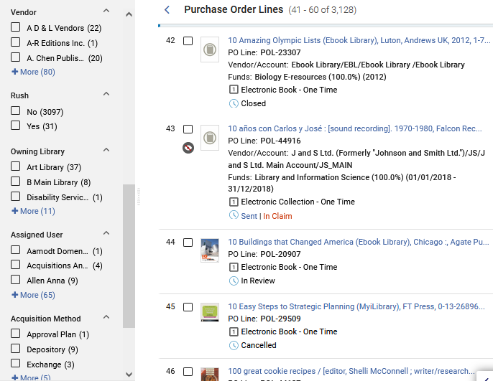
Multi-Select Facets

Slide 29
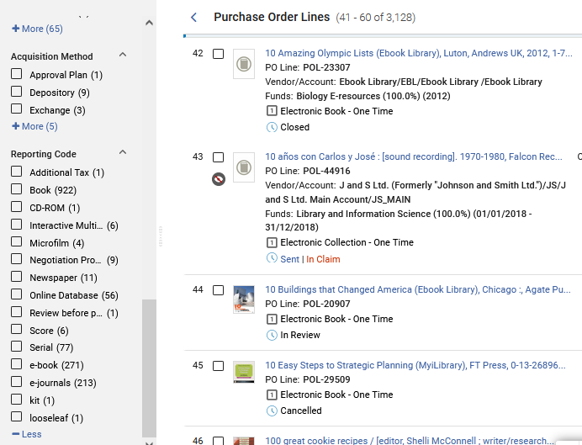
Multi-Select Facets

Slide 30
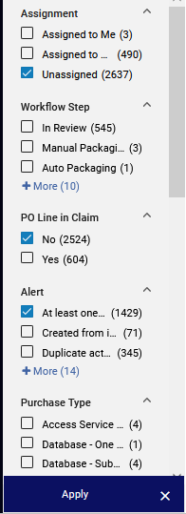
Multi-Select Facets
Multiple facets can be chosen simultaneously and then applied, allowing the staff user to arrive to a very specific group of PO Lines.
Apply the facets

Slide 31
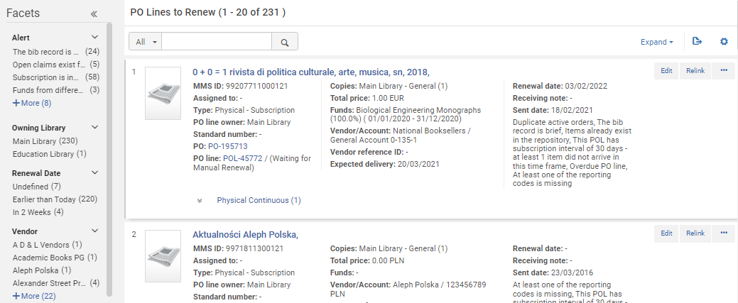
Multi-Select Facets
In the old PO Line list only one facet could be clicked (selected) at a time
Can only click one facet at a time

Slide 32
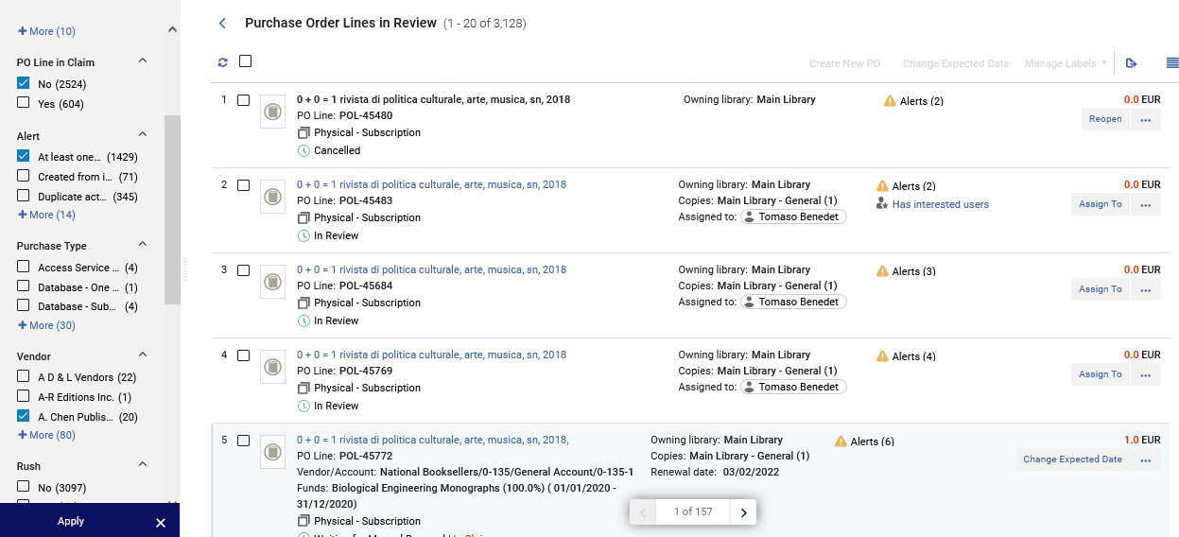
Multi-Select Facets
In the new PO Line list multiple facets can be selected and applied at once
Can choose multiple facets at a time
Apply the facets

Slide 33
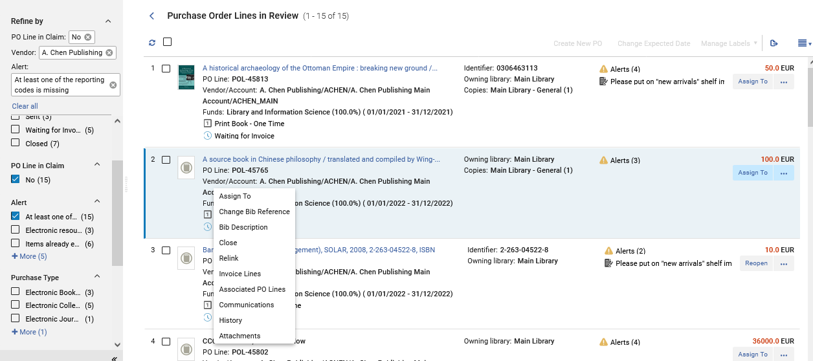
Multi-Select Facets
All three facets have been applied

Slide 34
Multi-Select Facets
On the next slide, for example, we have faceted by all PO Lines which are
Unassigned
Not in claim
For vendor "A. Chen Publishing"
In workflow step "Sent"

Slide 35
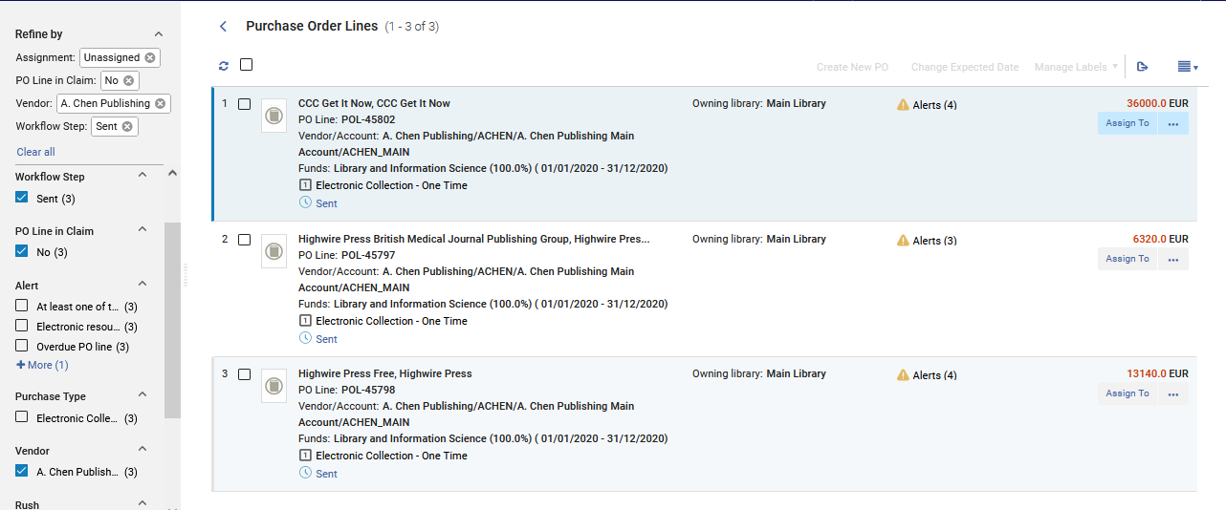
Multi-Select Facets

Slide 36
Sensitive Top List Actions

Slide 37
Sensitive Top List Actions
The actions presented on top of the search results list ("Create New PO", "Change Expected Date" and "Manage Labels") are sensitive to the selection of the user.
When one or more PO lines are selected, the top list actions are enabled.
The list actions are:
Create new PO - This action allows packaging multiple PO lines for which their workflow step is "Manual-Packaging" into a PO.
Change Expected Date - This action allows modifying multiple the PO lines and setting their "expected receipt date".
Manage Labels - This action allows the user to add/remove labels from multiple PO lines at once.

Slide 38
Sensitive Top List Actions
In a situation in which the staff user selects to run an operation on a PO line which does not support the specific action (for example "Create New PO" for PO line in workflow step is not "Manual Packaging") the operation will skip this PO line and an appropriate message will appear.
We will see this soon.

Slide 39
Sensitive Top List Actions
Here we see that no POLs are selected so the "Top List Actions" are not active
Actions are not active

Slide 40
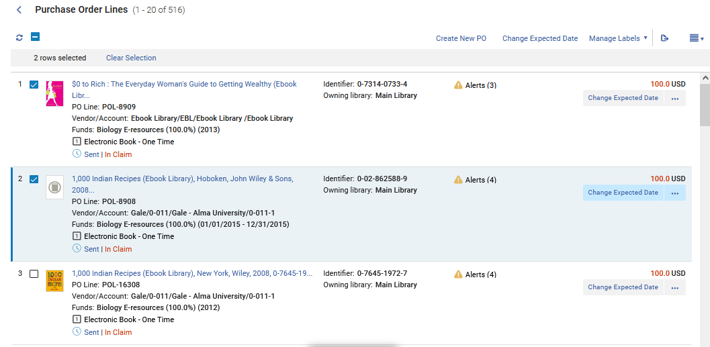
Sensitive Top List Actions
Now one or more POLs are selected so the "Top List Actions" are active

Slide 41
Sensitive Top List Actions
Now we will perform the action "Create New PO" on two PO Lines.
One is in workflow step "Manual Packaging", and one is in workflow step "Sent".

Slide 42
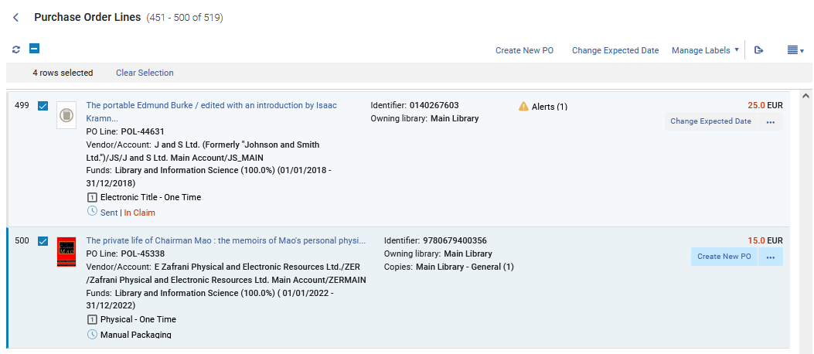
Sensitive Top List Actions

Slide 43
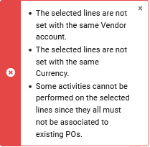
Sensitive Top List Actions
We receive an explanatory message that a new PO could not be created for all PO Lines.

Slide 44
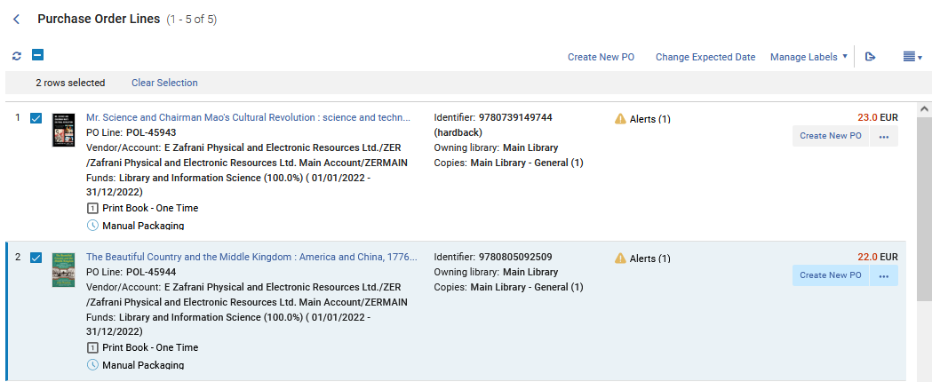
Sensitive Top List Actions
Now we will choose two different POLs and again click "Create New PO"

Slide 45
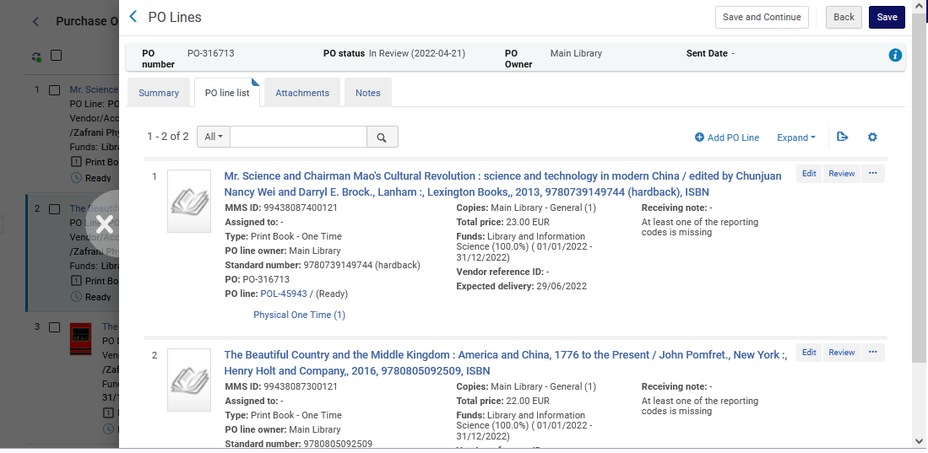
Sensitive Top List Actions
A new PO is created with both PO Lines. It appears in the "Slide-Out Panel" (which we will talk about later)

Slide 46
Clear Information Hierarchy

Slide 47
Clear Information Hierarchy
The New Unified PO Line Task List contains a clearer and more prominent information hierarchy of the PO line search results.
This enables Acquisitions staff users who are reviewing the PO line's search results list to find what they need faster and with less navigation needs.

Slide 48
Clear Information Hierarchy
Separation between the PO line's identifier and status.
Old
Identifier and status on one line
New
Identifier and status on two separate lines

Slide 49
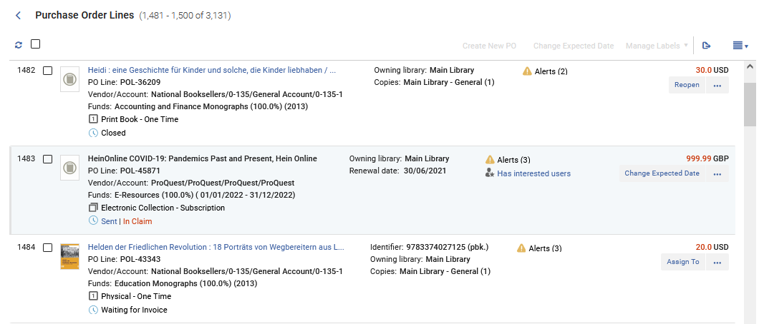
Clear Information Hierarchy
Permanent location for the PO line's type and status.

Slide 50
Clear Information Hierarchy
Fixed location to the PO line's price (on top of the main record action).

Slide 51
Clear Information Hierarchy
Fund and vendor (first column) provides staff overview on mandatory information.

Slide 52
Clear Information Hierarchy
Addition of icons for Alerts, Receiving note, and Rush improves the user's ability to quickly focus on the needed information within the PO line record.

Slide 53
Clear Information Hierarchy
Hovering on the receiving note shows the full note without needing to "enter" the PO Line.

Slide 54
Clear Information Hierarchy
PO Line Assignment Status
As the new PO line list supports assignment functionality for all types of PO lines (excluding PO lines in "Closed" and "Cancelled" workflow steps), a clear indication on the PO line record enables users to quickly understand the PO line assignment status:
"Assigned to Me" PO lines will have a dark grey badge indicating to the user that the PO line is assigned to them
"Assigned to Others" PO lines will have a white badge indicating to the user that the PO line is assigned to another user
"Unassigned" PO lines will have no indication badge

Slide 55
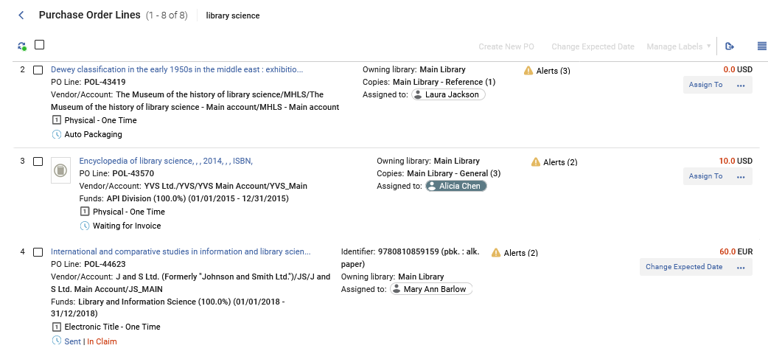
Clear Information Hierarchy
White Badge means "Assigned to another user"
Dark Grey Badge means "Assigned to me". (I am logged in as Alicia Chen).

Slide 56
Presentation Toggle Button

Slide 57
Presentation Toggle Button
The presentation toggle button is located on the top right corner of the page and enables users to determine the way the PO line is presented on the screen.
This allows users to work in the best way that suits their specific individual needs.

Slide 58
Presentation Toggle Button
There are three presentation options:
List view - presents the full list of PO lines in a single panel
Split view - presents the full list of PO lines on one side and more information about the selected PO line on the other side. Split view presentation can also be triggered by simply clicking on one of the PO lines presented in the full list. Users can determine the width of the left / right panel by selecting one of the 3 pre-set options or by clicking and dragging the vertical separator ruler to the right or to the left (vertical ruler separates between the left and right panels).
Full Page view - the presentation in this selection presents a specific PO line in full view.

Slide 59
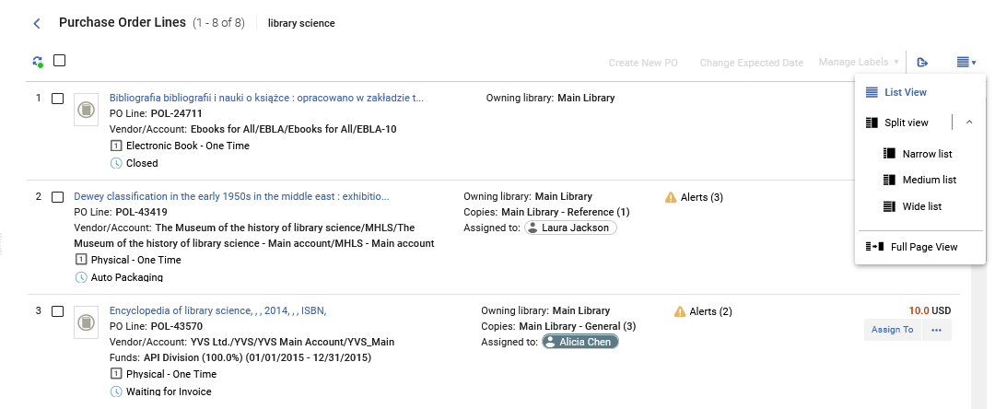
Presentation Toggle Button
Presentation Toggle Button

Slide 60
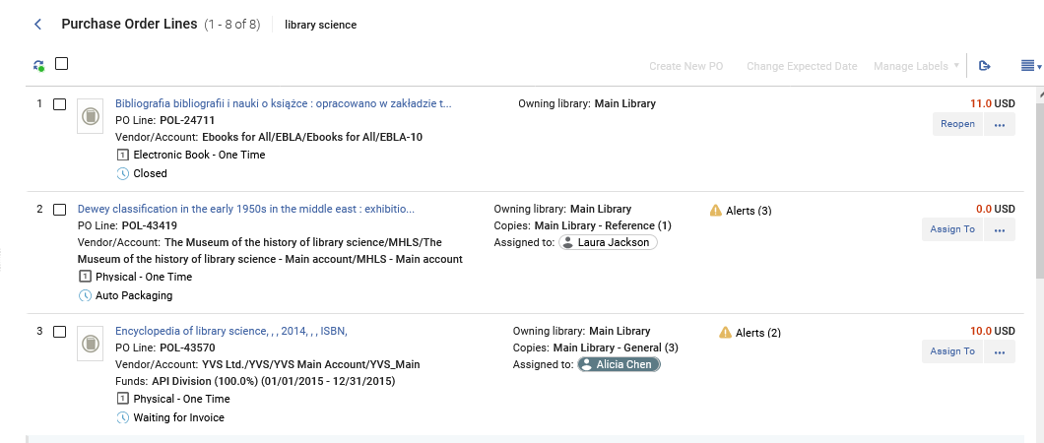
Presentation Toggle Button
This is the list view

Slide 61
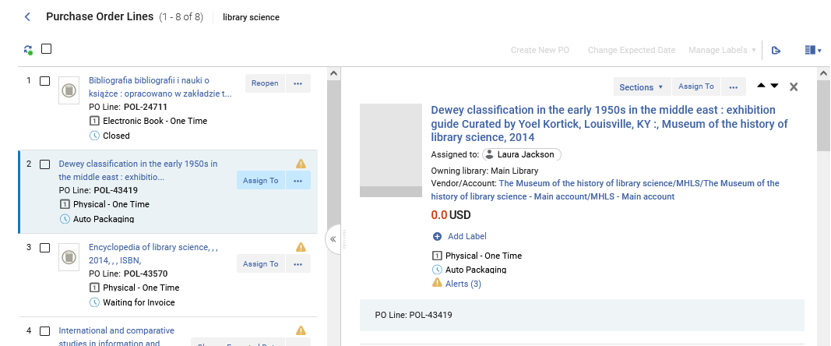
Presentation Toggle Button
This is the split view medium list
Pane divider can be dragged left or right to show more or less on a specific side.
Left pane can be collapsed here

Slide 62
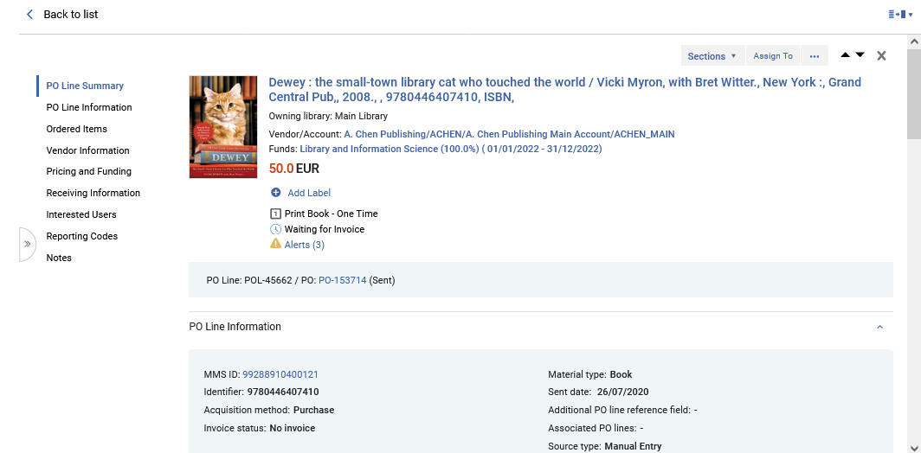
Presentation Toggle Button
This is the full-page view

Slide 63
Split View (Side By Side View)

Slide 64
Split View (Side By Side View)
To improve the usability of the unified PO line task list, a "Side By Side View" presentation enables users to view a list of PO lines on one side and detailed information regarding the selected PO line on the other side.
The right panel holds relevant information regarding the PO line, for users with relevant roles.
This information is editable from the panel itself, preventing users from the need to navigate to a specific PO line editing screen.

Slide 65
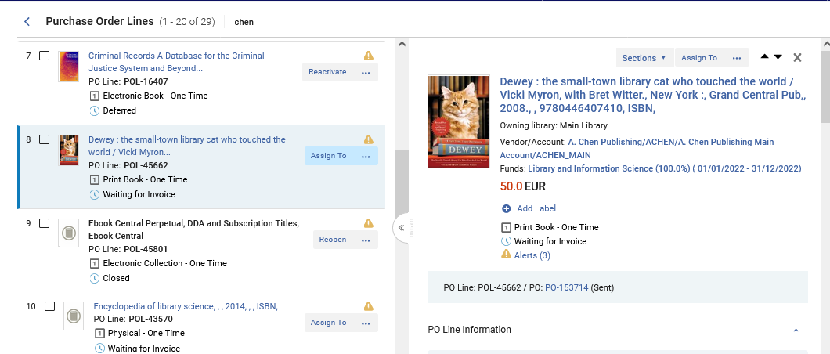
Split View (Side By Side View)
Editable POL details will open in the Right side panel
Select a POL from the Compact left side record view

Slide 66
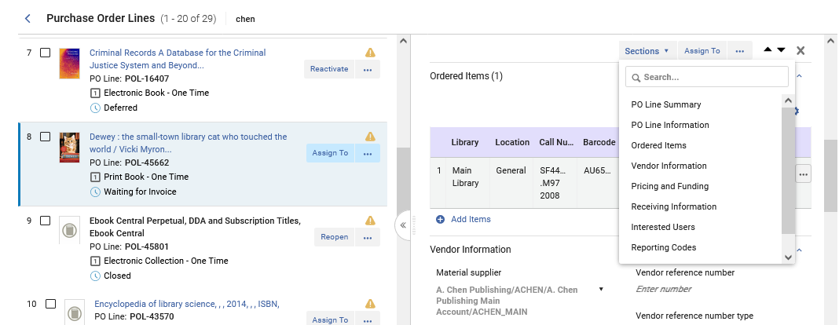
Split View (Side By Side View)
Navigate the POL via the sections or the scrollbar.
Navigate directly to the different parts of the POL using the "Sections" option or the scrollbar.

Slide 67
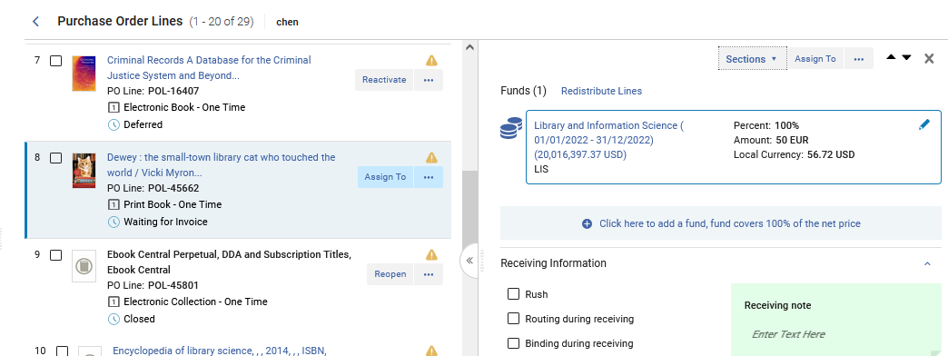
Split View (Side By Side View)
The POL can be edited in the right-side panel.
Edit the POL as desired

Slide 68
Split View (Side By Side View)
Both the Functional as well as Informative actions may be taken on the POL in the right-side panel.
Functional actions include "Assign To", "Change Bib Reference", "Close" and "Relink".
Informative Actions include "Bib Description", "Invoice Lines", Associated PO Lines", "Communications", "History" and "Attachments".

Slide 69
Split View (Side By Side View)
Functional and informative actions may be taken on the POL in the right side panel.
Functional actions
Informative actions

Slide 70
Slide-Out Panel

Slide 71
Slide-Out Panel
The slide out panel enables the staff user to access entities which relate to the PO line while keeping the PO line in the background at all times.
For example, staff users who work on a PO line and would like to view/modify the information of the item associated with the PO line can click on the ellipsis (...) action located at the "Ordered Items section" and from there navigate to a sliding panel which holds the item's information.
To close the panel users can either save the item or click on the "X" icon to close it. The sliding panel is used for displaying multiple entities while working on a PO line.

Slide 72
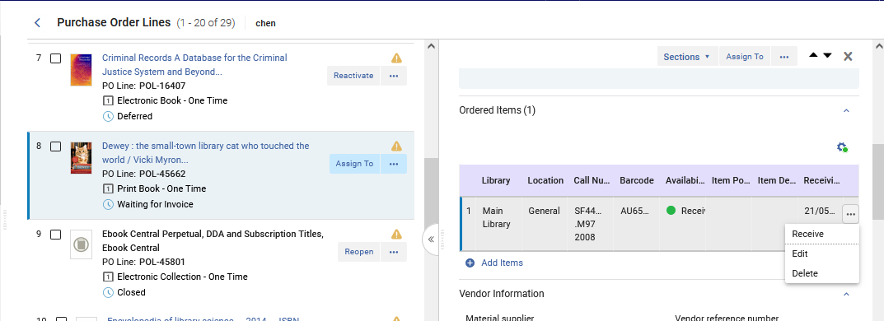
Slide-Out Panel
We will click now the "edit" link in the "Ordered Items" section

Slide 73
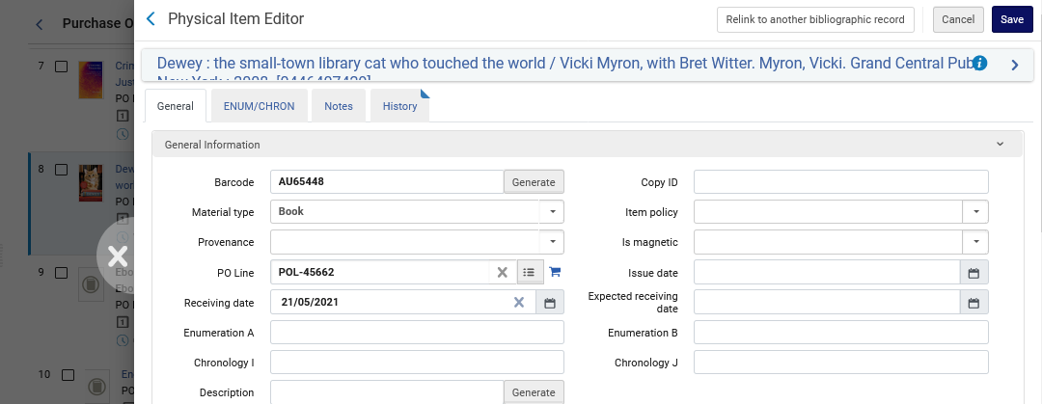
Slide-Out Panel
The Physical Item editor slides out in a new panel
Close the panel here

Slide 74
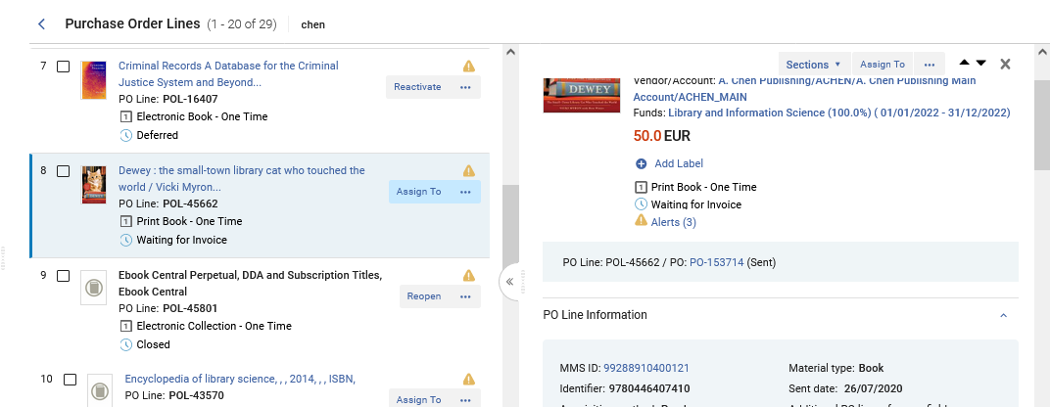
Slide-Out Panel
We will click now the link to the PO

Slide 75
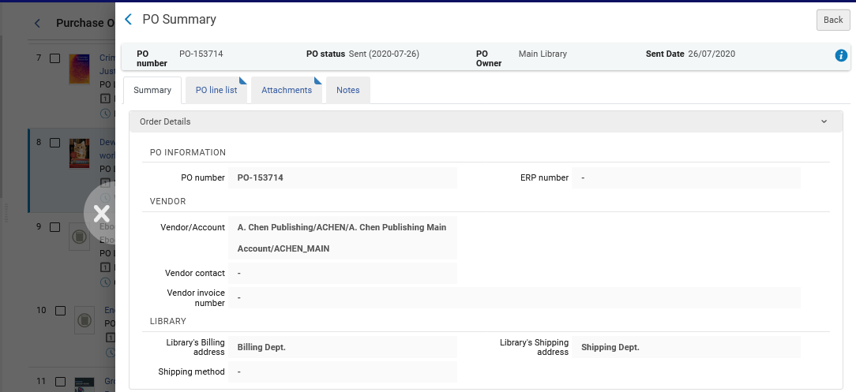
Slide-Out Panel
The PO slides out in a new panel
Close the panel here

Slide 76
Receiving Items from within the PO Line

Slide 77
Receiving Items from within the PO Line
It is possible to receive items for a PO Line directly from within the POL.
This saves time, preventing the staff user from needing to navigate to the Receiving Workbench in order to receive the item.
The staff user does not need to exit the PO Line and click the "Receive" link under the "Actions > Receiving and Invoicing" section of the menu.

Slide 78
Receiving Items from within the PO Line
Here we are in a PO Line in the "Ordered Items" section.
We will click "Receive" for item barcode AU66002

Slide 79
Receiving Items from within the PO Line
We then get a message that the receiving process was activated.

Slide 80
Receiving Items from within the PO Line
There is then an indication in the PO Line that the item was received

Slide 81
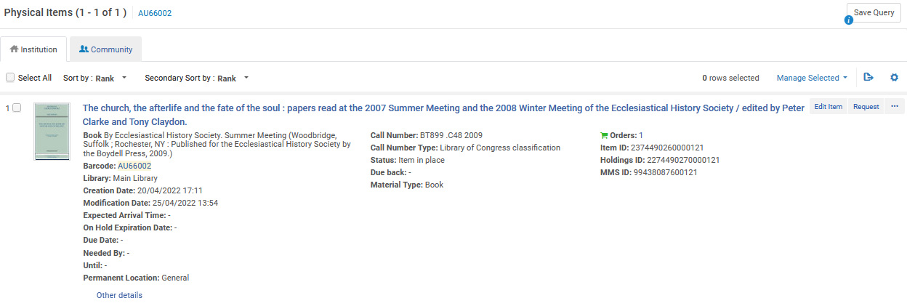
Receiving Items from within the PO Line
We can also see, in this case, that the item is now "In Place"

Slide 82
PO Line Actions Sensitive to Workflow Step

Slide 83
PO Line Actions Sensitive to Workflow Step
PO line actions in both the left and right panels are sensitive to the workflow step of the PO line.
As a result, different PO Lines may have different Main Actions depending on the workflow step.

Slide 84
PO Line Actions Sensitive to Workflow Step
For example, a POL Line in workflow step:
"In Review" will have Main Action "Assign To"
"Deferred" will have Main Action "Reactivate"
"Cancelled" will have Main Action "Reopen"
"Closed" will have Main Action "Reopen"
"Sent" and "In Claim" will have Main Action "Change Expected Due Date"
Sent" and not "In Claim" will have Main Action "Assign To"
"In Review" and "Unassigned" will have Main Action "Continue Workflow"
"In Review" and Assigned to a different user will have Main Action "Assign To" (The "Assign To" will appear for staff users with the proper roles. Staff users which cannot "assign to" will see "release assignment")

Slide 85
PO Line Actions Sensitive to Workflow Step
Here is a PO line in workflow step "In Review" with Main Action "Assign To".

Slide 86
PO Line Actions Sensitive to Workflow Step
Here is a PO line in workflow step "Cancelled" with Main Action "Reopen".

Slide 87
PO Line Actions Sensitive to Workflow Step
Here is a PO line in workflow step "Closed" with Main Action "Reopen".

Slide 88
PO Line Actions Sensitive to Workflow Step
Here is a PO line in workflow step "Sent" and "In Claim" with Main Action "Change Expected Due Date".

Slide 89
PO Line Actions Sensitive to Workflow Step
Here is a PO line in workflow step "Sent" and not "In Claim" with Main Action "Assign To".

Slide 90
PO Line Actions Sensitive to Workflow Step
Here is a PO line in workflow step "In Review" and "Unassigned" with Main Action "Continue Workflow".

Slide 91
PO Line Actions Sensitive to Workflow Step
Here is a PO line in workflow step "In Review" and also Assigned to a different user with Main Action "Assign To".
Assigned to a different user

Slide 92
The "Items In Claim" Section

Slide 93
The "Items In Claim" Section
When a PO Line for physical inventory is In Claim the PO Line will have the regular section "Ordered Items" and also a section "Items in Claim".
This is particularly useful when there are multiple items being ordered and only some of them are in claim.
It allows the staff user to quickly and easily identify the items which already arrived or are expected to arrive in the future, and the items which are still claimed.

Slide 94
The "Items In Claim" Section
Here is a PO Line for one item and the PO Line is In Claim
In this case the same item appears in both sections

Slide 95
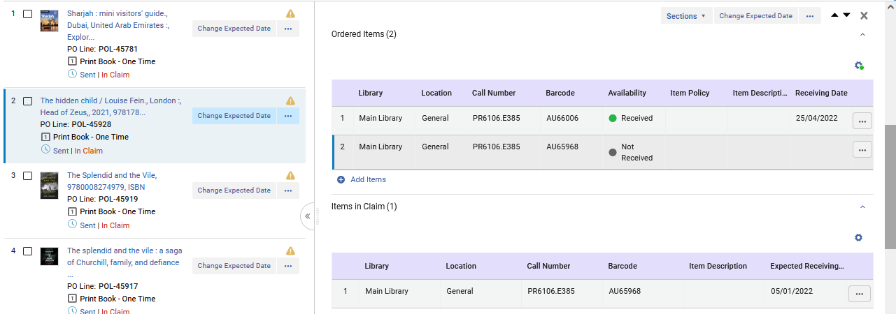
The "Items In Claim" Section
Here is a PO Line for two items and the PO Line is In Claim and one item has already arrived
Two items were ordered, and one arrived
This is the one claimed item

Slide 96
The Clickable "Sent" Status

Slide 97
The Clickable "Sent" Status
As part of a major improvement in navigation, the "Sent" status is clickable and sensitive to the inventory type of the PO Line.
This is the case in both the left and right panels.
Clicking on "Sent" for PO Lines with physical material will bring the user to the Receiving Workbench.
Clicking on "Sent" for PO Lines with electronic material will bring the user to the Electronic Resource Activation Task List.
This saves the user several navigation clicks.

Slide 98
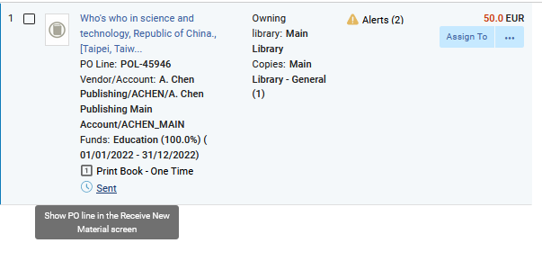
The Clickable "Sent" Status
Here is a PO Line for physical inventory in workflow step "Sent"
Hovering over the "Sent" link gives a pop-up text "Show PO Line in the Receive New Material Screen"

Slide 99
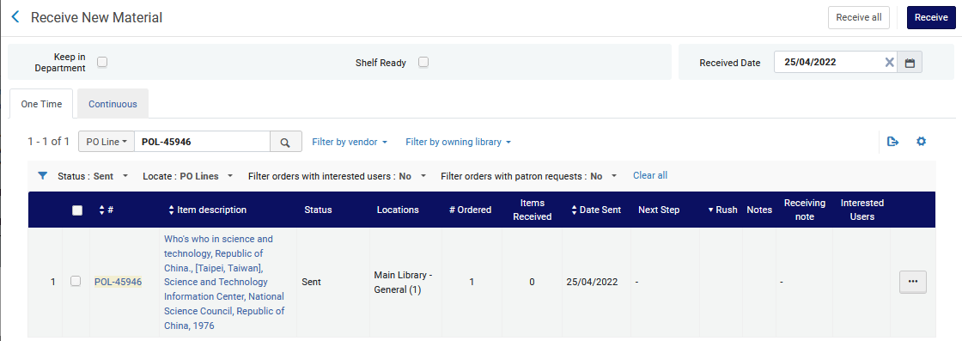
The Clickable "Sent" Status
Clicking the "Sent" link brings us to the Receiving Workbench already filtered for the PO Line from which we came.

Slide 100
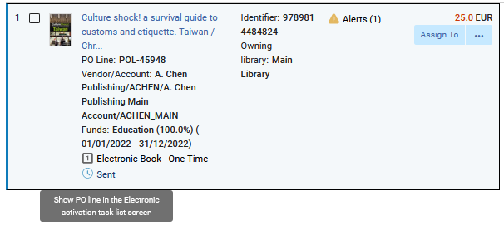
The Clickable "Sent" Status
Here is a PO Line for electronic inventory in workflow step "Sent"
Hovering over the "Sent" link gives a pop-up text "Show PO Line in the Electronic Activation Task List Screen"

Slide 101
The Clickable "Sent" Status
Clicking the "Sent" link brings us to Electronic Resource Activation Task List already filtered for the PO Line from which we came.

