Slide 1
Optimizing Overdue & Lost Loan Profiles in Alma
Presented By: Nicole Murphy

Slide 2
Overdue Notification Profiles

Slide 3
Overdue Notification Profiles
Sends Overdue & Lost Loan Notification Letters

Slide 4
Overdue Notification Profiles
Sends Overdue & Lost Loan Notification Letters
Creates overdue loan fines determined in the TOU’s (terms of use)

Slide 5
Overdue Notification Profiles
Sends Overdue & Lost Loan Notification Letters
Creates overdue loan fines determined in the TOU’s (terms of use)
Applies patron blocks

Slide 6
Overdue Notification Profiles
Sends Overdue & Lost Loan Notification Letters
Creates overdue loan fines determined in the TOU’s (terms of use)
Applies patron blocks
Assesses Overdue Notification fees (optional)

Slide 7
Overdue Notification Profiles
Sends Overdue & Lost Loan Notification Letters
Creates overdue loan fines determined in the TOU’s (terms of use)
Applies patron blocks
Assesses Overdue Notification fees (optional)
Does not change the status of loans

Slide 8
Change to Lost Profiles

Slide 9
Change to Lost Profiles
Changes loan statuses to Lost

Slide 10
Change to Lost Profiles
Changes loan statuses to Lost
Status change triggers events determined in the Loan TOU’s
(ex: fines/fees)

Slide 11
Change to Lost Profiles
Changes loan statuses to Lost
Status change triggers events determined in the Loan TOU’s
(ex: fines/fees)
Sends Overdue & Lost Loan letters

Slide 12
Change to Lost Profiles
Changes loan statuses to Lost
Status change triggers events determined in the Loan TOU’s
(ex: fines/fees)
Sends Overdue & Lost Loan letters
Assesses Overdue Notification Fees (optional)

Slide 13
Options for Configuration

Slide 14
Options for Configuration
Based on # of days after a due date or specific status change

Slide 15
Options for Configuration
Based on # of days after a due date or specific status change
Loans may be selected by particular statuses, material types, or locations

Slide 16
Options for Configuration
Based on # of days after a due date or specific status change
Loans may be selected by particular statuses, material types, or locations
Letter send format – Print vs. Email

Slide 17
Options for Configuration
Based on # of days after a due date or specific status change
Loans may be selected by particular statuses, material types, or locations
Letter send format – Print vs. Email
Notification type (if more than one has been configured)

Slide 18
Overdue & Lost Loan Profiles
Run by the Overdue & Lost Loan job (scheduled)
NOTE: Loans processed by a profile are flagged, so they are not processed more than once.

Slide 19
Overdue & Lost Loan Profiles
Run by the Overdue & Lost Loan job (scheduled)
NOTE: Loans processed by a profile are flagged, so they are not processed more than once.
Need an Administer role to configure Profiles, Letters, and Job
“Fulfillment Administrator” or “General Administrator”

Slide 20
Notification options
Configuration—Fulfillment—General—Other Settings-- switch_to_overdue_and_lost_loan_new_job parameter

Slide 21
Notification options
Configuration—Fulfillment—General—Other Settings-- switch_to_overdue_and_lost_loan_new_job parameter
True = sends Ful Overdue and Lost Loan Notification Letter/Ful Overdue and Lost Loan Letter.

Slide 22
Notification options
Configuration—Fulfillment—General—Other Settings-- switch_to_overdue_and_lost_loan_new_job parameter
True = sends Ful Overdue and Lost Loan Notification Letter/Ful Overdue and Lost Loan Letter.
False = sends Ful Lost Loan Notification Letter/Ful Lost Loan Letter.

Slide 23
Parameter setting = true

Slide 24
Parameter setting = true
Ful Overdue and Lost Loan Notification Letter
Warning sent to patrons listing all overdue loans before the items are declared lost. 5 different letter options.

Slide 25
Parameter setting = true
Ful Overdue and Lost Loan Notification Letter
Warning sent to patrons listing all overdue loans before the items are declared lost. 5 different letter options.
Ful Overdue and Lost Loan Letter
An invoice letter (for replacement fees) sent to the borrowing patron listing all overdue loans that have been declared lost.

Slide 26
Parameter setting = true
Ful Overdue and Lost Loan Notification Letter
Warning sent to patrons listing all overdue loans before the items are declared lost. 5 different letter options.
Ful Overdue and Lost Loan Letter
An invoice letter (for replacement fees) sent to the borrowing patron listing all overdue loans that have been declared lost.
Applies user blocks

Slide 27
Parameter setting = false

Slide 28
Parameter setting = false
Ful Lost Loan Notification Letter
Warning sent to patrons when a loan is overdue before the item is declared lost. Each letter is generated for a single item. 5 different letter options.

Slide 29
Parameter setting = false
Ful Lost Loan Notification Letter
Warning sent to patrons when a loan is overdue before the item is declared lost. Each letter is generated for a single item. 5 different letter options.
Ful Lost Loan Letter
An invoice letter (for the replacement fee) sent to the borrowing patron when a loan is overdue, and the item is declared lost. Each letter is generated for a single item.
NOTE: This is also the letter sent when an item is manually changed to Lost

Slide 30
Parameter setting = false
Ful Lost Loan Notification Letter
Warning sent to patrons when a loan is overdue before the item is declared lost. Each letter is generated for a single item. 5 different letter options.
Ful Lost Loan Letter
An invoice letter (for the replacement fee) sent to the borrowing patron when a loan is overdue, and the item is declared lost. Each letter is generated for a single item.
NOTE: This is also the letter sent when an item is manually changed to Lost
Does not apply user blocks

Slide 31
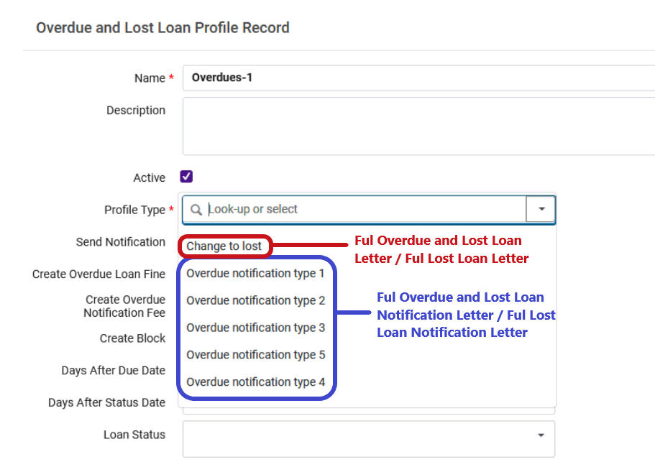

Slide 32
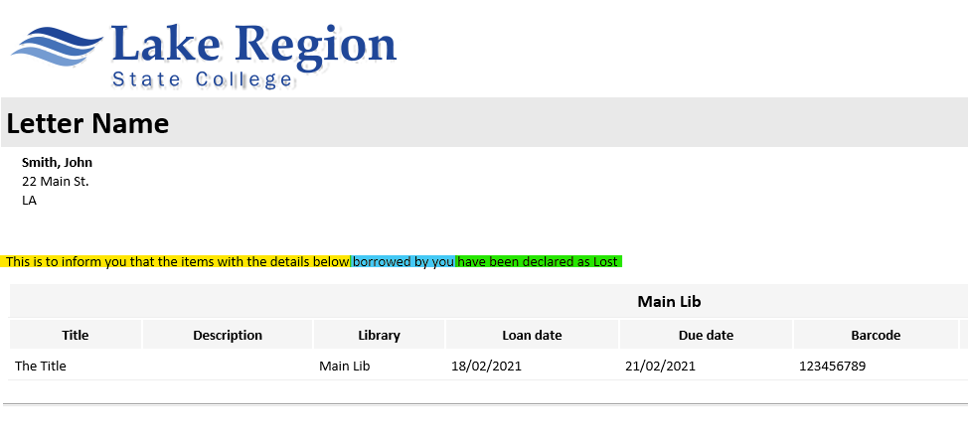

Slide 33
Configuring Loans
Overdue and Lost Loan Notification Letter XSL Considerations
https://knowledge.exlibrisgroup.com/Alma/Product_Documentation/010Alma_Online_Help_(English)/030Fulfillment/080Configuring_Fulfillment/Configuring_Loans#Configuring_Overdue_and_Lost_Loan_Profiles
Examples of XSL code that can be copied

Slide 34
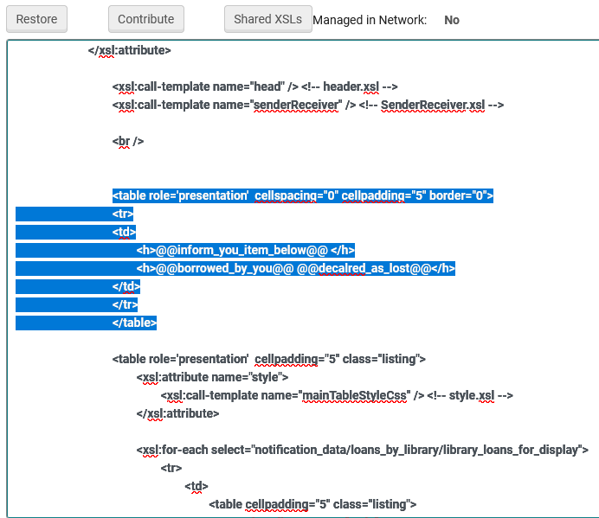
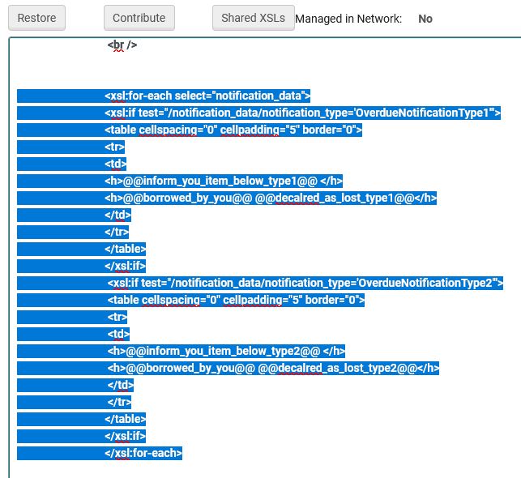
XSL Replacement examples

Slide 35
Configuring Alma letters – Letter List
https://knowledge.exlibrisgroup.com/Alma/Product_Documentation/010Alma_Online_Help_(English)/050Administration/050Configuring_General_Alma_Functions/070Configuring_Alma_Letters#Example_Letter_Customization:_Query_to_Patron_Letter

Slide 36
Nicole Murphy
nicole.m.murphy@ndus.edu
701.969.9159

