Slide 1
GFP_
Mobile
Self-Checkout

Slide 2
Prerequisites
Ease of use
Branding
Compatibility
Integration

Slide 4
Your brand, your logo, your colors.
The app can be configured during the setup phases to use your color palette, logos and text.

Slide 5
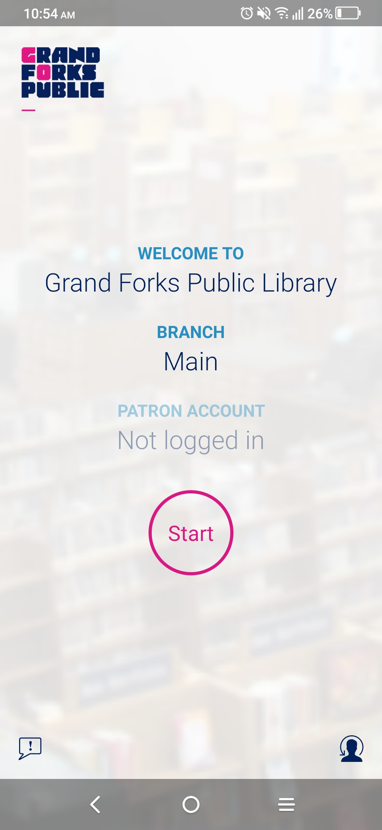
Ease of use

Slide 6
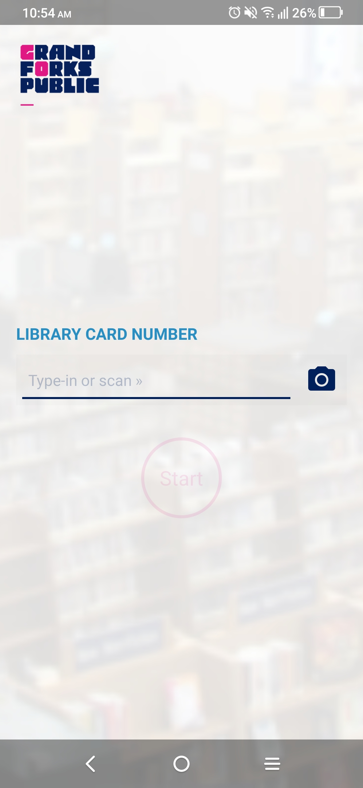
Enter or scan your library card number to store for quick access to a self-checkout.

Slide 7
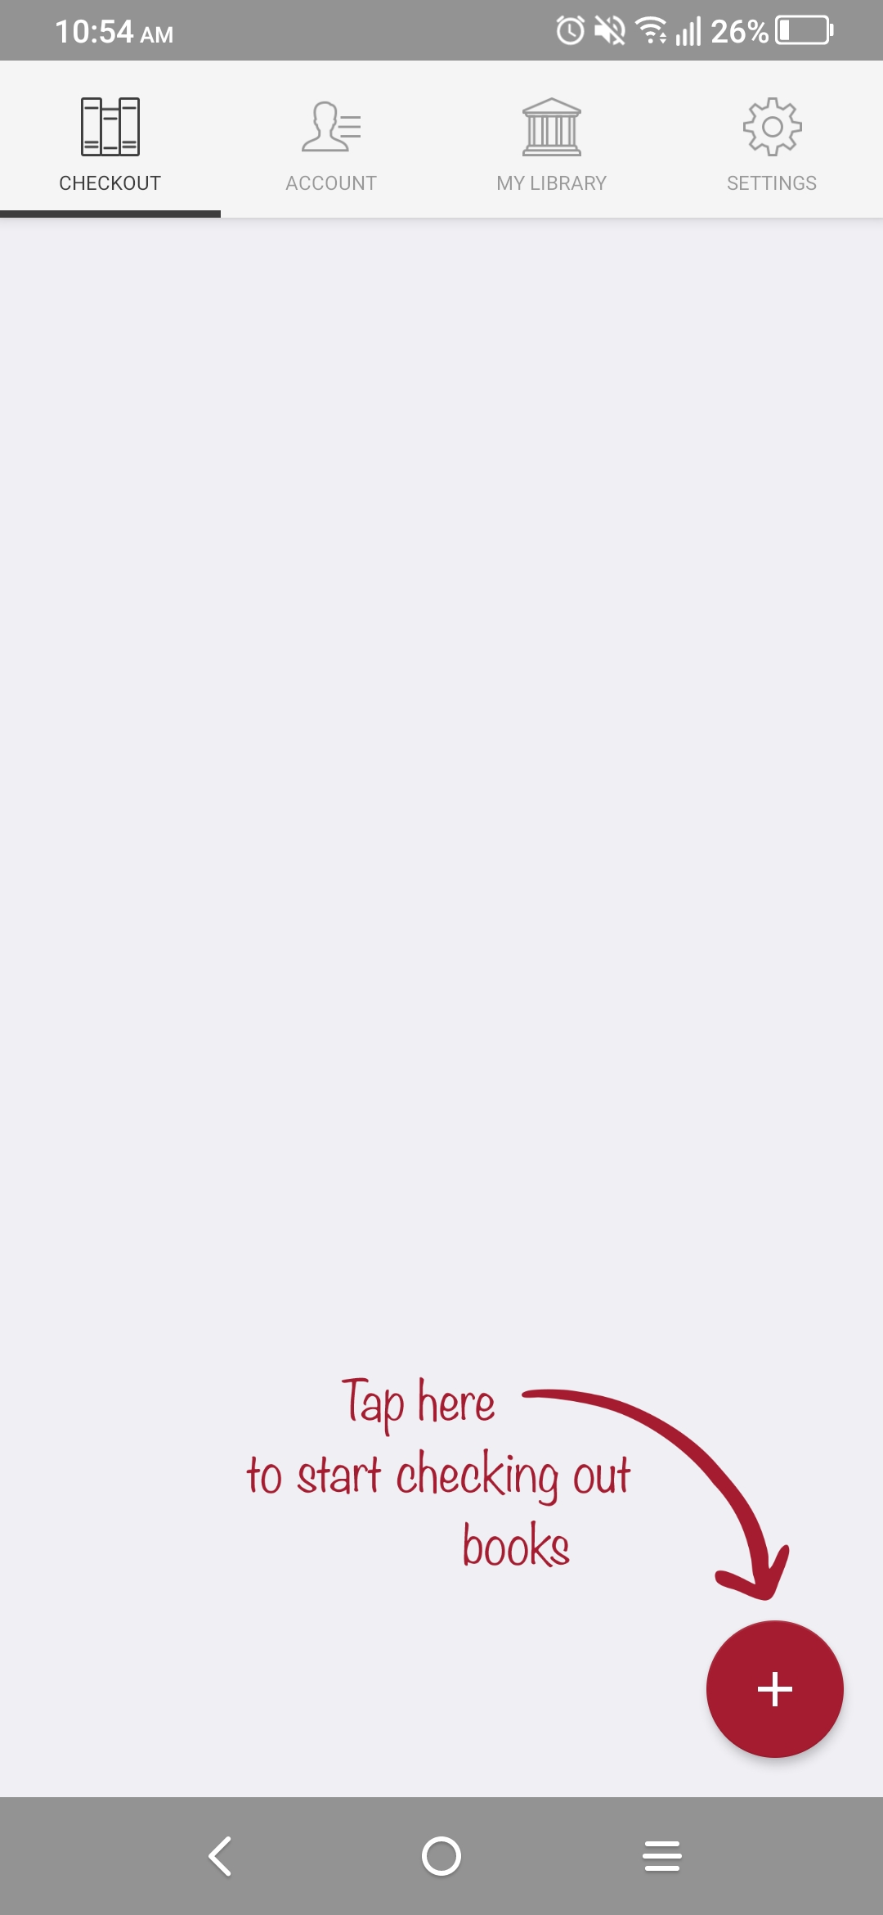
Click to scan barcodes using your phone or tablet camera!

Slide 8
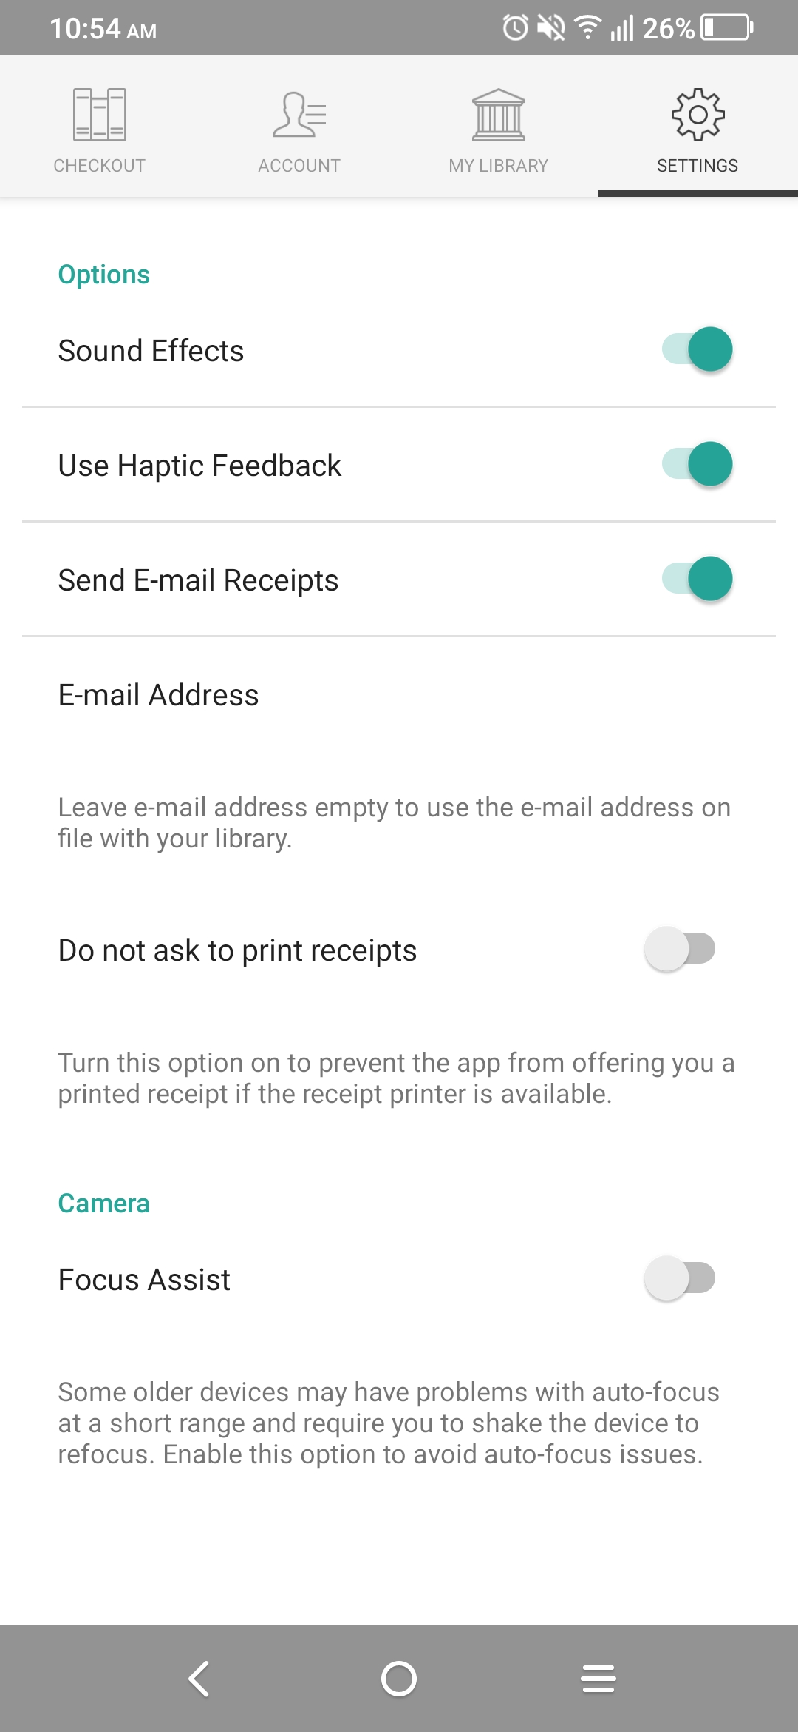
Preferences allow users to enable or disable audio, print receipts, and receive emails.

Slide 9
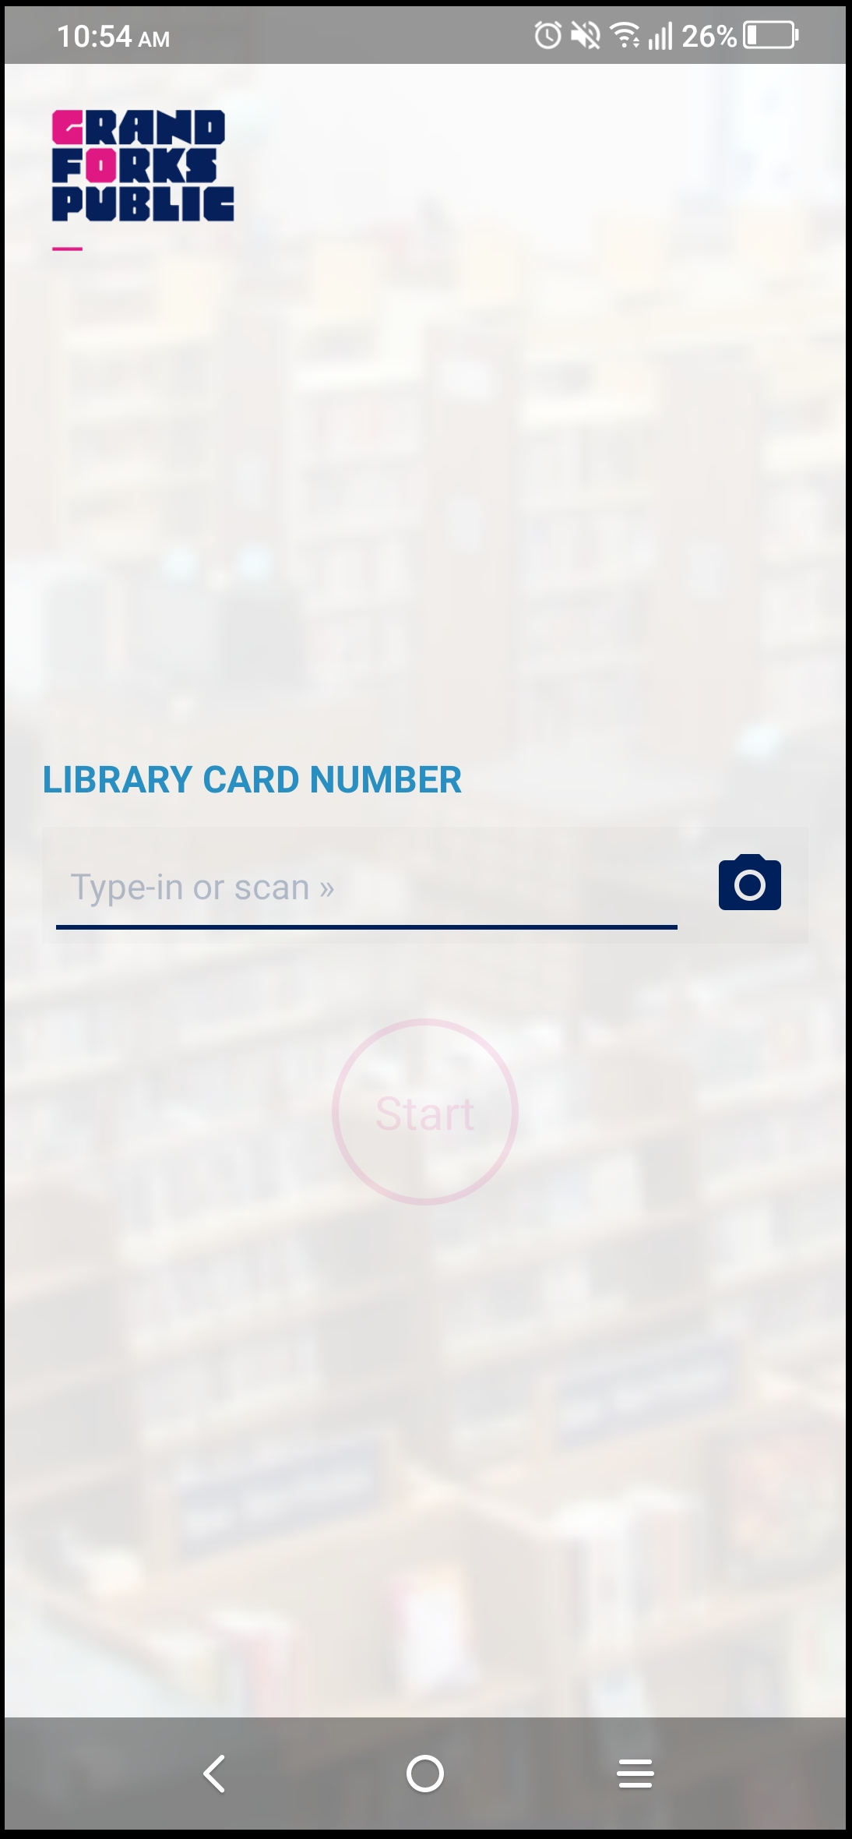
Branding is consistent from the appstore to checkout.

Slide 10
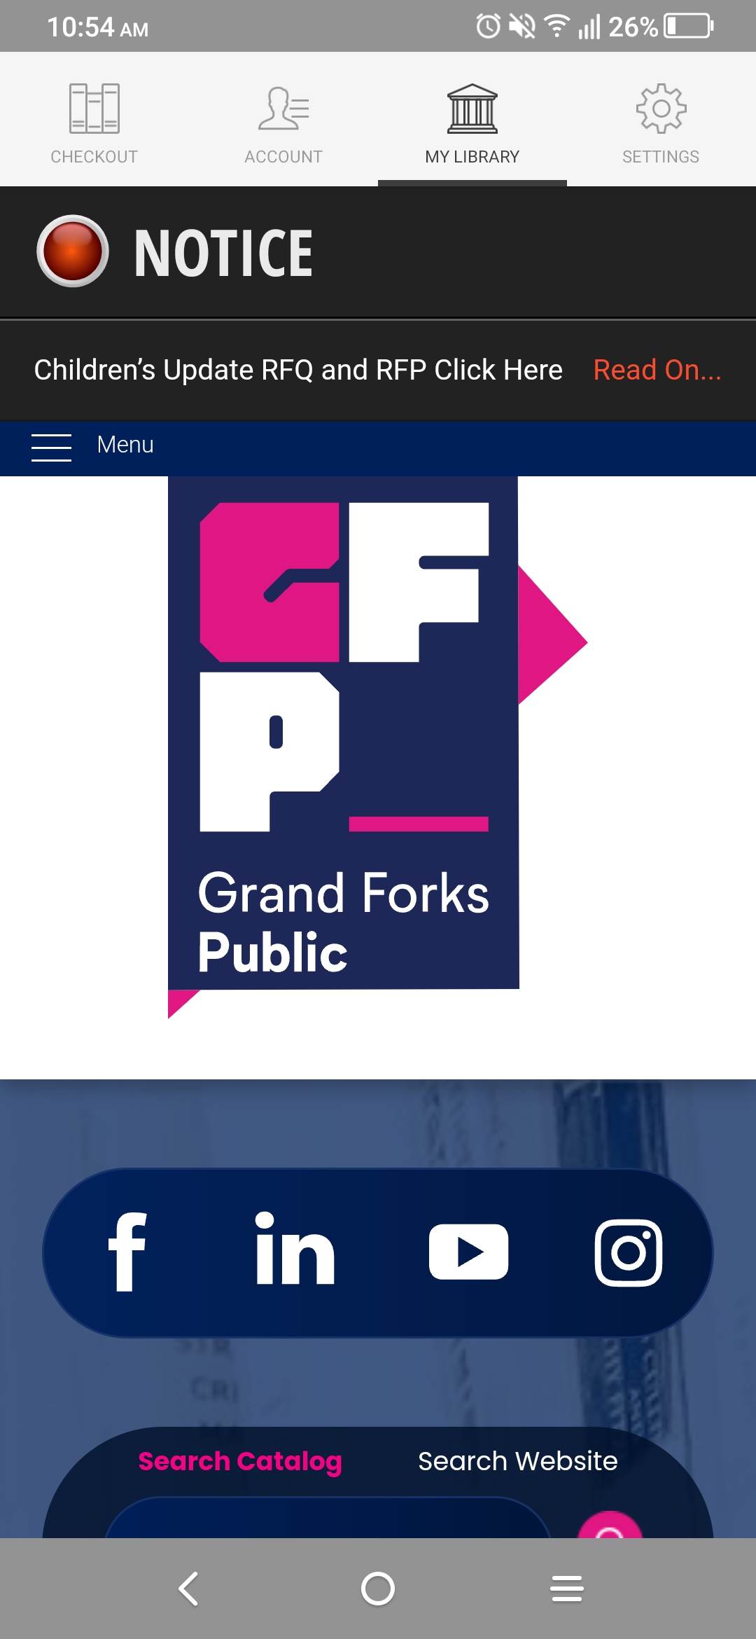
As part of our branding requirements the app provides access to our website and catalog.

Slide 11
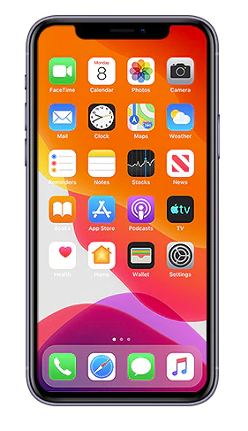
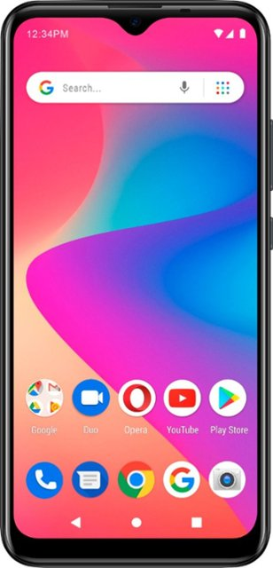
Compatibility
Android and Apple devices are supported including tablets.

Slide 12
Testing Phase
Patron IDs with blocks
Items with blocks
After Implementation
Testing blocked items and blocked patron accounts.

Slide 13
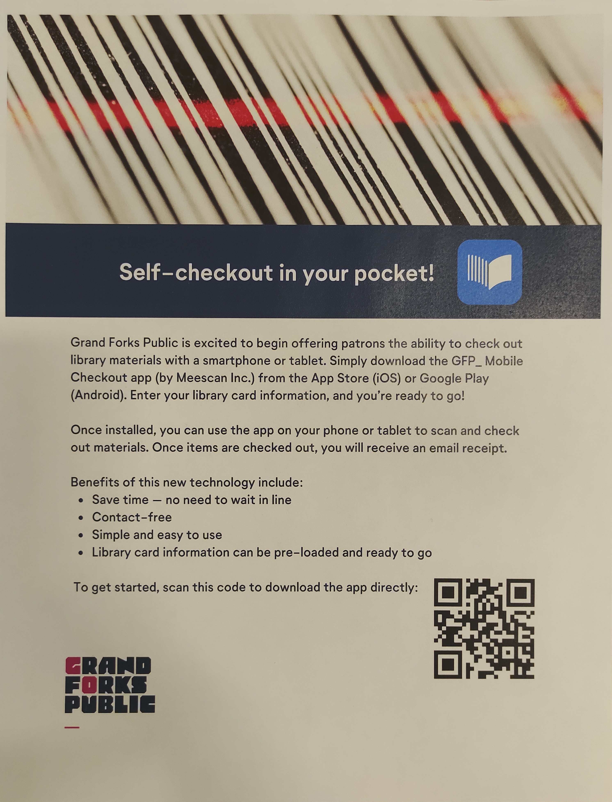
A self-checkout in your pocket!
One barcode provides access to the app store of your device/brand.

Slide 14
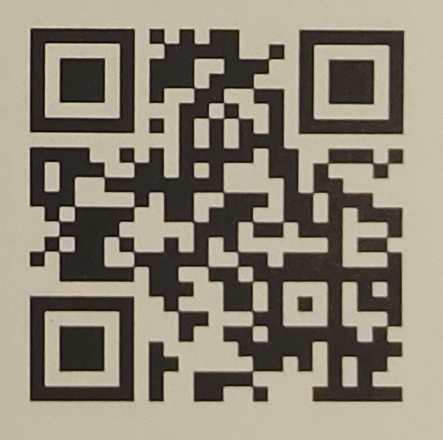
Try it out!
Scan the QR code to test drive our checkouts!

Slide 15
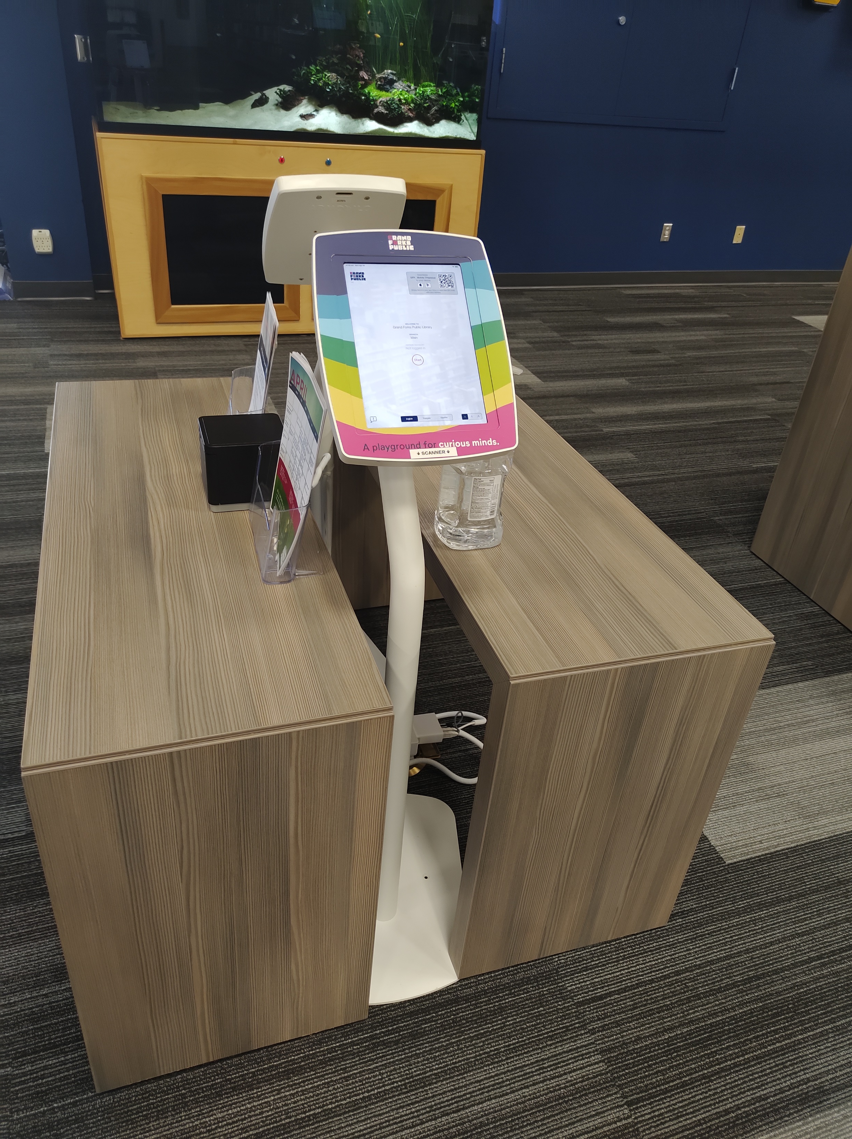
GFP_ opted for both mobile self-checkout and kiosks to make the patron experience as seamless as possible.

Slide 16
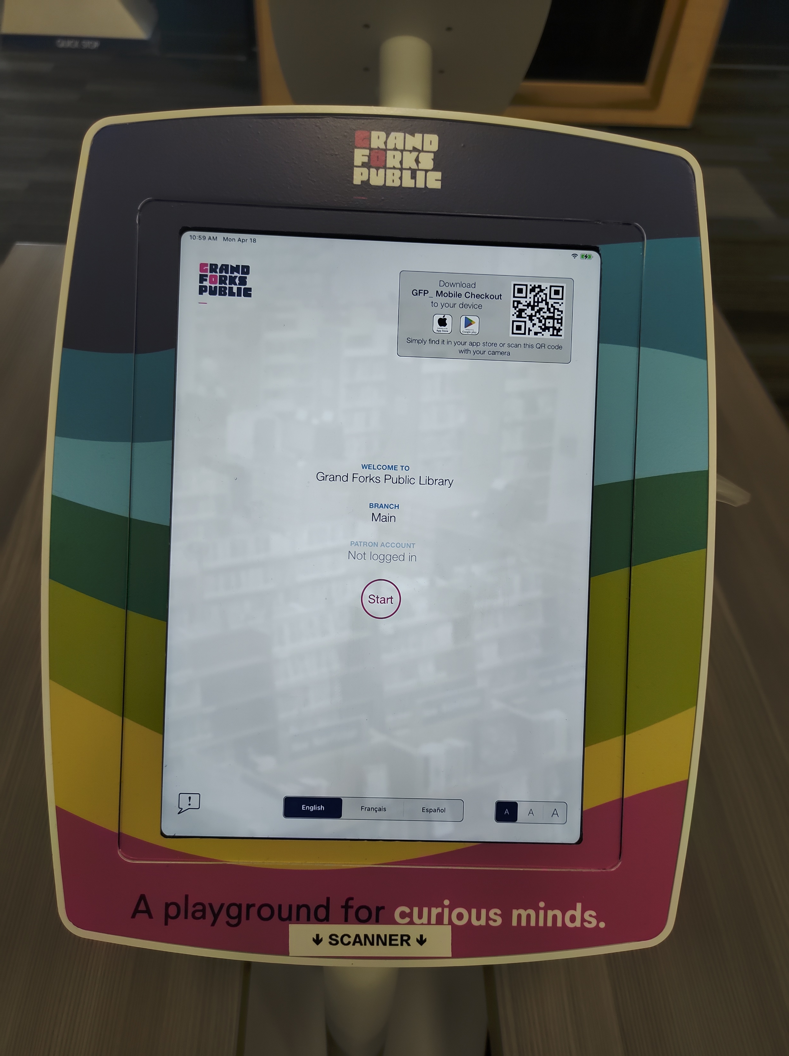
Integration
Vinyl wrap to match our brand!

Slide 17
Questions?

Slide 18
Thank You!
Tonya Palmer
Tonya.palmer@gflibrary.com

