Slide 1
Customization in primo ve
ODIN mini-session
2021 NDLA Annual conference – October 7, 2021

Slide 2
Links Menu
Options for customizations
Add new links
Delete links
Activate or deactivate links
Change the order the links appear

Slide 3
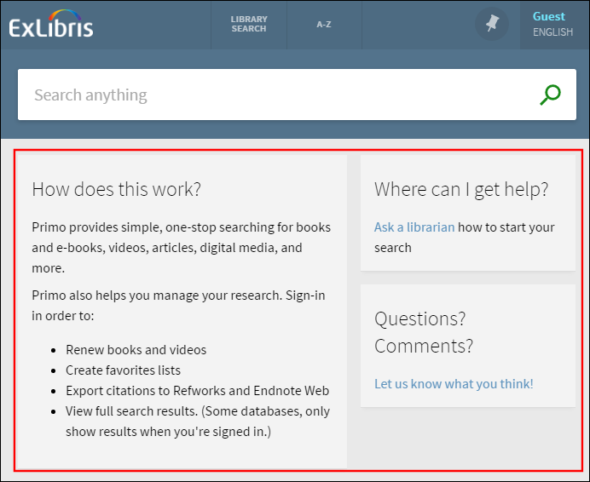
Home page
Options could include:
List of open hours
Contact list
Instruction for searching
Links to libguides
How to get help section
Chat box integration
Twitter feed
Feedback links
Link to library site

Slide 4
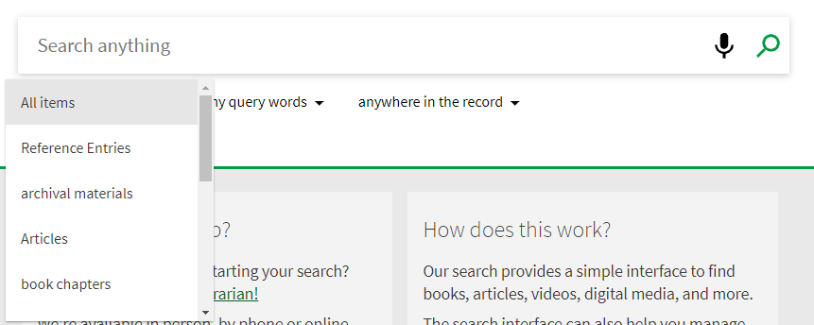
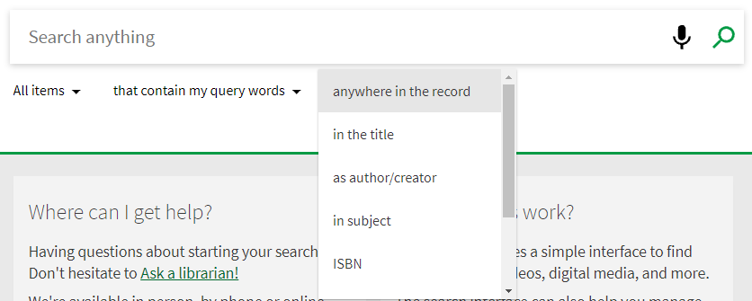
Pre-Filters for basic searches
Filters can allow search to focus on
resource types such as books, articles, scores or videos
search type with options
that contains my query words
with my exact phrase
begins with
search fields such as title, author or subject

Slide 5
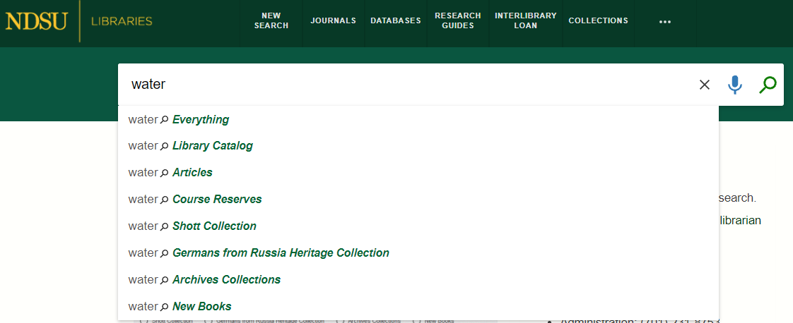
Search Profiles
Allow users to narrow search from certain sources.
Multiple profiles are allowed and may contain your library catalog, Central Index items, Course Reserves, individual collections, etc.

Slide 6
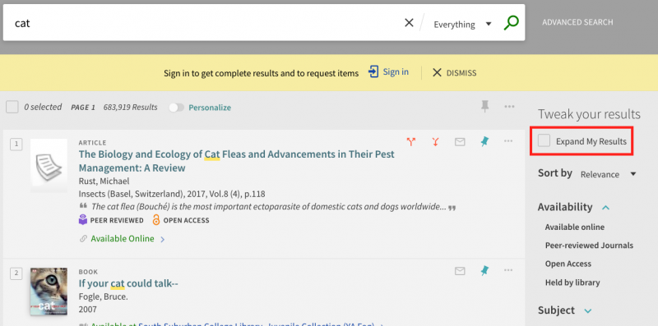
Search results
You may wish to remove the "Expand my Results" check box from the results page.
Under Alma Configuration > Discovery > Search Configuration > Search Profiles.
Any of the search profiles that have "Central Index" in the description will need to be edited. Click on the ellipsis button to edit the profile, then unchecked the "Filter by Availability" option, and save.
If you do decide you'd like the option back on the results page in the future, simply re-check the box and save.

Slide 7
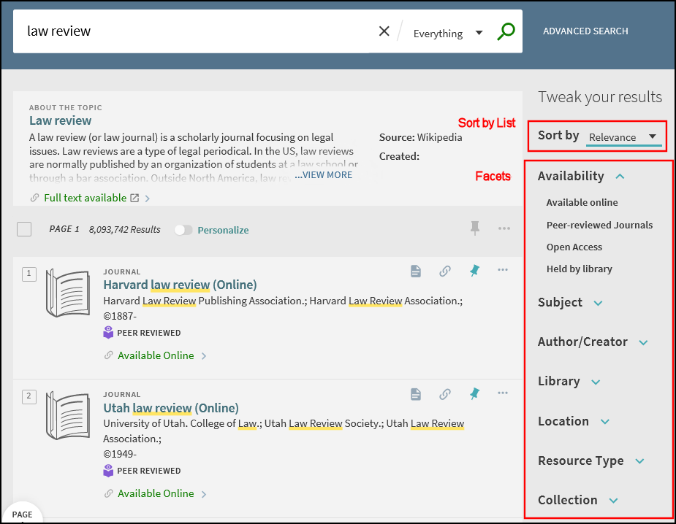
Brief results
Configurations for Brief Results
Expand My Results for CDI records beyond those with full text
Sort by list
Top level facets can be disabled
Facets
right/left side of screen
order they appear
number of values to display
how facet results are sorted (size/alpha numeric)
location can include library name/branch if needed

Slide 8
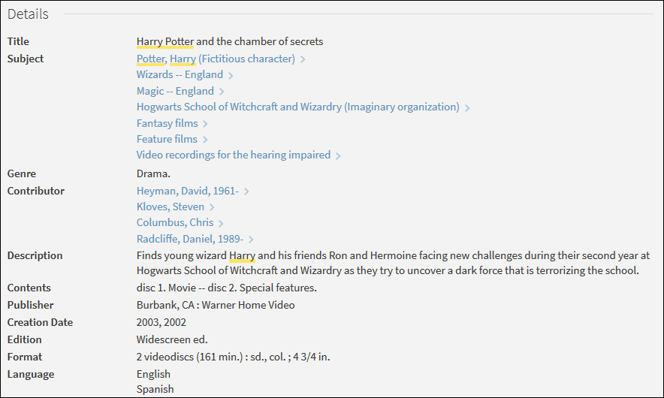
Full results
In the Details section, customization is available for which fields to appear and their order.
There are also sections to “virtually browse” the item’s shelf location, Links which can include Display Source Record (which is nice for the catalogers out there), and Send to area so the item information can be printed, emailed or citation information displayed.

Slide 9
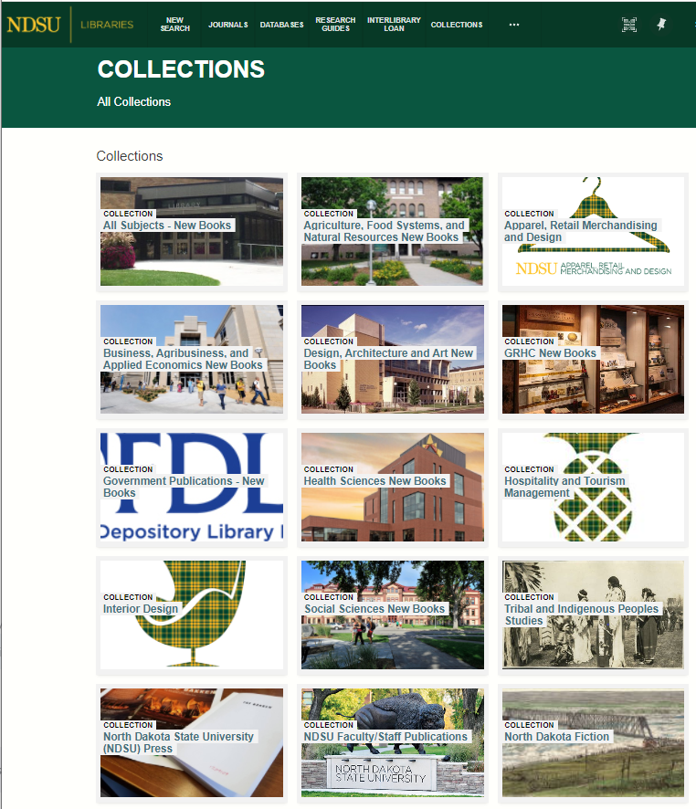
collections
Collections can be defined to group records based on topic or subject matter.
Collections can be used in searches.

Slide 10
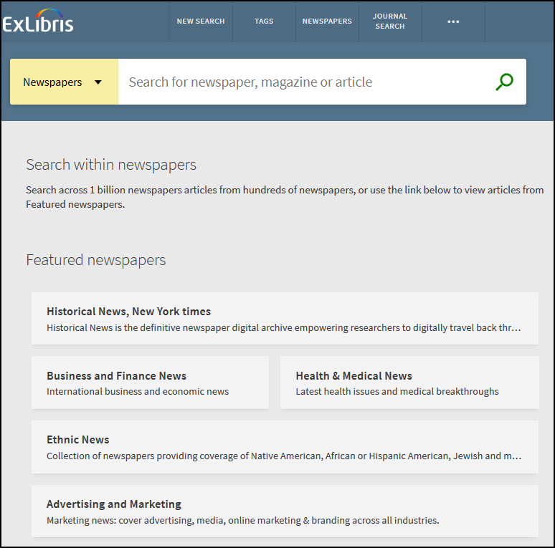
Newspaper search
Allows users to search only for newspaper content from dedicated set of newspaper collections.
When enabled, news items are removed from the CDI search results which increases focus on scholarly content.
Featured Newspapers can be selected and categorized

Slide 11
Labels and headings
Most labels in Primo VE that display in the Brief Results, Full Display page, different Services sections, and My Library Card pages are customizable for your library.
Many label description changes are immediate and the change will be seen right away but other labels may take up to several days to change.

Slide 12
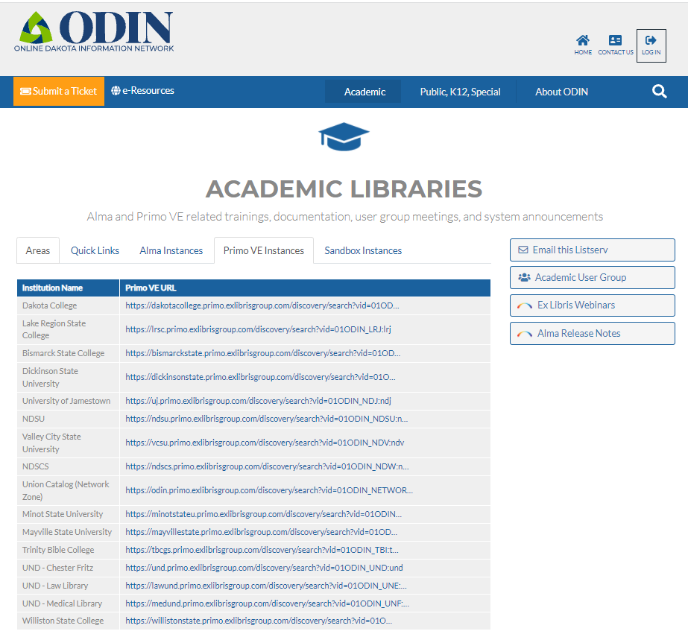
Explore options
You can review what Primo VE customizations other ODIN Libraries have implemented.
Links to each of the libraries’ view can be found on the ODIN website
www.odin.nodak.edu
Click on Academic in the blue bar
Select the Primo VE Instances tab

Slide 13
Thank you!
Contact the ODIN Office if you would like to explore any of the options or have questions.

