Slide 1
DSU Reading Lists Update

Slide 2
Summer Recap
Two Instructors, Three Classes
Two of the lists were constructed by the library
One list was a day after Memorial Day surprise created by the instructor
45 students impacted
The two lists created by the library consisted of physical course reserves and streaming video links from AVON.
The instructor created list consisted of library owned supplemental physical texts.

Slide 3
Fall Promotion
Personal Emails to faculty/departments we work closely with
Using the assigned textbook list provided by the bookstore to leverage the library collection for course reserves.
Using purchase and digitization requests as a gateway to start the conversation.
Kickoff Week – New employee presentation

Slide 4
Outcomes
Personal Emails: Minimal/unrelated responses initially. Recently received an email about finding materials that can be used for a new class for Spring Semester.
Textbook List: High response from faculty – introduced the idea of being able to attach reserves to Blackboard
Purchase/Digitization Requests: When instructors request that we purchase/digitize something they intend to use for class, we use this as a way to start the Reading Lists conversation. Success in Education, Agriculture, and Nursing departments.
Kickoff Week: Two new instructors expressed interest. One took off with it, and one has stalled.

Slide 5
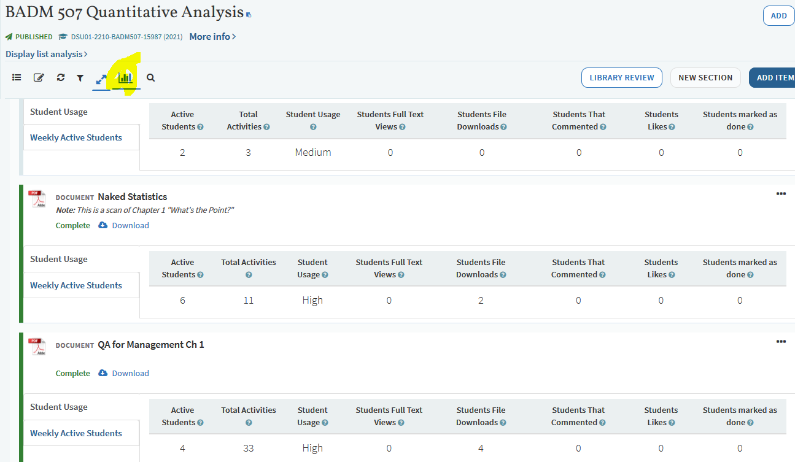
List Analysis
Send follow up emails to instructors to show how they can view the number of unique students who have interacted with the resources.

Slide 6
Barriers and Solutions
Barrier: Attaching Reading Lists to Blackboard
Solution: Interim – We get added to the classes temporarily and add the Tool Link for the instructors. Long term – We are considering working with Randy Wald to implement the Course Loader Integration.
Weigh out the benefit of being in Blackboard class or making it easier for instructors to start using the Reading Lists.

Slide 7
Barriers and Solutions, cont.
Barrier: Reading Lists is overwhelming. There are so many things that you can do with it, and it is being updated constantly.
Solution: For now, we are concentrating on the course reserves aspect. We try to strategically highlight new features that we think might make people interested (Ex. Social Reading (aka public notes on embedded PDFs) was just released!) We plan to start how-to presentations for faculty at the end of September.

Slide 8
Conclusion
We are committed to the product and we think it is a great solution for electronic course reserves.
We love it when we can see the resources being used.
We have developed stronger relationships with some instructors.
It fits in with the low cost/no cost initiatives of NDUS.
In the future, we hope to look more into copyright compliance.

Slide 9
Questions?

