Slide 1
Primo: Back Office Configurations
Primo Work Day
May 19, 2014
Lynn Wolf

Slide 2
Overview
We will touch briefly on what Back Office is and what it controls.
We will look at some of the basic configuration options available to your library.
Basic working documents will be the Ex Libris Primo Implementation Workbook Phase 2 and the Back Office Guide Version 4.x

Slide 3
Primo Back Office: What is it?
Primo Back Office is the administration tool used to:
  Configure and manage the Front End views
  Configure and manage the publishing platform pipe flows
  Monitor Primo system status

Slide 4
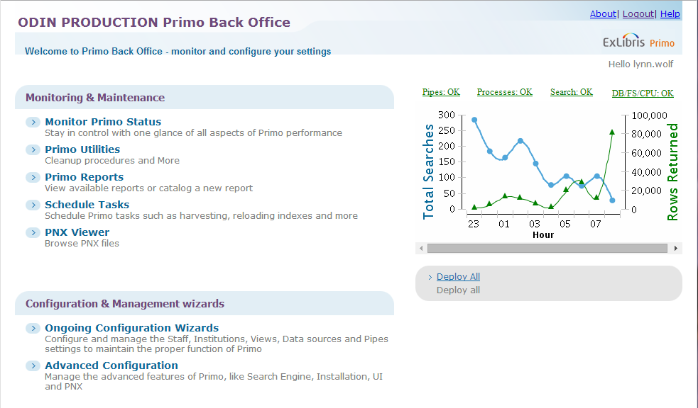
Example of ODIN PRODUCTION
Primo Back Office Home Page

Slide 5
Configure and manage
Front End Views
The user interface with Primo is called a view.
Each ADM has their own view which is customized through the Back Office.
There are 62 views plus the ODIN Consortial View in our ODIN Primo environment for a variety of data sources.

Slide 6
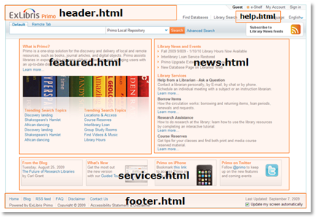
Front End Views
Home Page Tiles
Each view has a Home Page which serves as the user interface and presents basic information, links, and search box.

Slide 7
Home Page Tiles
Header section – library’s logo
Help files – typically includes links for New Search, Journal List, Library Home, Contact, and Help. Note: there are some variations among libraries
Featured, News and Services - not currently used
Footer – typically includes links for Home, FAQ and Contact Us. Again, some variations among libraries

Slide 8
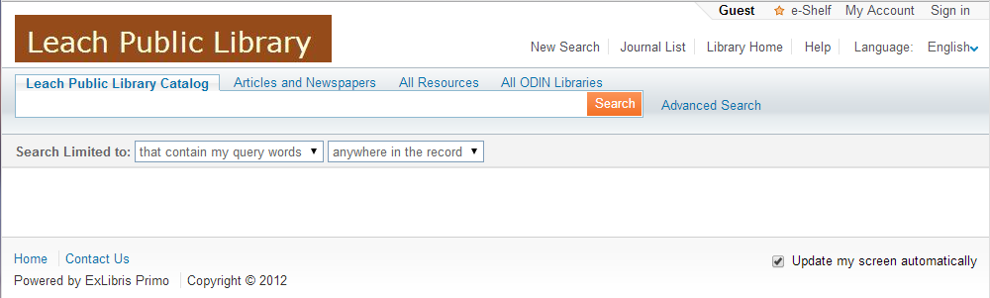
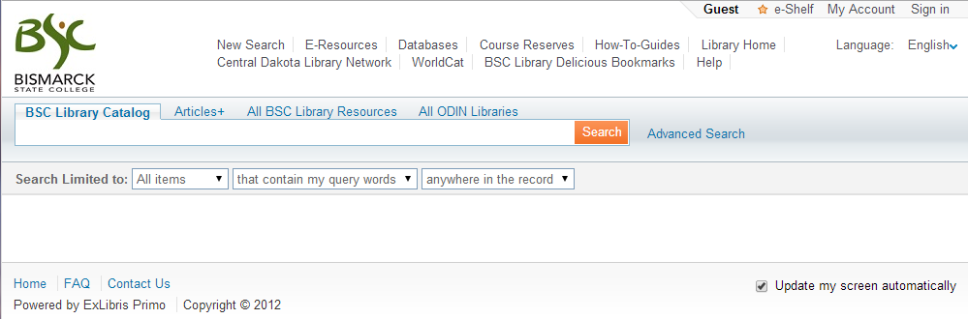
Comparison of Home Page
Leach Public Library – few options in header and footer
Bismarck State College – more options especially in header

Slide 9
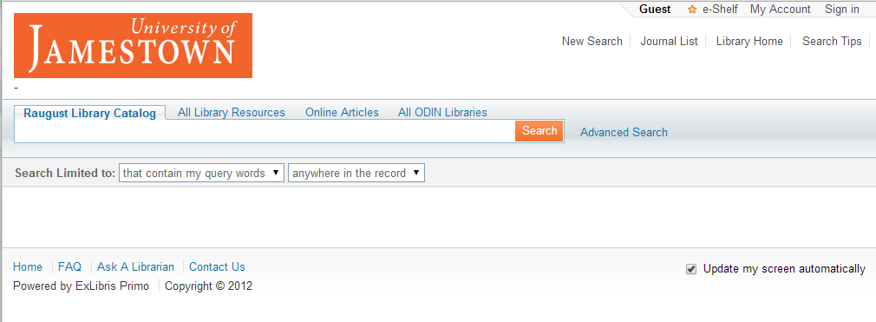
Search Box
Allows patron to enter search terms.

Slide 10
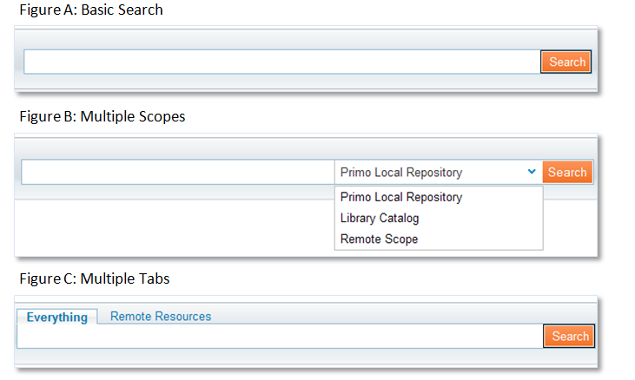
Format options for a search box -- basic search, multiple scopes (dropdown), multiple tabs or combination of scopes and tabs.

Slide 11
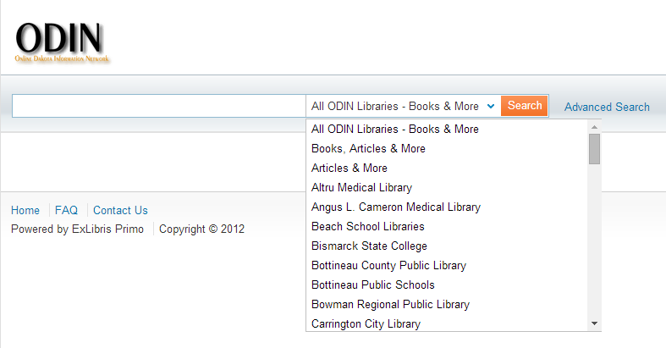
Example of Multiple Scopes:
ODIN view – dropdown contains each ADM as well as all our ALEPH libraries

Slide 12
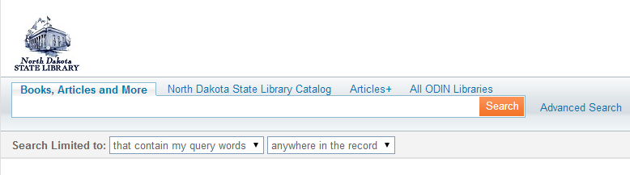
Example of Multiple Tabs:
North Dakota State Library

Slide 13
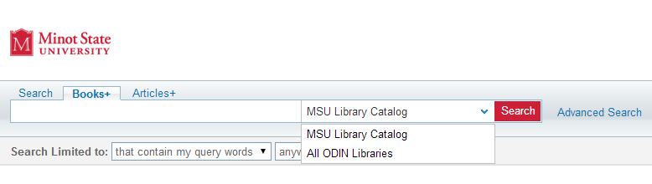
Example of combination:
Minot State Library includes a dropdown in their Books+ tab

Slide 14
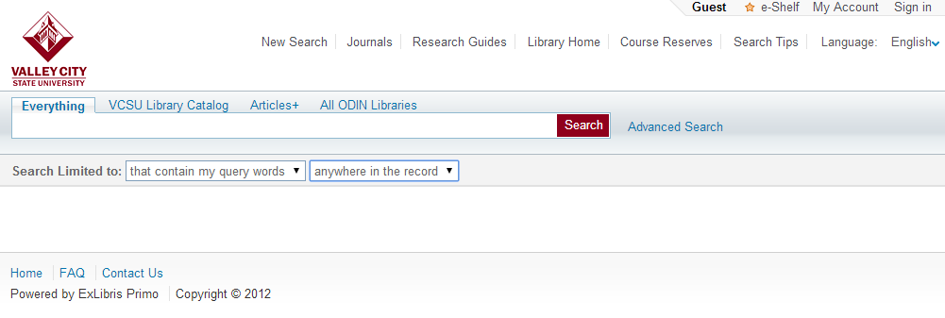
Search Limiters
Allows pre-filter of search results.
Precision operator allows limiting search:
-- That contain my query words
-- with my exact phrase
-- starts with

Slide 15
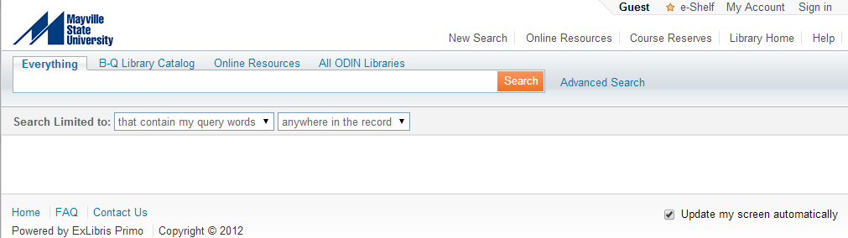
Search Limiters
The second prefilter option involves limiting within certain fields.
Most views have filters to limit search by:
Anywhere in record (default)
In the title
As author/creator
In subject
With some views also adding:
ISBN
ISSN

Slide 16
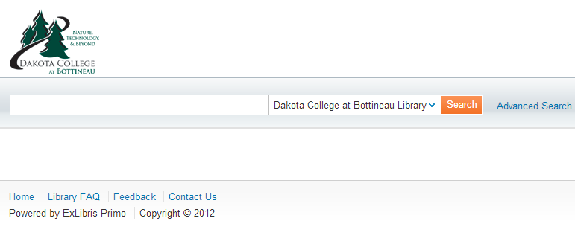
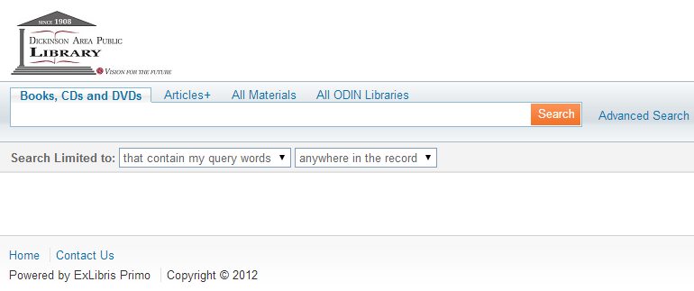
Search Limiters:
BSF - No search limiters
DIP – multiple Search Limiters

Slide 17
Front End Views
Data Building Blocks
A “scope” is a way to group records. There are scopes defined for individual libraries, Primo Central resources, Content DM, DSpace and all of ODIN ALEPH resources.
Each tab within a view can have one or more scopes.

Slide 18
Scopes
A search scope groups records so that a search can be restricted to only those records.
Search scopes can consist of:
  Individual libraries
  Individual sublibraries
  Collection from remote data source (such as ContentDM or DSpace)

Slide 19
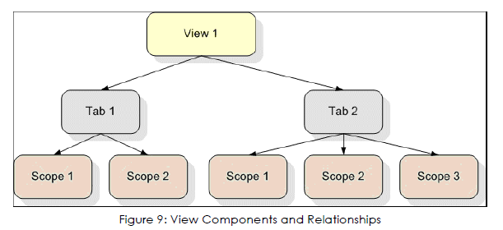
Relationship between views, tabs and scopes

Slide 20
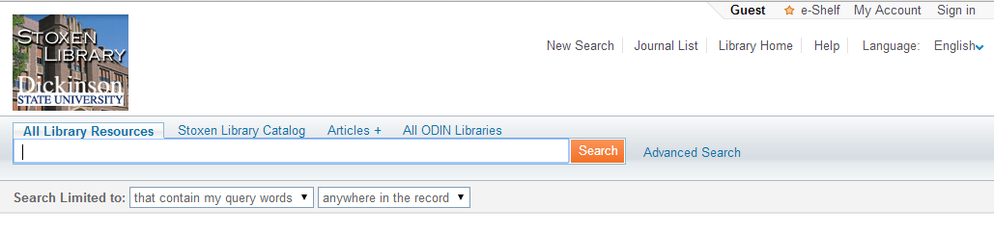
In the example below, NDI has 4 different TABS
-- “All Library Resources” includes ALEPH NDI records and the Primo Central Index (PCI) scope
-- “Stoxen Library Catalog” contains records from the ALEPH catalog with own code of NDI
-- “Articles+” contains records from PCI
-- “All ODIN Libraries” includes all ODIN ALEPH libraries

Slide 21
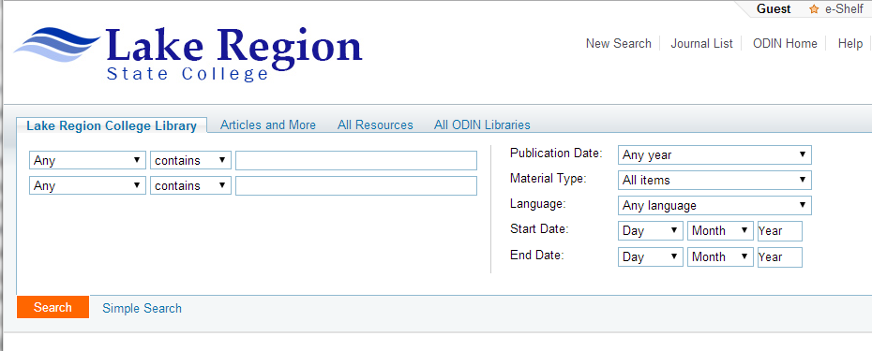
Advanced Search screen can contain multiple search lines and multiple options for each line

Slide 22
Search Results
Facets – intended to help users refine results list
Brief Results Tab Labels – enables patron to Request, see Locations, View Online, see Details, or More from SFX
Details Tab – contains specific fields from the record

Slide 23
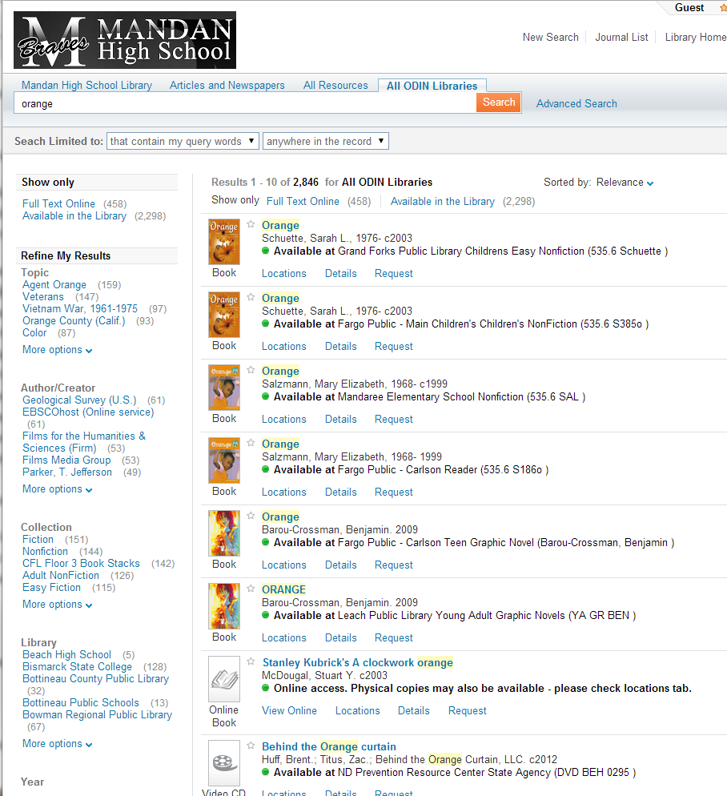
Facets

Slide 24
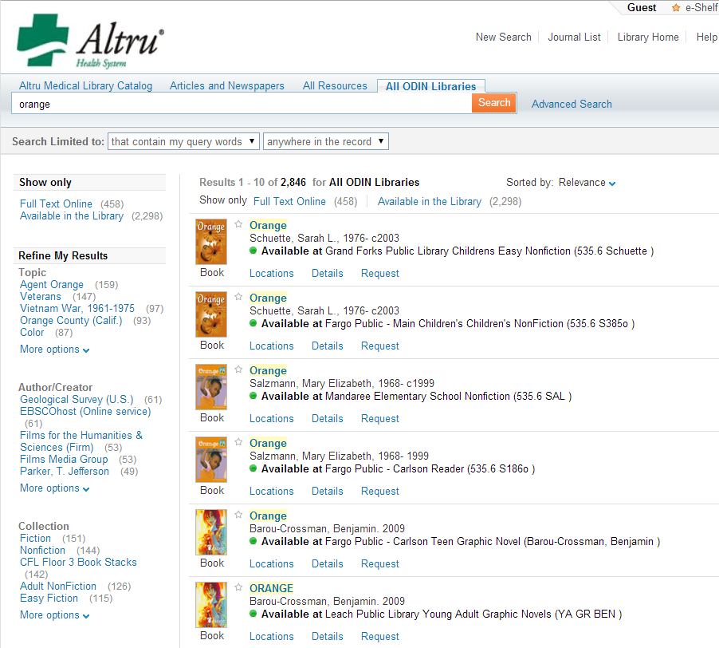
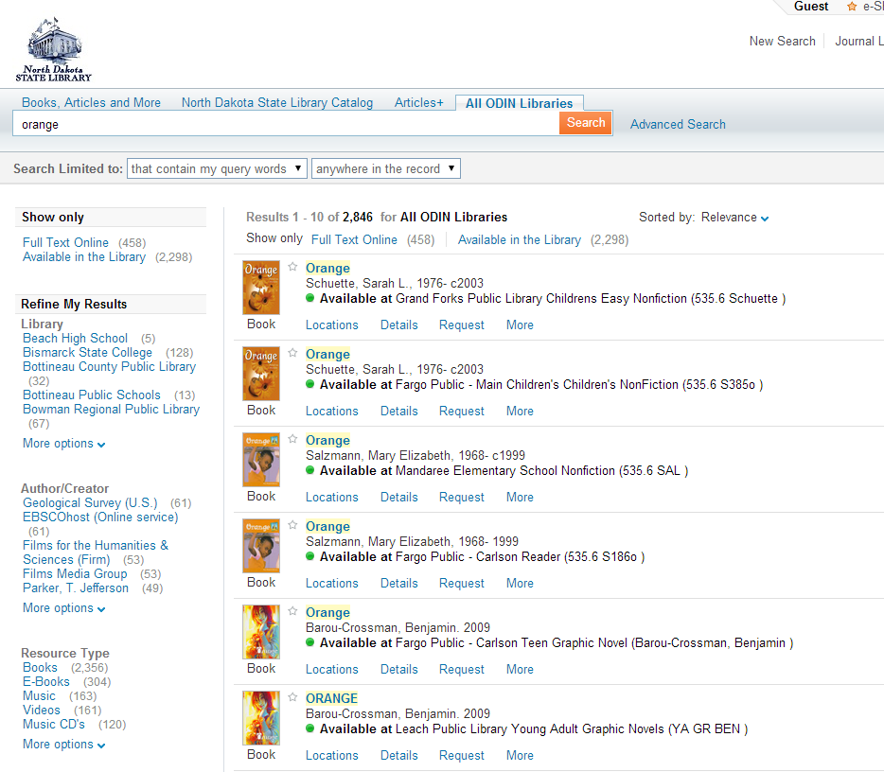
Order of Facets
GFH – default list of facets include Topic, Author/Creator, Collection, Library, Year, Resource Type and Language
NDS – facets order and content modified moving Library to top of list and including Genre/Form, and Classification LCC

Slide 25
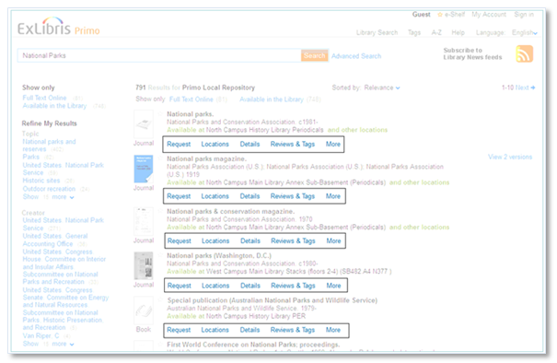
Brief Results Tab Labels
Request – Displays for physical items and opens a new window to the OPAC. Also referred to Find/Request
Locations – Displays physical items
View Online – Displays for online items: opens to full view
Details – Displays full metadata record for all items (next slide will cover the default fields used)
Reviews & Tags – Can create reviews and create tags to categorize search records.
More – Displays delivery options from SFX menu

Slide 26
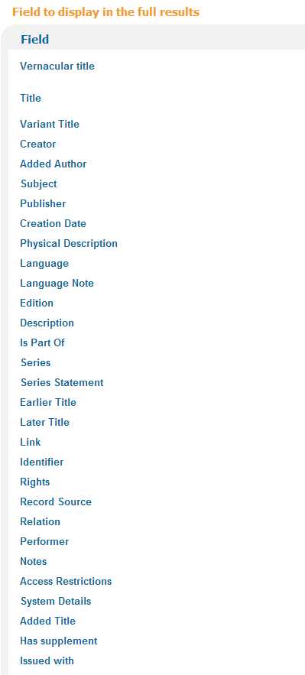
Details Tab
To the right is the default list of what fields are defined to appear within the details tab.
** The fields will be displayed if they are present in the bib record.

Slide 27
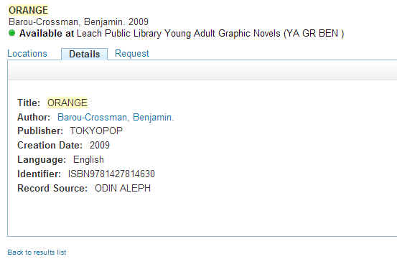
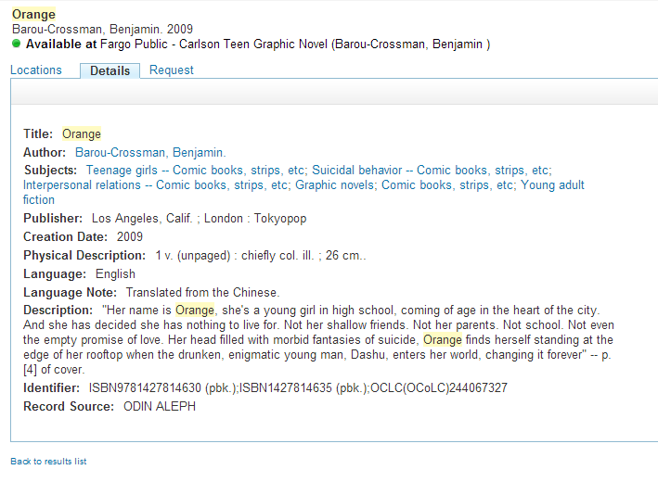
Example of same title cataloged by different libraries

Slide 28
Other Back Office Functionality
In addition to:
  creating/maintaining views
  managing harvesting pipes and indexing processes
  monitoring the system status
  Back Office is the interface used to:
  -- adjust code tables (controls display text)
  -- change mapping tables (configure parts of system)
  -- update normalization rules (converts original source data into Primo Normalized XML – PNX records)

Slide 29
Publishing
Publishing is the method used to harvest records from different data sources for use in the Primo interface. Normal ALEPH daily runtime is 10-20 minutes however a complete ALEPH database extract takes 30+ hours.
Each source (currently ALEPH, ALMA, ContentDM, Dspace) has a separate pipe that retrieves and processes the harvested records. These pipes can run from 1 minute up to 8-10 hours or more.
After the pipe completes, records run through indexing. Normal daily runtime is around 1 hour however it can take in excess of 20 hours depending on record count.

Slide 30
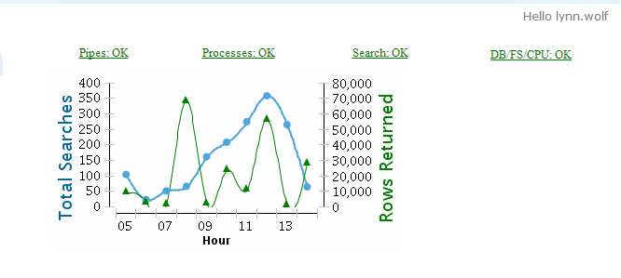
Monitor System Status
This is an example of the Dashboard Monitor from the Back Office home page.
The graph indicates number of searches done in the past 6 hours and the average amount of records returned for those searches.
The status indicators display an overall status of the system’s processes, pipes, search engines, file system, CPU load and database.

Slide 31
What’s new?
Recently we upgraded PRODUCTION from 4.4 to 4.6.
There were several major enhancements that we had been waiting for in these releases.
A few enhancements require additional system work before you will be able to see full functionality.

Slide 32
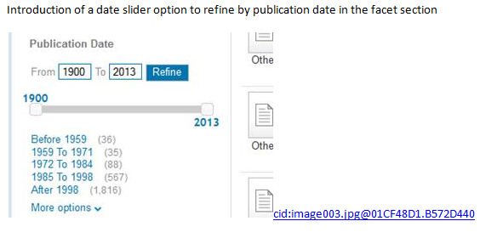
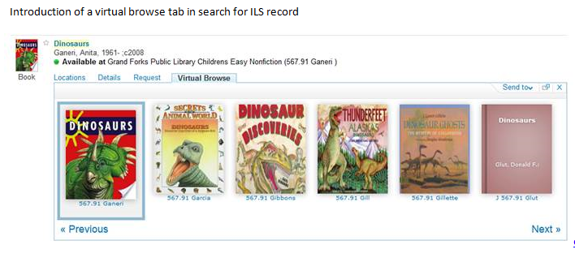
New in SP4.5

Slide 33
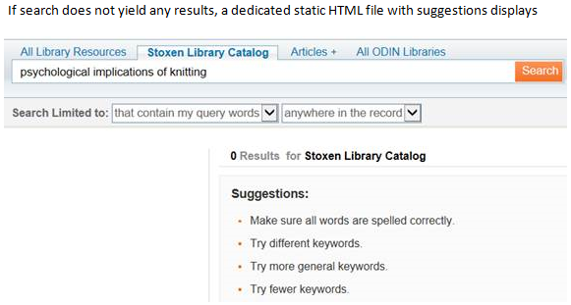
New in SP4.5
In My Account/Fines && Fees, the Fines Balance total only included one decimal – this has been fixed
Limiting to resource type: Books when conducting an Everything search sometimes included book reviews – this was deemed to be an issue with Ebsco data and has been fixed (tested – can no longer recreate the issue)
When switching between tabs using the Advanced Search option, only the search query was retained from tab to tab; now all search parameters are retained

Slide 34
Enhancements from SP4.5 that are still being worked on
Background work needed for Material Types being searched via the limiter on the Advanced Search screen.
Some browse functionality was updated and fixed however additional work is needed before feature is ready to put into production. Soon author, title and subject browse functionality will be available. Call number browse will be implemented at later date.

Slide 35
New in SP4.6
An ODIN submitted enhancement asking for ability to create citations for bibliography (APA, MLA, etc.) has been added to the ‘Send to’ drop down menu in the details tab of records.
The last column in My Account | Loans List was incorrectly names ‘column8’ if patron had no loans to display. This has been fixed.
Primo treats words with O’ (such as O’Leary) as a stop word and indexes them as two separate words – causing issues if the word is searched without the apostrophe (Oleary). This has be resolved so searches without an apostrophe will be searched both with and without the apostrophe, using a file of common names that start with O’.

Slide 36
How new versions are rolled out
Generally a new SP (or version upgrade) is available every few months.
When announced, ODIN requested install on our SANDBOX (TEST) environment.
Once that is installed by Support, ODIN Staff implements, evaluates, and tests functionality.
Any changes or adjustments are made before released to libraries for testing.

Slide 37
How new versions are rolled out
Unless specifically noted in the email notification that SANDBOX is ready for testing, ODIN Office believes the upgrade is functional and will not adversely affect our libraries.
*** We rely on your evaluation prior to upgrading PRODUCTION ***
If further issues are identified on SANDBOX, the PRODUCTION upgrade may be delayed until those issues are resolved.

Slide 38
Next upgrade
It was announced at ELUNA that the next upgrade for PRIMO (SP4.7) would be released in the May/June timeframe.

Slide 39
Questions or Comments?

Slide 40
Thank you for attending!
Please make sure to submit a Help Ticket if you have any questions or experience any problems. We cannot try to resolve a problem if we are unaware of it.

