Slide 1
PLIF for ACADEMIC LIBRARIES
Comments to --------
ellen.kotrba@ndus.edu

Slide 2
PLIF – Patron Loader Interface Format
Export data from ConnectND
  Data is mapped into pre-defined PLIF format per patron
    PLIF format maps fields according to Aleph configuration tables
  A match point is determined – empl id is used in type 05
Export data is fed into p_file_20
  p_file_20 new patrons:
    Patron ID comes from util-g-2 last-bor-id & prefix is three-letter library code + PL
      Example: BSFPL12345
    Barcode comes from util-g-2 bor-id-1 & prefix is three-letter library code + ID
      Example: BSFID65432
Z111 (user record keywords) & Z353 (patron index) - automatically updates & indexes
Error codes available upon request

Slide 3
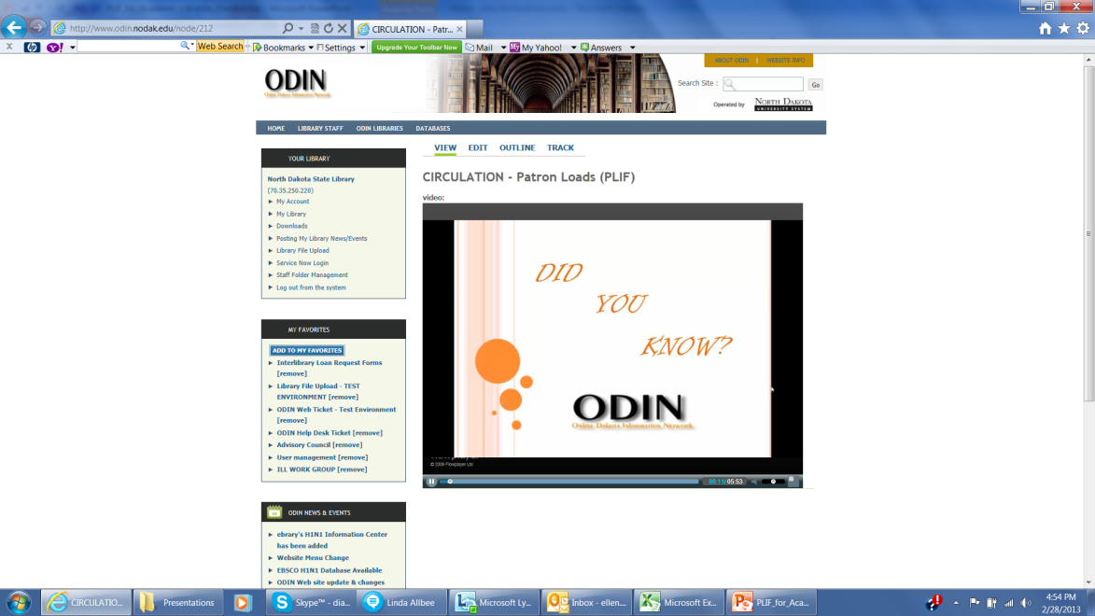
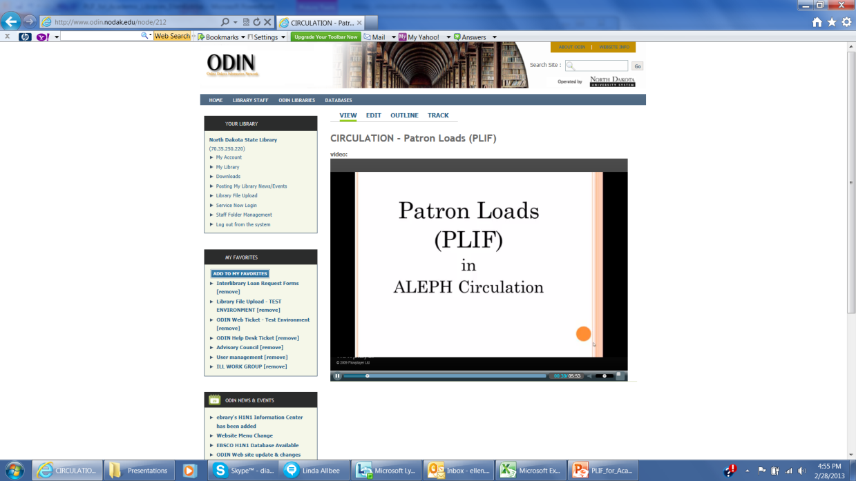
http://www.odin.nodak.edu/node/212
Circulation – Patron Loads (PLIF)

Slide 4
http://www.odin.nodak.edu/webticket
Put answer to each question in each ODIN Help Desk ticket –
1. What is your ADM Code?
2. What term should be loaded? Include YEAR and SEMESTER
  Default will be current semester if no term is specified
3. Who should be loaded? STUDENTS or FACULTY/STAFF or BOTH
  Default is BOTH if nothing is specified
4. Is Address to be loaded? YES or NO
  Default is NO if nothing is specified
4. Is tab31 updated? YES or NO
    col. 14 (Expiration Date) and col. 15 (Cash Overspend Limit)
5. Would you like the file run in UPDATE mode if no errors are reported in non-update report? YES or NO
Submit one ticket per PLIF load

Slide 5
Cust-88
Update Patron Home Library after Plif run
Automatically run
This service will Update the Patron Home Library and ILL Unit fields which are unfilled by the PLIF patron record loader
This service is restricted to ODIN staff use and requires a special user

Slide 6
Cust-89
Populate Patron Record Fields
This service will Update the Patron Record 1) ILL Total Limit, 2) ILL Active Limit and 3) Profile fields for active patrons with a specified patron status
The service may only be run in an ADMinistrative library
This service is restricted to users with permissions to run a priv-05 service (username format begins with “updserv” & needs to be assigned by the ODIN Office)
Use Help to ensure requested report fields have proper # of characters and upper/lowercase
A report will list the record ids of the patron records changed and the value of the fields prior to the requested changes

Slide 7
Cust-89 questions from UND
Will this affect all patrons or only UND50 patrons? It will affect patrons who have UND local privileges
Are patrons selected by home library or local privileges? It’s selecting by ILL Library
What about shared patrons? Only affects patron status stated on the form and patron needs to have local privileges @ UND
What about blocked patrons? It’ll change them too
Will it change records with existing data (overwrite) or only blank fields? Overwrite - it will update each patron record matching the patron status listed in the service according to service parameters, report will show what is was before the change
Profile may reset a patrons’ preferences? It’s possible, but if you put a profile in this service, it’ll change it – it’s that powerful! You will be able to see the “before” values in the report and of course could reset a patrons’ preference

Slide 8
Cust-205 patron records without an ill unit
This service retrieves Patron Records that do not have an ILL Unit code assigned to them
The service may only be run in an ADMinistrative library

Slide 9
Cust-86 update aleph expiry dates
This service will check the ALEPH Expiry Date on the ALEPH patron for any local privilege record that was updated
Basically checks & updates the ALEPH patron (for any patron whose local patron record expiry date was updated) so that expiration date on the ALEPH patron is the farthest into the future
  Prevents a patron dropping out of Aleph pre-maturely

Slide 10
something to think about as we go along
Currently there is only one PLIF mapping job @ ConnectND for students and one PLIF mapping job @ ConnectND for faculty/staff
  used by all ODIN libraries – Do you think there should be PLIF mapping jobs per academic library?
  UND, UNE, UNF may have to be considered separately
NDUS policies and standards – no clear answers

Slide 11
ISSUES raised by Lynn Wolf/ODIN
Cell phone numbers
  Is this needed? Smart phones & email access via cell phones is now available
Structure of Address
  ex. UND Campus postal services requires Street Name and Stop # for faculty/staff addresses and only the building name & number were included in PLIF
What is preferred address order @ each academic institution?
  ex. Home, Dorm, Permanent OR Dorm, Permanent, Home OR etc.
  If separate pulls from ConnectND, this could be different for each institution
Are any standards in place to use per student, faculty, staff?
  ex. mandated by NDUS/CIO
Is data in same fields @ each academic institution?
  If separate pulls from ConnectND, is this an issue – Lynn Wolf says: it WOULD matter if the staff working with ConnectND within a single campus is not being consistent in how they are entering information (we have seen cases of inconsistent data entry on the ConnectND side). This also could be affected if any of the information is being entered by the student/staff via Self Service and the format (or lack of format) the patron chooses to follow

Slide 12
ISSUES raised by UND-Chester Fritz Library
Can UND loads differ from UNE and/or UNF loads?
  ex. one wants addresses, another may not
Address Lines
  ex. not picking up both address lines from ConnectND
    Chester Fritz Library, Chester Fritz Library Room 242, 3051 University Avenue Stop 9000, Grand Forks, ND 58202-9000 in ConnectND
    Chester Fritz Library, Chester Fritz Library Room 242, Grand Forks, ND 58202-9000
    The 2nd address line is being dropped – completely unacceptable
    PLIF format was written BEFORE ConnectND
      The original PLIF file feed designated 5 lines for address with 1st line being name, 2nd being ADDRESS1, 3rd being ADDRESS2, 4th being CITY and 5th being STATE.
      Again because the data is loaded from an extract, the accuracy and consistency is determined by the source of the data
    Request needs to come from ODIN Office
Address type 1 vs. address type 2
  UND uses 01 for permanent address – most of the time, this is parent’s address
  UND uses 02 for local address – dorm or apartment address
  PLIF is designed to pull only one address and populate the 02 address

Slide 13
PLIF logic for Address extraction & Loading
Student Addresses – retain 1st non-blank address field found – loaded into type 2 address
  If student is ACTIVE – examine addresses in this sequence – take 1st non-blank address
    Dorm | Mail | Home | Permanent | Parent
  If student is INACTIVE – examine addresses in this sequence – take 1st non-blank address
    Home | Permanent | Parent
Faculty/Staff Addresses – retain 1st non-blank address field found – loaded into type 2 address
  If fac/staff is ACTIVE or INACTIVE – examine addresses in this sequence
    Campus (only choice available)

Slide 14
ISSUES raised by UND-Chester Fritz Library
Is there a limit to how many PLIF loads may be loaded per semester?
  Lynn Wolf says: currently we do not limit number of PLIFs – some libraries request several times a week at start of semester
How is data pulled determined to be current?
  It’s current data from ConnectND – it’s from the “Master Record”
  Data is requested and pulled on same day and loaded shortly thereafter
  Includes the information fields being coded consistently within a single campus and across all campuses

Slide 15
UND Specific questions
Can the “valid from” and “valid to” dates for the address types be changed or will they always be the “current date” and “10 years from the current date”?
  Currently they are hard-coded
  Would require a programming request to ConnectND
  Addresses should be into the future unless it’s a temporary address
Does a PLIF patron status change cause the ALEPH level patron to change?
  Aleph level patron statuses are “different” than local patron status but are uniform across ODINland – see tab31
  Expiration date of ALEPH level patron is always the “most into the future” from whichever local patron has that latest expiration date
  Cust-86 is run daily to keep things up-to-date for the ALEPH level patron
  Cust-85 can be used to identify which libraries a person belongs to – must use Patron ID in this custom service

Slide 16
UND Specific questions
If multiple type 2 addresses exist, is there a way to know which one will get changed?
  Should update only a type 2 with valid dates
  Need to test this
Is there a way to tell if an address will get “added” vs. “changed”?
  There are two action codes
    REWRITE – data is populated & will be updated/overwritten
    INSERT – data is new/not populated & will be inserted

Slide 17
Questions & Issues – All campuses
Are email address included in a PLIF load?
  Not currently
  Would require a programming request to ConnectND
    Do all campuses populate email addresses the same per patron record?
Lynn Wolf indicates this is an issue that affects all PLIF libraries as several libraries have
asked about email addresses being populated. The source of the data (ConnectND)
needs to standardize placement of the email addresses. Once ConnectND has finished
standardizing across all institutions, a request will need to be submitted to programming to
include email addresses. Currently, the PLIF extracts are not programmed to include that
information. When we are able to start including the email address, it is assumed that
“the official email address” for a campus will be used.

Slide 18
Questions & Issues – all campuses
Could cell phone numbers be included in a PLIF load
  Lynn Wolf indicates this is another issue that affects all PLIF libraries as several libraries have asked about cell phone numbers The source of the data (ConnectND) needs to standardize placement of the cell phone number. Once ConnectND has finished standardizing across all institutions, a request will need to be submitted to programming to include cell phone numbers. Currently, the PLIF extracts are not programmed to include that information.

Slide 19
Known issues with plif
Patron index does not get updated properly
  If a patron was originally loaded in one PLIF load but then changes or is included in another PLIF load – patron information is loaded but index does not get properly updated
  No results display when doing a patron search & Display Local Patrons Only is checked
  Reported to Ex Libris – no solution yet

Slide 20
PLIF Facts
If an academic library requests both a student & a faculty/staff load – the student file is processed first followed by the faculty/staff file so that faculty/staff privileges override student privileges
Some academic libraries prefer to load faculty and/or staff manually but all academic libraries load student records
UND/UNE/UNF are all loaded from same request to ConnectND. Three specific files are received containing different patron type codes depending on what department the patron belongs. The UND file is processed first since the majority of students would be primary patrons. The UNE file is processed next and then the UNF file.

Slide 21
MORE
OPEN DISCUSSION

