Slide 1
One, Two Three Migrations!
ODIN’s Website is changing too!
Notes:
NOTE:
To change the image on this slide, select the picture and delete it. Then click the Pictures icon in the placeholder to insert your own image.

Slide 2
Agenda
Refresher for the current website
Other consortia for inspiration/ideas
“Must have” and “Wants” for new site
Feedback / Q&A

Slide 3
About Me
Build websites and customize views
CMS: Drupal, Wordpress, Libguides, etc.
Repositories: Dspace/CONTENTdm
Discovery: Primo NUI/VE
Teach web design/development & media design
New(ish) to ODIN – Sept. 2018
At NDSU previously (and NDSCS, Mayville, and LRSC)
Live in West Fargo

Slide 4
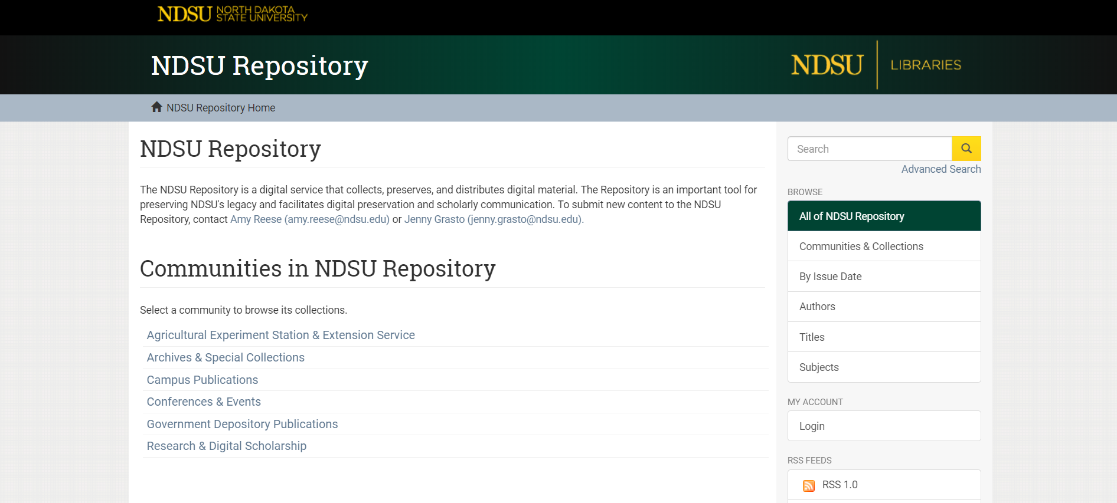
Some Previous Projects

Slide 5
Current ODIN Website Highlights
Major Project Pages
Alma/Primo VE: http://www.odin.nodak.edu/alma
Polaris: http://www.odin.nodak.edu/polaris
30 Year Anniversary
http://www.odin.nodak.edu/30-years-odin
Databases
http://www.odin.nodak.edu/databases
Submitting a ticket
https://ndus.teamdynamix.com/TDClient/Requests/TicketRequests/NewForm?ID=22971&ShowNav=0&ShowFoot=0

Slide 6
Current ODIN Website Highlights (cont.)
Statistics
http://www.odin.nodak.edu/stats
Training and Documentation
http://www.odin.nodak.edu/training-and-documentation
ODIN Member Libraries
http://www.odin.nodak.edu/lib_users/libraries
“My Favorites”
Create your own list!

Slide 7
Other Consortia
Inspiration and Ideas
Carli
Rails
Orbis Cascade
PALS

Slide 8
Other Consortia
https://www.carli.illinois.edu/
https://www.railslibraries.info/

Slide 9
Other Consortia (cont.)
https://www.mnpals.org/
https://www.orbiscascade.org/

Slide 10
What do they all have – Content Inventory
Support
Training requests
Outage reporting
Issue tracking
Services List
Catalog Support
ILL
Databases
Digital Collections
E-book Delivery
Servers/website hosting
Resources
Product documentation
Training videos
FAQs
Workflows
News and Events
Calendar of events
Library news
System news
Webinars
About/Contact
Member lists
Contact info
Governance
Community
Work Groups
Committees
Policy / Board

Slide 11
The ‘Pillars’
ODIN Office Website
Support
About / Members
Community
Documentation / Training
Governance
What consortia website have in common

Slide 12
Feedback and Questions?
What would you like to see added/different?
Any thoughts on future projects/plans ODIN should explore9?
Thanks for attending!

