Slide 1

No Rhyme or Reason
various contributors
Notes:
Welcome to all of you! This session is intended to educate you on various topics too short for an hour long session. As with everything, more information is available in documentation and through ODIN staff. Please send in any questions or requests for more information on any topic via an ODIN Help Desk ticket available @ http://www.odin.nodak.edu/webticket.

Slide 2
Thanks for visualizing
AGENDA
What is Primo Central?
Educate me! What is a proxy?
Setting up emailing of notices
EBSCOhost e-book records replacing netLibrary e-book records
Various custom reports
Report Formats found in various Services
Notes:
Our agenda for this session includes Primo Central, Proxies, Emailing of Notices, netLibrary e-book bib records being replaced by EBSCOhost e-book bib records, various custom reports and Report Formats found in various Services.

Slide 3

What is Primo Central?
Notes:
First, What is Primo Central?

Slide 4
Primo Central
Primo Central is a mega-aggregate of over 350 million records (primarily articles and newspaper articles) accessible via the Primo interface.
These records are harvested from various publishers and aggregators, and come together in one, centralized index.
Notes:
Primo Central is a large collection of over 350 million records accessible through the Ex Libris Primo discovery interface. The records, primarily journal & newspaper articles are brought together in one centralized index courtesy of various publishers and other aggregators. To put this in perspective, an aggregator is a firm or web application that clusters information for use by others.

Slide 5
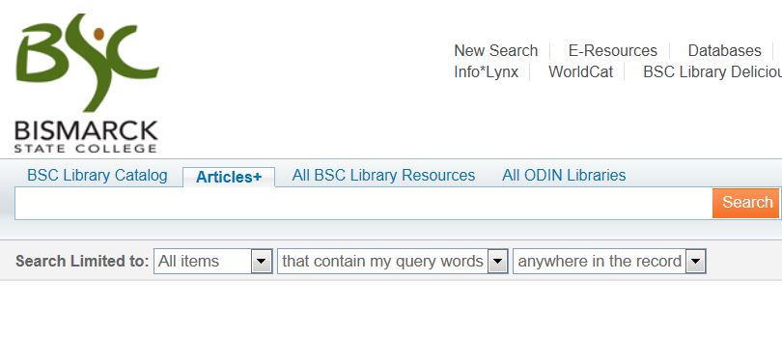
Primo Central
Many libraries have chosen to name the Primo Central search scope ‘Articles’, ‘Articles+’, or ‘Articles and More’ in their Primo view.
Notes:
Libraries in ODIN have chosen to name this Primo Central search scope various titles: Articles | Articles and More | Articles+ | you get the picture – In our example, Bismarck State College has chosen to name their Primo Central scope – Articles+

Slide 6
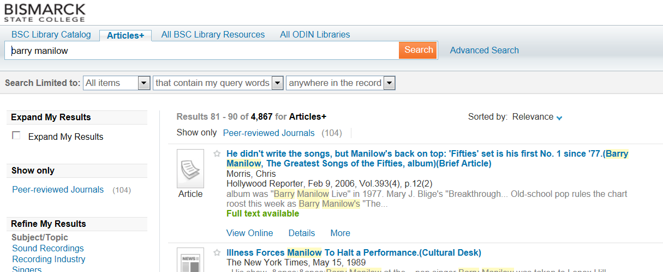
Primo Central
Primo Central provides the index, and once the search is conducted, SFX provides information as to availability of the item, as well as what options are available for retrieval.
Notes:
Primo Central is an index and after a search completes, SFX shows availability as well as retrieval options. In our examples, one may immediately see that full-text is available for an article.

Slide 7
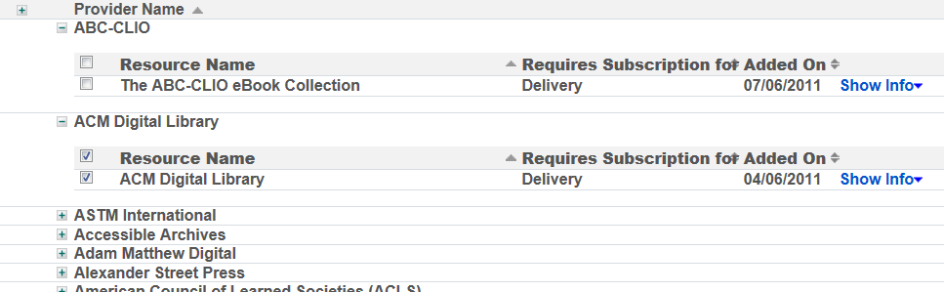
Primo Central
Before searching Primo Central, resources need to be activated. The ODIN office has activated resources for libraries based on subscribed databases, and other resources available to be searched free of charge.
Notes:
Resources need to be activated by the ODIN Office before Primo Central searching is able to provide valid results. Resources are activated based on subscription & free databases.

Slide 8
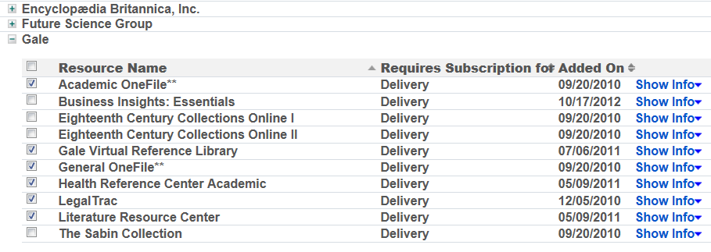
Primo Central
While some databases – such as Gale – are very straightforward in their activation….
Notes:
Aggregator packages (such as those from Gale) are very easy to activate offering one-to-one title activation.

Slide 9
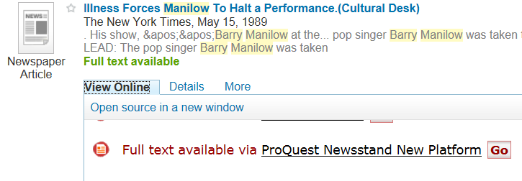
Primo Central
…other databases – such as Proquest – do not have a one-to-one activation resource. In these cases, most items in these databases are also in other resources in Primo Central. When the items appear in the search results, users are directed to the library’s databases.
Notes:
Proquest is more of a “package” activation. This usually means that most articles are also in other resources in Primo Central.

Slide 10
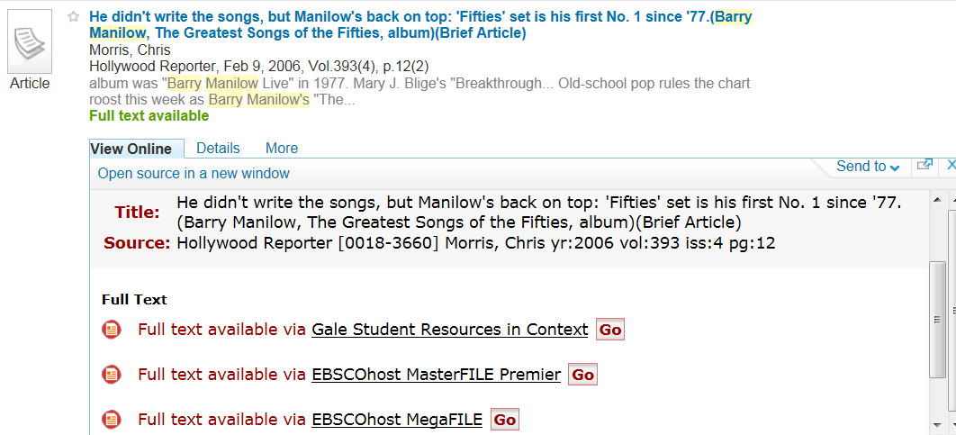
Primo Central
In the case of Ebsco databases, an interface (Ebsco API) has been developed, and Primo has been set-up to search it in conjunction with the Primo Central index. If a retrieved item is available via an Ebsco database, the user is directed accordingly.
Notes:
EBSCO is an exception. An EBSCO API was developed by Ex Libris and if a retrieved item is available via an EBSCO database, the user is directed accordingly.

Slide 11
EDUCATE me! What is a proxy server?
Notes:
Our next topic is Proxies

Slide 12

DEFINED
Proxy Server
Reasons to use a Proxy Server
A server (web or computer) used to facilitate access to resources on other servers
Authenticates users via login credentials
Security
To speed access by caching
Filtering
One IP address to give to vendors
Notes:
First of all, you need to know what a proxy does. A proxy authenticates a user via login credentials. A proxy server – which can be on the web or on a computer – is used to forward a user to access resources on other servers. One IP address is used to facilitate this access. Proxies provide security, filtering and speeds access to resources by way of caching. Caching is holding information (that has been accessed before) so that it may be delivered quicker when requested again.

Slide 13
A proxy URL is added to an existing URL
$$uhttp://odinproxy7.ndus.nodak.edu/login?url=http://search.ebscohost.com/login.aspx?direct=true&scope=site&db=nlebk&db=nlabk&AN=14883
odinproxy7.ndus.nodak.edu is equivalent to 134.129.94.225
The IPs of the library (on site) are not required to login
when a proxy is used in a bibliographic record
if the proxy is set up correctly!
Notes:
A proxy address that ODIN maintains looks something like this: http://odinproxy7.ndus.nodak.edu. This proxy address is used to authenticate a user linked to Jamestown College. The proxy address may then be combined with resource URLs to authenticate access and direct the user to a resource. Most vendors require authentication before delivering their product. As you can see in this slide, we add the proxy to the $$u and then add /login?url= so the user is directed to their chosen resource. Also, a numerical IP is also associated with an alpha proxy address. In this case, that IP is 134.129.94.225. It’s also important to note that users within the library or campus should not have to log in. Only remote users whose IPs are not recognized should have to log in. If you wish to know more about proxies, please send in an ODIN Help Desk ticket.

Slide 14
Setting up Emailing of Notices
Notes:
Setting up Emailing of Notices – this will be a very brief overview and should you wish to set this up at your library, please send in an ODIN Help Desk ticket.

Slide 15
Did You Know is available
http://www.odin.nodak.edu/node/209
Notes:
A “Did You Know” is available on this topic. It may be found on the ODIN Home Page, in the Library Staff Section under Training – the address is http://www.odin.nodak.edu/node/209

Slide 16
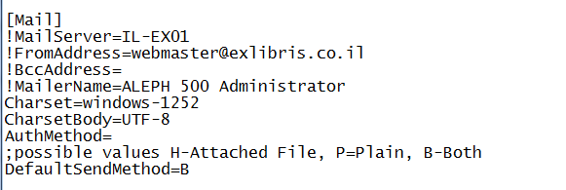
Get Client Ready
Update alephcom/tab/alephcom.ini file – change is active “per PC”
Need to know:
* Mail Server – exchange MailServer address
* FromAddress - email to where email bounces or replies are sent
* MailerName – who is sending email
* DefaultSendMethod= [default is B-Both]
Notes:
The very first thing you should think about is getting your client ready to email. This is done in the [Mail] section of the alephcom.ini file in the alephcom/tab directory. The most important thing is to find out from your library tech people what your Mail Server information is. This is what your emails run through. Without it, you are not able to email. You will also need to decide who will receive email bounces and replies and what name/title/etc should show as who is sending the email. In addition, should the information coming via email be – as an attached file, in plain text within the email or both. Many recipients don’t like to open attachments due to viruses so we suggest either Plain or Both. The mail attachment parameter (DefaultSendMethod) in this section would “override” values set in the Global Patron Information node on the patron record. It’s also important to understand that changes to an alephcom.ini file on a particular PC is readying ONLY that PC – you’d have to set up another PC should you wish to send email addresses on that additional PC.

Slide 17
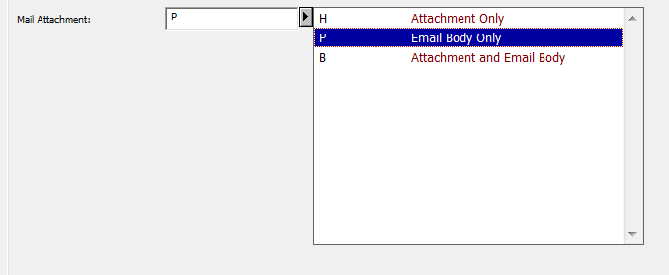
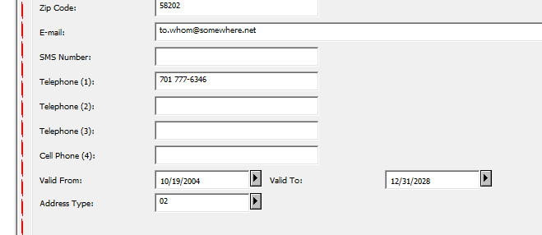
Ready Patron Records
Get Patron Record ready
Get Patron Record ready
Mail Attachment needs to be set to include email
Must have valid email address on Address Information Node “usually type 2”
Notes:
Next, we have to ready the patron records. You decided in the last step what your DefaultSendMethod was and thus you’d want your patron record in the Global Patron Information node to reflect the same. Note, however, if you forget, at least you’ve covered it in the alephcom.ini file. The most important thing is to have a valid email address in the Address Information node in the address type you are using. Type 2 is the one that is used in ODIN unless you’ve modified tables to change it.

Slide 18
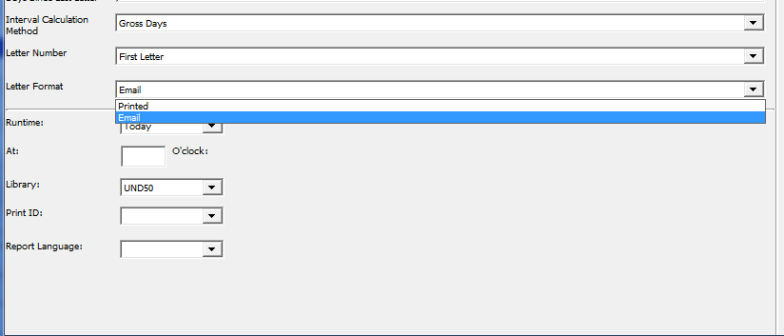
LETTER FORMAT – example – Cir-52 Overdue Summary
If running via service, make sure Letter Format is Email
If running via joblist, let ODIN staff know to switch to Email
Notes:
It’s also important that the service you are running contains the proper Letter Format – that of Email – instead of Printed. You can see this in the example here on the cir-52 overdue summary notice. A reminder – if you have set up services via joblist with the ODIN Office, you will need to notify them – that you are switching to emailing of notices.

Slide 19
Task Manager Emailing / Printing – it prints those that don’t email
Move file (ex. Overdue Summary) to Local Drive
Change:
  Print Configuration to Normal Printing
  Setup Type to Mail
  Print Setup to Y
When you highlight file and click Print, those notices with valid emails are sent via email and those that cannot be emailed are printed out
Notes:
The workflow is as follows – a service is run that results in a notice – let’s say an overdue summary (cir-52) – when the notices are ready, they’ll appear in the Task Manager of the Circulation module. Move the file or files from the remote server to your local drive. In the lower pane, update print configuration to “Normal Printing”, update Setup Type to Mail and update Print Setup to Y. In the upper pane, highlight a file and click Print. The notices with valid emails are then sent via email and those that cannot be emailed are printed out for you to send via snail mail.

Slide 20
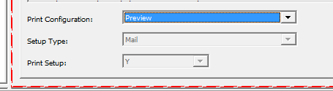
Re-setting Preview – so duplicate emails don’t get sent
Change Print Configuration back to Preview
other options gray out:
Setup Type
Print Setup
Notes:
If this PC is used for anything other than emailing notices, then you MUST reset the Print Configuration back to Preview before leaving the client to avoid possible duplicate emailing. You may be wondering why? It’s because the chance of duplicating emails is higher when Normal Printing is set as the Print Configuration (because a human may pick the wrong file and before you know it, the emails are sent). Keeping Print Configuration in Preview when not consciously sending email is the preferred workflow (unless the PC is only used for emailing notices)

Slide 21
EBSCOhost ebooks
Notes:
Next, let’s talk about EBSCOhost ebooks

Slide 22
EBSCOhost e-books
Records from OCLC
Loaded via loader
EBSCOhost e-book bib records merging with netLibrary e-book records thereby deleting netlibrary URLs
Notes:
EBSCOhost bought out netLibrary a few years ago. Last summer, proxies were added to most existing URLs so that remote users could still access the netLibrary ebooks. EBSCOhost has informed us that the URLs within those netLibrary bib records will cease working sometime in the future. Therefore, ODIN would like to be proactive and replace these netLibrary bibliographic records with EBSCOhost bibliographic records as soon as possible. EBSCOhost has agreed to provide MARC records from OCLC, free of charge, and these files can then be loaded into ODIN via the loaders and merged with the netLibrary records, thus effectively removing the netLibrary links.

Slide 23
Libraries “involved”
NDS – ND State Library chose to just delete the netLibrary records and “not” load any ebooks at all
Many ODIN libraries do not have the ebook bibliographic records loaded
NBJ – Bismarck State College – done
NDJ – Jamestown College – almost done
BSF – Dakota College @ Bottineau – in progress
Left to do:
DIP NDI
LRJ NDV
NDW NFG
NGF NMI
NMY UND
TBI UNW
UNW DZF
WFP HPC
JSH
MPS
Notes:
Bismarck State College was the pilot project to see how everything would work. The cataloger has very little involvement other than to test and verify. We did find out that we had to “delete” some additional 856 fields that come with the new EBSCO host records but all that is accomplished globally. It is the intent of the ODIN Office to 1) verify that you still want ebooks 2) ask for the records from EBSCOhost and 3) load into ODIN after discussion of collections and loader tables. Everything is done in test before doing the load to production.

Slide 24
Custom Reports - Circulation
Notes:
Many custom reports have been added to Aleph throughout the years – they are designed to be copied into Excel with ease. There are so many more custom reports than are presented here today so take some time and see which custom reports your library may benefit from.

Slide 25
ODIN-Custom Usage and Statistics
Notes:
The following custom reports are found in the Circulation Module under Services/ODIN-Custom Usage and Statistics

Slide 26
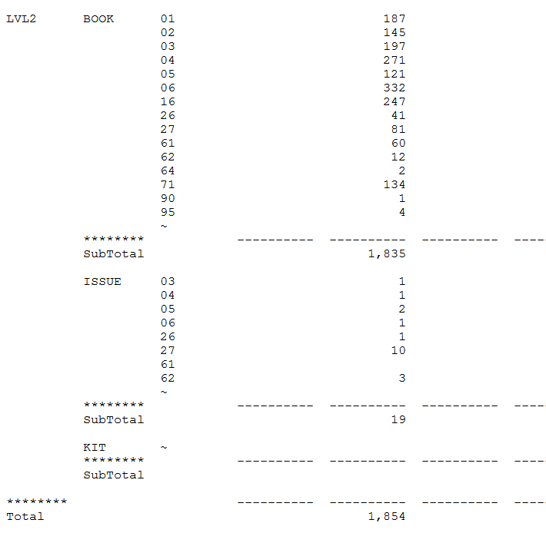
Circulation Transactions
I sorted by Collection, then Material Type &
finally by Borrower Status – shows simple loan
Cust-05
Circulation Transactions by date range
Three-way sort:
  Sublibrary
  Borrower Status
  Item Status
  Material Type
  Collection
  None
Notes:
Custom-05 tracks circulation transactions by date range. There are various sorting options and in this example I did a report of the LVL2 collection sorted first by Collection and then within collection by Material Type and finally within Collection/Type by Borrower Status. The report shows far more than just simple loans – it also shows web renewals, returns, etc.

Slide 27
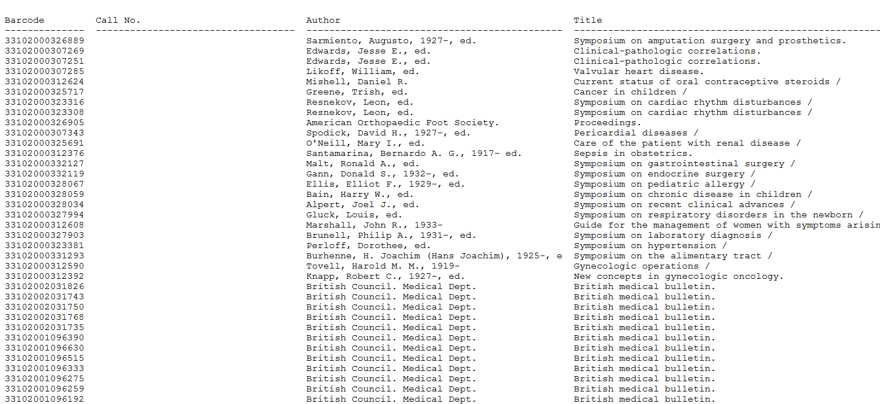
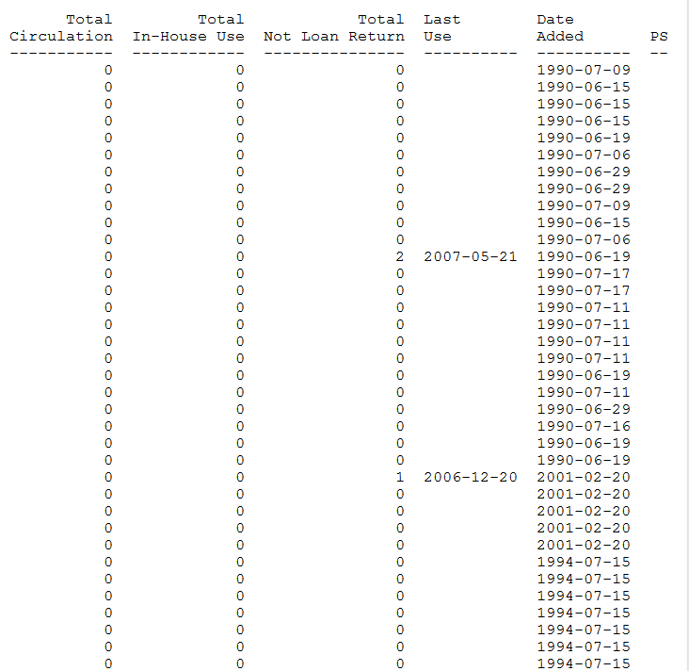
Weeding Report
Cust-30
Identifies items that have not circulated since a specified date
Report contains:
  item barcode
  call number
  author
  title
  total circs
  total in-house use
  total not loan return
  last use date
  date added
  processing status
Notes:
Custom-30 is useful in the weeding process. The report identifies items that have not circulated since a specified date. You load that date into the service workform. For my example, I used a date of 01/01/2008 and a collection of LVL2S. You could do the report for all collections but think of how huge that report would be for your library. We suggest breaking these weeding reports down by collection to make them manageable.

Slide 28
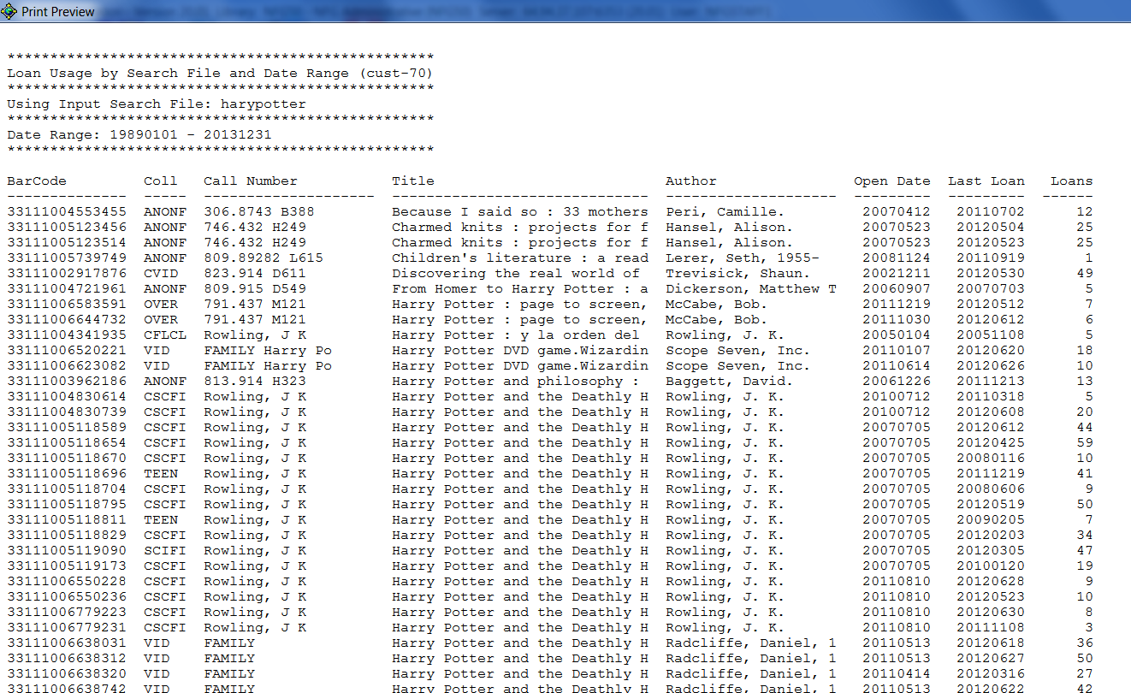
Loan Usage per search file
Cust-70
Loan usage by search file and date range
Search for something and save to use for input file
I searched for
title of Harry Potter
and then saved file
as harypotter
When I ran the service
I used dates of
1/1/1989 through
12/31/2013
Notes:
Custom-70 is useful when you want to see loan usage by some sort of search criteria. Let’s say you want to find out if the Harry Potter collection is still being used extensively and perhaps need more titles ordered. You can search by title in the Search tab (the tab with the binoculars) and then save the set. In this example, 107 titles were found and then saved as filename harypotter (note: the filename can be only 10 characters when saving via the search tab). In cust-70, use that filename as input to find out usage in a specific date range. The report that is generated also lists open date and last loan. In this example, item 33111002917876 (CVID collection) has 49 loans for the date range of 1/1/1989 through 12/31/2013 and that the last loan date was 5/30/2012. That’s a lot of loans but hasn’t been used for almost 10 months. Probably wouldn’t need another copy.

Slide 29
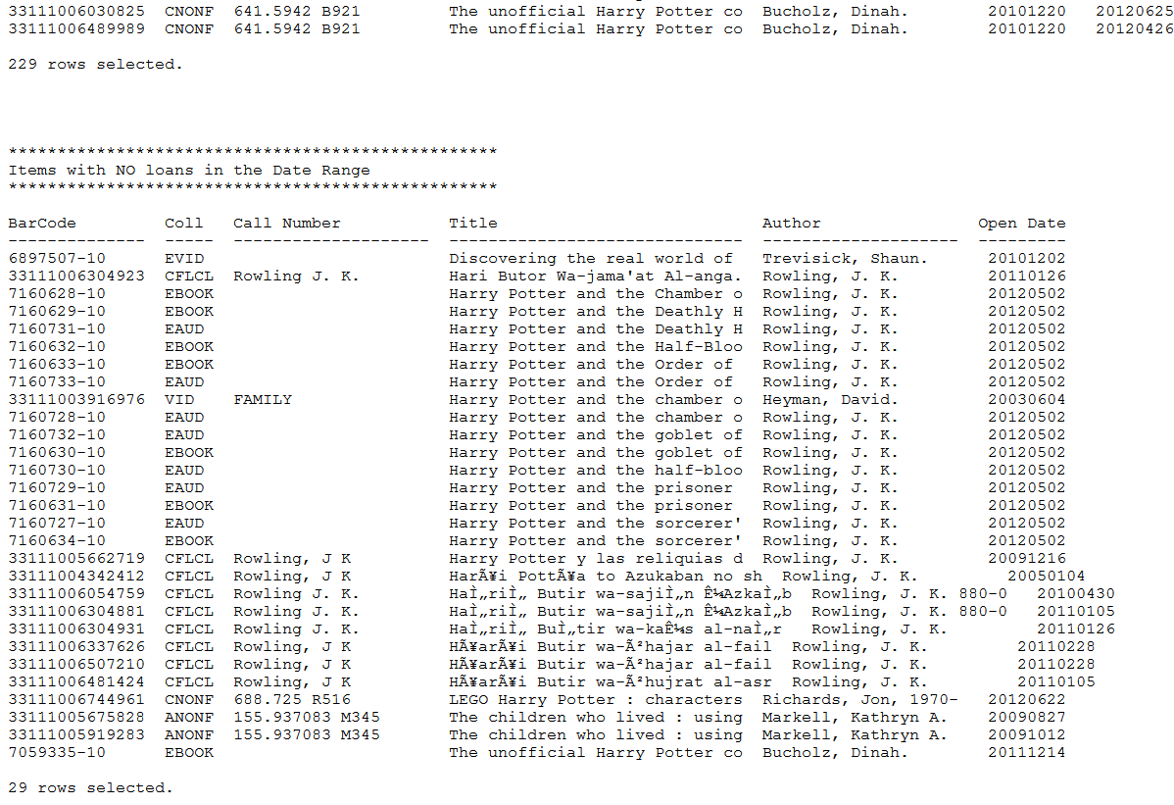
Loan Usage per search file
Cust-70
Also records items that had “no” usage
Able to see total of items being reported on
Notes:
Custom-70 also allows one to see how many items are being reported on – in this example, we are looking at 229 items that had loan usage. And this report will also show the titles that had no loans in the date range – in this example, 29 items had no loans – so to recap, our title search had 107 titles but there were 258 items.

Slide 30
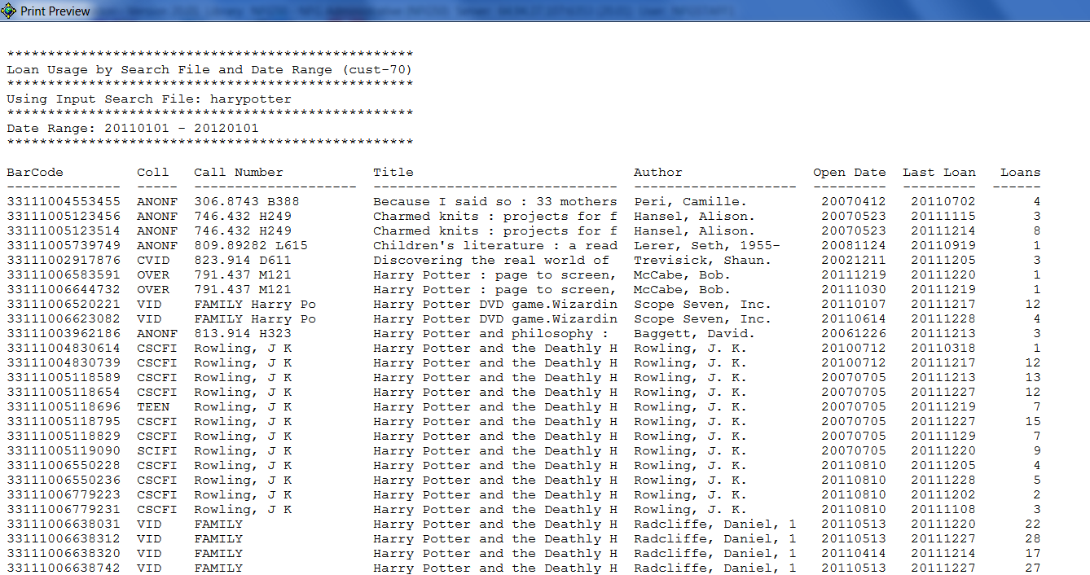
Loan Usage per search file
Cust-70
Using same harypotter as input file
When I ran the service I used dates of
1/1/2011 through 1/1/2012
to get all of 2011 loan usage
... continued
Notes:
The same input file (harypotter) was run using different date ranges – in this example, the date range used was 1/1/2011 and 1/1/2012 to get all the 2011 loan usage. Remember in our previous example, item 33111002917876 had 49 loans overall, but, in this date range, that item only has 3 loans.

Slide 31
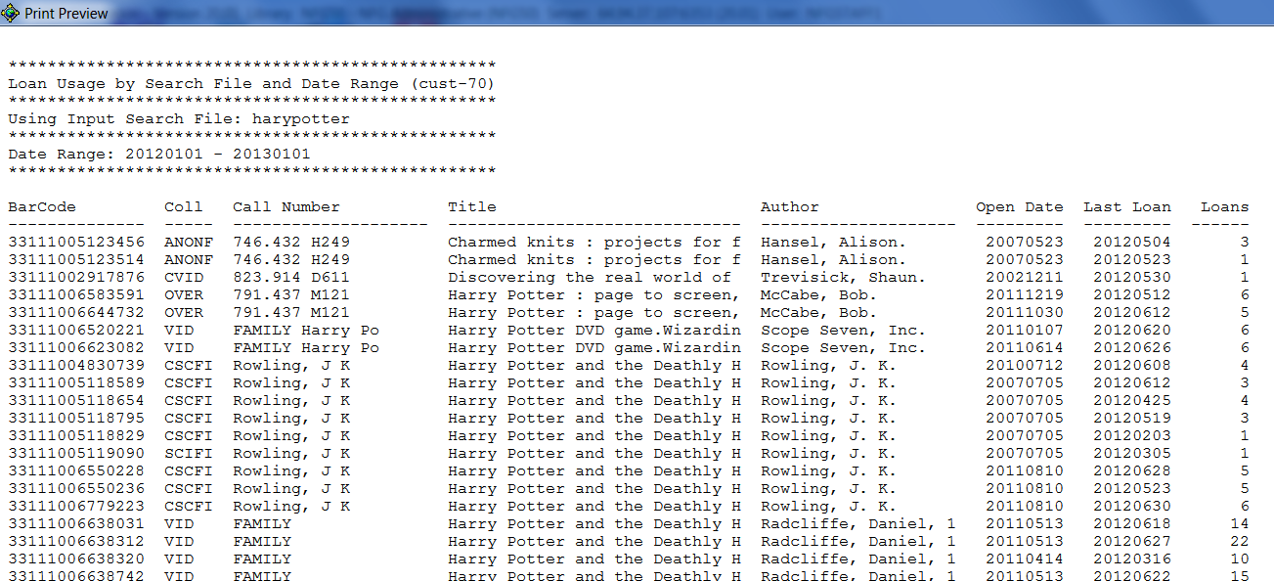
Loan Usage per search file
Cust-70
Using same harypotter as input file
When I ran the service I used dates of
1/1/2012 through 1/1/2013
to get all of 2012 loan usage
... continued
Notes:
Using the same input file again (harypotter) with the date range of 1/1/2012 and 1/1/2013 to get all the 2012 loan usage I can see that the same item now has only 1 loan. To recap, item 33111002917876 had 49 loans in the date range of 1/1/1989-12/31/2013, had 3 loans in the date range of 1/1/2011-1/1/2012 and now has only 1 loan for 1/1/2012-1/1/2013. And the last loan date was 5/30/2012 on all three reports. This just shows how using one report may result in more than one way to use it.

Slide 32
ODIN-Custom Items
Notes:
The following custom reports are found in the Circulation Module under Services/ODIN-Custom Items

Slide 33
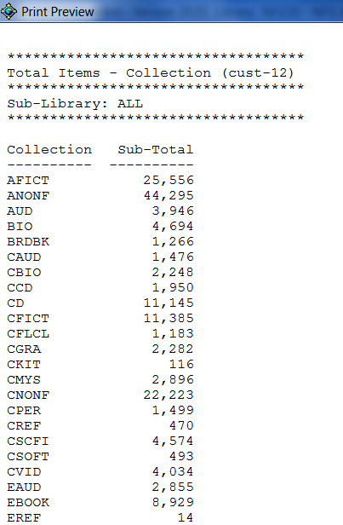
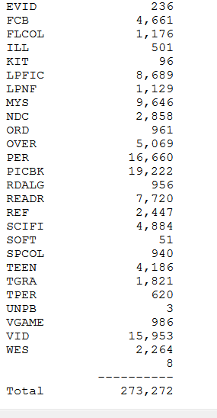
Total # of barcodes
Cust-12
Total Items
  By collection
  By item status
Total # of barcodes in a single sublibrary
Notes:
Custom-12 counts total barcodes – by collection or item status – in a single sublibrary. The report then totals all the barcodes and supplies the count at the end of the report. This is an example showing total items by collection in a single sublibrary.

Slide 34
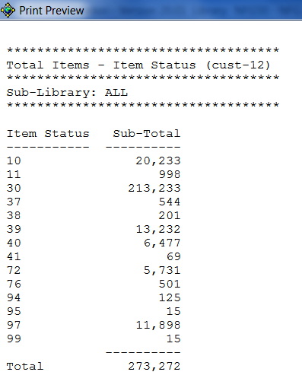
Total # of barcodes
Cust-12
Total Items
  By collection
  By item status
Total # of barcodes in a single sublibrary
Notes:
This slide shows total items by item status in a single sublibrary.

Slide 35
ODIN-Custom Bib Records
Notes:
The following custom reports are found in the Circulation Module under Services/ODIN-Custom Bib records

Slide 36

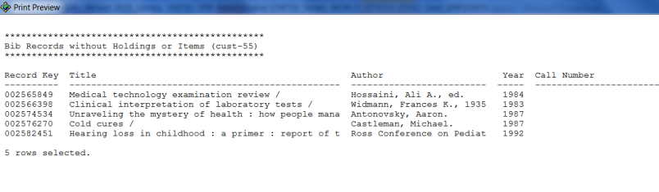
Bibs without holdings or items
Cust-55
Bib records without holdings or items
Look through list and then all may be deleted via p_manage_33
Notes:
Cust-55 lets you find all bibliographic records without holdings or items. It’s important to find and fix these as ODIN’s standard is to have at least one holding and one item per bibliographic record. This service also provides a file for input into manage-33 to totally delete records (bib, hold and items)

Slide 37
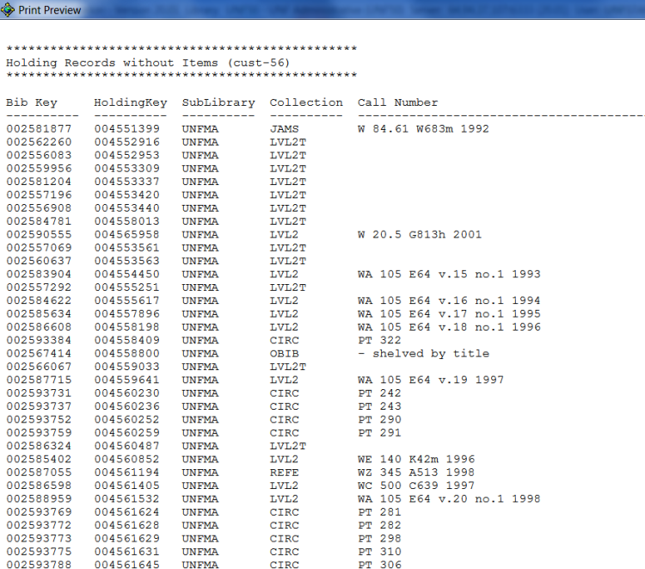
HOLs without items
Cust-56
Hol records without items
Notes:
Cust-56 is a service that finds all HOL records without items. Remember that the HOL record (not the item record) is the “supreme holder”, the “kahuna” for sublibrary, collection and call number. This service lets you know which records need attention. Sometimes this service will contain order records that have not had items arrive yet. Please be aware of this fact when using this service (you would not have to fix these)!

Slide 38
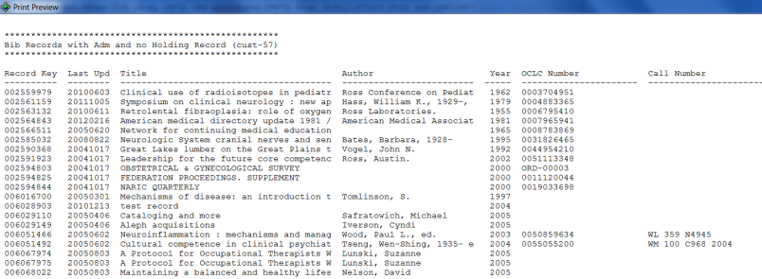
Bibs with items but no Hols
Cust-57
Bib records with items but no Hol
Notes:
Cust-57 is a service that lists any bib records with items but missing the HOL record – again, these need to be fixed. Don’t ignore them.

Slide 39
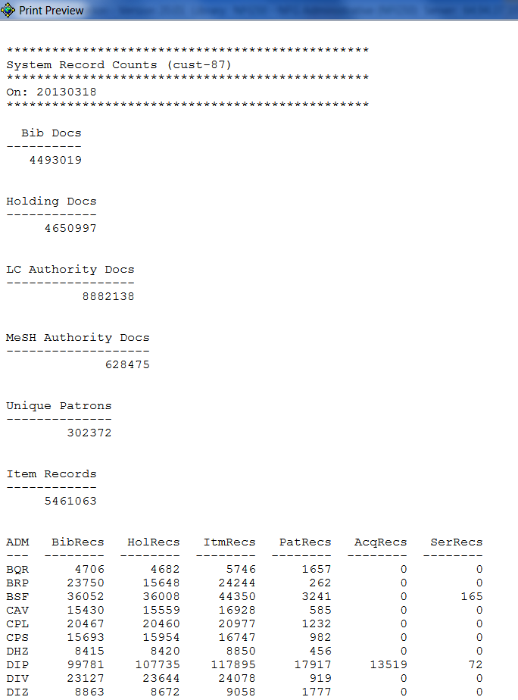
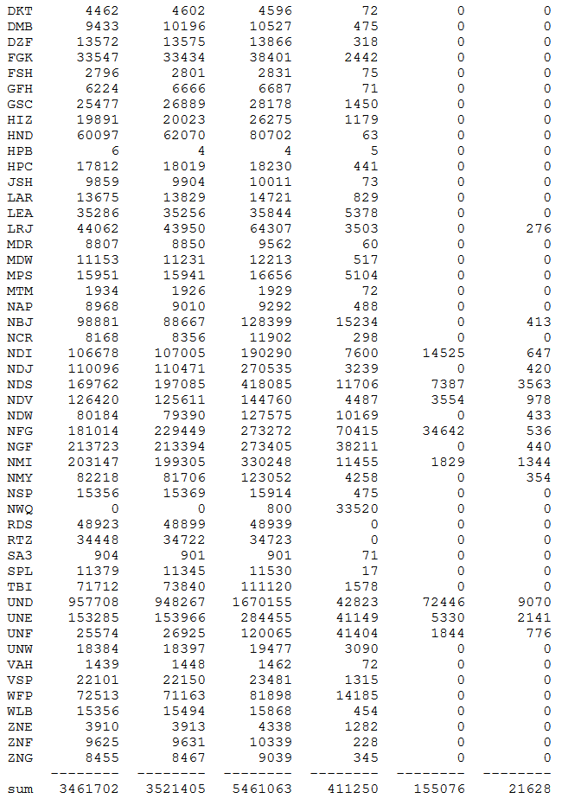
CUST-87
SYSTEM
RECORD
COUNTS
* Included deleted records
Notes:
Cust-87 does system-wide counts of bibliographic records, holding records, item records, patron records, LC authority docs and MeSH authority docs. Counts do include deleted records.

Slide 40
ODIN-Custom Patrons
Notes:
The following custom reports are found in the Circulation Module under Services/ODIN-Custom Patrons

Slide 41
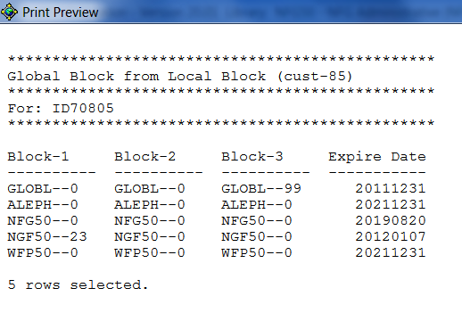
Local Blocks by Patron ID
Cust-85
Lists Local and Global Blocks for a particular patron id
Also indicates if there are local privileges at another ADM
Service needs the “Patron ID”
Patron ID (ID70805) has local privileges in NFG50, NGF50 and WFP50
There is a Global Block 99 and because NGF50 has a 23 local block, that is
what is causing the global block
Notes:
Cust-85 allows you to find out where a person has local privileges at other ADMs so that you may see if global blocks at those ADMs may be blocking transactions at your ADM. If a patron is globally blocked and you do “not” see any local blocks on your side, you can use this service to find out where the block may be at another ADM. Remember, the patron can always find out by accessing their patron account on the web, but you the staff member would only be able to see where they may be blocked by using this service. If you remove the global block on the Global Patron Information screen, tab2 and wish the patron to be getting services immediately, you do need to make sure the patron expirations of both the local patron AND the Aleph patron are “into the future”. If the patron doesn’t need services immediately, then the daily running of cir-77 will automatically remove the global black (assuming all local blocks were taken care of). Let me repeat another way. The global block may be removed either manually or automatically. Cir-77 removes a global block automatically the next day IF all local blocks were taken care of. Global & local blocks may be removed manually by clearing the field and clicking update, however, patrons need valid expiration dates on both the local patron record AND the ALEPH level patron in order to get services.

Slide 42

Globally update patron records
Cust-89
Globally updates patron records
  ILL Total Limit
  ILL Active Limit
  Profile
Need special username/password from the ODIN Office
Notes:
Cust-89 requires a special username/password from the ODIN Office to run it. This service globally updates a patron’s ILL Total Limit, ILL Active Limit and Profile. A report prints upon completion showing the patron and what value was in fields prior to the running of the service. This service is especially useful after an academic PLIF load, however any library may user it once they have been trained and have the proper username/password.

Slide 43
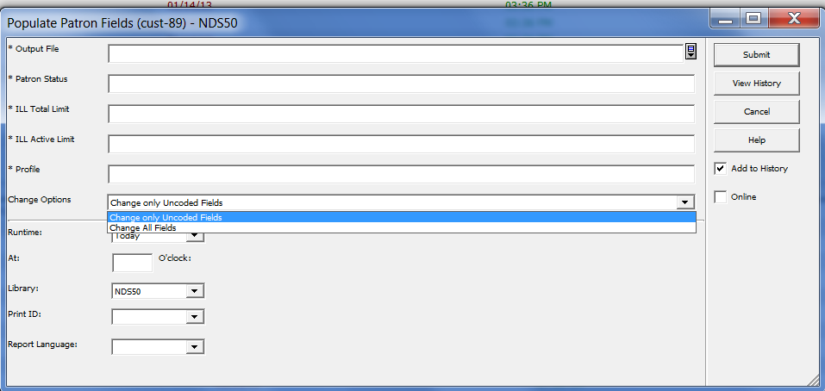
Notes:
Cust-89 has been enhanced to allow the choice of Change only “Uncoded Fields” or Change “All” fields. Both are referring to the ILL Total Limit, ILL Active Limit & Profile in a patron record in the Global Patron Information node. Uncoded Fields means that patrons would have to have 0000 in both the ILL Total Limit and ILL Active Limit and a blank Profile.

Slide 44
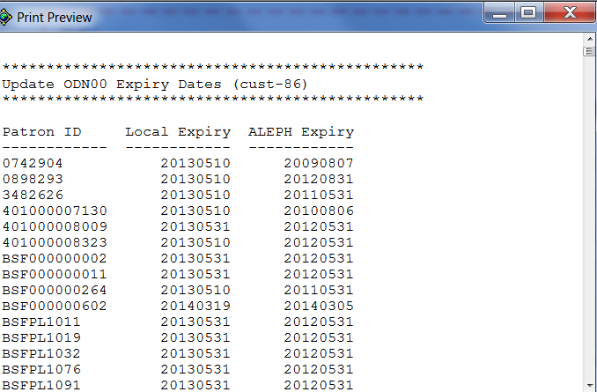
Update “Aleph level” patron Expiration Date
Cust-86
If a local patron expiration date gets updated, this service checks the “aleph-level” patron expiration date and if necessary, updates it to the “farthest into the future” expiration date
Run daily by ODIN
For example,
For the 1st patron, the
Aleph-level patron expiration
date will change to
20130510 – it would have
stayed at 20090807 without
this service OR human
intervention!
Notes:
Cust-86 syncs the ALEPH level patron to a date “farthest into the future” when a local patron expiration date is updated. This service is run daily by ODIN staff however, anyone may run it anytime. Note – this service looks at “all” patrons in ODIN. In our example, cust-86 was run after patron 0742904 local expiry was updated to 20130510. Without this service or human intervention, the ALEPH level patron would have stayed at 20090807. This service will update the ALEPH level patron expiration date to 20130510 unless the patron has other local privileges in ODIN at another ADM and that has a local expiration date longer than 20130510 (to which the longest date into the future is used).

Slide 45
Globally update patron records
Cust-88
Globally updates patron records
  Blank Home Library
  If Home Library is updated, then ILL Library is updated
Performed after PLIF load by ODIN Staff
Notes:
Cust-88 is run right after an academic PLIF load. It requires a special username/password to run. This service looks at the home library and if blank, inserts the home library for the ADM that is running the PLIF. If a home library is inserted, then the service looks at the ILL Library and if blank, inserts the ILL library for the ADM that is running the PLIF. Because of the ALEPH level patron being added late-in-the-Aleph-version and because of human intervention, some home and ILL libraries may not match. When noticed, this should be corrected immediately. Always check to see if any ILL is active and if not, please make sure that the ILL and HOME library match the ADM to which the patron belongs for Interlibrary Loan.

Slide 46
Report Formats on Services
Notes:
Report Formats exist on services to aid staff in getting the reports they need with the fields they need.

Slide 47
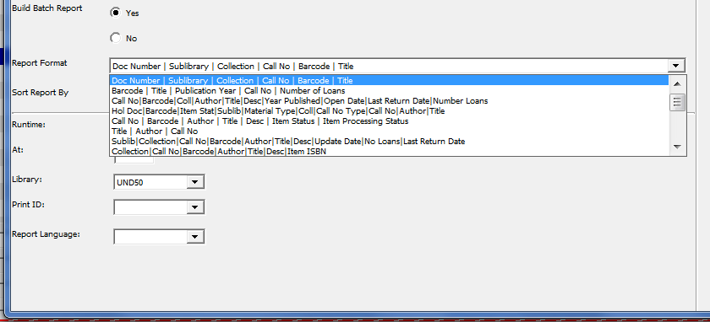
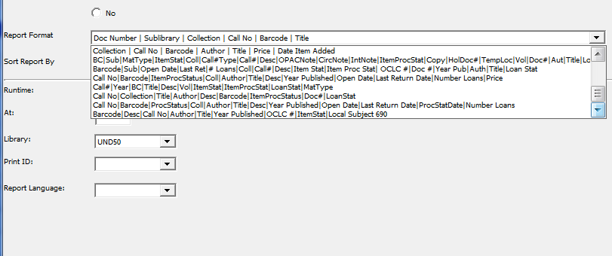
Use current Report Formats or bring into Excel
ret-adm-01 – General retrieval form
Notes:
As you can tell from the example, choices are available for you to choose. However, behind each report is more xml which contains lots more information that these report formats indicate. So, if you find that you are in need of more information, you will need to check the xml and then try to create a report you need by importing to Excel.

Slide 48
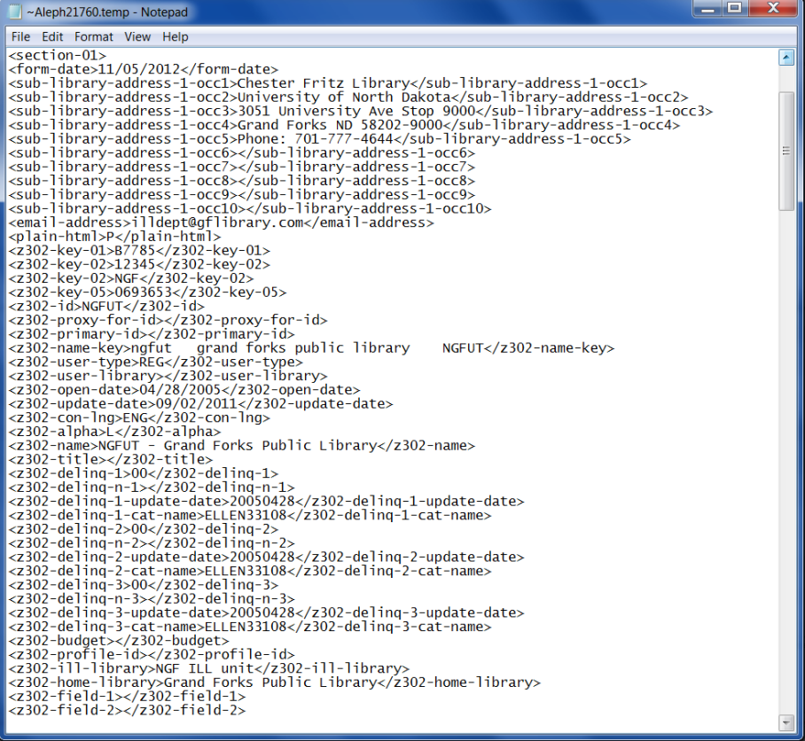
Xml data behind report format
<z302-update-date>09/02/2011</z302-update-date>
Notes:
If there is data between the symbols >< then that data can be imported into an excel report – an example: <z302-update-date>09/02/2011</z302-update-date> The 09/02/2011 can be imported into a report regardless if there is a report format for it.

Slide 49
Excel / Importing
Used when:
Size is over 9 digits
Data is suited for columns
Additional and/or Other fields are desired
Report won’t open in ALEPH
  Note – Must be an ALEPH canned report “not” a custom report
DYK (Did You Know) recording & word doc also both available @
http://umwug.odin.nodak.edu/OtherInformation
Notes:
There is a Did You Know that showcases how to import this information into Excel. It is available @ http://www.odin.nodak.edu/node/183 - Importing Aleph Reports into Excel – it’s fun – as you can see, the documentation is also available at http://umwug.odin.nodak.edu/OtherInformation - try it out when you can!

Slide 50
Send in questions & comments to http://www.odin.nodak.edu/webticket/
Notes:
And there you go – some fun facts! Thanks for your attention and if you have an questions or comments, please put in an ODIN Help Desk ticket @ http://www.odin.nodak.edu/webticket

