Slide 1
Accessing and running Primo Statistics/Analytics
Presented by
Lynn Wolf / Jonathan Moorman
ODIN Technical Support
ODIN Work Day 2016
April 19, 2016

Slide 2
Primo Reporting
There are two main areas for reporting in the Primo Back Office: Primo Analytics and Primo Reports.
Primo Analytics category is relatively new – November 2015 - and built on OBI (Oracle Business Intelligence).
Primo Reports category has been around for a little while and uses BIRT (an open source platform) to create reports based on information saved in the Primo Oracle tables.
Notes:
How presentation will benefit audience: Adult learners are more interested in a subject if they know how or why it is important to them.
Presenter’s level of expertise in the subject: Briefly state your credentials in this area, or explain why participants should listen to you.

Slide 3
Primo Reports
There are two different types of reports:
List Reports – display information about the settings and fields related to the configuration of Primo.
Statistical Reports – display statistical information about processes within the system.
Notes:
Lesson descriptions should be brief.

Slide 4
List Reports
Chart is from the documentation referenced at the end of this presentation and you will not see every report option in your list.
Much of the information found in this area is controlled at a higher level (Installation) due to being part of a shared configuration or shared database (ALEPH bib database). Specific institution information such as IPs and scopes will not change often if at all.
One report that might be helpful when developing training material is Top Searches with No Results Report.
Notes:
Example objectives
At the end of this lesson, you will be able to:
Save files to the team Web server.
Move files to different locations on the team Web server.
Share files on the team Web server.

Slide 5
Example of Top Primo Searches with No Results
The report could be used to identify hurdles to finding material --- the construction of the query, errors in spelling, and using a tab for the local collection when there is no local holdings (but in case of soccer in Honduras, there were 566 results in the “Everything” tab that searched both local holdings and the PCI database).
Categories used in search statistic reports:
Local – includes searches done on local Primo index (your library catalog tab).
Deep_search – includes searches performed in Primo Central, EBSCO, etc. (Articles+, Articles & More, Online Resources tabs)
Blended – includes searches performed in both local and deep_search adaptor (Everything tab)

Slide 6
Statistical Reports
Chart is from the documentation referenced at end of presentation. The documentation describes each report in detail, provides instructions for generating, and in most cases presents an example of the report output.
Statistical reports contain information from the servers (such as searches and click actions on the front end). Sources for those statistics are the Primo FE, web services, x-services, deep links or the Services Page (for ALMA sites).

Slide 7
Example of Annual Event Statistics – Basic Search
This report displays annual statistics for selected institution, view and event. Shown in this example is Mayville State University’s nmy view and the event type is Basic Search.
Some things to note on this report:
Data is presented in a variety of formats
Each year is shown from implementation through current date.
Shows only ONE Event Type

Slide 8
Example of Annual Event Statistic – Advanced Search
Same report but different Event Type. When evaluating the results, the Basic Search is more heavily used but overall usage trends are very similar.

Slide 9
Example of [NEW] Search Statistic Report
Another search statistic report where user is able to specify what date range is needed.

Slide 10
Facets Click Events Report
Example was run from January 1st through April 13, 2016.
This report could be used when evaluating a search results page.
Which facets are the most frequently used?
Are these facets placed near the top of the facet list?
Are there any facets that could be eliminated?

Slide 11
Click Events
Displays event statistics for all functions used during a period of time. This example is for April 1-13, 2016.

Slide 12
Things to keep in mind when working with reports ….
Be careful when choosing parameters
There is A LOT of information out there and some of these reports can run several minutes generating multiple pages.
Run a sample report to make sure it is the information you need.
Some reports contain links where you can drill deeper into the results. Those links can and will expire after awhile. If that happens you have to generate the report again to view information.

Slide 13
BIRT Report Viewer Operations
After reports are generated, these are the options for the buttons across the top of the display. Most importantly you can EXPORT the file to a variety of formats or you can PRINT the file.

Slide 14
Primo Analytics
Primo Analytics – OBI is a fairly recent enhancement. It was implemented for ODIN in October 2015.
Full information can be found at the documentation center:
Documentation Center > Primo > Technical Documentation > User Guides > Primo Analytics Guide
Please note that the data is based on the centralized Data Base starting from May and the usage data from January to April is estimated data that we added in order to have full year usage trend information.

Slide 15
Initial screen when entering the Analytics area
There are out of the box reports as well as options to create your own reports and adding graphs to reports.
To access the out of the box reports, click on the Catalog tab across the top.
Look for the Folders and expand the Shared Folders by clicking on the +
Next expand Primo > Usage > Reports and click on Reports to have options displayed in right pane.

Slide 16
Out of the Box Report Options
From this screen you can OPEN the report to run, edit or use the options under More (Print, Export, Add to Briefing Book, Schedule, Copy, etc).

Slide 17
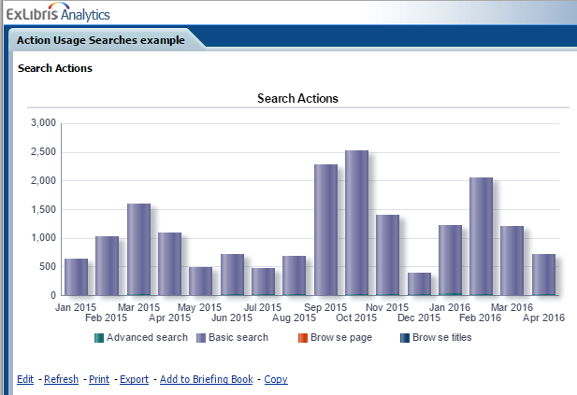
Action Usage Searches example

Slide 18
Action Usage Searches example - UND

Slide 19
Action Usage Searches example - NDSU

Slide 20
Device Usage Report
Breaks down by Device / Operating System / Browser
Note the dropdowns for the Month – you can quickly walk through several months comparing the results.

Slide 21
More Device Usage examples
Device Usage - NDSU
Device Usage - UND

Slide 22
Popular Searches

Slide 23
Popular Searches Last Month
Again, you can change the Searches for month dropdown.
The columns can be sorted. Default is number of searches (descending) but can sort any of the columns ascending or descending order.

Slide 24
Primo Reporting vs Primo Analytics
Primo Reporting
Primo Analytics
Multiple out of the box reports available
Easy to use – click and populate
Reports can take excessive amount of time to generate results
Can export or print results
Multiple out of the box reports available as well as option to create your own report
Intimidating to use since the module is so extensive and powerful
Reports are generated very quickly
Can export or print results

Slide 25
Recap for access procedures
Sign in to the ODIN Website (odin.nodak.edu) using either your library’s generic Primo Reporting login or your personal login that has been given back_office permissions.
In the YOUR LIBRARY box, click on Primo Back Office Access
Select which Back Office server you wish to access – Sandbox (test server) or Production
Use your library’s generic Primo Reporting login to access the Back Office --- your personal ODIN site login WILL NOT allow access here.

Slide 26
Final notes:
Documentation for both Primo Reporting and Primo Analytics is found on the Ex Libris Documentation Portal under Primo > Technical Documentation > User Guides. A copy has also been placed on the ODIN website Primo Back Office Access page for your convenience.
Primo Reporting is chapter 12 in the Back Office Guide (dated November 2015).
Primo Analytics has its own document (also dated November 2015)

Slide 27
Questions?

