Slide 1
Creating and using record sets

Slide 2
agenda
Ways to create record sets
Patron record sets and their uses
Item record sets and their uses
Bibliographic record sets and their uses
Final tips & takeaways

Slide 3
Ways to create record sets
From the new menu, select record set, choose the type of set, and scan in barcodes
Create a set from Find Tool search results
Create a set from Find Tool search results and select individual records to add to a set
From the new menu, select record set, choose the type of set, and upload a file of barcodes

Slide 4
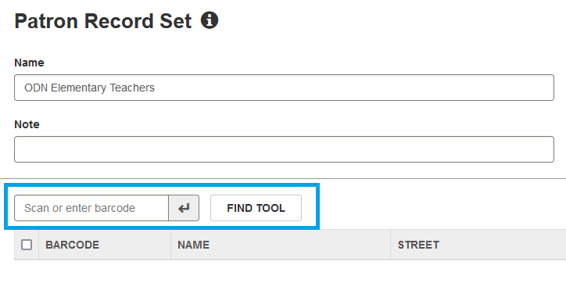
Create set by scanning in barcodes

Slide 5
Create set by importing a file of barcodes
Item record sets can be created by uploading a file of barcodes.
Patron record sets can be created by uploading a file of patron IDs.

Slide 6
Create a set from search results
Click the shopping bag icon to set up the record set options. Then click the magnifying glass to execute the search.
All search results will be added to the record set.

Slide 7
Create a record set with the find tool by selecting specific search results
Select the results you want to add to a new or existing record set.
Click the "Add to Record Set" button and select New or Existing.

Slide 8
Patron Record Sets
If you want to know what items were checked out to a set of patrons, you can create an item record set of those checked out items.
Use Simply Reports if you want to know additional information about a set of patrons, such as last activity date.

Slide 9
Item Record Sets
Create a missing item record set from the Find Tool and export it to Excel to create a list for checking shelves.
Scan items that you suspect are no longer circulating into an item record set and evaluate the items using Simply Reports.
Note: to export a record set to an Excel spreadsheet, the owner of the record set must be a branch or library. This is true for all types of record sets.

Slide 10
Bibliographic record sets
Bibliographic record sets are useful for reader's advisory
Bibliographic record sets are useful for shareable links
Bibliographic record sets are necessary for enhancing the PAC.
TIP: You can scan item barcodes into a bibliographic record set and it will load the bibliographic record associated with that item barcode.

Slide 11
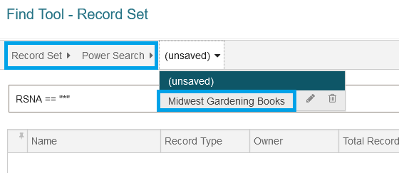
Bibliographic record sets in power search
You can create a curated list of books for use at the public service desk.
Create a saved power search for quick retrieval of the set.

Slide 12
Shareable links
You can create shareable links for record sets. Some potential uses for shareable links include: popular storytime titles, booklists shared through newsletters or webpages, and reading lists that tie-in with library programs.

Slide 13
Template for shareable links
https://polaris.odinlibrary.org/polaris/view.aspx?ctx=92&brs=39643
Where ctx is the branch id, and brs is the bib record set id
You can find your branch id in the PAC URL (the number before the period):
You can find the bib record set id in the record set:

Slide 14
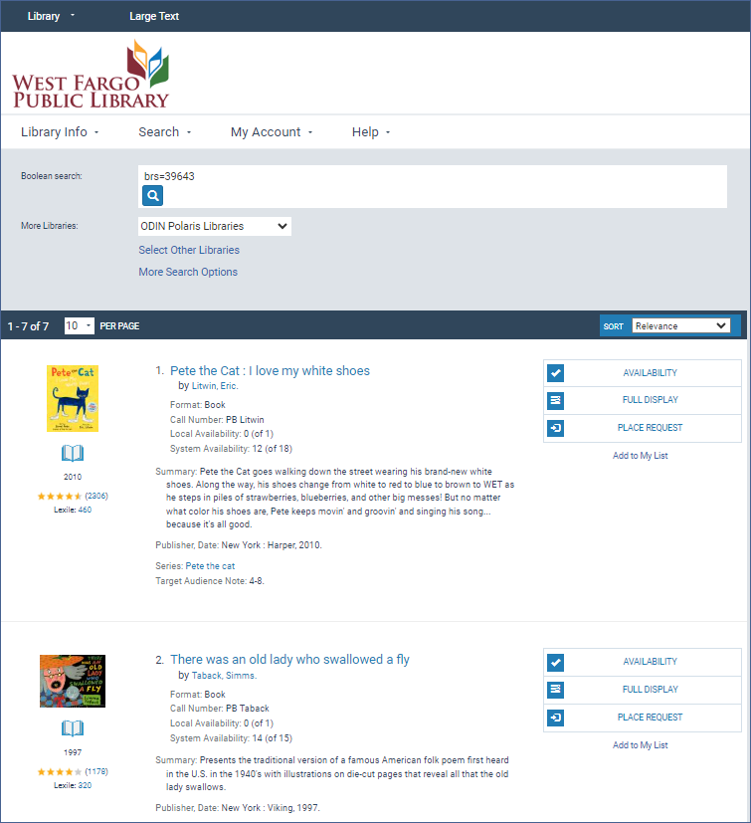
A shareable link provides pac search results

Slide 15
Using record sets with the pac
Bibliographic record sets can be used to create a web part for the Pac
Bibliographic record sets can be used to create carousel in the Pac
Tips:
Must be a bibliographic record set
Ownership of the set must be at the branch or library level
Carousels can have up to 50 titles
Open a Helpdesk ticket and include: Bib record set ID, whether you want a carousel or a web part, and any other helpful details.

Slide 16
Carousels and web parts

Slide 17
Tips & takeaways
Record sets are used with three main record types: Patron, Item, Bibliographic.
If you want additional information about the records, use Simply Reports and the tab that corresponds to the record type.
Set the ownership of a record set to the branch level so you will be able to export the set to a spreadsheet, or to set up a PAC carousel or web part. If the set is for your own use, you can leave the ownership at your username.
If you are having trouble creating a record set, please contact the ODIN helpdesk

Slide 18
Thank you
The recording and slides for this presentation will be available on the
ODIN webpage in a couple of days!

